Slide 1
BIOLOGICAL DATABASES
Overview

Slide 2
BIOLOGICAL DATA
Bioinformatics is the science of Storing, Extracting, Organizing, Analyzing, and Interpreting information in biological sequences
Bioinformatics has been mainly fueled by advances in
DNA sequencing
Genome mapping techniques
There are 3 billion base pairs that make up human DNA
Handling the massive amount of data is a challenge
Hence the necessity for Biological Databases
Biological Data also includes protein sequences
The most famous example of the application of bioinformatics and biological databases was the Human Genome Project

Slide 3
Entrez
Integrated Search: Entrez is an NCBI search engine that accesses multiple biological and medical databases like PubMed, Gene, and Protein.
Cross-Database Access: It allows users to search various databases, including literature, genetic sequences, and clinical data.
Bioinformatics Tool: Entrez supports researchers by providing access to diverse biological information, from DNA sequences to scientific articles.
Easy Interface: It offers a user-friendly interface with advanced search options and filters for precise data retrieval.
Linked Databases: Entrez connects related records across databases, helping explore biological relationships efficiently.
http://www.ncbi.nlm.nih.gov/Entrez/

Slide 4
One Stop Search of 20+ Databases
PubMed – Biomedical literature.
PubMed Central (PMC) – Free full-text archive of biomedical and life sciences journal literature.
Bookshelf – Free access to books and documents in life science and healthcare.
MeSH (Medical Subject Headings) – Controlled vocabulary for indexing articles.
Nucleotide – Database of nucleotide sequences.
Protein – Database of protein sequences.
Genome – Database of genomes.
Structure – Database of 3D macromolecular structures.
Gene – Gene-specific information.
OMIM (Online Mendelian Inheritance in Man) – Human genes and genetic disorders.

Slide 5
Contd..
SNP (Single Nucleotide Polymorphism) – Variants and polymorphisms in populations.
GEO (Gene Expression Omnibus) – Data from gene expression experiments.
dbVar – Database of large genomic variants.
dbGaP – Database of Genotypes and Phenotypes.
Probe – Information about nucleic acid reagents.
BioSystems – Biological pathways and systems.
Assembly – Genome assemblies.
ClinVar – Reports of the relationships among human variants and phenotypes.
dbSNP – Single nucleotide polymorphisms.
Taxonomy – Names and classifications for organisms.
BioProject – Research projects related to sequences and genomes.
BioSample – Information about biological samples.
PMC – Full-text journal articles in the life sciences.

Slide 6
Data Sources
Biological data can be of derived from a variety of sources
Sequencing
Analyzing DNA to find the exact sequence of nucleotides
This method is used for the Human Genome Project
Gene Expression
Determining which, previously known, genes are produced by a specific organism
One such way to detect expression is a Microarray
A synthetic chip to which certain DNA sequences will only bond to a certain location
Allows for easy cataloging of genes produced by a specific organism
Online Mendelian Inheritance in Man (OMIM)
Shows relations between diseases and any known responsible genes within the human genome

Slide 7
Nucleotide Databases
GenBank
EMBL
DDBJ
— All collaborate and share information

Slide 8
GENBANK DIVISIONS
A division is a three letter abbreviation used to broadly divide genbank records
Divisions may be based on the type of organism the record is from or more technical classifications, such as “environmental sampling sequences” or “high-throughput genomic sequences”
The GenBank database is currently divided into 18 divisions
1 | PRI – primate sequences | 10 | SYN – synthetic sequences
2 | ROD – rodent sequences | 11 | UNA – un-annotated sequences
3 | MAM – other mammalian sequences | 12 | EST – expressed sequence tags
4 | VRT – other vertebrate sequences | 13 | PAT – patent sequences
5 | INV – invertebrate sequences | 14 | STS – sequence tagged sites
6 | PLN – plant, fungal, & algal sequences | 15 | GSS – genome survey sequences
7 | BCT – bacterial sequences | 16 | HTG – high-throughput genomic sequences
8 | VRL – viral sequences | 17 | HTC – unfinished high-throughput cDNA sequencing
9 | PHG – bacteriophage sequences | 18 | ENV – environmental sampling sequences

Slide 9
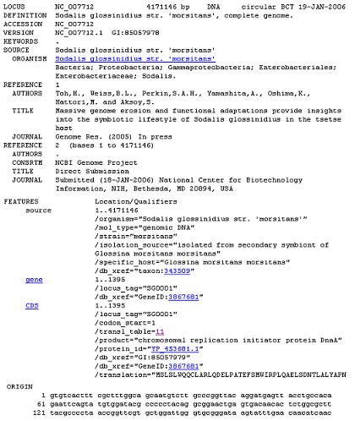
GENBANK RECORD LAYOUT

Slide 10
Genbank Record Summary
Genbank is an annotated collection of all publicly available biological sequences
The Genbank record format must be flexible enough to allow for biological data from numerous sources to be integrated without difficulty
Genbank records contain comprehensive information on an entry, including information on the source, distinguishing characteristics, and information on journal articles pertaining to the entry

Slide 11
PROTEIN DATABASE
Database containing protein sequences
Compiled from a variety of protein sequence databases, including:
Swiss-Prot
Protein Information Resource (PIR)
TrEMBL

Slide 12
Genome vs. Protein Database
Protein database contain information about: -description and function of protein sequence
-Domains and Sites
-secondary, quaternary structure
-similarities to other proteins etc
Genome databases contain genome information collected from many sources:-
-genome assembly
-gene predictions
-known genes,mRNA,ESTs, proteins etc

Slide 13
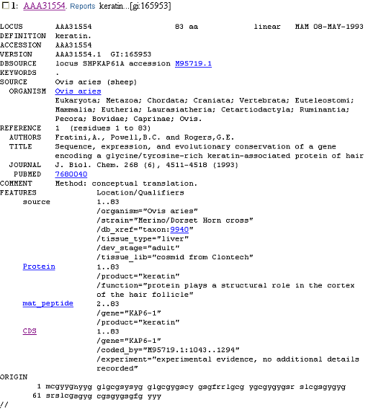
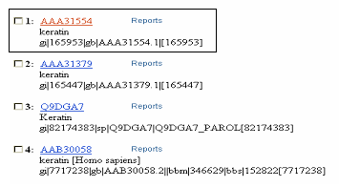
ENTREZ PROTEIN DATABASE
An Example of a protein sequence in the NCBI’s Entrez Protein Database

Slide 14
SWISS-PROT
Swiss-Prot is an annotated protein sequence database that was established in 1986. Currently, maintained collaboratively at
The Swiss Institute of Bioinformatics (SIB)
The European Bioinformatics Institute (EBI)
Swiss-Prot strives to minimize redundancy by merging data of protein sequences with different literature reports
As of 07-Feb-06 Swiss-Prot contains 207132 sequence entries comprising 75438310 amino acids abstracted from 139151 references
Access Swiss-Prot at http://www.expasy.org/sprot/

Slide 15
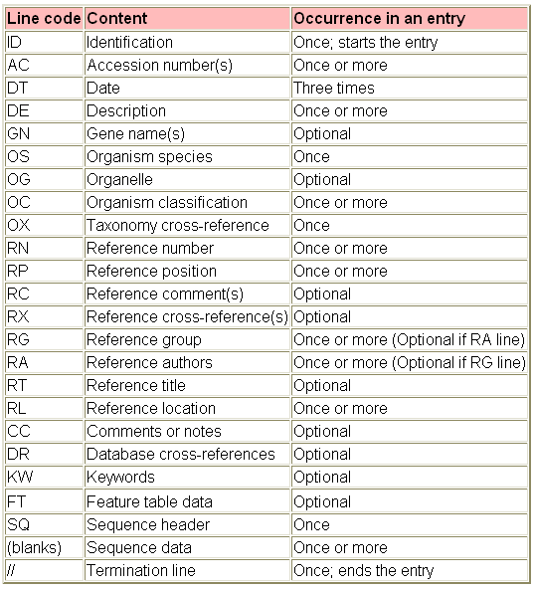
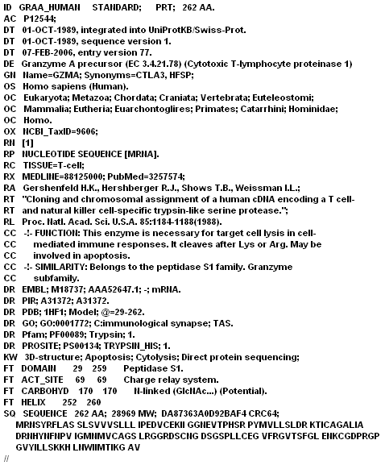
Swiss-Prot Record
SWISS-PROT CODE LEGEND AND SAMPLE SEQUENCE ENTRY
SOURCE: http://expasy.org/sprot/userman.html

Slide 16
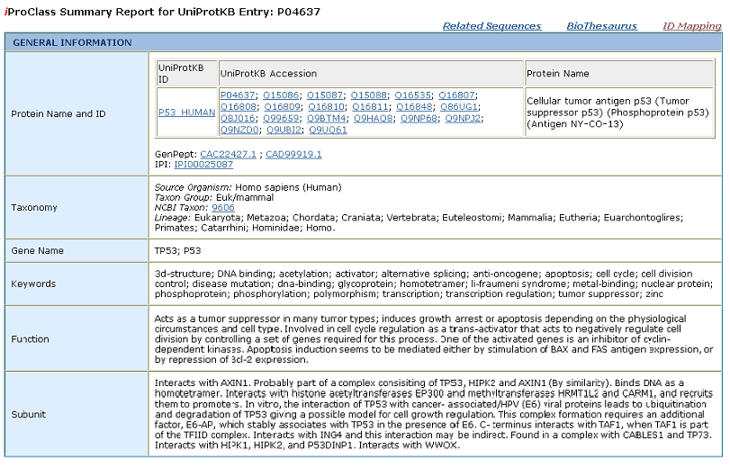
PROTEIN INFORMATION RESOURCE
Protein Information Resource (PIR) is
An integrated public bioinformatics resource to support
genomic research
proteomic research
scientific studies
Located at Georgetown University Medical Center (GUMC)
PIR was established in 1984 by the National Biomedical Research Foundation (NBRF)
Access PIR at http://pir.georgetown.edu/
SAMPLE SEQUENCE ENTRY
SOURCE: http://pir.georgetown.edu/cgi-bin/ipcEntry?id=P04637

Slide 17
ONLINE MENDELIAN INHERITANCE IN MAN
Catalog of human genes and genetic disorders
Online version of the book Mendelian Inheritence in Man maintained by Johns Hopkins University and located at http://www.ncbi.nlm.nih.gov/entrez/query.fcgi?db=OMIM
Contains same information as the book, only more up to date
16532 entries for genes or suspected Mendelian traits as of February 1st, 2006
Used primarily by genetics researchers and those interested in genetic diseases
One of the oldest non-relational databases still available

Slide 18
OMIM DATABASE
Only a few aspects of OMIM are stored as a relational database; it is primarily store as formatted text
Each entry in OMIM is given:
A unique six-number ID (In this case, the ID is “176730”) that can be used to identify it
A symbol used to classify the type of entry (in this case a plus)
The locus of the gene (if applicable)
A lists of alias the entry can be described by
All of these are used to identify an entry that contains large sections of text and references relevant to the entry
A heavily abbreviated entry is shown at the right
Mim-entry ::= { mimNumber "176730" , mimType plus , title "INSULIN; INS" , copyright "Copyright (c) 1966-2005 Johns Hopkins University" , symbol "INS" , locus "11p15.5" , aliases { "PROINSULIN" } , included { "HYPERPROINSULINEMIA, INCLUDED" }
…
text { { label "TEXT" , text "Insulin, synthesized by the beta cells of the islets of Langerhans, consists of 2 dissimilar polypeptide chains, A and B, which are linked by 2 disulfide bonds. However, unlike many other proteins, e.g., hemoglobin, made up of structurally distinct subunits, insulin is under the control of a single genetic locus; chains A and B are derived from a one-chain precursor, proinsulin, which was discovered by {72:Steiner and Oyer (1967)}. Proinsulin is converted to insulin by the enzymatic removal of a segment that connects the amino end of the A chain to the carboxyl end of the B chain. This segment is called the C (for 'connecting') peptide. The insulin gene contains 3 exons and 2 introns; exon 2 encodes the signal peptide, the B chain, and part of the C peptide, while exon 3 encodes the remainder of the C peptide and the A chain."} }

Slide 19
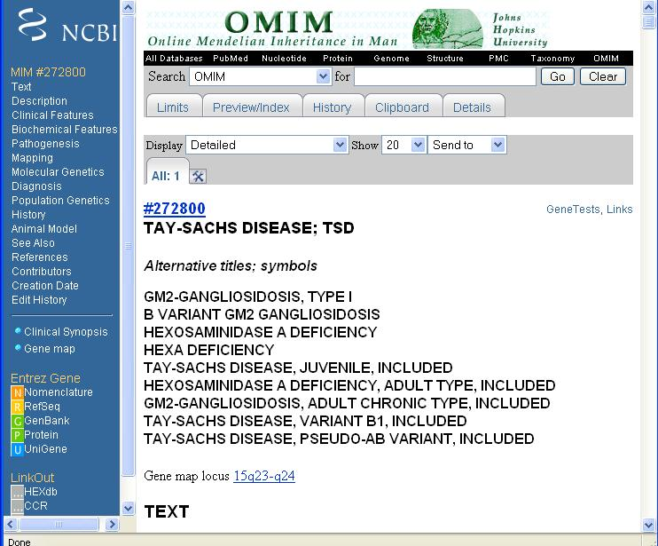
Example: Tay-Sachs Disease
Suppose a user wished to find information on Tay-Sachs disease
The OMIM entry contains the following for Tay-Sachs disease:
Alternative Titles
Description
Clinical Features
Biochemical Features (chemical changes in the body caused by the disease)
Pathogenesis (the origination and development of a disease)
Mapping (what area of a chromosome causes the disease)
Molecular Genetics
Diagnosis (techniques for finding the disease)
Population Genetics (which genetic groups are susceptible to the disease)
History
Animal Model (efforts to replicate and study the disease in animals)
References

Slide 20
Tay-Sachs continued
An entry in OMIM typically contains extensive information both for individuals who may have a personal stake in the disease in question and professionals and students studying the disease
OMIM is constantly updated to reflect the most current knowledge and research on genes and genetic diseases

Slide 21
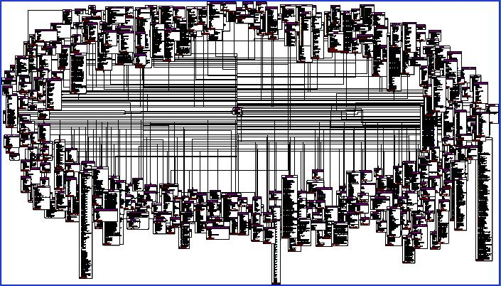
PROTEIN STRUCTURE DATABASE SCHEMA
Below is the database schema used by the RCSB Protein Data Bank
Each box indicates a separate attribute set
Bioinformatics databases are very large
Source: http://www.rcsb.org/pdbschema/

Slide 22
STRUCTURE DATABASES
The goal of structure databases is to explore the relationship between the three-dimensional structure of a macromolecule (such as a protein) and it’s function
A protein is a linear chain of amino acids that folds and bonds with itself
Only 20 different amino acids contribute for protein synthesis.
How a protein folds is determined by it’s amino acid composition
Understanding how structure affects function is essential to creating synthetic proteins

Slide 23
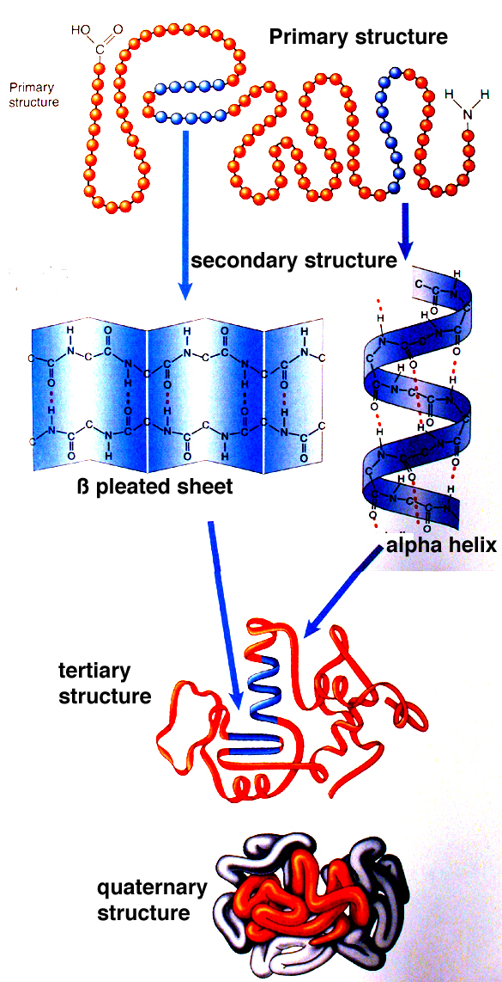
PROTEIN STRUCTURE TERMINOLOGY
Primary Structure: The simple linear chain of amino acids connected by peptide bonds.
Secondary Structure: Collection of the alpha helixes and beta sheets formed by the interaction of amino acids in the sequence.
Tertiary Structure: The overall 3-dimensional shape of a single protein. The chain folds and bonds with disulfide bridges.
Quaternary Structure: The structure formed by the bonds between different polypeptide chains.
Source: http://academic.brooklyn.cuny.edu/biology/bio4fv/page/prot_struct-4143.JPG

Slide 24
GOALS AND APPLICATIONS
One of the goals of bioinformatics is to be able to determine the shape taken by a protein just by analyzing it’s primary structure
Applications:
Drug design, such as improving insulin
Agriculture, such as developing fruits that stay ripe longer
Synthesizing enzymes to perform industrial tasks
An average cell creates 15,000 different kinds of proteins, so there is still much left to discover in this area

Slide 25
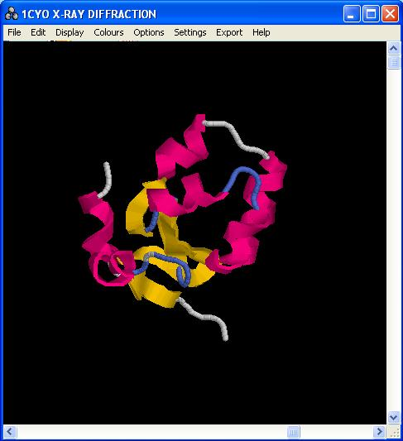
RASMOL
RasMol is a free tool for viewing protein structure
Available at http://www.openrasmol.org/ and many other websites
Viewable data for RasMol can be obtained from the RCSB Protein Data Bank at http://www.rcsb.org/pdb/Welcome.do

Slide 26
WHAT IS TAXONOMY?
Taxonomy is the hierarchical classification of plants and animals according to their presumed natural relationships
Taxonomy shows where each species stands in the evolution tree.
Knowing the taxonomical position of an organism helps
in the study of that species.
Bioinformatics used DNA and RNA comparisons to establish taxonomy, removing the need to rely on morphology
Bioinformatics can be used to provide much more detail to the current taxonomic knowledge base and can also be used to track genetic changes within a species

Slide 27
Taxonomic Classification
The naming convention in taxonomy is the generic name followed by species name. (Carolus Linnaeus in Systema Naturae ).
The taxonomical classification has the following order:
Organism
Domain
Kingdom
Phylum
Class
Order
Family
Genus
Species
The tree of life can be constructed from the data present in taxonomic databases.

Slide 28
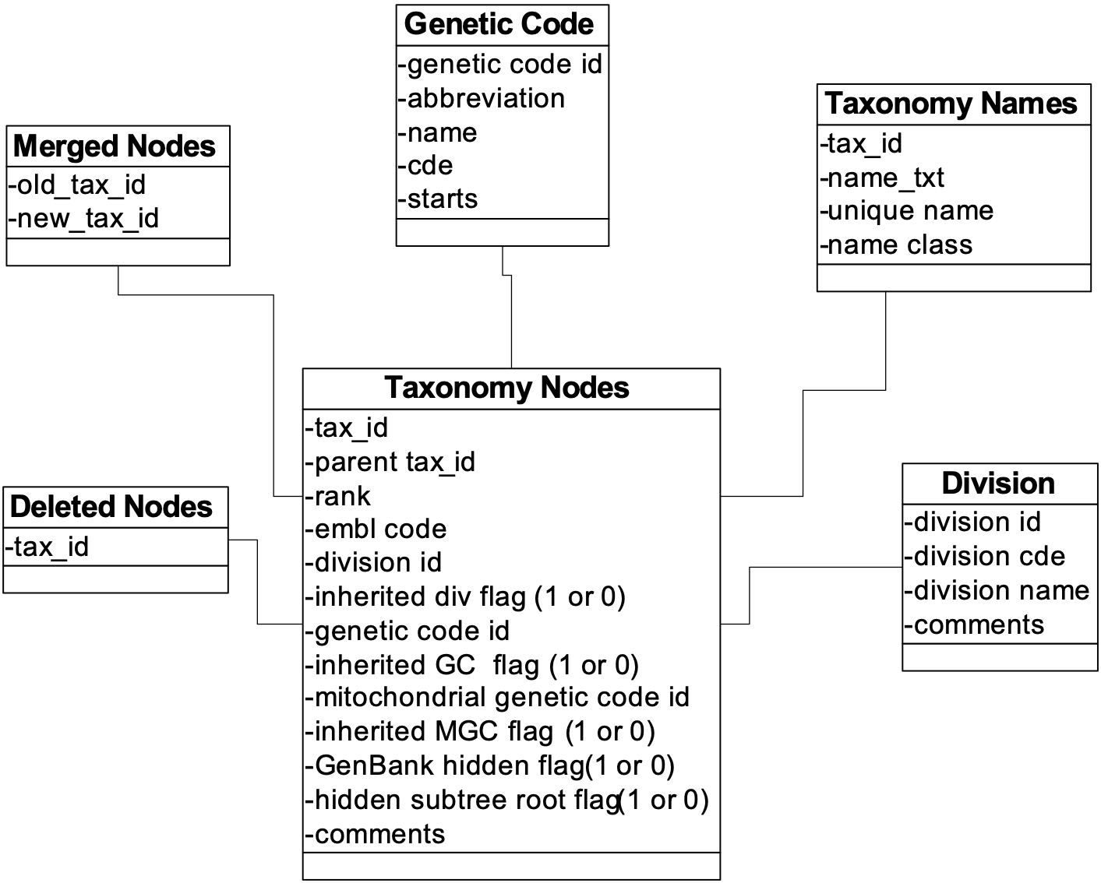
TAXONOMIC DATABASE
At right is the schema used by the NCBI Taxonomy Database
Key genealogical history and classifications are stored
The database is designed to be able to handle new data as well as changes to previous data

Slide 29
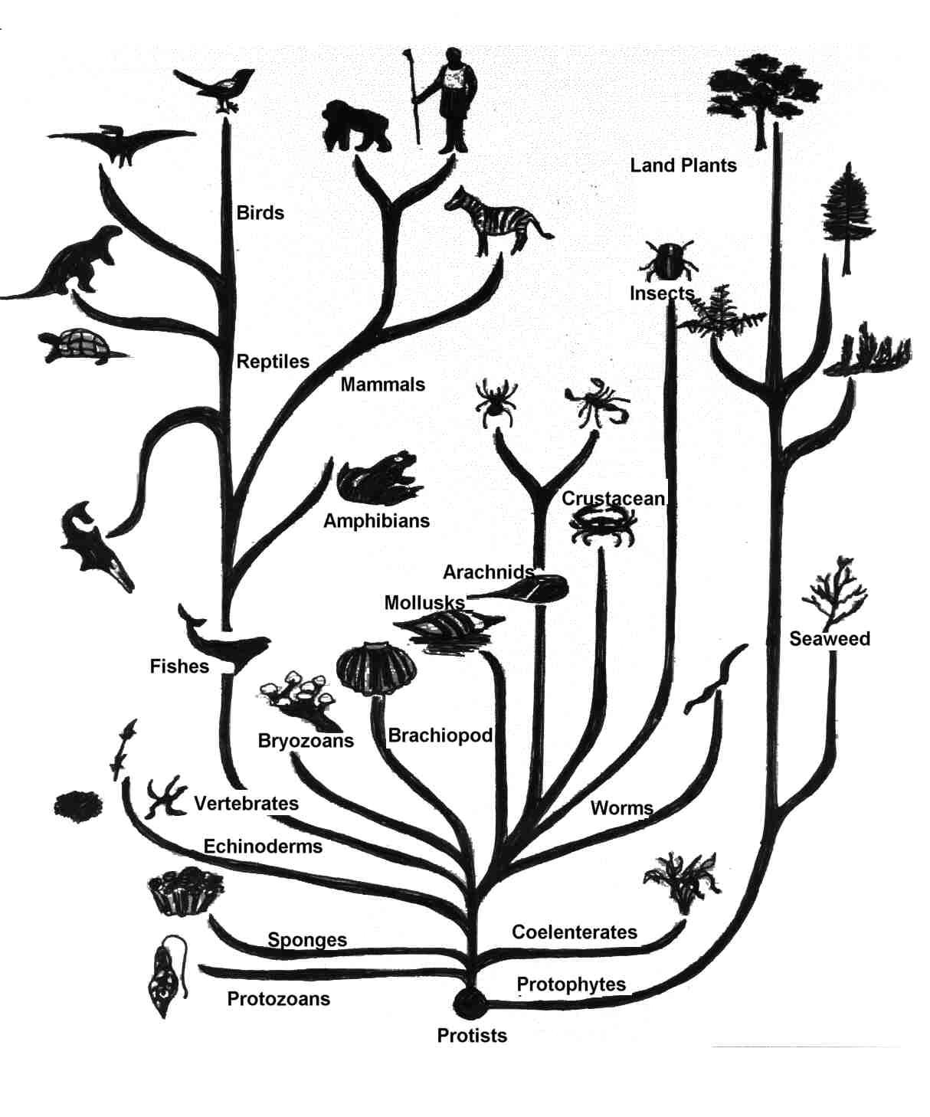
TREE OF LIFE
Once taxonomy has been established, a tree of life may be constructed
The tree at the right is a simple example of a tree of life
A tree of life consisting of all species that have ever lived would be too complex to display on a single page
Source: http://library.thinkquest.org/19012/media/treeolif.jpg

Slide 30
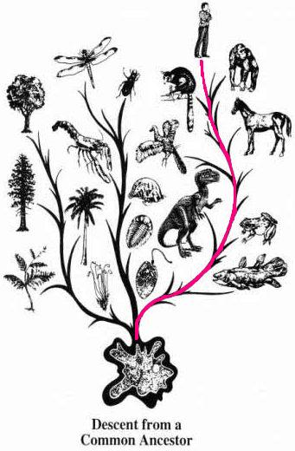
TREE OF LIFE CONTINUED
Species are organized based on their lineage
For example, in the picture to the right the lineage of human beings is traced from cellular organisms
Every species that has ever lived can be categorized in this way

Slide 31
PROSITE
PROSITE is a database of protein families and domains consisting of:
biologically significant sites
Patterns that help identify protein families a new sequence
http://www.expasy.org/prosite/
Sample prosite query:
[AV]-R-[NFY]-R-x(2,3)-[ST]-x-S-x-S
[] – indicates an OR for the next entry based on the letters between the brackets
A letter – (such as R, above) indicates the next entry MUST be the letter
x(2,3) - 2 or 3 random entries
x – any random entry
Query above may be read: A OR V, then R, then N OR F OR Y, then R, then any 2 or 3 entries, then S OR T, then any 1 entry, then S, then any 1 entry, finished by an S
Some matching sequences:
ARFRCGHTYSDS
VRYRRRTRSRS

Slide 32
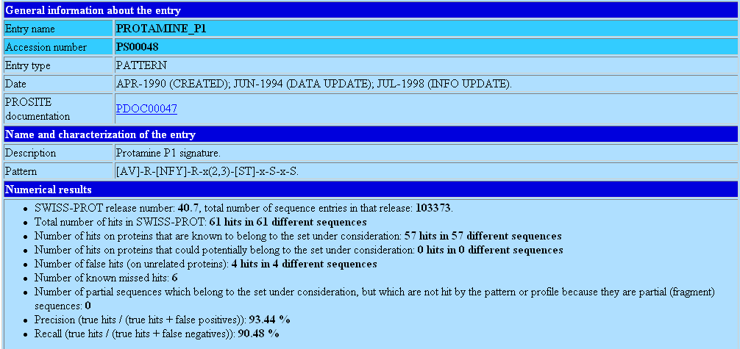
Recognizing ProSite patterns
Given is the result for a random sequence search based on the pattern:
[AV]-R-[NFY]-R-x(2,3)-[ST]-x-S-x-S
Most significant profile domain found by the search: “P1 Protamine,” seen below
SOURCE: http://www.expasy.org/prosite/

Slide 33
PFAM
PFAM is a collection of multiple sequence alignments and hidden Markov models covering many common protein domains and families
The PFAM database may be search for similarity to a query protein sequence
PFAM may also be used to analyze proteomes and domain architectures
http://pfam.sanger.ac.uk/

Slide 34
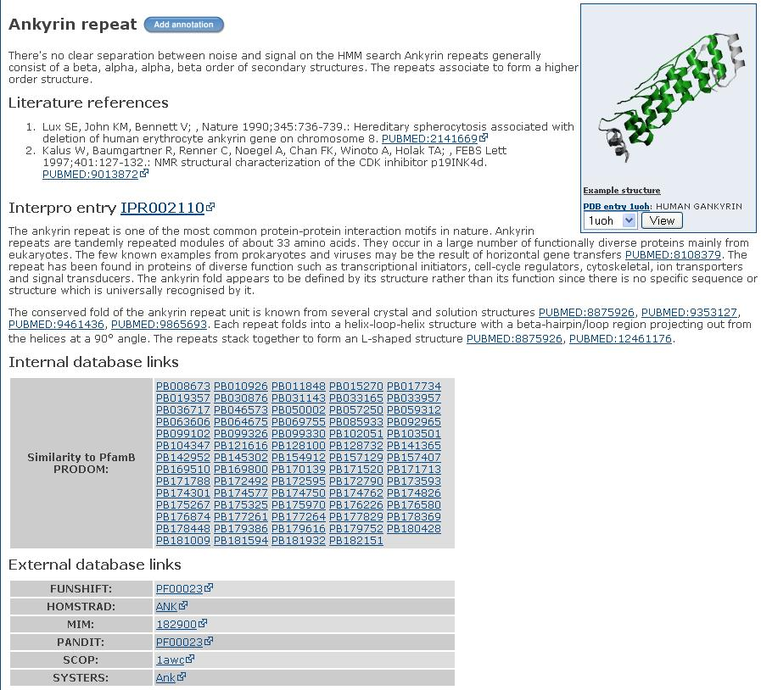
PFAM Entries
An entry in PFAM will consist mainly of text, literature references, and links to similar patterns in PFAM
Entries in PFAM are classified in four ways:
Family: A collection of related proteins
Domain: A structural unit which can be found in multiple protein contexts
Repeat: A short unit which is unstable in isolation but forms a stable structure when multiple copies are present
Motifs: A short unit found outside globular domains
Source: http://pfam.sanger.ac.uk/family?acc=PF00023

Slide 35
Tools Using PFAM
Conserved Domain Architecture Retrieval Tool (CDART) performs similarity searches of the NCBI Entrez Protein Database based on domain architecture, defined as the sequential order of conserved domains in proteins
http://www.ncbi.nlm.nih.gov/Structure/lexington/lexington.cgi?cmd=rps
iPFAM is a tool for describing physical interactions between PFAM domains
http://ipfam.sanger.ac.uk/

Slide 36
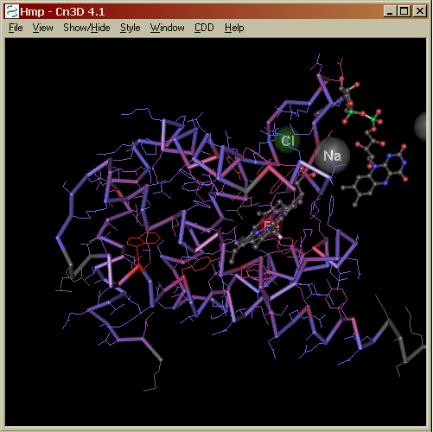
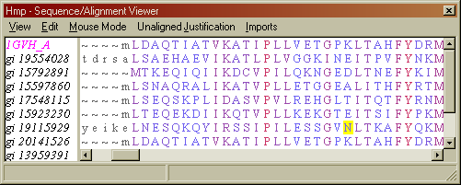
Conserved Domain Database
NCBI's Conserved Domain Database (CDD) is a collection of multiple sequence alignments for ancient domains
To identify conserved domains present in a protein query, access the CD-Search service at http://www.ncbi.nlm.nih.gov/Structure/cdd/wrpsb.cgi
A structure viewer tool, Cn3D, allows to view the domain of the
Hemoglobin-like flavoprotein (Hmp) shown above.
SOURCE: http://www.ncbi.nlm.nih.gov/Structure/cdd/cddsrv.cgi?uid=COG1017

