Slide 1
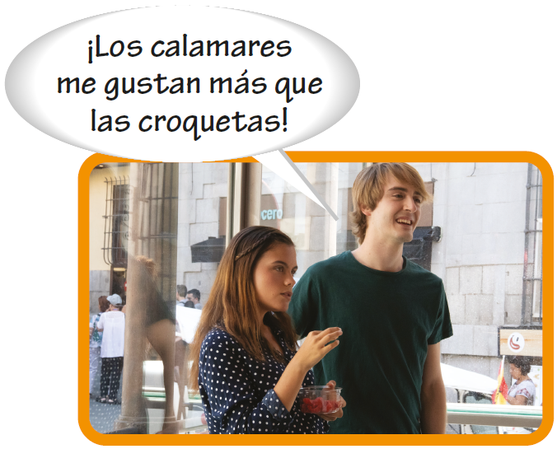
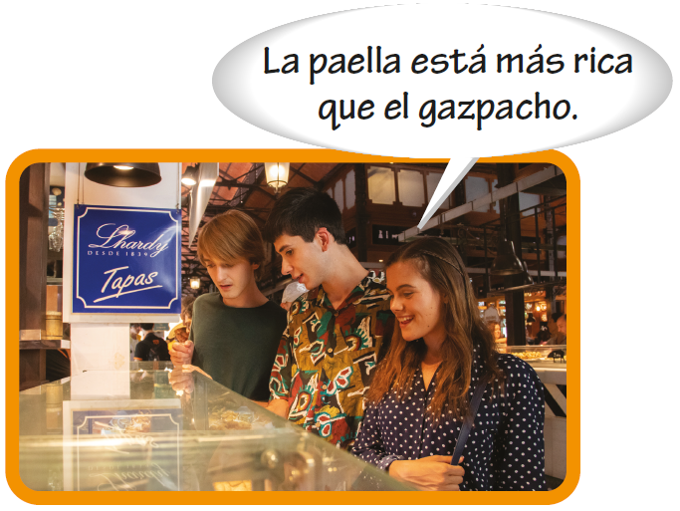
Comparatives and superlatives
Comparisons of inequality
Comparisons of inequality are formed by placing más (more) or menos (less) before adjectives, adverbs, and nouns and que (than) after them. When the comparison involves a numerical expression, use de before the number.

Slide 2
Comparatives and superlatives
Comparisons of inequality (cont’d)
El té es más caro que el jugo. Tea is more expensive than juice. Susana es menos generosa que su prima. Susana is less generous than her cousin. | Luis se despierta más temprano que yo. Luis gets up earlier than I (do). Tomo más clases que Enrique. I take more classes than Enrique.

Slide 3
Comparatives and superlatives
Comparisons of inequality (cont’d)
With verbs, use this construction to make comparisons of inequality:
[verb] + más/menos que.
Mis hermanos comen más que yo. My brothers eat more than I (do). Antonio viaja más que tú. Antonio travels more than you (do). | Arturo duerme menos que su padre. Arturo sleeps less than his father (does). Ana habla menos que yo. Ana talks less than I (do).

Slide 4
Comparatives and superlatives
Comparisons of equality
The constructions tan + [adverb, adjective] + como and tanto/a(s) + [singular noun, plural noun] + como are used to make comparisons of equality.
Este plato es tan delicioso como aquél. This dish is as delicious as that one. Yo comí tanta comida como tú. I ate as much food as you (did). | Tu amigo es tan simpático como tú. Your friend is as nice as you (are). Ustedes probaron tantos platos como ellos. You tried as many dishes as they (did).

Slide 5
Comparatives and superlatives
Comparisons of equality (cont’d)
Comparisons of equality with verbs are formed by placing tanto como after the verb. Note that tanto does not change in number or gender.
No duermo tanto como mi tía. I don’t sleep as much as my aunt (does). | Estudiamos tanto como ustedes. We study as much as you (do).

Slide 6
Juan es mas alto que Pedro
Juan es tan inteligente como Pedro adverbs
Juan es menos amable que Pedro
Juan come más comida que Pedro
Juan corre tanto como Pedro
Juan come tanta comida como Pedro
Juan corre tantas horas como Pedro
Juan escucha tanto ruido como Pedro
Juan ve tantos carros como Pedro
Juan estudia menos horas que Juan.

Slide 7
Comparatives and superlatives
Superlatives
Use this construction to form the superlative. Note that the noun is preceded by a definite article. De is equivalent to the English in or of.
el/la/los/las + [noun] + más/menos + [adjective] + de
Es el café más rico del país. It’s the most delicious coffee in the country. | Son las tiendas menos caras de la ciudad. They are the least expensive stores in the city.

Slide 8
Comparatives and superlatives
Superlatives (cont’d)
The noun in a superlative construction can be omitted if it is clear to whom or what the superlative refers.
¿El restaurante El Cráter? Es el más elegante de la ciudad. The El Cráter restaurant? It’s the most elegant (one) in the city. | Recomiendo la ensalada de papa. Es la más sabrosa del menú. I recommend the potato salad. It’s the most delicious one on the menu.

Slide 9
Comparatives and superlatives
Superlatives (cont’d)
¡ojo! The absolute superlative, which ends in –ísimo/a(s), is equivalent to the English extremely/very + [adjective/adverb]. For example: muchísimo/a(s) (very much), malísimo/a(s) (very bad), facilísimo/a(s) (extremely easy).

Slide 10
Comparatives and superlatives
Superlatives (cont’d)
Note these spelling changes.
rico ➔ riquísimo joven ➔ jovencísimo | largo ➔ larguísimo trabajador ➔ trabajadorcísimo | fácil ➔ facilísimo feliz ➔ felicísimo

Slide 11
Comparatives and superlatives
Irregular comparatives and superlatives
Irregular comparative and superlative forms
bueno/a malo/a grande pequeño/a joven viejo/a | good bad big; old small; young young old | mejor peor mayor menor menor mayor | better worse older younger younger older | el/la mejor el/la peor el/la mayor el/la menor el/la menor el/la mayor | (the) best (the) worst (the) oldest (the) youngest (the) youngest (the) oldest
Adjective
Comparative form
Superlative form

Slide 12
Comparatives and superlatives
Irregular comparatives and superlatives (cont’d)
When grande and pequeño/a refer to age, use the irregular comparative and superlative forms, mayor/menor. However, when grande and pequeño/a refer to size, use the regular forms, más grande/más pequeño/a.
Isabel es la mayor. Isabel is the oldest. | Tu ensalada es más grande que ésa. Your salad is bigger than that one.

Slide 13
Comparatives and superlatives
Irregular comparatives and superlatives (cont’d)
Bien and mal have the same comparative forms as bueno/a and malo/a.
Julio nada mejor que los otros chicos. Julio swims better than the other boys. | Ellas cantan peor que las otras chicas. They sing worse than the other girls.

