Slide 1
Double object pronouns
You have already learned that direct and indirect object pronouns replace nouns. You’ll now learn how to use these pronouns together.
INDIRECT OBJECT PRONOUNS
me te le (se) nos os les (se)
+
DIRECT OBJECT PRONOUNS
lo la los las

Slide 2
Double object pronouns
When object pronouns are used together, the indirect object pronoun precedes the direct object pronoun.
DOUBLE OBJECT
PRONOUNS
I.O.
D.O.
El camarero me muestra el menú. The waiter shows me the menu. | El camarero me lo muestra. The waiter shows it to me.
Nos sirven los platos. They serve us the dishes. | Nos los sirven. They serve them to us.
Maribel te pidió una hamburguesa. Maribel ordered a hamburger for you. | Maribel te la pidió. Maribel ordered it for you.

Slide 3
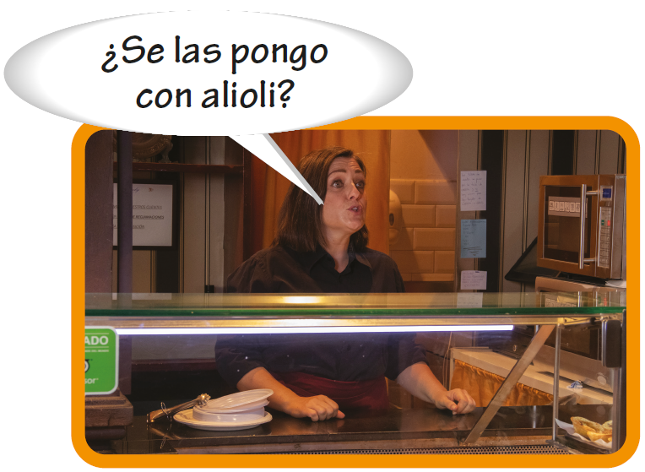
Double object pronouns

Slide 4
Double object pronouns
The indirect object pronouns le and les always change to se when they precede lo, los, la, and las.
DOUBLE OBJECT
PRONOUNS
I.O.
D.O.
Le escribí la carta. I wrote him/her the letter. | Se la escribí. I wrote it to him/her.
Les sirvió los entremeses. He served them the appetizers. | Se los sirvió. He served them to them.
Le pedimos un café. We ordered him/her a coffee. | Se lo pedimos. We ordered it for him/her.

Slide 5
Double object pronouns
Because se has multiple meanings, you can clarify to whom the pronoun refers by adding a usted, a él, a ella, a ustedes, a ellos, or a ellas.
¿El sombrero? Carlos se lo vendió a ella. The hat? Carlos sold it to her. | ¿Las llaves? Yo se las di a ella. The keys? I gave them to her.

Slide 6
Double object pronouns
Double object pronouns are placed before a conjugated verb. With infinitives and present participles, double object pronouns may be placed before the conjugated verb or attached to the end of the infinitive or present participle.

Slide 7
Double object pronouns
When double object pronouns are attached to an infinitive or a present participle, an accent mark is added to maintain the original stress.
DOUBLE OBJECT
PRONOUNS
DOUBLE OBJECT
PRONOUNS
Te lo voy a mostrar. Nos las están sirviendo. | Voy a mostrártelo. Están sirviéndonoslas.
Me lo estoy poniendo. Estoy poniéndomelo. I am putting it on. | Se las van a traer. Van a traérselas. They are going to bring them to you.

Slide 8
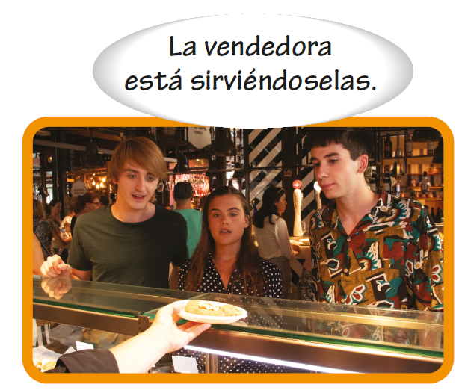
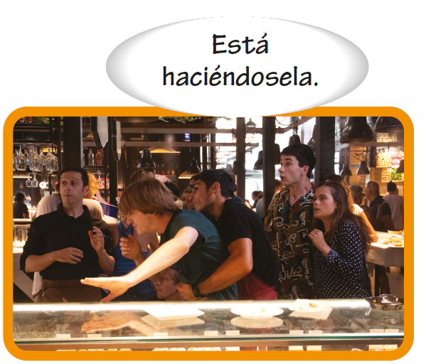
Double object pronouns

