Slide 1
Preterite of stem-changing verbs
As you know, –ar and –er stem-changing verbs have no stem change in the preterite. –Ir stem-changing verbs, however, do have a stem change.
Preterite of –ir stem-changing verbs
 | servir | morir (to die)
yo tú Ud./él/ella nosotros/as vosotros/as Uds./ellos/ellas | serví I served serviste sirvió servimos servisteis sirvieron | morí I died moriste murió morimos moristeis murieron
e➞i
o➞u

Slide 2
Preterite of stem-changing verbs
In the preterite, stem-changing –ir verbs have an e to i or o to u stem change in the Ud./él/ella and Uds./ellos/ellas forms.
INFINITIVE
VERB STEM
STEM CHANGE
PRETERITE
pedir dormir
ped- dor-
pid- dur-
pidió, pidieron durmió, durmieron

Slide 3
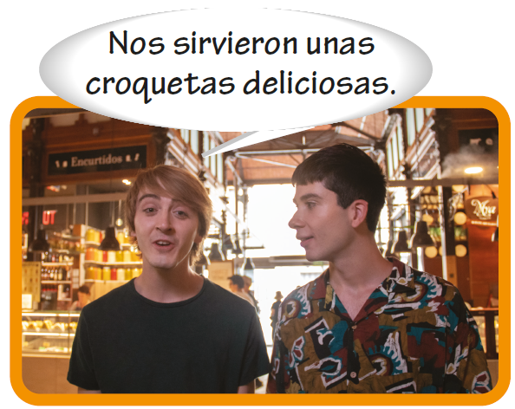
Preterite of stem-changing verbs

