Slide 1
Gustar and verbs like gustar
Me gusta(n) and te gusta(n) express the concepts of I like and you (fam.) like. The literal meaning of gustar is to be pleasing to (someone).
Me gusta ese champú. That shampoo is pleasing to me. I like that shampoo. | ¿Te gustan los deportes? Are sports pleasing to you? Do you like sports?

Slide 2
Gustar and verbs like gustar
Me gusta(n) and similar constructions require an indirect object pronoun. In Spanish, the object or thing being liked (el champú) is the subject of the sentence. The person who likes the object is an indirect object that answers the question to whom is the object pleasing?
I.O.
PRONOUN
SUBJECT
SUBJECT
DIRECT OBJECT
Me gusta ese champú. I like that shampoo.

Slide 3
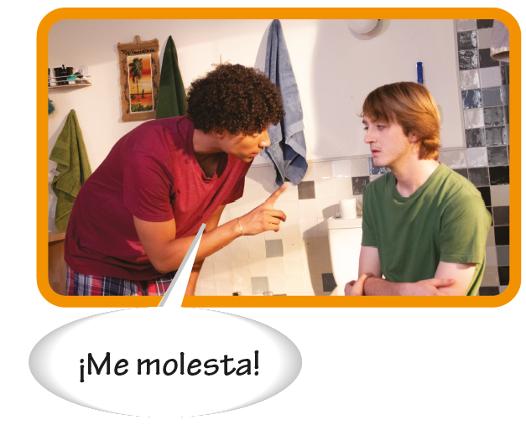
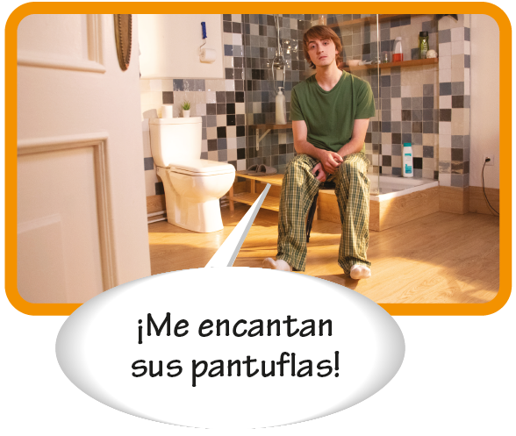
Gustar and verbs like gustar

Slide 4
Gustar and verbs like gustar
Gustar and similar verbs are usually used in the third-person singular and plural. When the object or person liked is singular, the form gusta is used. When two or more objects or persons are liked, gustan is used.
Me gustan el mar y la montaña. I like the ocean and the mountains. | ¿Les gusta la ciudad? Do you/they like the city?

Slide 5
Gustar and verbs like gustar
me, te, le nos, os, les
gusta gustó gustan gustaron
la película el concierto las computadoras los libros
SINGULAR
PLURAL

Slide 6
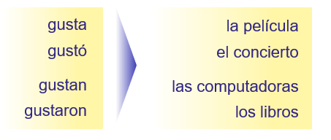
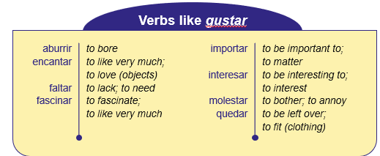
I like it/-them) A mí me…
You like it/it A ti te…
He likes it/them A él, A Juan…
She likes it/them A ella, A mi prima…
We like it/them A nosotros(as) nos…
You’all like it/them A ustedes…
They like it/them A ellos/A ellas…

Slide 7
Gustar and verbs like gustar
To express what someone likes or does not like to do, the singular form gusta is used, followed by one or more infinitives.
Me gusta levantarme tarde. I like to get up late. | Me gusta comer y dormir. I like to eat and sleep.

Slide 8
Gustar and verbs like gustar
To express the English equivalent of would like (something or to do something), use the construction [i.o. pronoun] + gustaría(n).
¿Te gustaría ver esa película? Would you like to see that movie? | Me gustarían unos días sin clases. I would like a few days without class.

Slide 9
Gustar and verbs like gustar
Using the verb gustar
The construction a + [personal pronoun] (a mí, a ti, a usted, a él, a ella, a nosotros/as, a vosotros/as, a ellos, a ellas, a ustedes) clarifies or emphasizes the people who are pleased. A + [noun] can also be used.
A mí me gusta levantarme temprano. ¿Y a ti? I like to get up early. How about you? | Al profesor le gustó el libro. The teacher liked the book.

Slide 10
Gustar and verbs like gustar
Using the verb gustar (cont’d)
Here is a list of common verbs used in the same way as gustar.
Verbs like gustar
aburrir encantar faltar fascinar | to bore to like very much; to love (objects) to lack; to need to fascinate; to like very much | importar interesar molestar quedar | to be important to; to matter to be interesting to; to interest to bother; to annoy to be left over; to fit (clothing)

Slide 11
Gustar and verbs like gustar
Using the verb gustar (cont’d)
Faltar expresses what is lacking or missing. Quedar expresses how much of something is left. Also, quedar is used to talk about how clothing fits or looks on someone.
Le falta dinero. He/she is short of money. Nos quedan cinco libros. We have five books left. | Me faltan dos pesos. I need two more pesos. La falda te queda bien. The skirt looks good on you.

