Slide 1
Indefinite and negative words
Indefinite words, such as someone or something, refer to people and things that are not specific. Negative words, like no one or nothing, deny the existence of people and things or contradict statements.

Slide 2
Indefinite and negative words
Indefinite and negative words
Indefinite words
Negative words
algo alguien alguno/a(s), algún o… o | something; anything someone; somebody; anyone some; any either… or | nada nadie ninguno/a, ningún ni… ni nunca, jamás tampoco | nothing; not anything no one; nobody; not anyone no; none; not any neither… nor never, not ever neither; not either

Slide 3
Indefinite and negative words
There are two ways to form negative sentences in Spanish. You can place the negative word before the verb, or you can place no before the verb and the negative word after the verb.
Nadie piensa en mí. No piensa nadie en mí. Nobody thinks of me. Ninguno me gusta. No me gusta ninguno. I don’t like any. | Ellos nunca se enojan. Ellos no se enojan nunca. They never get angry. Nada me despierta. No me despierta nada. Nothing wakes me up.

Slide 4
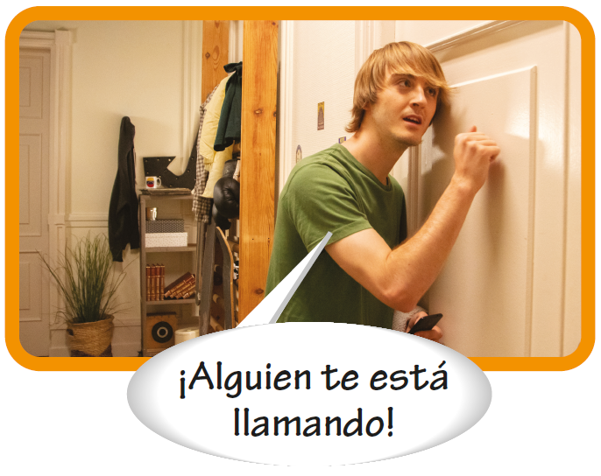
Indefinite and negative words

Slide 5
Indefinite and negative words
In Spanish, sentences frequently contain two or more negative words. Once a sentence is negative, all indefinite ideas must be expressed in the negative.
Ella no tiene ninguna idea. She doesn’t have any idea. Jamás me preocupo por nada. I never worry about anything. | Nunca te pido nada. I never ask you for anything. Tampoco me acuerdo de nadie. I don’t remember anyone either.

Slide 6
Indefinite and negative words
Using indefinite words
Alguien and nadie are often used with the personal a. The personal a is also used before alguno/a, algunos/as, and ninguno/a when these words refer to people and are the direct object of a verb.
—Carlos, ¿ves a alguien allí? —No, no veo a nadie. | —¿Oyes a alguno de los chicos? —No, no oigo a ninguno.

Slide 7
Indefinite and negative words
Using indefinite words (cont’d)
¡ojo! Before a masculine singular noun, alguno and ninguno are shortened to algún and ningún. Note that the personal a is not used with these words when they function as adjectives.
—¿Tienen ustedes algún amigo peruano? —¿Visitaste algún museo? | —No, no tenemos ningún amigo peruano. —No, no visité ningún museo.

Slide 8
Indefinite and negative words
Pero and sino
Although the conjunctions pero and sino both mean but, they are not interchangeable. Sino is used when the first part of a sentence is negative and the second part contradicts it. In this context, sino means but rather or on the contrary. In all other cases, pero is used to mean but.

Slide 9
Indefinite and negative words
Pero and sino (cont’d)
No se acuesta temprano, sino tarde. He doesn’t go to bed early, but rather late. No queremos irnos, sino quedarnos. We don’t want to leave, but rather stay. | Canto, pero nunca en público. I sing, but never in public. Me desperté a las once, pero estoy cansada. I woke up at eleven, but I’m tired.

