Slide 1
Demonstrative adjectives and pronouns
Demonstrative adjectives
Demonstrative adjectives demonstrate or point out nouns. They precede the nouns they modify and agree with them in gender and number.
este vestido this dress | esos zapatos those shoes | aquella tienda that store (over there)

Slide 2
MASCULINE este ese aquel | FEMININE esta esa aquella | MASCULINE estos esos aquellos | FEMININE estas esas aquellas | this; these that; those that; those (over there)

Slide 3
Demonstrative adjectives and pronouns
Demonstrative adjectives (cont’d)
Demonstrative adjectives
Singular forms
Plural forms
MASCULINE este ese aquel | FEMININE esta esa aquella | MASCULINE estos esos aquellos | FEMININE estas esas aquellas | this; these that; those that; those (over there)

Slide 4
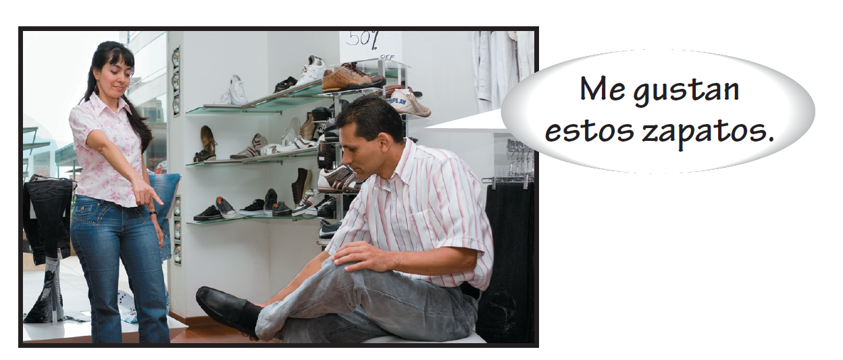
Demonstrative adjectives and pronouns
Demonstrative adjectives (cont’d)
The demonstrative adjectives este, esta, estos, and estas are used to point out things that are close to the speaker and the listener.

Slide 5
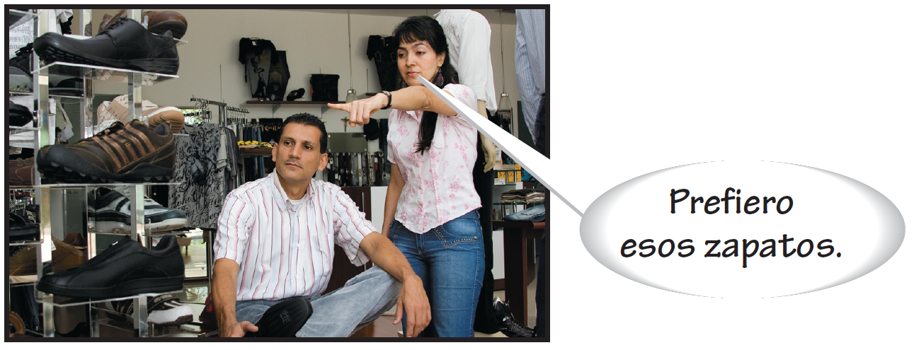
Demonstrative adjectives and pronouns
Demonstrative adjectives (cont’d)
The demonstrative adjectives ese, esa, esos, and esas are used to point out things that are not close in space and time to the speaker. They may, however, be close to the listener.

Slide 6
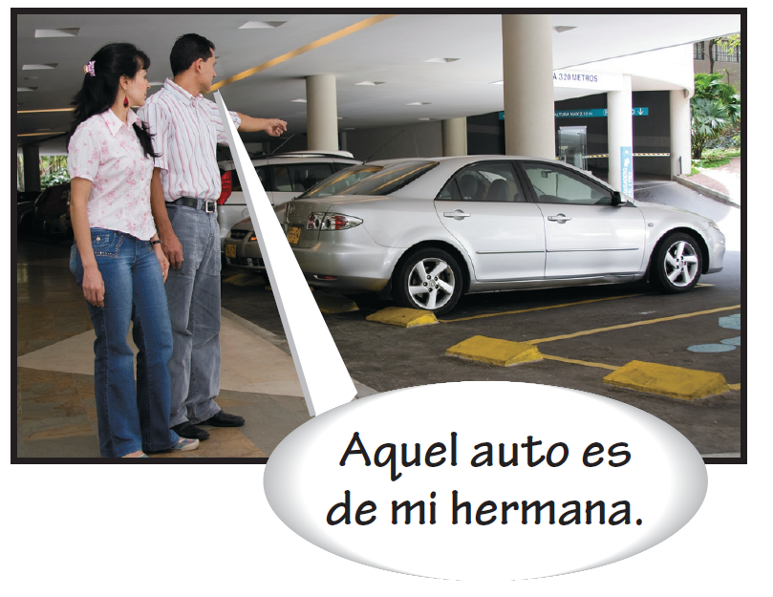
Demonstrative adjectives and pronouns
Demonstrative adjectives (cont’d)
The demonstrative adjectives aquel, aquella, aquellos, and aquellas are used to point out things that are far away from the speaker and the listener.

Slide 7
Demonstrative adjectives and pronouns
Demonstrative pronouns (cont’d)
Demonstrative pronouns are identical to demonstrative adjectives, except that they traditionally carry an accent mark on the stressed vowel. They agree in number and gender with the corresponding noun.

Slide 8
Demonstrative adjectives and pronouns
Demonstrative pronouns (cont’d)
No me gusta este suéter. Prefiero ése. I don’t like this sweater. I prefer that one. No voy a comprar estos zapatos. Quiero aquéllos. I’m not going to buy these shoes. I want those over there. | Ella quiere comprar esa bolsa, no aquélla. She wants to buy that purse, not that one over there. ¿Qué precio tienen esos pantalones? Ésos cuestan quince dólares. How much do those pants cost? Those cost fifteen dollars.

Slide 9
Demonstrative adjectives and pronouns
Demonstrative pronouns (cont’d)
Demonstrative pronouns
Singular forms
Plural forms
MASCULINE éste ése aquél | FEMININE ésta ésa aquélla | MASCULINE éstos ésos aquéllos | FEMININE éstas ésas aquéllas | This one; these That one; those That one; those (over there)

Slide 10
Demonstrative adjectives and pronouns
Demonstrative pronouns (cont’d)
There are three neuter forms: esto, eso, and aquello. These forms refer to unidentified or unspecified things, situations, and ideas. They do not change in gender or number and never carry an accent mark.
¿Qué es esto? What’s this? | Eso es interesante. That’s interesting. | Aquello es bonito. That’s pretty.

