Slide 1
The preterite tense of regular verbs
In order to talk about events in the past, Spanish uses two simple tenses: the preterite and the imperfect. In this lesson, you will learn about the preterite tense.

Slide 2
The preterite tense of regular verbs
The preterite is used to talk about actions or states completed in the past.
Preterite of regular –ar, –er, and –ir verbs
comprar
vender
escribir
yo tú Ud./él/ella nosotros/as vosotros/as Uds./ellos/ellas | compré I bought compraste compró compramos comprasteis compraron | vendí I sold vendiste vendió vendimos vendisteis vendieron | escribí I wrote escribiste escribió escribimos escribristeis escribieron

Slide 3
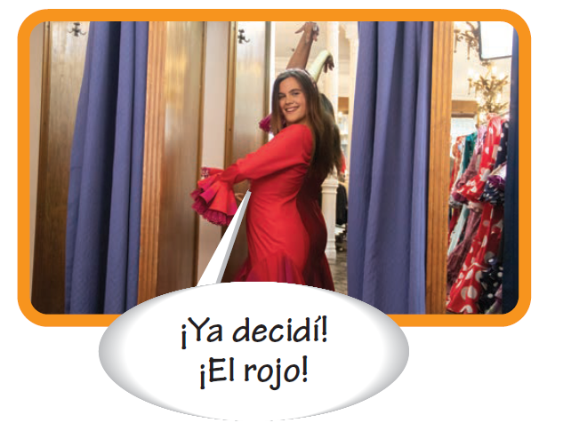
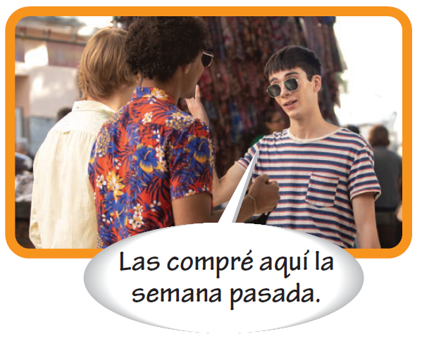
The preterite tense of regular verbs
The preterite endings for regular –er and –ir verbs are identical. Also, note that the yo and Ud./él/ella forms of all three conjugations have written accents on the last syllable.

Slide 4
The preterite tense of regular verbs
Note that the nosotros/as forms of regular –ar and –ir verbs in the preterite are identical to the present-tense forms. Context will help you determine which tense is being used.
En invierno compramos suéteres. In the winter we buy sweaters. Escribimos poemas en clase. We write poems in class. | Anoche compramos unas sandalias. Last night we bought some sandals. Ya escribimos dos veces al presidente. We already wrote to the president twice.

Slide 5
The preterite tense of regular verbs
–Ar and –er verbs that have a stem change in the present tense do not have a stem change in the preterite.
INFINITIVE
PRESENT
PRETERITE
cerrar (e:ie) volver (o:ue) jugar (u:ue) pensar (e:ie)
Ana cierra la puerta. Juan vuelve a las dos. Él juega al fútbol. Pienso mucho.
Ana cerró la puerta. Juan volvió a las dos. Él jugó al fútbol. Pensé mucho.

Slide 6
The preterite tense of regular verbs
Verbs with spelling changes
Verbs that end in –car, –gar, and –zar have a spelling change in the yo form of the preterite. All the other forms are regular.
buscar ➔ busqué llegar ➔ llegué empezar ➔ empecé

Slide 7
The preterite tense of regular verbs
Verbs with spelling changes (cont’d)
Creer, leer, and oír have spelling changes in the preterite.
creer | creí, creiste, creyó, creímos, creísteis, creyeron
leer | leí, leiste, leyó, leímos, leísteis, leyeron
oír | oí, oiste, oyó, oímos, oísteis, oyeron

Slide 8
The preterite tense of regular verbs
Verbs with spelling changes (cont’d)
Ver is regular in the preterite, but none of its forms has an accent.
ver ➔ vi, viste, vio, vimos, visteis, vieron

Slide 9
The preterite tense of regular verbs
Words commonly used with the preterite
anoche anteayer el año pasado ayer de repente | last night the day before yesterday last year yesterday suddenly | desde… hasta… pasado/a la semana pasada una vez dos veces ya | from… until… (adj.) last; past last week once twice already
Ayer compré una camisa. Yesterday I bought a shirt. | Miré la televisión anoche. I watched TV last night.

Slide 10
The preterite tense of regular verbs
Useful phrases
¿Qué hiciste? ¿Qué hizo usted? ¿Qué hicieron ustedes? ¿Qué hizo él/ella? ¿Qué hicieron ellos/ellas? | What did you (fam., sing.) do? What did you (form., sing.) do? What did you (pl.) do? What did he/she do? What did they do?

Slide 11
The preterite tense of regular verbs
¡ojo! Use acabar de + [infinitive] to say that something has just occurred. Note that acabar is in the present tense in this construction.
Acabo de comprar un suéter. I just bought a sweater. | Acabas de ir de compras. You just went shopping.

Slide 12
