Slide 1
Indirect object pronouns
An indirect object is the noun or pronoun that answers the question to whom or for whom an action is done. In this example, the indirect object answers this question: ¿A quién le presto Roberto cien pesos? To whom did Roberto loan 100 pesos?

Slide 2
Indirect object pronouns
SUBJECT | INDIRECT OBJECT PRONOUN | VERB | DIRECT OBJECT | INDIRECT OBJECT
Roberto | le | prestó | cien pesos | a Luisa.
Roberto |  | loaned | 100 pesos | to Luisa.

Slide 3
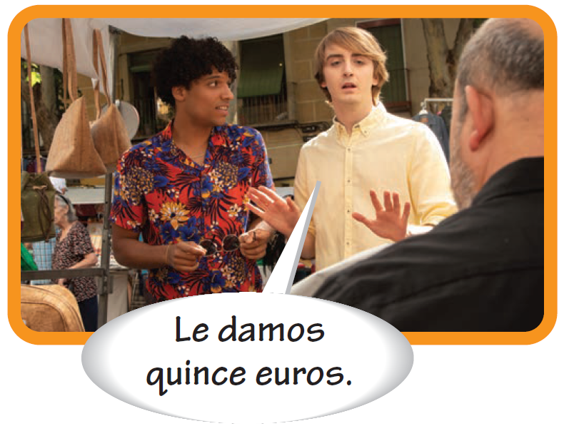
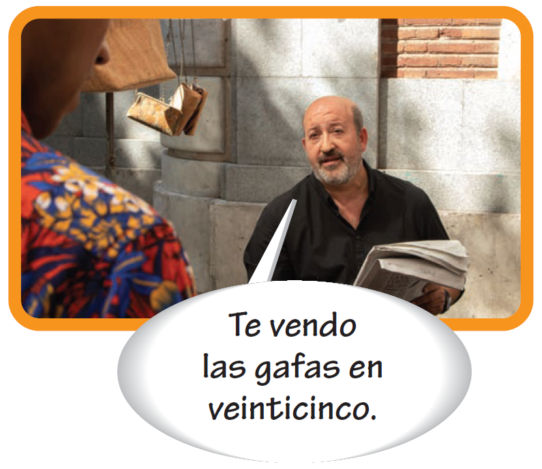
Indirect object pronouns
Indirect object pronouns
Singular forms
Plural forms
me te le | (to, for) me (to, for) you (fam.) (to, for) you (form.); (to, for) him; (to, for) her | nos os les | (to, for) us (to, for) you (fam.) (to, for) you; (to, for) them

Slide 4
Indirect object pronouns
Spanish speakers often use the object pronoun and the noun to which it refers in the same sentence to emphasize or clarify to whom the pronoun refers. The indirect object pronoun is often used without the indirect object noun when the person for whom the action is being done is known.
Iván le prestó un lápiz a Juan. Iván loaned a pencil to Juan. Sabrina le compró un café a Valeria. Sabrina bought Valeria a coffee. | También le prestó papel. He also loaned him paper. También le compró un sándwich. She also bought her a sandwich.

Slide 5
Indirect object pronouns
¡ojo! Since le and les have multiple meanings, a + [noun] or a + [pronoun] is often used to clarify to whom the pronouns refer.
Unclear
Clearer
Ella les vendió ropa. She sold clothing (to them or to you all). Yo le presté una camisa. I loaned a shirt (to you or to him or to her). | Ella les vendió ropa a ellos. She sold clothing to them. Yo le presté una camisa a Luis. I loaned a shirt to Luis.

Slide 6
Indirect object pronouns
Using indirect object pronouns
Indirect object pronouns usually precede the conjugated verb. In negative sentences, place the pronoun between no and the conjugated verb.
Te compré un abrigo. I bought you a coat. | No te compré nada. I didn’t buy you anything.

Slide 7
Indirect object pronouns
Using indirect object pronouns (cont’d)
When an infinitive or present participle is used, there are two options for indirect object pronoun placement: before the conjugated verb, or attached to the infinitive or present participle. When a pronoun is attached to a present participle, an accent mark is added.
¿Vas a comprarle un regalo a Carla? ¿Le vas a comprar un regaloa Carla? Are you going to buy a gift for Carla? | Estoy mostrándoles las fotos a ellos. Les estoy mostrando las fotos a ellos. I’m showing them the photos.

Slide 8
Indirect object pronouns
Using indirect object pronouns (cont’d)
The irregular verbs dar (to give) and decir (to say; to tell) are often used with indirect object pronouns.
Dar and decir
dar
decir
yo tú Ud./él/ella nosotros/as vosotros/as Uds./ellos/ellas Present participle | doy das da damos dais dan dando | digo dices dice decimos decís dicen diciendo

Slide 9
Indirect object pronouns
Using indirect object pronouns (cont’d)
Mi abuela me da muchos regalos. My grandmother gives me lots of gifts. Voy a darle un beso. I’m going to give her a kiss. | Te digo la verdad. I’m telling you the truth. No les estoy diciendo mentiras a mis padres. I am not telling lies to my parents.

Slide 10
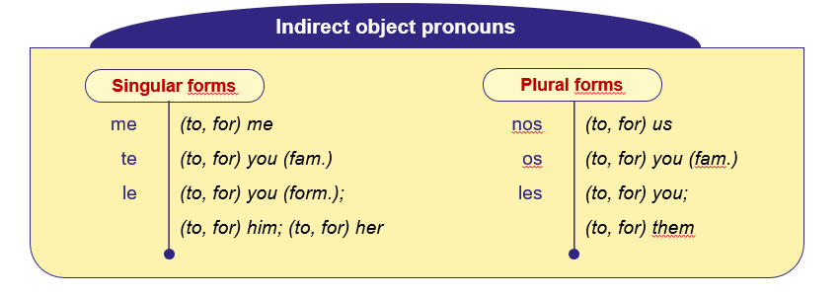
Indirect object pronouns

