Slide 1
Estar with conditions and emotions
In Spanish, the verb estar is used to talk about how people feel and to say where people, places, and things are located. (See page 42.)
Estoy bien, gracias. I’m fine, thanks. | Juan está en la biblioteca. Juan is at the library.

Slide 2
Estar with conditions and emotions
Estar is used with adjectives to describe the physical condition of things.
La puerta está cerrada. The door is closed. | Todo está muy limpio. Everything is very clean.

Slide 3
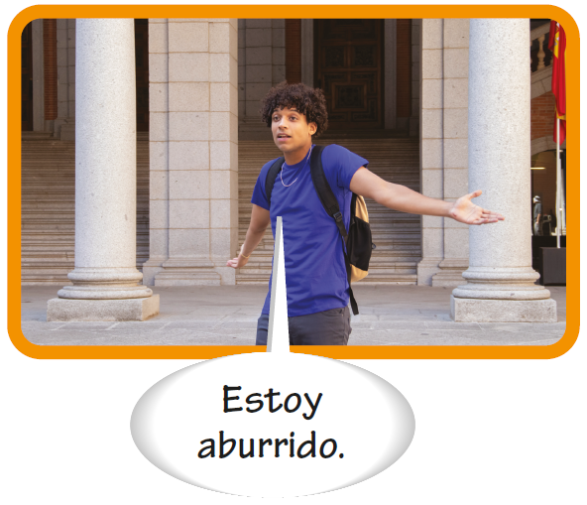
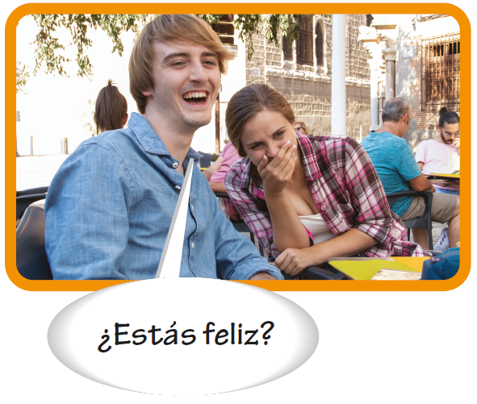
Estar with conditions and emotions
Use estar with adjectives to describe how people feel.

Slide 4
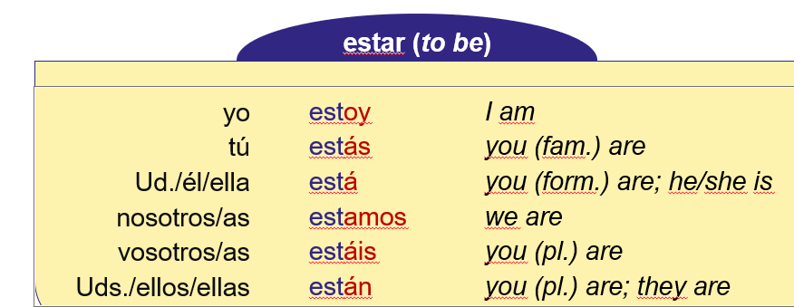
Estar with conditions and emotions
Adjectives that describe emotions and conditions
abierto/a aburrido/a alegre avergonzado/a cansado/a cerrado/a cómodo/a contento/a desordenado/a enamorado/a (de) enojado/a | open bored happy embarrassed tired closed comfortable content disorderly in love (with) angry | equivocado/a feliz limpio/a listo/a nervioso/a ocupado/a ordenado/a preocupado/a (por) seguro/a sucio/a triste | wrong happy clean ready nervous busy orderly worried (about) sure; safe; confident dirty sad

Slide 5
Estar with conditions and emotions
Note that the plural of feliz is felices.
Pedro esta | Pedro y Juan estan | Julieta esta | Julieta y Ana estan
triste | tristes | triste | tristes
feliz | felices
enojado | enojados | enojada | enojadas
contento | contentos | contenta | contentas
enamorado | enamorados | enamorada | enamoradasb

