Slide 1
Verbs with irregular yo forms
In Spanish, several verbs have irregular yo forms in the present tense.

Slide 2
Verbs with irregular yo forms
The verbs hacer (to do, to make), poner (to put, to place), salir (to leave), suponer (to suppose), and traer (to bring) have yo forms that end in -go. The other forms are regular.
Verbs with irregular yo forms
hacer
poner
salir
suponer
traer
 | to do; to make | to put; to place | to leave | to suppose | to bring
yo tú Ud./él/ella nosotros/as vosotros/as Uds./ellos/ellas | hago haces hace hacemos hacéis hacen | pongo pones pone ponemos ponéis ponen | salgo sales sale salimos salís salen | supongo supones supone suponemos suponéis suponen | traigo traes trae traemos traéis traen

Slide 3
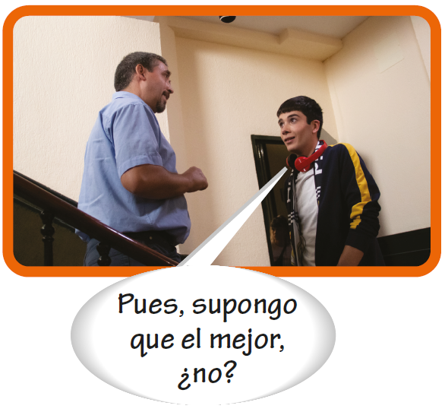
Verbs with irregular yo forms

Slide 4
Verbs with irregular yo forms
Poner can also mean to turn on a household appliance.
Carlos pone la radio. Carlos turns on the radio. | María pone la televisión. María turns on the television.

Slide 5
Verbs with irregular yo forms
Salir de is used to indicate that someone is leaving a particular place.
Salgo de casa muy temprano. I leave home very early. | El tren sale de la estación a las dos. The train leaves the station at two.

Slide 6
Verbs with irregular yo forms
Salir para is used to indicate someone’s destination.
Mañana salgo para México. Tomorrow I leave for Mexico. | Hoy salen para España. Today they leave for Spain.

Slide 7
Verbs with irregular yo forms
Salir con means to leave with someone or something, or to date someone.
Alberto sale con su amigo. Alberto is leaving with his friend. Hoy voy a salir con mi hermana. Today I’m going out with my sister. | Margarita sale con su mochila. Margarita is leaving with her backpack. Raúl sale con una chica muy bonita. Raúl is going out with a very pretty girl.

Slide 8
Verbs with irregular yo forms
The verbs ver and oír
The verb ver (to see) has an irregular yo form. The other forms of ver are regular but note that the vosotros/as form does not carry an accent.

Slide 9
Verbs with irregular yo forms
The verbs ver and oír (cont’d)
ver (to see)
Singular forms
Plural forms
yo tú Ud./él/ella | veo ves ve | nosotros/as vosotros/as Uds./ellos/ellas | vemos veis ven
Ve a su abuela todos los domingos. He sees his grandmother every Sunday. | No veo el problema. I don’t see the problem.

Slide 10
Verbs with irregular yo forms
The verbs ver and oír (cont’d)
The verb ver also means to watch.
¿Cuándo vemos la película? When are we watching the movie? Quiero ver el partido de béisbol. I want to watch the baseball game. | Veo las noticias por la mañana. I watch the news in the morning. Veo a los niños jugar en el parque. I’m watching the kids play in the park.

Slide 11
Verbs with irregular yo forms
The verbs ver and oír (cont’d)
The verb oír (to hear) has an irregular yo form and a spelling change in the tú, usted/él/ella, and ustedes/ellos/ellas forms. The nosotros/as and vosotros/as forms have an accent mark.

Slide 12
Verbs with irregular yo forms
The verbs ver and oír (cont’d)
oír (to hear)
Singular forms
Plural forms
yo tú Ud./él/ella | oigo oyes oye | nosotros/as vosotros/as Uds./ellos/ellas | oímos oís oyen
Oigo a unas personas en la otra sala. I hear some people in the other room. | ¿Oyes la música? Do you hear the music?

