Slide 1
Stem-changing verbs: e ➔ ie, o ➔ ue
In stem-changing verbs, the stressed vowel of the stem has a change when the verb is conjugated.
INFINITIVE
VERB STEM
STEM CHANGE
CONJUGATED FORM
empezar volver
empez- volv-
empiez- vuelv-
empiezo vuelvo

Slide 2
Stem-changing verbs: e ➔ ie, o ➔ ue
In many verbs, such as empezar (to begin), the stem vowel changes from e to ie. Note that the nosotros/as and vosotros/as forms don’t have a stem change.
empezar (e:ie)
Singular forms
Plural forms
yo tú Ud./él/ella | empiezo empiezas empieza | nosotros/as vosotros/as Uds./ellos/ellas | empezamos empezáis empiezan

Slide 3
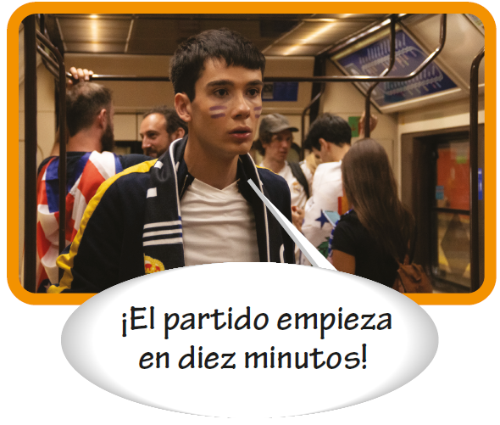
Stem-changing verbs: e ➔ ie, o ➔ ue

Slide 4
Stem-changing verbs: e ➔ ie, o ➔ ue
In many other verbs, such as volver (to return), the stem vowel changes from o to ue. The nosotros/as and vosotros/as forms do not have a stem change.
volver (o:ue)
Singular forms
Plural forms
yo tú Ud./él/ella | vuelvo vuelves vuelve | nosotros/as vosotros/as Uds./ellos/ellas | volvemos volvéis vuelven

Slide 5
Stem-changing verbs: e ➔ ie, o ➔ ue
Jugar (to play a sport or a game) is the only Spanish verb that has a u:ue stem change. Jugar is followed by a + [definite article] when the name of a sport or game is mentioned.

Slide 6
Stem-changing verbs: e ➔ ie, o ➔ ue
Stem-changing verbs are identified like this throughout the text:
empezar (e:ie) volver (o:ue)

Slide 7
Stem-changing verbs: e ➔ ie, o ➔ ue
Common stem-changing verbs
e:ie
o:ue
cerrar comenzar empezar entender pensar perder preferir querer | to close to begin to begin to understand to think to lose; to miss to prefer to want; to love | dormir encontrar jugar* mostrar poder recordar volver | to sleep to find to play to show to be able to; can to remember to return
*Jugar is grouped with the o:ue verbs because it follows a similar pattern to these verbs.

Slide 8
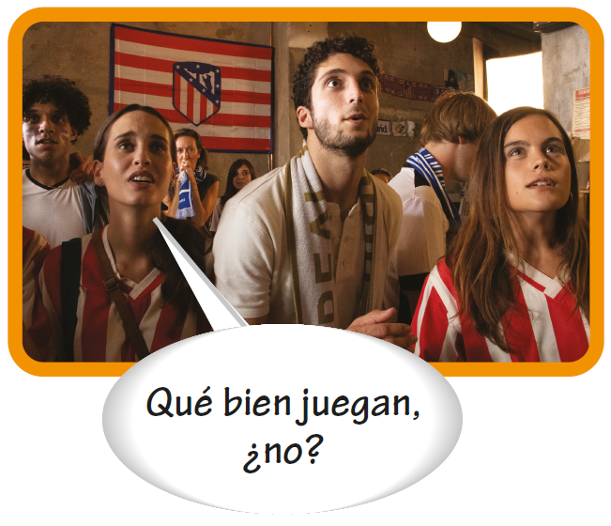
Stem-changing verbs: e ➔ ie, o ➔ ue

Slide 9
Stem-changing verbs: e ➔ ie, o ➔ ue
Comenzar and empezar require the preposition a when they are followed by an infinitive.
Comenzamos a jugar a las siete. We begin playing at seven. | Ana empieza a trabajar hoy. Ana starts working today.

Slide 10
Stem-changing verbs: e ➔ ie, o ➔ ue
Pensar + [infinitive] means to plan or to intend to do something. Pensar en means to think about someone or something.
—¿Piensan ir al gimnasio? Are you planning to go to the gym? —¿En qué piensas? What are you thinking about? | —Sí, pensamos ir al mediodía. Yes, we are planning to go at noon. —Pienso en el examen final. I’m thinking about the final exam.

