Slide 1
The present tense of ir
The verb ir (to go) is irregular in the present tense.
ir (to go)
Singular forms
Plural forms
yo tú Ud./él/ella | voy vas va | nosotros/as vosotros/as Uds./ellos/ellas | vamos vais van

Slide 2
The present tense of ir
Ir is often used with the preposition a (to). When a is followed by the article el, the words form the contraction al. There is no contraction
when a is followed by la, las, and los.
a + el = al
Voy al cine con María. I’m going to the movies with María. | Ellos van a las montañas. They are going to the mountains.

Slide 3
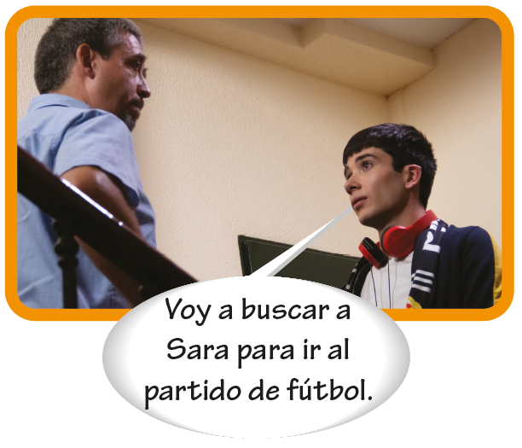
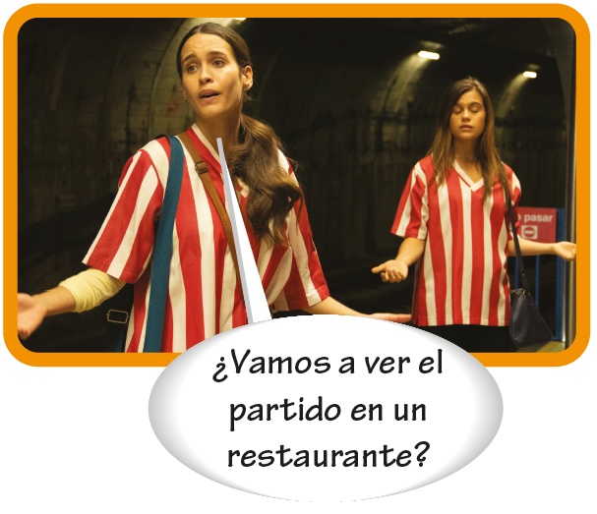
The present tense of ir
The construction ir a + [infinitive] expresses actions that are going to happen in the future. It is equivalent to the English to be going to + [infinitive].

Slide 4
The present tense of ir
Vamos a + [infinitive] can also express the idea of let’s (do something).
Vamos a pasear. Let’s take a walk. | ¡Vamos a ver! Let’s see!

Slide 5
The present tense of ir
¡ojo! Use adónde instead of dónde when asking a question with ir.
¿Adónde vas? Where are you going? | ¿Dónde estás? Where are you?

