Slide 1
Present tense of tener and venir
The verbs tener (to have) and venir (to come) are frequently used. Since most of their forms are irregular, you will have to learn each one individually.

Slide 2
Present tense of tener and venir
Present tense of tener and venir
tener
venir
 | to have | to come
yo tú Ud./él/ella nosotros/as vosotros/as Uds./ellos/ellas | tengo tienes tiene tenemos tenéis tienen | vengo vienes viene venimos venís vienen

Slide 3
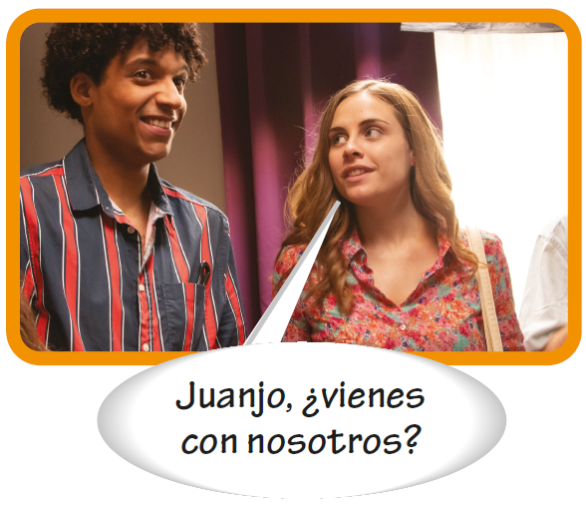
Present tense of tener and venir

Slide 4
Present tense of tener and venir
Note that the yo forms are irregular:
tengo | vengo

Slide 5
Present tense of tener and venir
The nosotros and vosotros forms are regular:
tenemos tenéis | venimos venís

Slide 6
Present tense of tener and venir
In the tú, Ud./él/ella, and Uds./ellos/ellas forms, the e of the stem changes to ie as shown.
INFINITIVE
VERB STEM
VERB FORM
tú Ud./él/ella Uds./ellos/ellas | tienes tiene tienen
tener
ten-
tú Ud./él/ella Uds./ellos/ellas | vienes viene vienen
venir
ven-

Slide 7
Present tense of tener and venir
Expressions with tener
In certain expressions, Spanish uses the construction tener + [noun] instead of ser or estar to express the English equivalent
to be + [adjective].

Slide 8
Present tense of tener and venir
Expressions with tener (cont’d)
Common expressions with tener
tener… años tener (mucho) calor tener (mucho) cuidado tener (mucho) frío tener (mucha) hambre tener (mucho) miedo tener (mucha) prisa tener razón no tener razón tener (mucha) sed tener (mucho) sueño tener (mucha) suerte | to be . . . years old to be (very) hot to be (very) careful to be (very) cold to be (very) hungry to be (very) afraid/scared to be in a (big) hurry to be right to be wrong to be (very) thirsty to be (very) sleepy to be (very) lucky

Slide 9
Present tense of tener and venir
Expressions with tener (cont’d)
To express an obligation, use tener que (to have to) + [infinitive].
—¿Tienes que estudiar hoy? Do you have to study today? | —Sí, tengo que estudiar física. Yes, I have to study physics.

Slide 10
Present tense of tener and venir
Expressions with tener (cont’d)
To ask people if they feel like doing something, use tener ganas de (to feel like) + [infinitive].
—¿Tienes ganas de comer? Do you feel like eating? | —No, tengo ganas de dormir. No, I feel like sleeping.

