Slide 1
Present tense of regular –er and –ir verbs
In Lesson 2, you learned how to form the present tense of regular –ar verbs. This chart contains the forms of the regular –ar verb trabajar, which is conjugated just like other –ar verbs you have learned. There are other regular verbs in Spanish: regular –er and –ir verbs. The chart also shows the forms of an –er verb and an –ir verb.

Slide 2
Present tense of regular –er and –ir verbs
Present tense of –ar, –er, and –ir verbs
trabajar
comer
escribir
 | to work | to eat | to write
yo tú Ud./él/ella nosotros/as vosotros/as Uds./ellos/ellas | trabajo trabajas trabaja trabajamos trabajáis trabajan | como comes come comemos coméis comen | escribo escribes escribe escribimos escribís escriben

Slide 3
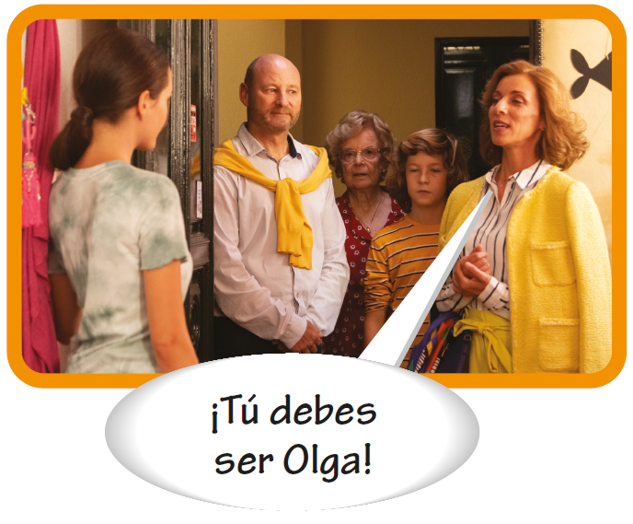
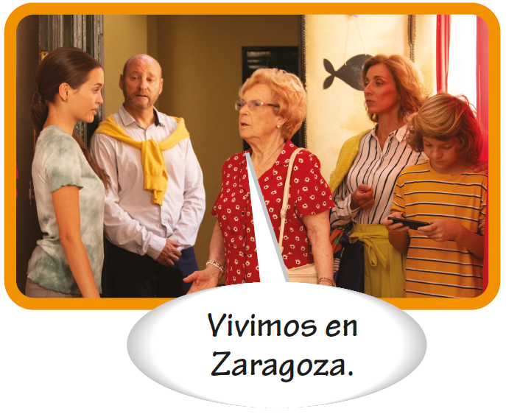
Present tense of regular –er and –ir verbs
–Ar, –er, and –ir verbs have very similar endings. Study the chart to detect the patterns that make it easier for you to use the verb endings to communicate in Spanish.

Slide 4
Present tense of regular –er and –ir verbs
Like –ar verbs, the yo forms of –er and –ir verbs end in –o.
trabajo | como | escribo

Slide 5
Present tense of regular –er and –ir verbs
The endings for –ar verbs begin with –a, except for the yo form.
hablo hablas | habla hablamos | habláis hablan

Slide 6
Present tense of regular –er and –ir verbs
The endings for –er verbs begin with –e, except for the yo form.
como comes | come comemos | coméis comen

Slide 7
Present tense of regular –er and –ir verbs
–Er and –ir verbs have the exact same endings, except in the nosotros/as
and vosotros/as forms.
nosotros | comemos escribimos
vosotros | coméis escribís

Slide 8
Present tense of regular –er and –ir verbs
Common –er and –ir verbs
Common –er and –ir verbs
–er verbs
–ir verbs
aprender beber comer comprender correr creer (en) deber (+ inf.) leer | to learn to drink to eat to understand to run to believe (in) should to read | abrir asistir (a) compartir decidir describir escribir recibir vivir | to open to attend to share to decide to describe to write to receive to live

Slide 9
Present tense of regular –er and –ir verbs
Common –er and –ir verbs (cont’d)
Lucía y Marcos corren en el parque.
Rosa vive en la residencia estudiantil.

