Slide 1
Numbers 31–100
Numbers 31–100
31 32 33 34 35 36 | treinta y uno treinta y dos treinta y tres treinta y cuatro treinta y cinco treinta y seis | 37 38 39 40 41 42 | treinta y siete treinta y ocho treinta y nueve cuarenta cuarenta y uno cuarenta y dos | 50 60 70 80 90 100 | cincuenta sesenta setenta ochenta noventa cien

Slide 2
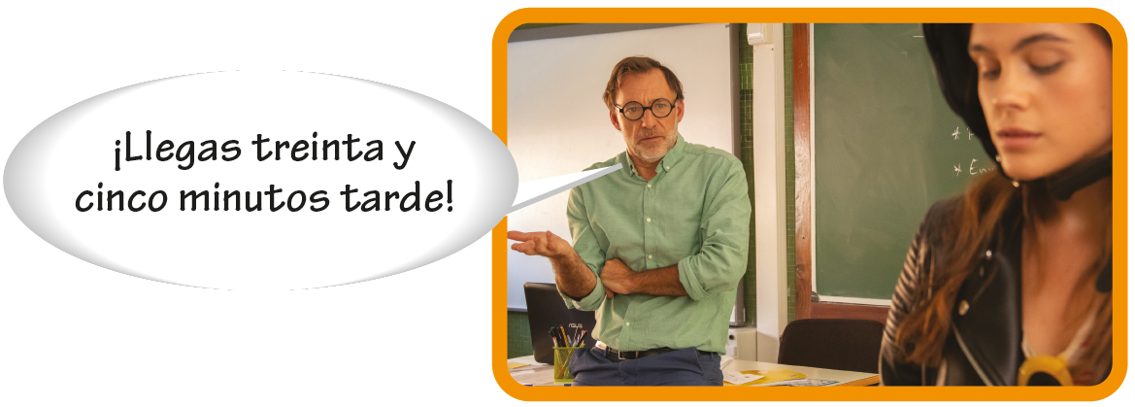
Numbers 31–100

Slide 3
The word y is used in most numbers from 31 through 99.
Hay ochenta y cinco exámenes. There are eighty-five exams. | Hay cuarenta y dos estudiantes. There are forty-two students.

Slide 4
Numbers 31–100
With numbers that end in uno (31, 41, etc.), uno becomes un before a masculine noun and una before a feminine noun.
Hay treinta y un chicos. There are thirty-one guys. | Hay treinta y una chicas. There are thirty-one girls.

Slide 5
Numbers 31–100
Cien is used before nouns and in counting. The words un, una, and uno are never used before cien in Spanish.
—¿Cuántos libros hay? How many books are there? —¿Cuántas sillas hay? How many chairs are there? | —Hay cien libros. There are one hundred books. —Hay cien sillas. There are one hundred chairs.

