Slide 1
The present tense of estar
In Lesson 1, you learned how to conjugate and use the verb ser (to be). Spanish has a second verb which means to be, the verb estar.

Slide 2
The present tense of estar
Although estar ends in –ar, it does not follow the pattern of regular –ar verbs. The yo form (estoy) is irregular. Also, all forms but the yo and nosotros/as forms have an accented á. As you will see, ser and estar are used in different ways.

Slide 3
The present tense of estar
estar (to be)
yo tú Ud./él/ella nosotros/as vosotros/as Uds./ellos/ellas | estoy estás está estamos estáis están | I am you (fam.) are you (form.) are; he/she is we are you (pl.) are you (pl.) are; they are

Slide 4
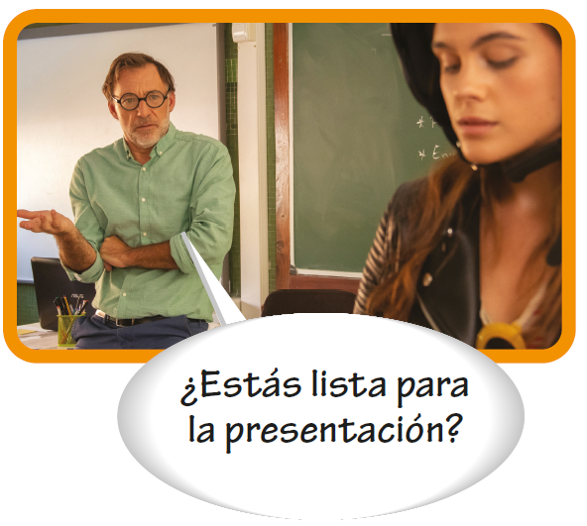
The present tense of estar

Slide 5
The present tense of estar
Uses of estar and ser
Uses of estar
Uses of ser
location | identity
Estoy en la biblioteca. I am at the library. Sara está al lado de Daniel. Sara is next to Daniel. Health Javier está enfermo hoy. Javier is sick today. well-being ¿Cómo estás, Juanjo? How are you, Juanjo? Estoy muy bien, gracias. I’m very well, thank you. | Hola, soy Valentina. Hello, I’m Valentina. occupation Soy estudiante. I’m a student. Origin ¿Eres de España? Are you from Spain? Sí, soy de España. Yes, I’m from Spain. telling time Son las cuatro. It’s four o’clock.

Slide 6
The present tense of estar
Estar with prepositions of locations
Estar is often used with certain prepositions to describe the location of a person or an object.
Prepositions of location
al lado de a la derecha de a la izquierda de en cerca de debajo de | next to to the right of to the left of in; on; at near below | delante de detrás de encima de entre lejos de sobre | in front of behind on top of between far from on; over

Slide 7
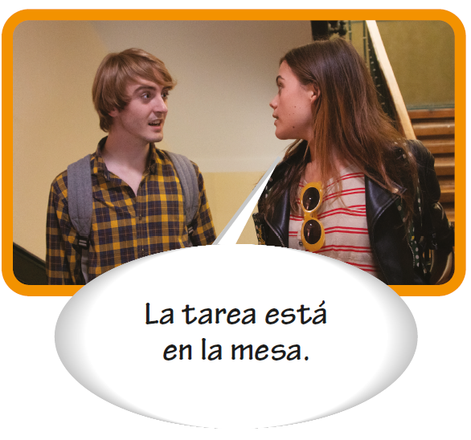
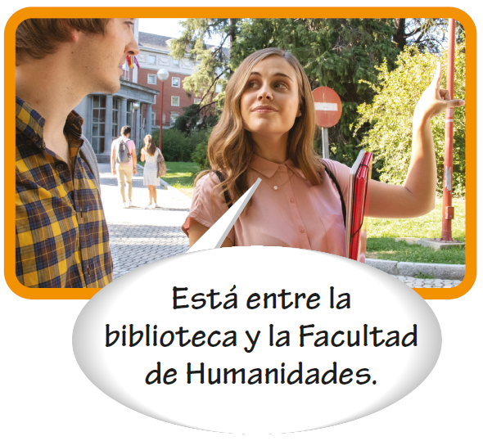
The present tense of estar
Estar with prepositions of locations (cont’d)

Slide 8
The present tense of estar
Estar with prepositions of locations (cont’d)
La cafetería está al lado de la biblioteca. The cafeteria is next to the library. Los libros están encima del escritorio. The books are on top of the desk. El laboratorio está cerca de la clase. The lab is near the classroom. Carla está delante de José. Carla is in front of José. | El estadio no está lejos de la librería. The stadium isn’t far from the bookstore. Estamos entre la puerta y la ventana. We are between the door and the window. Manuel está en la biblioteca. Manuel is at the library. El libro está sobre la mesa. The book is on the table.

