Slide 1
The present tense of regular -ar verbs
To create the forms of regular verbs, drop the infinitive endings (–ar, –er, –ir). Then add the endings that correspond to the different subject pronouns. This chart shows how to conjugate regular –ar verbs.
estudiar (to study)
yo tú Ud./él/ella nosotros/as vosotros/as Uds./ellos/ellas | estudio estudias estudia estudiamos estudiáis estudian | I study you (fam.) study you (form.) study; he/she studies we study you (pl.) study you (pl.) study; they study

Slide 2
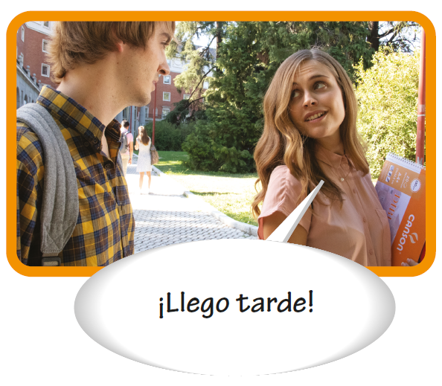
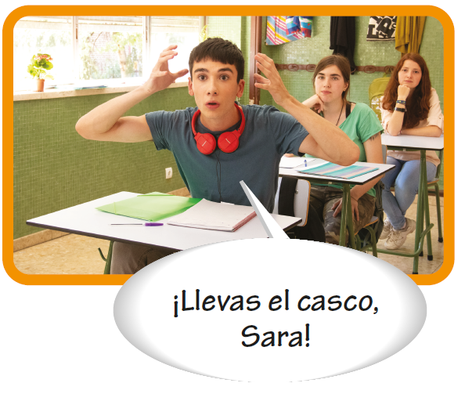
The present tense of regular -ar verbs

Slide 3
The present tense of regular -ar verbs
Common –ar verbs
bailar buscar caminar cantar comprar contestar conversar descansar desear dibujar enseñar escuchar esperar estudiar | to dance to look for to walk to sing to buy to answer to talk; to chat to rest to want; to wish to draw to teach to listen (to) to wait (for); to hope to study | explicar hablar llegar llevar mirar necesitar practicar preguntar preparar regresar terminar tomar trabajar viajar | to explain to talk; to speak to arrive to carry to look (at); to watch to need to practice to ask (a question) to prepare to return to end; to finish to take; to drink to work to travel

Slide 4
The present tense of regular -ar verbs
The Spanish present tense has several meanings in English. Note the following examples.
Ana trabaja en la cafetería. Ana works in the cafeteria. Ana is working in the cafeteria. Ana does work in the cafeteria. | Paco viaja a Madrid mañana. Paco travels to Madrid tomorrow. Paco is traveling to Madrid tomorrow. Paco does travel to Madrid tomorrow.

Slide 5
The present tense of regular -ar verbs
Using verbs in Spanish
When two verbs are used together with no change of subject, the second verb is generally in the infinitive.
Deseo hablar con Felipe. I want to speak with Felipe. | Necesito comprar lápices. I need to buy pencils.

Slide 6
The present tense of regular -ar verbs
Using verbs in Spanish (cont’d)
To make a sentence negative, use no before
the conjugated verb.
Yo no miro la televisión. I don’t watch television. | Ella no desea bailar. She doesn’t want to dance.

Slide 7
The present tense of regular -ar verbs
Using verbs in Spanish (cont’d)
Subject pronouns are often omitted; the verb endings indicate who the subject is. They may, however, be used for clarification or for emphasis.
—¿Qué enseñan? What do they teach? —¿Quién desea trabajar hoy? Who wants to work today? | —Él enseña arte y ella enseña química. He teaches art and she teaches chemistry. —Yo no deseo trabajar. I don’t want to work.

Slide 8
The present tense of regular -ar verbs
The verb gustar
The verb gustar, which is used to express likes and dislikes, is different from other -ar verbs. The most common forms of this verb are gusta and gustan. Use a singular noun with gusta and a plural noun with gustan. Also, there is no subject pronoun (yo, tú,...) before gusta(n).
Me gusta la historia. I like history. | Me gustan las lenguas extranjeras. I like foreign languages.

Slide 9
The present tense of regular -ar verbs
The verb gustar (cont’d)
To say what you like, use me before gusta(n). To ask a friend what he/she likes, use te before gusta(n). To express dislikes, insert no before me or te. To talk about what you like and don’t like to do, use (no) me gusta + [infinitive].

Slide 10
The present tense of regular -ar verbs
The verb gustar (cont’d)
—¿Te gusta la biología? Do you like biology? —¿Te gustan las clases este semestre? Do you like your classes this semester? —¿Te gusta bailar salsa? Do you like to dance salsa? | — No, no me gusta la biología. No, I don’t like biology. — Sí, me gustan las clases este semestre. Yes, I like my classes this semester. — Sí, me gusta bailar salsa. Yes, I like to dance salsa.

