Slide 1
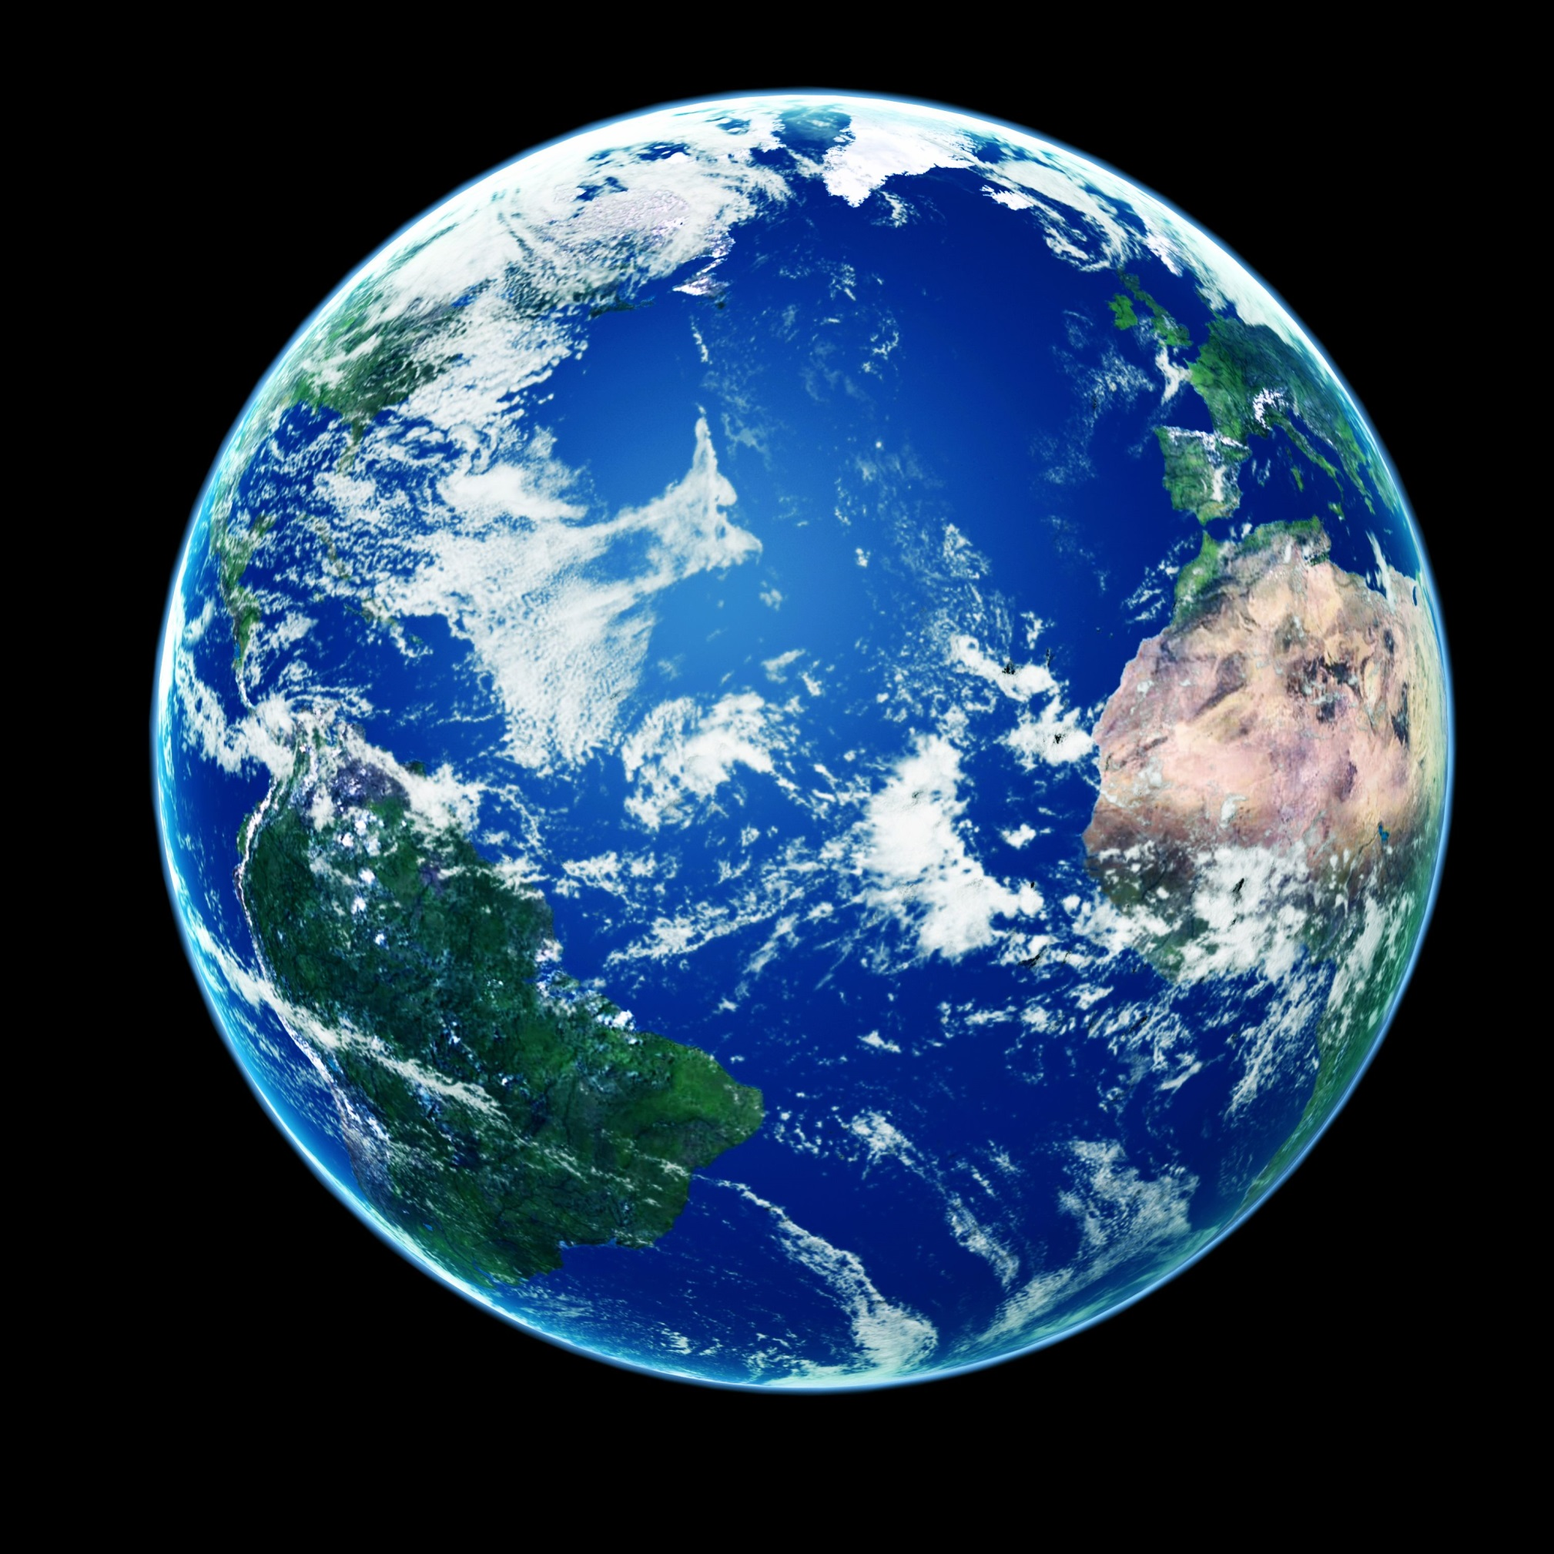

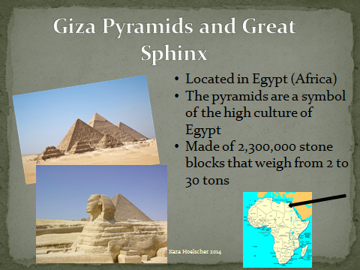
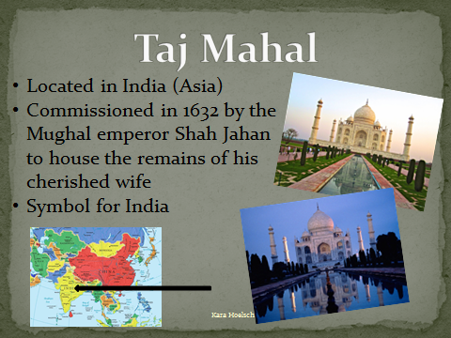
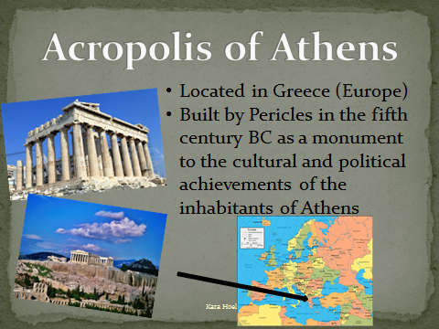
Landmarks
of the
World

Slide 2
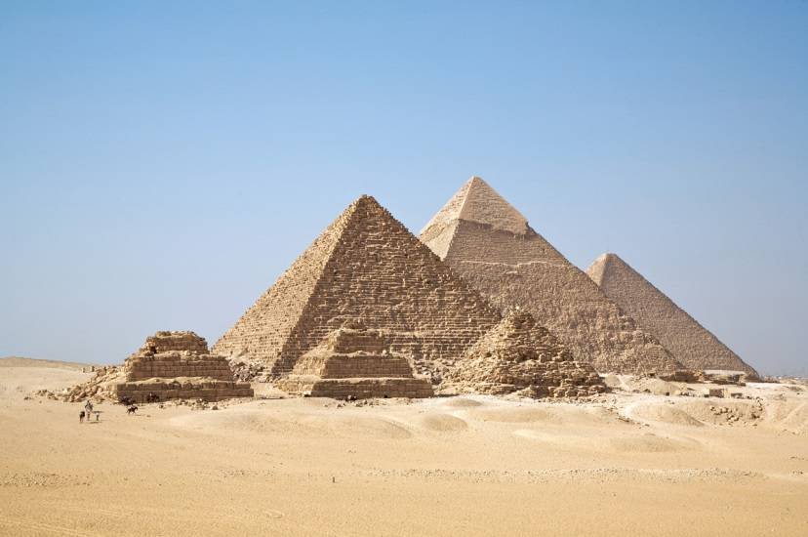
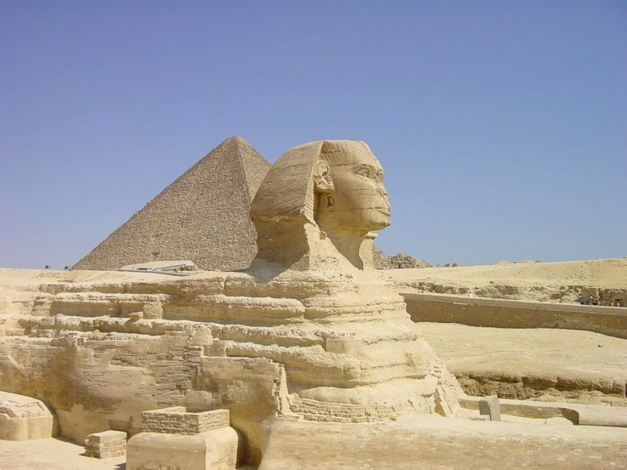
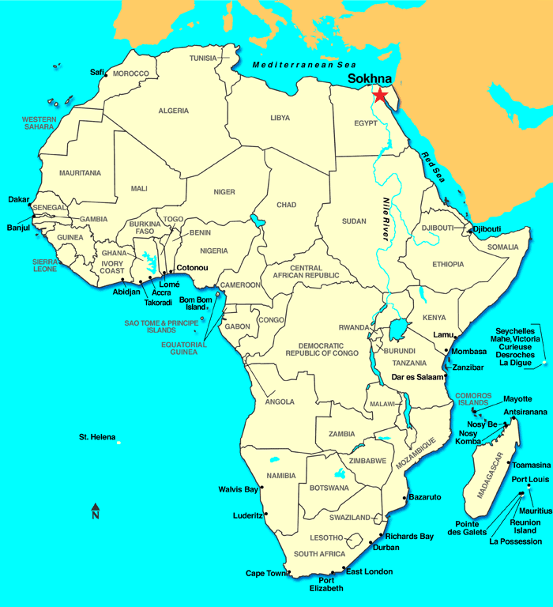
Giza Pyramids and Great Sphinx
Located in Egypt (Africa)
The pyramids are a symbol of the high culture of Egypt
Made of 2,300,000 stone blocks that weigh from 2 to 30 tons

Slide 3
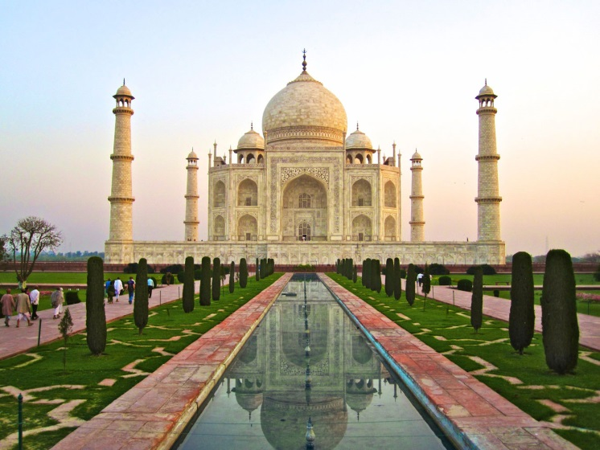
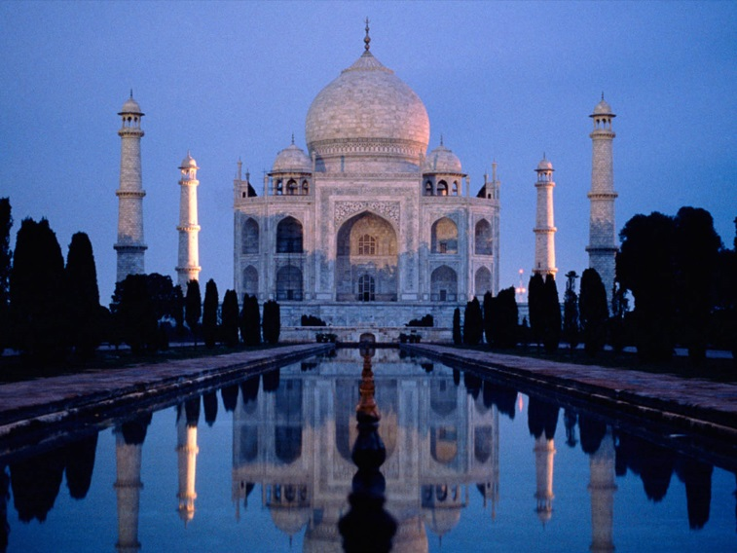
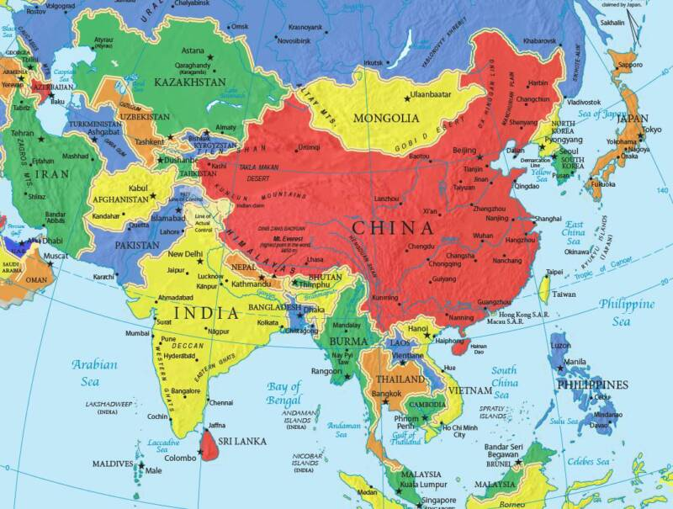
Taj Mahal
Located in India (Asia)
Commissioned in 1632 by the Mughal emperor Shah Jahan to house the remains of his cherished wife
Symbol for India

Slide 4
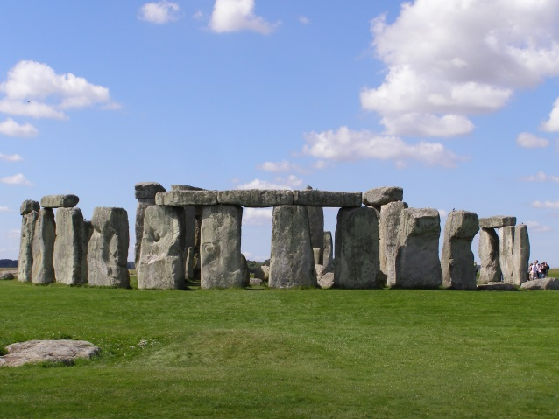
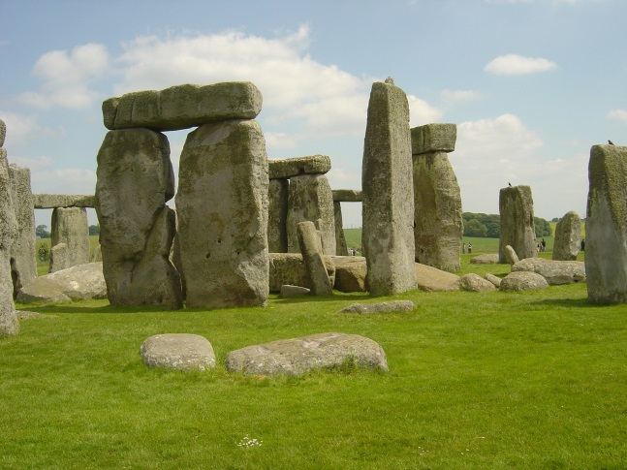
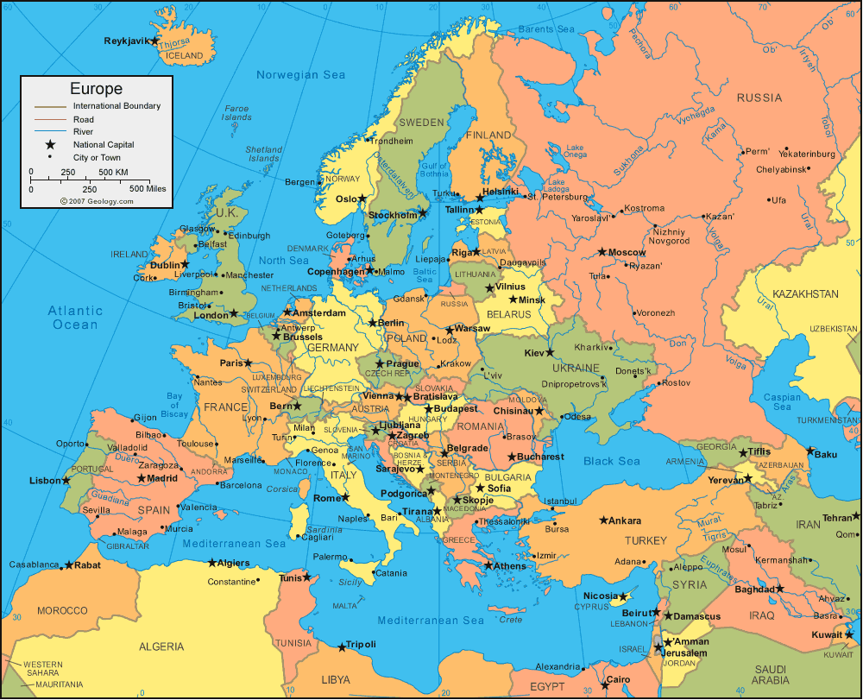
Stonehenge
Located in England (Europe)
It’s a mystery as to who built it and why it was built
Built 5,000 years ago
Its stones are up to 30 feet tall and weigh 25 tons

Slide 5
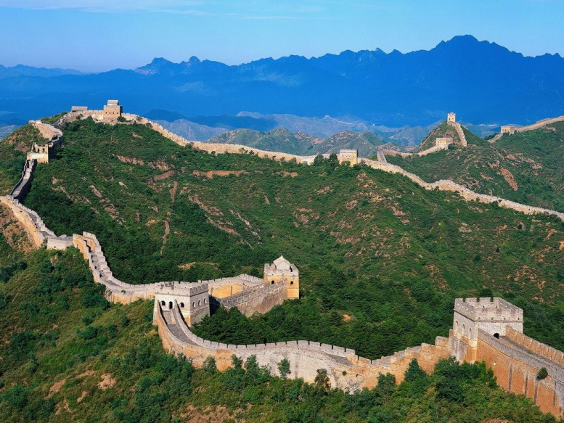
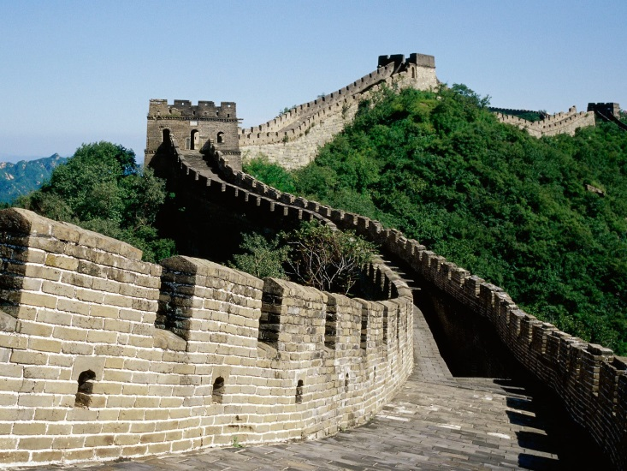
Great Wall of China
Located in China (Asia)
2.5 thousand years old
Constructed to protect tribes against one another

Slide 6
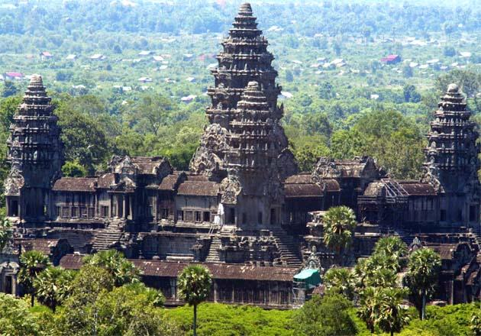
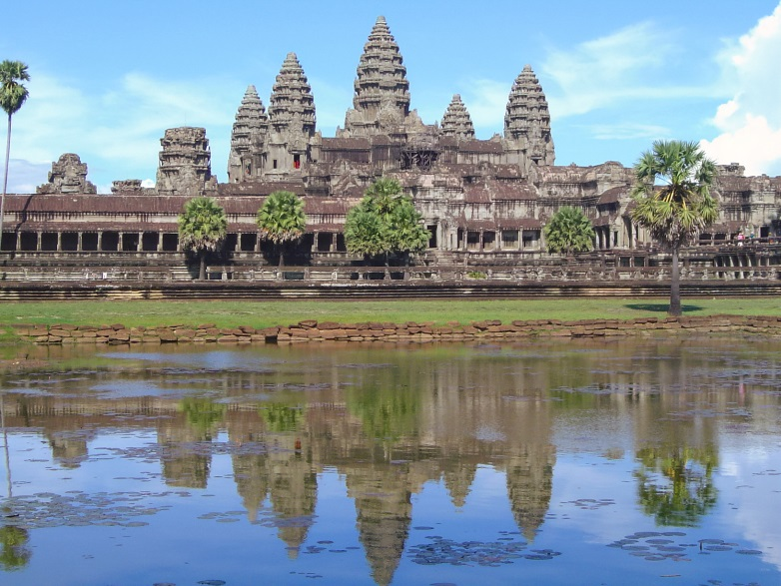
Angkor
Located in Cambodia (Asia)
Was the ancient capital of the Khmer empire
Today it is the national symbol of the country

Slide 7
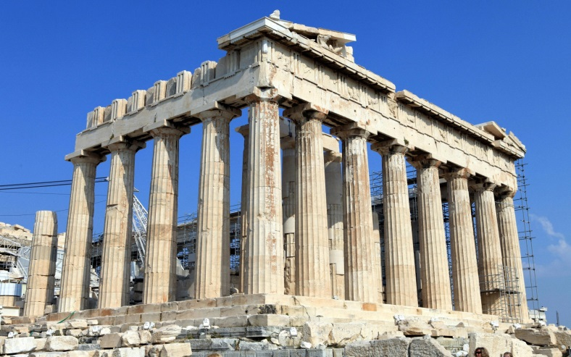
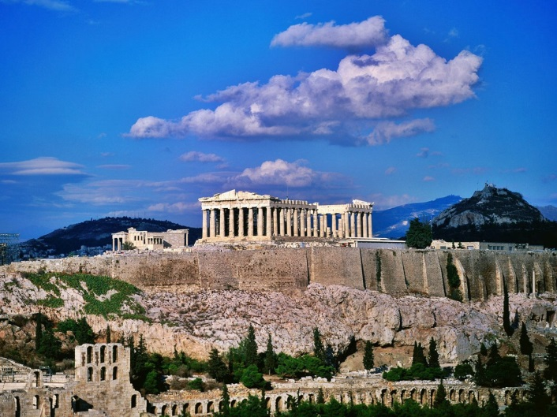
Acropolis of Athens
Located in Greece (Europe)
Built by Pericles in the fifth century BC as a monument to the cultural and political achievements of the inhabitants of Athens

Slide 8
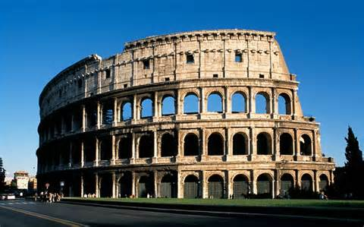
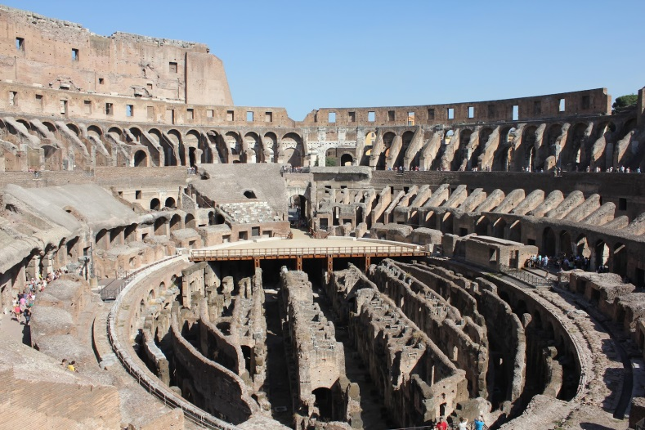
Roman Colosseum
Located in Italy (Europe)
The most famous monument to have survived from the classical world
It was built nearly two thousand years ago for the purpose of hosting violent gladiator games

Slide 9
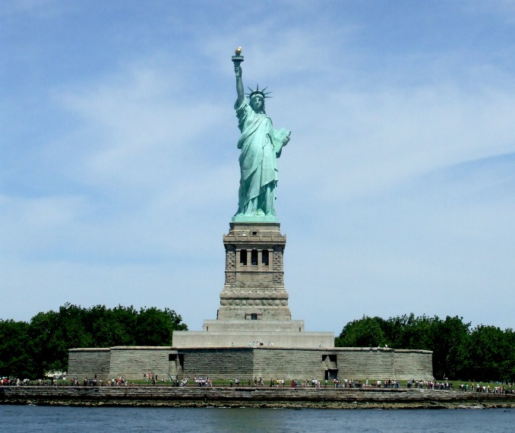
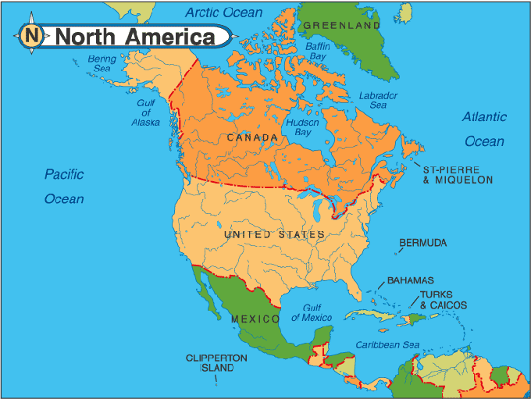
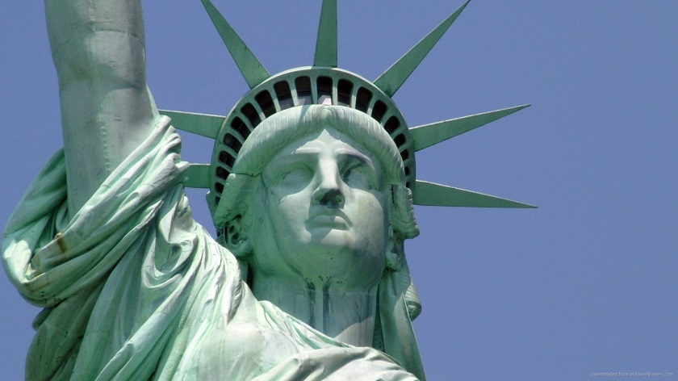
Statue of Liberty
Located in New York City (North America)
Gift from France
Universal symbol of freedom and democracy

Slide 10
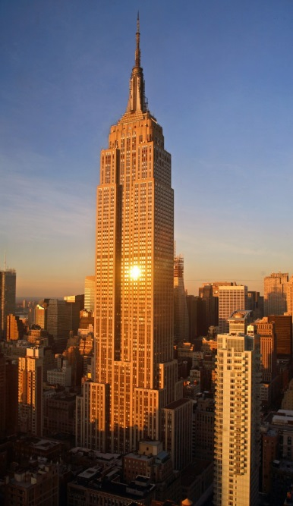
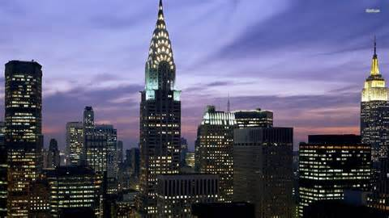
Empire State Building
Located in New York City (North America)
New York’s most popular landmark
Symbol for the American way of life

Slide 11
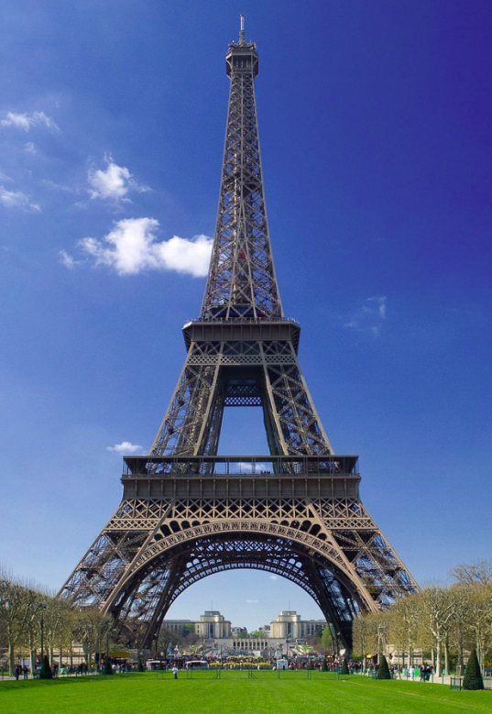
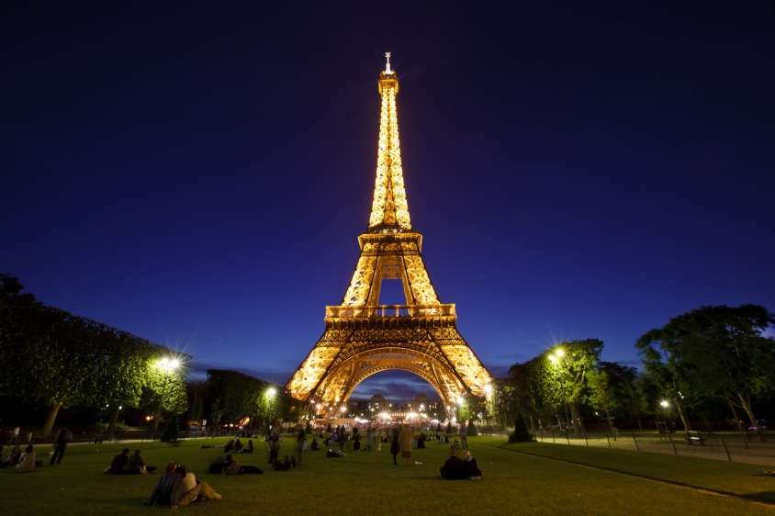
Eiffel Tower
Located in France (Europe)
It’s the tallest structure in Paris
324 meters high

Slide 12
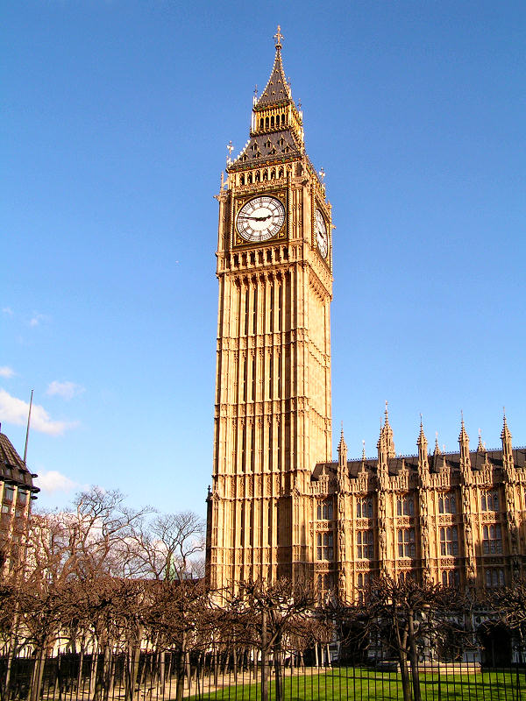
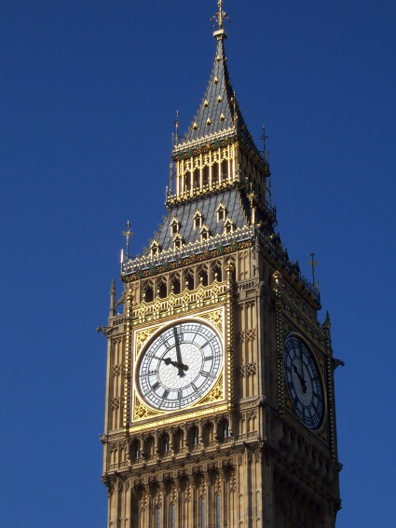
Clock Tower
Known as “Big Ben”
Located in England (Europe)
The clock movement is famous for its accuracy
Symbol of England
Completed in 1858

Slide 13
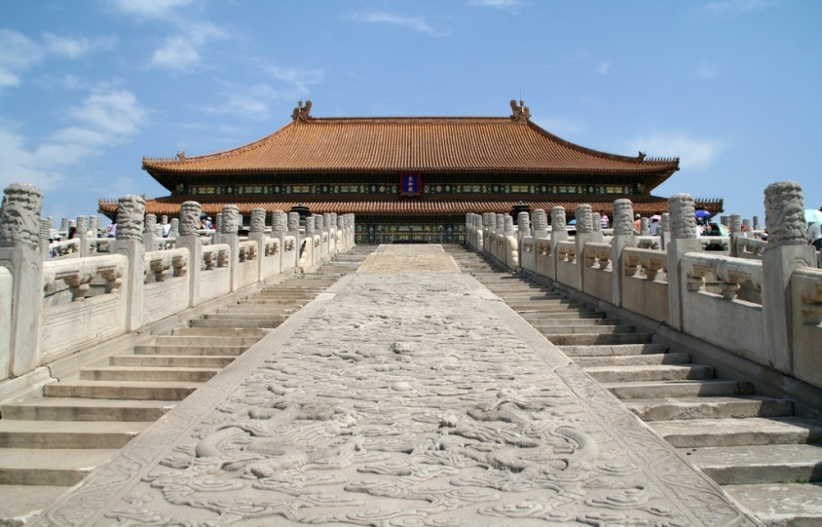
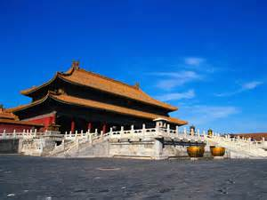
Forbidden City
Located in China (Asia)
Largest cluster of ancient buildings in the world
It is a city within a city

Slide 14
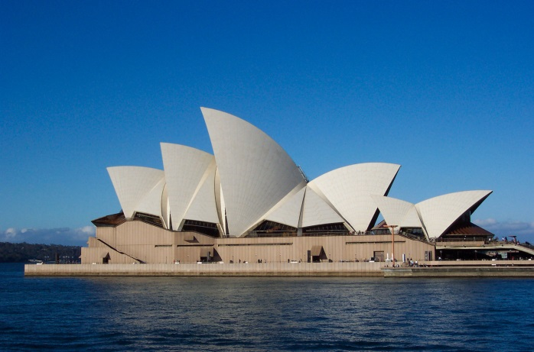
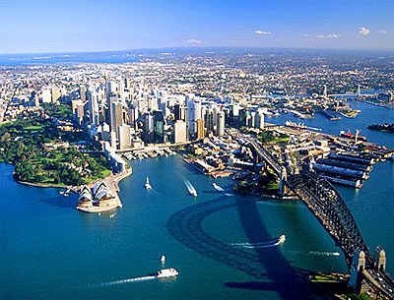
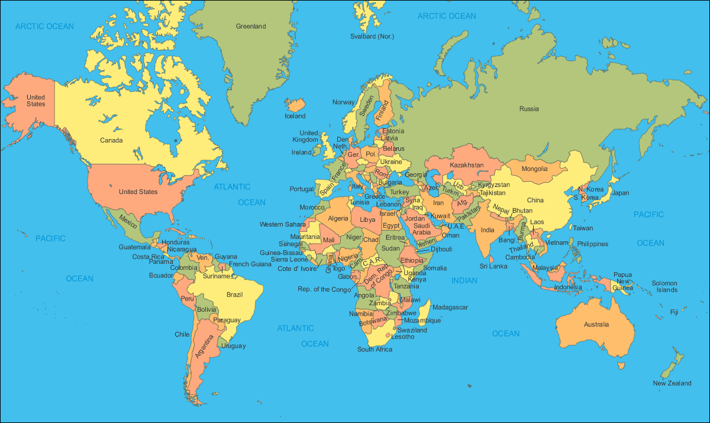
Sydney Opera House
Located in Australia
A multi-venue performing arts center
It is an architectural marvel

Slide 15
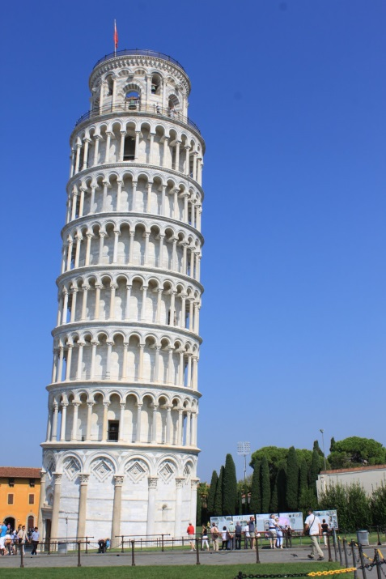
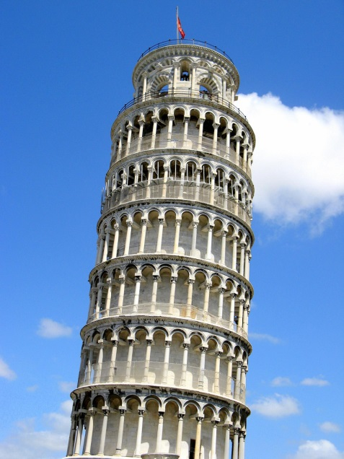
Leaning Tower of Pisa
Located in Italy (Europe)
It leans as a result of unstable soil
Construction on it began in 1172

Slide 16
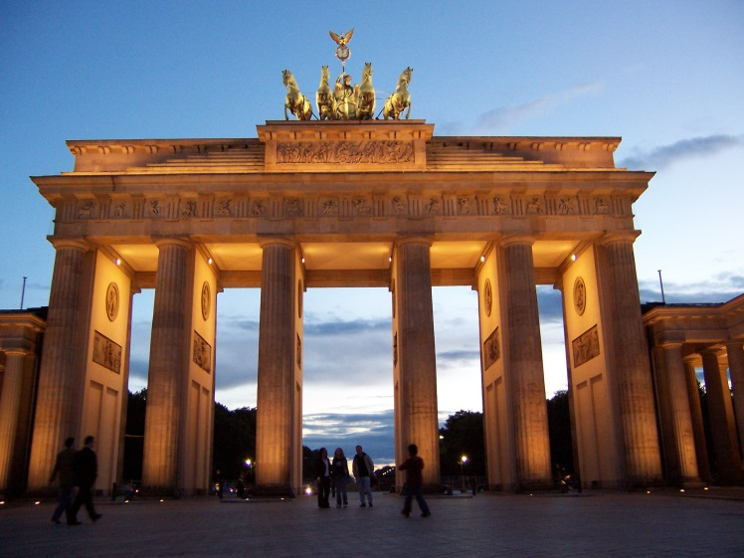
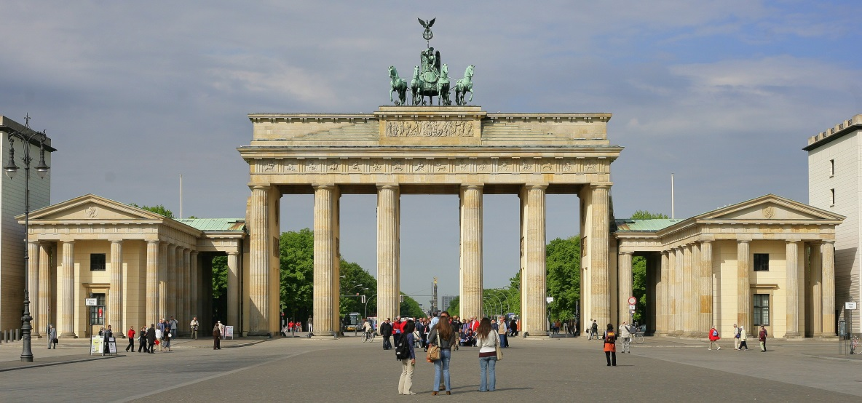
Brandenburg Gate
Located in Germany (Europe)
Main symbol of Berlin
Symbol of the reunited Germany

Slide 17
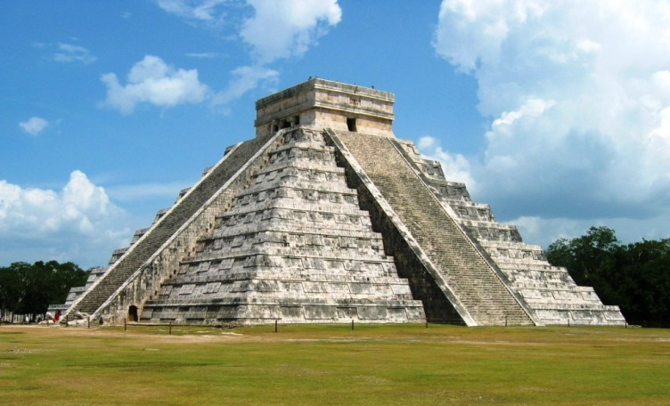
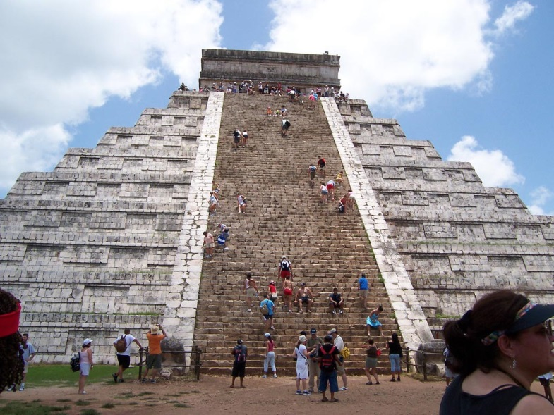
Chichen Itza
Located in Mexico (North America)
Most important regional capital of the Mayan culture between the years of 750 and 1200 A.D.

