Slide 1
“DISMANTLING ISLAM HISTORICALLY”
A Response to Raymond Ibrahim on why Muhammad didn’t Exist
Dr Jay Smith
Calvary Chapel Chino Hills
July 6, 2025

Slide 2
INTRODUCTION
Finally, a response to the Historical Critique

Slide 3
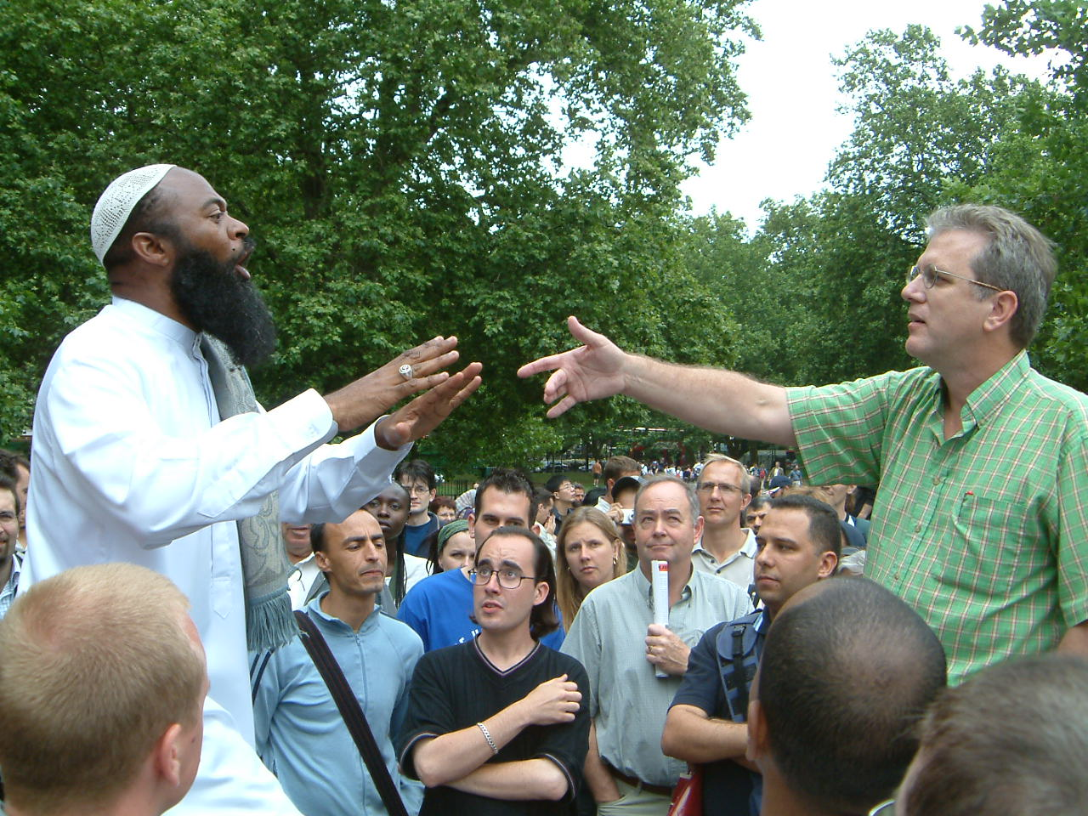
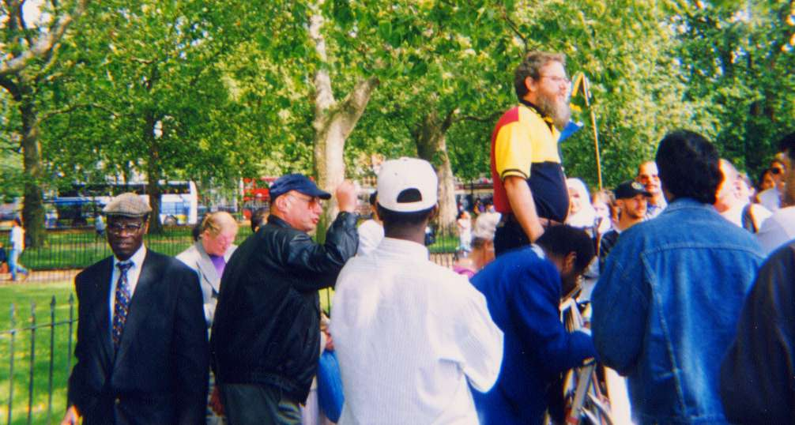

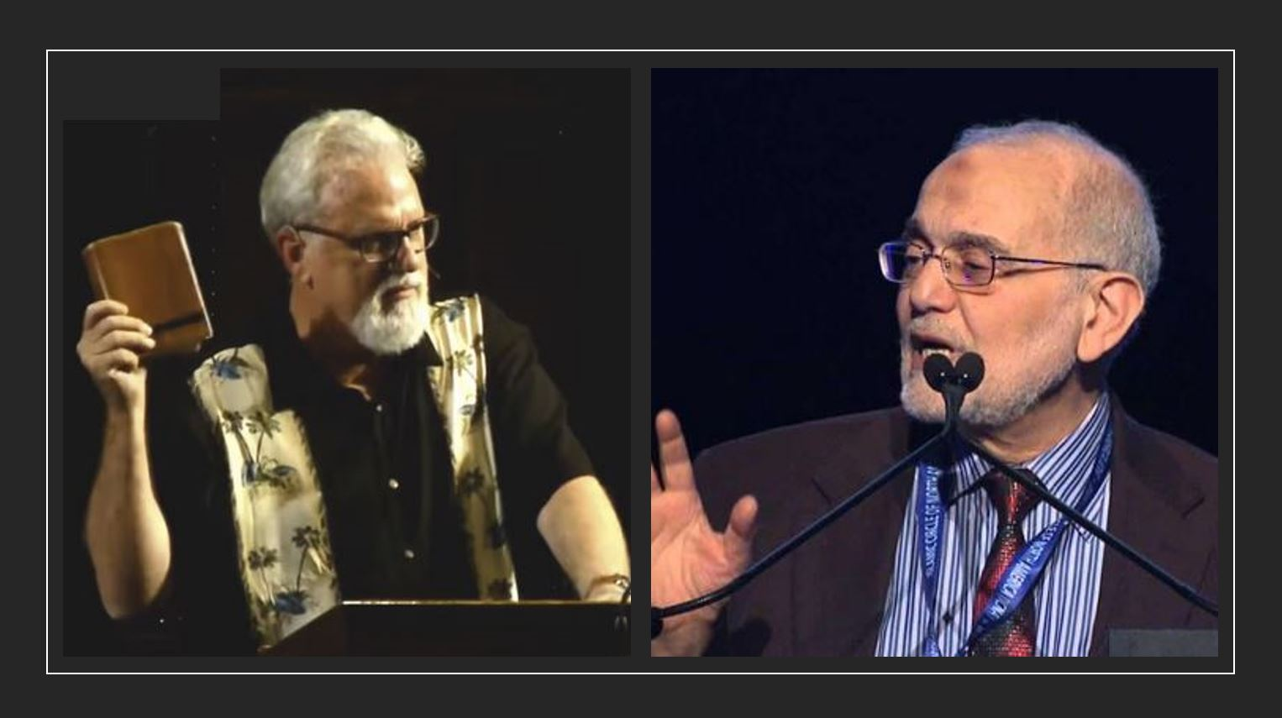
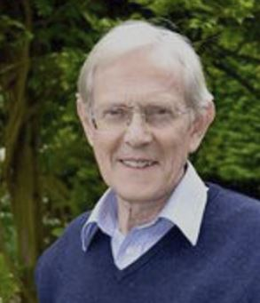
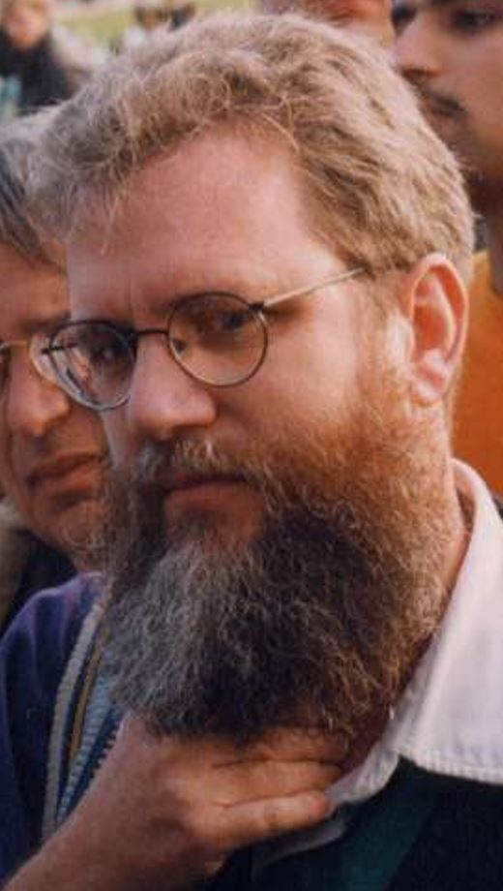
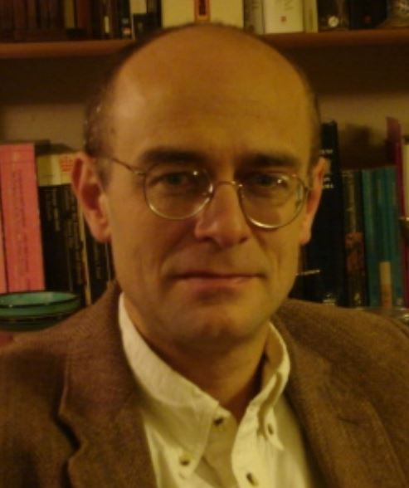
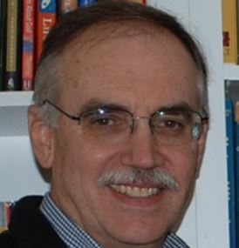
My Story on Islam’s Origins since 1992, in London
1992: I started going to Speaker’s Corner, London
  I began using Polemics “Btsomp”
1994: I took Dr Gerald Hawting’s class on the ‘Origins of Islam’ at SOAS
  I began using Historical Criticism against Islam at Speaker’s Corner
1995: I debated Dr Jamal Badawi at Cambridge University
  I gave 10 Historical challenges which he couldn’t answer
1997: Colin Chapman had me debate Dr David Marshall at Selly Oaks College, Birmingham
Jay debating at Speaker’s Corner
Dr Gerald Hawting
Jay vs Dr Jamal Badawi
Topics:
Should we use Polemics with Muslims?
Should we employ Historical Criticism?
Result:
25 supported Dr Marshall, 25 supported me
Split evenly between Academics and missionaries
Explained by Dr Peter Riddell
Colin Chapman
Jay vs Dr David Marshall
Dr Peter Riddell

Slide 4
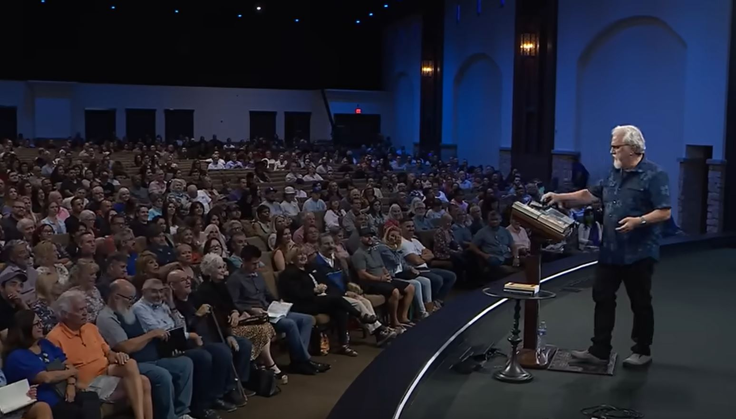
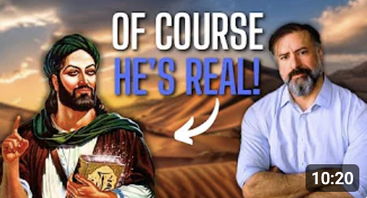
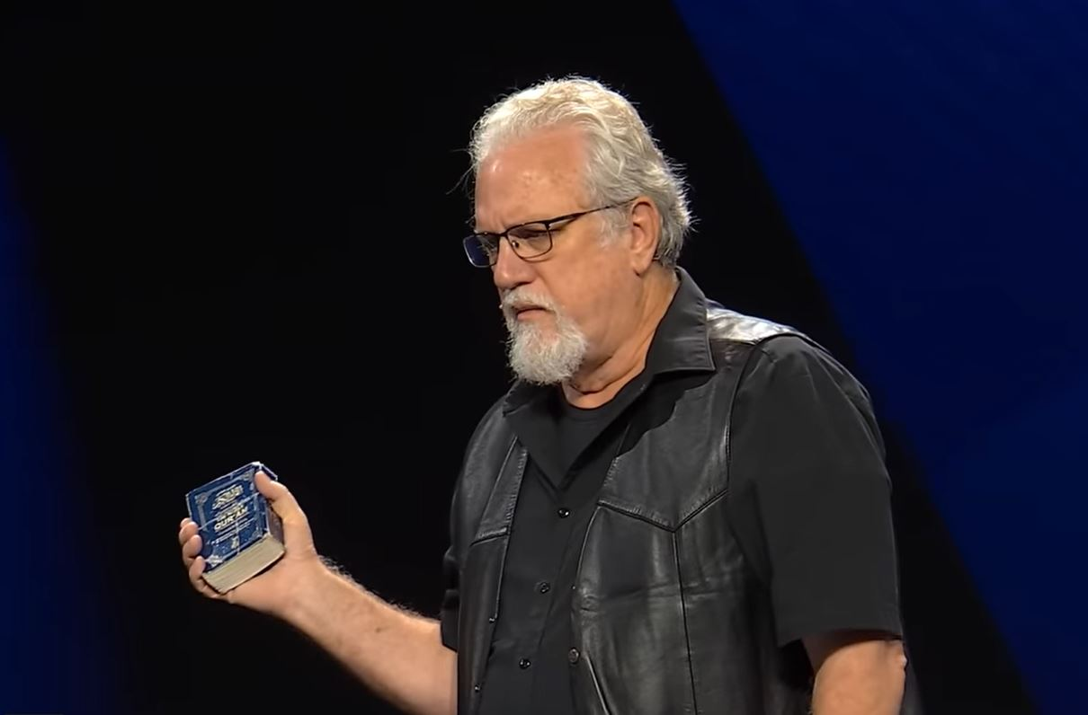
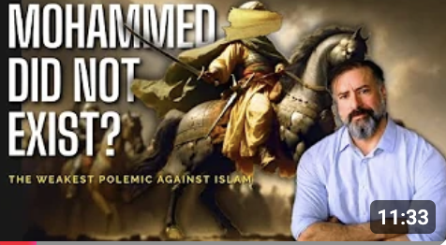
Since then, our material has matured
So, has the Criticism, ironically by a Christian
Calvary Chapel Chino Hills – Sept. 15, 2023
(2.5 million views)
Raymond Ibrahim – April 9, 2025
(18,000 views)
Calvary Chapel Chino Hills – Dec. 4, 2023
(700,000 views)
Raymond Ibrahim – April 11, 2025
(8,000 views)

Slide 5
Raymond Ibrahim’s 10 Suppositions
Muhammad is one of the most historically supported people in history.
Muhammad has more historical support than Jesus.
If Muhammad didn’t exist, how do we understand the Sunni/Shia divide?
There are no incontrovertible proofs of Muhammad’s non-existence.
Since the Traditions about Muhammad are so embarrassing, why write them?
Mecca, is not an argument against Muhammad.
No one can prove or disprove historical data.
It comes down to a matter of faith.
Claims against Muhammad’s existence are merely an academic and subjective exercise.
The best Polemic is to prove how irrelevant Muhammad is for us today!
Let’s go through all 10 and see if Ibrahim is correct about Muhammad…

Slide 6
MUSLIM’S CLAIMS
Their “Standard Islamic Narrative” (SIN)

Slide 7
Muslim’s SIN’s Traditional Claims
For the last 1400 years…
Muhammad was the last and greatest prophet,
  He modeled ‘Islam’ as the paradigm for the world
  He received the Qur’an as the ‘final’ revelation for the world
The Qur’an, his revelation, was sent down only to him between 610 – 632 AD
  It is the greatest, the only perfectly preserved, and the final revelation
  It corrects all previous revelations
Mecca was the city Muhammad was born in, and lived in for the first 52 years of his life.

Slide 8
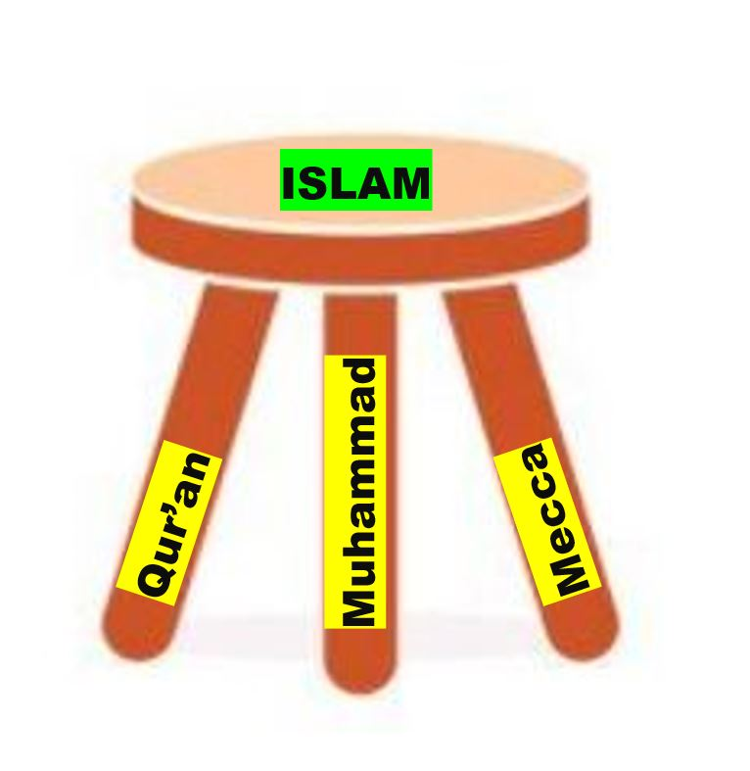
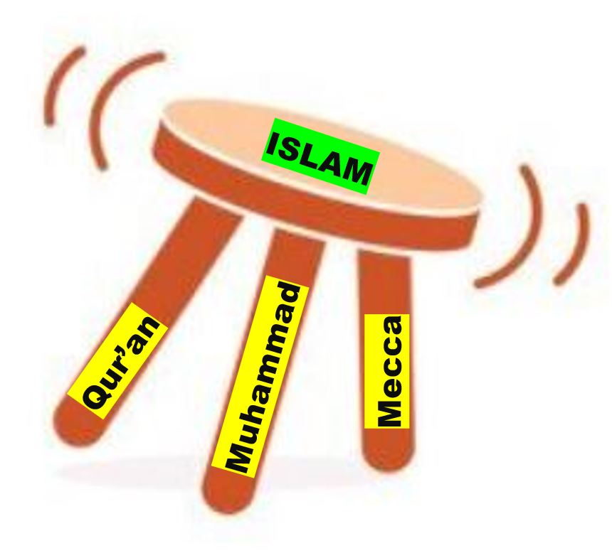
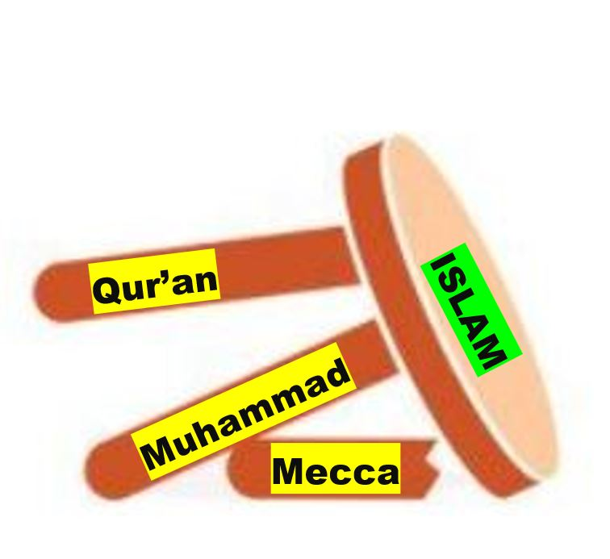
Thus, Islam is completely dependent on:
THE QUR’AN = ‘The Book’
MUHAMMAD = ‘The Man’
MECCA = ‘The Place’
Since these 3 areas are foundational to Islam, we should investigate them
  At the time they all existed (i.e. the early 7th century)
  In the place they existed (i.e. the Hijaz = Central Western Arabia)
Notice, if you confront and destroy one of those legs, the other two fall as well….
With that in mind, let’s now look at Raymond’s 10 suppositions and assess them…

Slide 9
Supposition #1
“Muhammad is one of the most historically supported people in history”

Slide 10
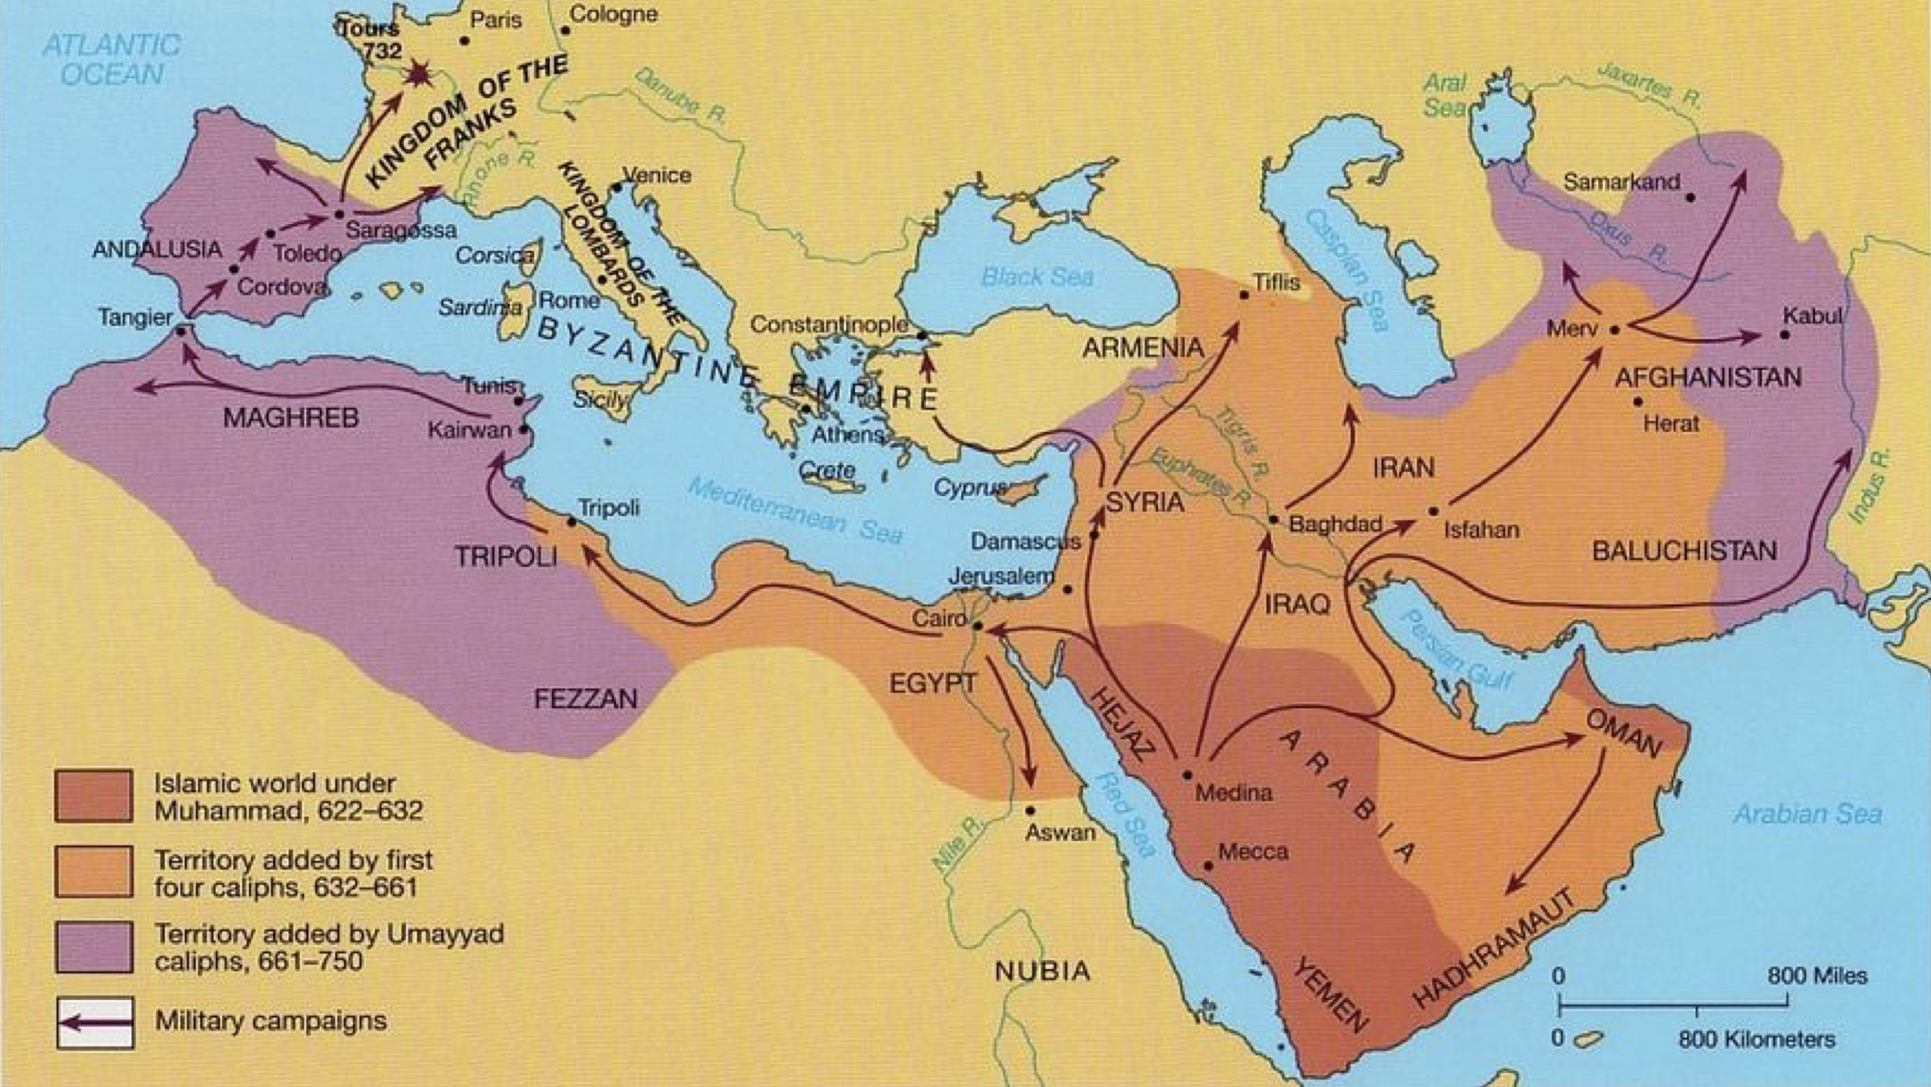
Islam’s early Expansion
The Umayyad Dynasty
(661-750 AD)
The ‘Rushidun Period’
(632-661 AD)
Muhammad’s Empire (632 AD)
According to the ‘Standard Islamic Narrative’

Slide 11

Ali
656 - 661
A Timeline of Islam’s Emergence (according to the “SIN”)
Uthman
644 - 656
Conclusion: Islam was fully formed, in the Hijaz, by 661 AD!
Umar
634 - 644
Abu Bakr 632 - 634
Muhammad dies 632
Mecca 630
Qur’an compiled 652
Muhammad is born 570
The Qur’an is first revealed 610
Hijra
622
Mi’raj
621
570
576
582
588
594
600
606
612
618
624
630
636
642
648
654
660
Muhammad’s life
Question: How do we know all of the above? Where did it come from?

Slide 12

Sources for the ‘ISLAMIC TRADITIONS’ (SIN)…according to Muslims
Sira = Biography of Muhammad
Conclusion: Muhammad was revealed 84 years after the Abbasids created him, 141 years after he was first introduced, yet 201 years after he supposedly lived! Raymond, however, considers this 200-year gap as perfectly acceptable, and thus not a problem!
Hadith = Sayings of Muhammad
Tafsir = Commentaries on the Qur’an
Tarikh = Histories of Mankind
Ibn Hisham (d.833 AD)
Al Waqidi (d.835 AD)
Muhammad dies 632 AD
Al Bukhari (d.870 AD)
Sahih Muslim (d.875 AD)
At-Tirmidhi (d.884 AD)
201 YEARS
Ibn Majah (d.887 AD)
Abd al-Malik
(692 AD)
Abu Dawud (d.899 AD)
An-Nisa’i (d.915 AD)
141 YEARS
Abbasids
(749 AD)
84 YEARS
Al Tabari
(d.923 AD)
Ibn Ishaq
(d.765 AD)
632
652
670
690
710
730
750
770
790
810
830
850
870
890
910
930

Slide 13
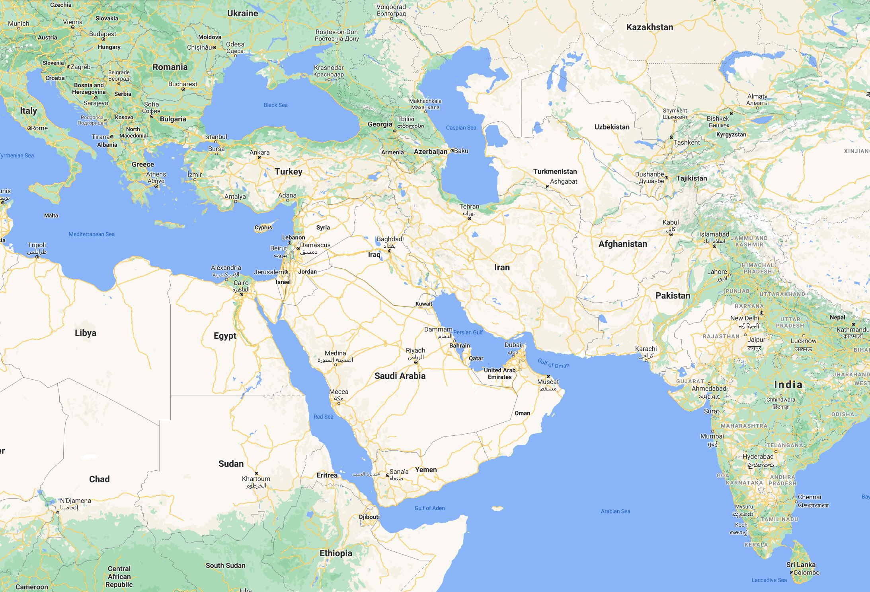
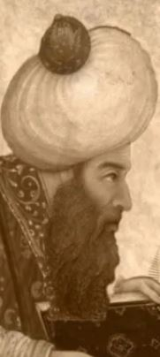
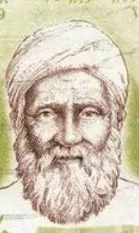
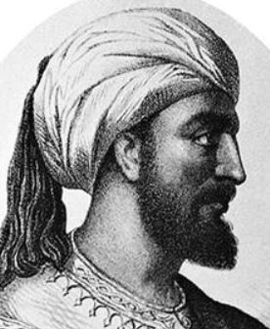
The problem of Distance & Direction
Ibn Hisham
Al Tabari
Al Bukhari
The Islamic Traditions say everything happened in Mecca and Medina (in the Hejaz)
Bukhara
Yet, all of the writers of the Traditions worked in Baghdad, which is 1,200 mi. too far north
Tabaristan
Baghdad
Ibn Hisham (The Sira) is from Basra
But he grew up in Cairo
Cairo – Mecca = 990 mi.
Basra – Mecca = 1,200 mi.
Cairo
Basra
Medina
Mecca
Al Bukhari (The Hadith) is from Bukhara
Bukhara – Mecca = 2,600 mi.
Al Tabari (The Tafsir & Ta’rikh) is from Tabaristan
Tabaristan - Mecca = 1,700 mi.
632
652
670
690
710
730
750
770
790
810
830
850
870
890
910
930
Conclusion: None of the Traditional writers lived or worked in Mecca or Medina,
They were too far to the north of Mecca, and came from the West and East of Baghdad
NOTE: Doesn’t Raymond realize that these Abbasids (Post 750 AD) are too far away?

Slide 14
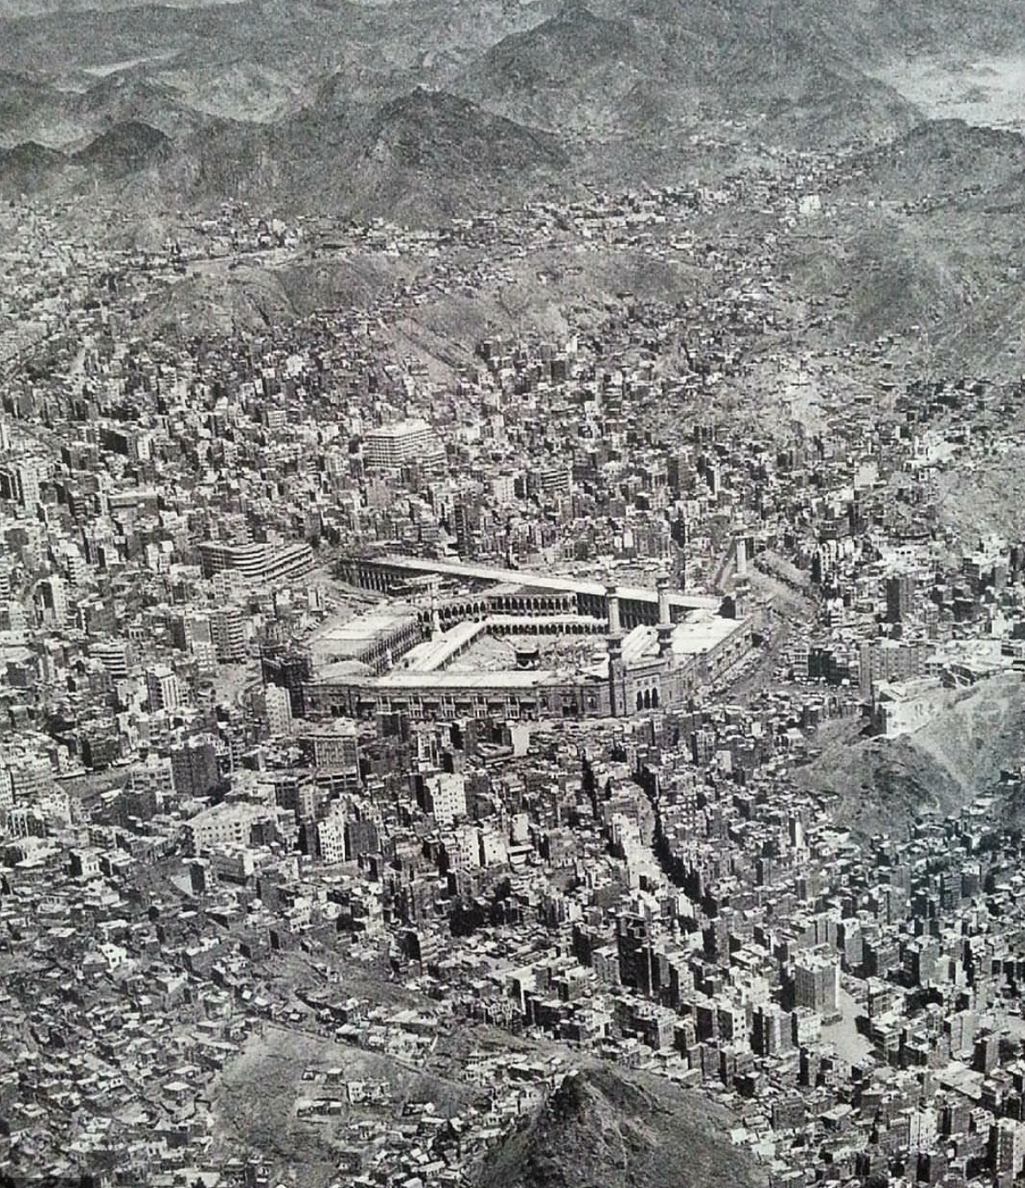

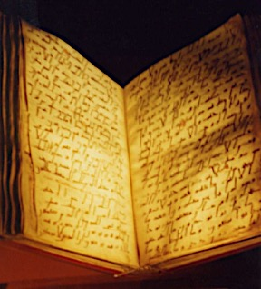
But which Muhammad is Raymond supporting?
The “Muhammad” of Islam requires four things:
He must have used the name “MUHAMMAD”
He must have lived in the city of Mecca
He must have received the Qur’an (all 114 Suras)
He must have existed in the 7th century
Conclusion: All four of the above criteria (the man, the place, the book, and the time) must be fulfilled in order to prove that the Muhammad of Islam actually existed.

Slide 15
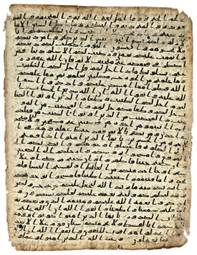
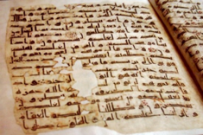
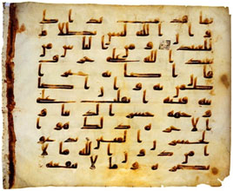
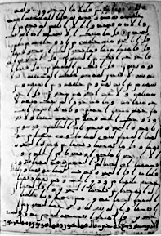
Let’s start with the name itself
Raymond suggests that we can find the name “Muhammad” in a written text
But that name requires 4 consonants and 3 vowels, in a written form
In the 7th century or earlier, in Arabic, it would have been simply ‘mhmd’ because there were no vowels in Arabic that early, just 16 consonantal letters. The vowels were only created and added in the 8th and the 9th centuries. The earliest Qur’anic manuscripts prove that point…
Samarkand Manuscript
Sana’a Manuscript
Ma’il Manuscript
Petropolitanus Manuscript
Topkapi Manuscript

Slide 16



What does the word “Muhammad” look like today?
(With help from research introduced by Mel from “Islamic Origins”, a researcher from Ireland)
So, what did that word look like in the 7th century?
daal
mim
ha
mim
It has 3 vowels: Dhamma, Fatah & Fatah
How, then, would you pronounce this word?
But these vowels didn’t exist in the 7th century. They were introduced in the 8th - 9th centuries
“MAHMAD” or “MAMED”, but not “Muhammad”!
Conclusion: We should be looking for “MHMD” in the 7th century, not “Muhammad”!

Slide 17
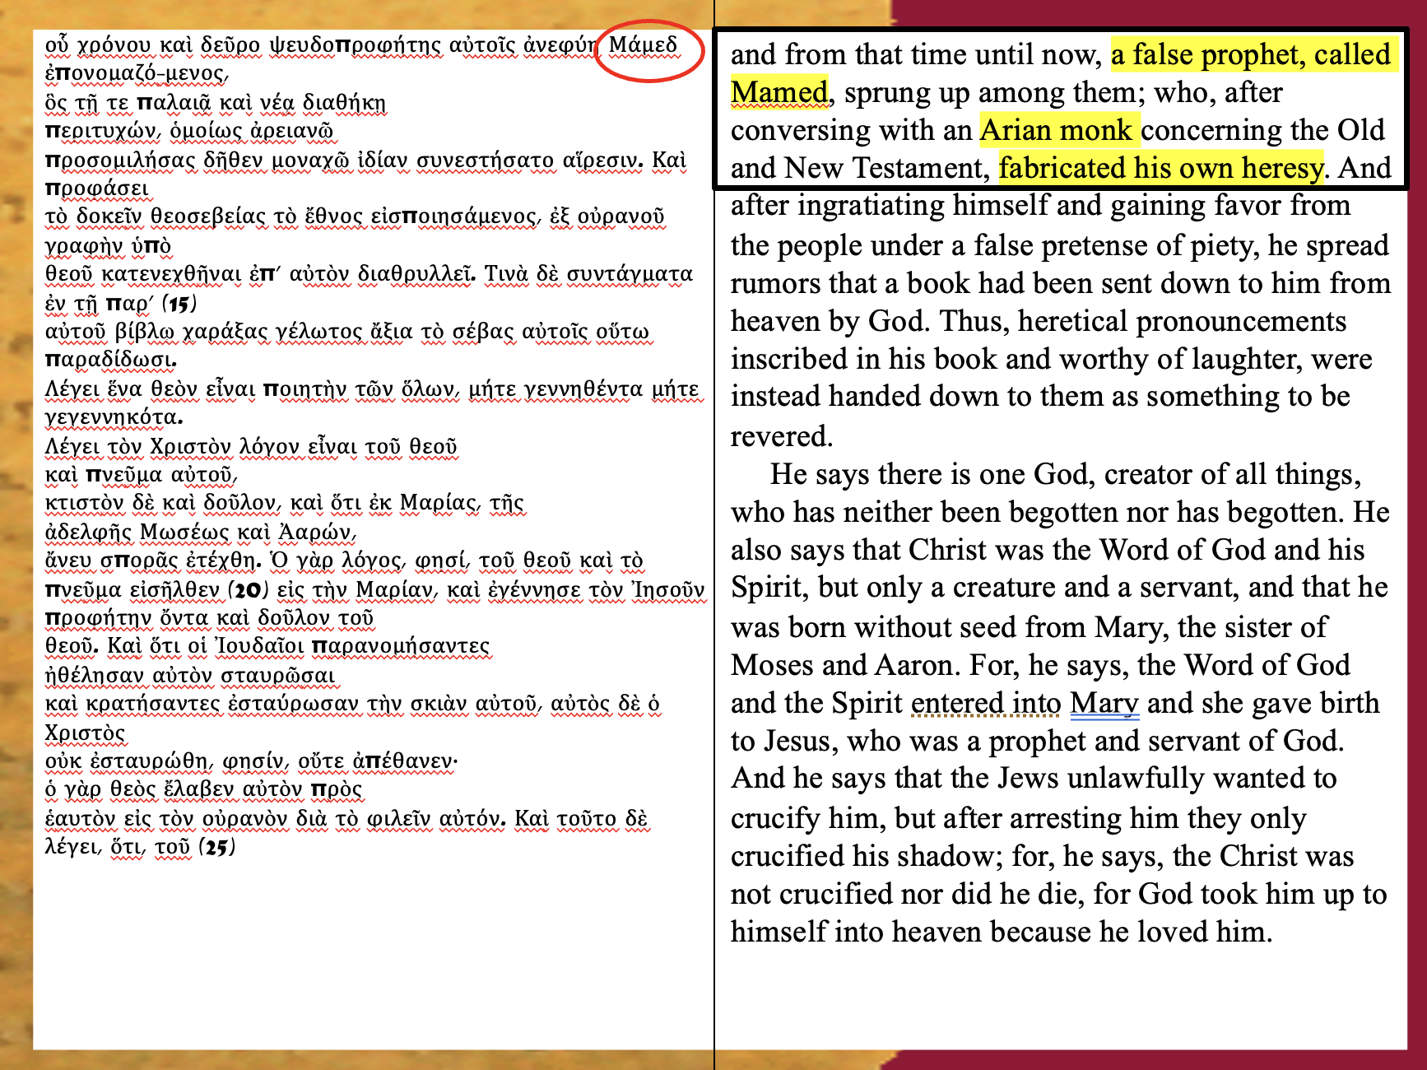
How do we know ‘MHMD’ should be pronounced ”Mamed”?
John of Damascus, in 730 AD writes it in Greek as “Mamed”

Slide 18
What does MHMD mean in Arabic?
MHMD means “the praised one”, or “the blessed one”, or “the anointed one”
Or even “the Messiah” later on..
  Thus, it is not a name but a title
It was first used in Ugaritic in 1400 BC
Then it was used in Hebrew, in 1000 BC, and is found in the Bible 11 times
  i.e. Song of Solomon 5:16 = ‘Machmad’ = “Altogether Lovely”, referring to Solomon
It was subsequently employed by Saint Ambrose in the 4th c. AD as a title for Jesus Christ, the Messiah
From the 4th century other church father’s employed MHMD to refer to Jesus Christ

Slide 19
Examples of Church Fathers, who interpreted the Song of Songs passage as the Church and Christ, and subsequently used “MHMD” for Christ:
Origen, an early 3rd century Christian theologian, interpreted the Song of Songs 5:16 passage as the unique Scripture where the eschatological nuptials of Christ and his Bride are present
Saint Ambrose in the 4th century AD introduced the ideas that the Song of Solomon 5:16 passage reference to ‘MHMD’ was to be considered a title for Jesus Christ, the Messiah
Gregory of Elvira (d. 392AD)
St John Cassian (360-435AD)
St Augustine (396-430AD)
Apponius in the middle of the 7th century
Conclusion: “MHMD” was a common title for Jesus by the 7th century in the church in that part of the world, so we shouldn’t be surprised when we find it written in many places, at that time
But the Jews also considered the MHMD as the “anointed one”…

Slide 20
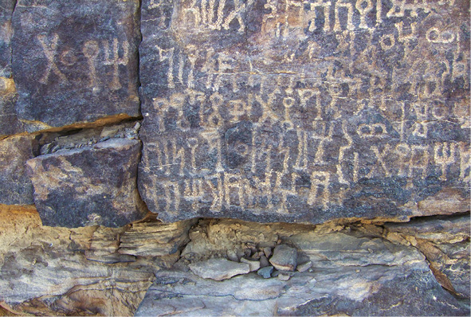

Notice this 523 AD Inscription
6th century Jewish rock Inscription
This rock inscription was found in situ in Biʾr Ḥimà, Najraan (today Yemen).
It is part of a Jewish Himyaritic inscription dated to 523 AD.
It says: “rb-Hd b-mḥmd”
Translation: “[By the] Lord of Jews. By the Mhmd”

Slide 21
Synopsis:
MHMD means “the praised one”, or “the blessed one”, or “the anointed one”
Or even “the Messiah” later on..
  So, it’s not a name but a title
It was first used in Ugaritic in 1400 BC
Then it was used in Hebrew, in 1000 BC, and is found in the Bible 11 times
  i.e. Song of Solomon 5:16 = ‘Machmad’ = “Altogether Lovely”, referring to Solomon
It was subsequently employed by Saint Ambrose in the 4th c. AD as a title for Jesus Christ, the Messiah
Then by the “Jews” from a 523 AD inscription; so that we can find 7-8 inscriptions with this title
Thus, by the 7th century, the Christians used MHMD to refer to the returning ‘Messiah’, while the Jews used MHMD to refer to the Messiah yet to come (and at times interchanging it with ‘Messiah’)
Conclusion: Therefore, the term “MHMD” was well known in that part of the world, and at that time, but it was not pronounced as “Muhammad”…that is how we now pronounce it today, and there lies the confusion for Raymond
Knowing that, let’s now look to see exactly when “Muhammad’s” story was created within Islam itself

Slide 22
HOW WELL DID THE MUSLIMS PRESERVE MUHAMMAD’S STORY?
Are there any eye-witnesses to what Muhammad did or what he said?

Slide 23
The Problem with Extant Manuscripts
Problem: When anyone asks Muslims how they can be sure that the story they have of Muhammad is true, they point to numerous books on their bookshelves and claim that they were written by those who knew Muhammad; that they saw what he did and heard what he said. But they never show us their original “extant” codices or manuscripts, nor do they ever give us any forensically tested dates concerning when exactly those books were originally written
To be valid witnesses for Muhammad we must have these traditional writer’s original “extant” manuscripts to look at, in order to know whether they really wrote what they are purported to have written
Remember, the compilers of the prophet’s life and sayings all worked under the authority of the Muslim Caliphs. So, they would have had access to durable writing material, such as Parchments and Vellum (i.e. using animal skins), unlike our earliest Christian writings, which were all written on Papyrus (non-durable leaves). So, the Muslim written texts should still be in existence even today, a mere 1400 years later. Consequently, there is no excuse not to have the original manuscripts
Let’s find out what we now know about the “extant” manuscripts of the Sira (his biography), the Hadith (his sayings), the Sahaba’s codices (his companions) and the Tabi’un’s codices (the 2nd generation), as well as the Ta’rikh (his history) and the Tafsir (his commentaries)

Slide 24
The Sahaba = The eye-witness, or the “Companions of the Prophet”
The Tabi’un = Those who received what they knew from the Sahaba
The ”Sahaba” and the “Tabi’un”
Claim: The Sahaba/Tabi’un of Muhammad (7th - 8th centuries) – This is a lie!...take a look…
Muwatta ibn Malik: 9th century (200 years later)
Sahifa Hamman B. Munabbih: 12th century (500 years later)
Musnad ibn Hanbal: 13th century (600 years later)
Musanaf Abdul Razzaq: 13th century (600 years later)
Musnad al-Tayalisi: 13th century (600 years later)
Abi Shaybah: 13th century (600 years later)
Conclusion: These documents were all supposedly created in the 7th century; yet they don’t begin to appear until the 9th – 13th centuries; thus, from 200 – 600 years too late!
This suggests that they were all written by others 100s of years later…Consequently, they are All REDACTED ATTRIBUTIONS!

Slide 25
Sahaba (Companions of Muhammad = 7th c.), & the Tabi’un (the 2nd generation = 8th century)
Let’s put their compilations on to a TIMELINE:
Muwatta ibn Malick (7th century)
Sahifa Hamman B. Munabbih
Musanaf Abdul Razzaq
Abi Shaybah (8th century)
Musnad ibn Hanbal
Musnad al-Tayalisi
Muwatta ibn Malik (9th century AD)
Sahifa Hamman B. Munabbih (12th century AD)
Musanaf Abdul Razzaq (13th century AD)
Musnad Ibn Hanbal (13th century AD)
Abi Shaybah (13th century AD)
Muhammad dies 632 AD
Musnad al-Tayalisi (13th century AD)
Between the 9th – 13th centuries. Thus 200 – 600 YEARS TOO LATE!
600
650
700
750
800
850
900
950
1000
1050
1100
1150
1200
1250
1300
1350
1400
1450
1500
1550
1600
1650
1700
1750
1800
1850
CONCLUSIONS: Muslim scholars believe that the stories surrounding Muhammad’s life were written by the ‘Sahaba’ or the ‘Tabi’un’ (1st and 2nd generations from the prophet); thus, by eyewitnesses (our equivalent would be John and Matthew). Yet, they were all written by others over 200 – 600 years later and simply redacted back to the 7th & 8th centuries! Thus, they are all probably fraudulent!

Slide 26
What about the Muwatta of Ibn Malik?
Recent Muslims claim: “It’s from the 9th century, so it is indeed very early…”
Let’s take a look at this claim:
There is a partial copy of the Muwatta in Dublin’s Chester Beatty Library (Mss. 3001). It is described as ‘The second ‘third’ of a celebrated treatise on Islamic jurisprudence’ and is dated to 890 AD. (Arberry, Arthur J., A Handlist of the Arabic Manuscripts, Volume I, Mss. 3001 to 3250, Dublin: Emery Walker, p. 1)
The oldest complete manuscript of the ‘Muwatta’ currently known dates to approximately 1030 AD and is the earliest surviving ‘Muwatta’ manuscript in complete form. This manuscript was copied on gazelle parchment in a beautiful early Andalusi hand, indicating its Maghrebi-Andalusian provenance. It follows Yaḥyā al-Laythī’s transmission (the most widely received version of Malik’s text) as preserved through the Andalusian scholarly tradition (https://qurantalkblog.com/2025/05/07/oldest-surviving-manuscript-of-imam-maliks-muwatta/)
In other words, as of today, the circa 1030 AD manuscript is the earliest fully extant copy of Imam Malik’s work. Any manuscripts older than the 5th century AH exist only in fragmentary form, or as a few folios (Al-Muwatta by Malik b. Anas (d. 179/795) [The Recension of Yahya¯ b. Yah.ya¯ al-Laythı¯ (d. 234/848)] A translation of the Royal Moroccan Edition, Edited and translated by Mohammad Fadel & Connell Monette, Published by the Program in Islamic Law, Harvard Law School, Distributed by Harvard University Press Cambridge, Massachusetts 2019)
Most important, however, the Muwatta is only about rules of Jurisprudence, and not about early Islam, so it doesn’t help us with any historical data on how Islam actually began, or who Muhammad was. This also explains why the “Muwatta” is never included as one of the major Islamic Traditions, since it doesn’t belong to that genre.

Slide 27
Let’s relook at the Sahaba (Companions of Muhammad = 7th c.), & the Tabi’un (the 2nd generation = 8th century) Let’s redo the compilations on a new & corrected TIMELINE:
Muwatta ibn Malick (7th century)
Sahifa Hamman B. Munabbih
Musanaf Abdul Razzaq
Abi Shaybah (8th century)
Musnad ibn Hanbal
Musnad al-Tayalisi
Muwatta ibn Malik (COMPLETE) (11th century AD)
Muwatta ibn Malik (Partial) (9th century AD)
Sahifa Hamman B. Munabbih (12th century AD)
Musanaf Abdul Razzaq (13th century AD)
Musnad Ibn Hanbal (13th century AD)
Abi Shaybah (13th century AD)
Muhammad dies 632 AD
Musnad al-Tayalisi (13th century AD)
Between the 11th – 13th centuries. Thus 400 – 600 YEARS TOO LATE!
600
650
700
750
800
850
900
950
1000
1050
1100
1150
1200
1250
1300
1350
1400
1450
1500
1550
1600
1650
1700
1750
1800
1850
CONCLUSIONS: There simply weren’t any ‘Sahaba’ or ‘Tabi’un’ (1st and 2nd generations from the prophet). So, we have nothing written down by any eyewitnesses. What we do have were all written by others over 400 – 600 years later and simply redacted back to the 7th & 8th centuries! Thus, they are all probably fraudulent!

Slide 28
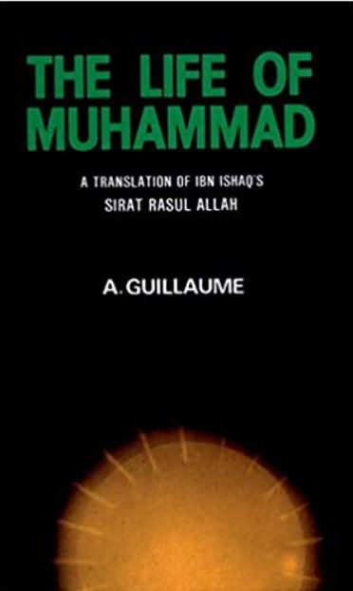
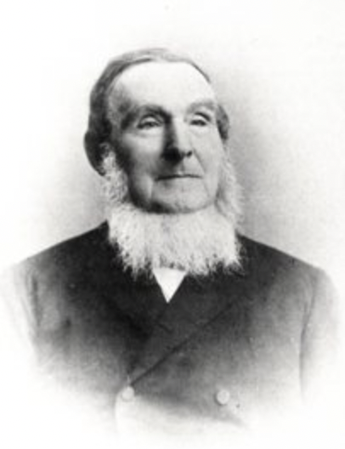
Who really created our Sira?
The “Sira” (Biography of Muhammad)
Alfred Guillaume, taken from Ibn Ishaq, or Ibn Hisham, or…?
We have 36 different biographies written down in the last few hundred years, but who wrote the standard work which everyone uses today?
It was Heinrich Ferdinand Wustenfeld (1808 – 1899), who between 1858 – 1860 compiled the Sira
Taken from libraries and museums in 6 mostly European cities (Fez, London, Oxford, Dublin, Paris & London)
Then translated into French and English, & “sanitized” by Guillaume and others later on
Furthermore, in 1967 Fouad Sezgin compiled another Sira from documents found in Morocco
Conclusion: The man whom Muslims are dependent on to know who their prophet is or what he did, is an elderly German linguist who wrote Muhammad’s story 160 years ago, thus over 1,000 years too late!

Slide 29
To make this point stronger, let’s put the extant SIRA compilation on to a TIMELINE:
Everything is compiled between the 11th – 19th centuries. Thus 400 – 1,200 YEARS TOO LATE!
Muhammad dies 632 AD
Al Waqidi (d. 835 AD)
Ibn Hisham (d. 833 AD)
OR 6475 (British Library, London) - 1278 AD
MS. Arab (Bodleian Library, Oxford) - 1324 AD
Fez (Qarawiyyun mosque) – only partial = 1063 AD
Chester Beatty Library (Dublin, Ireland) - 1331 AD
Wustenfeld (1860 AD)
MS 19320 (SOAS Library, London) - 1589 AD
BnF (Paris, France) - 1420 AD
200 - 300 YEARS
600
650
700
750
800
850
900
950
1000
1050
1100
1150
1200
1250
1300
1350
1400
1450
1500
1550
1600
1650
1700
1750
1800
1850
CONCLUSIONS: Every Western and Muslim scholar believes that the SIRA compilation was just 200 – 300 years after Muhammad, which is bad enough. Won’t they be surprised when they find that they are really much later; between the 11th – 19th centuries, in other words between 400 – 1,200 years after Muhammad!

Slide 30
Who really created the 9th – 10th Century Hadith?
The “Hadith” (Sayings of Muhammad)
Muslims claim that all the Hadith were compiled in the 9th-10th centuries, but that is a lie! Let’s see when their earliest extant manuscripts were actually created…
Abu Dawud: 11th century (400 years after Muhammad)
An-Nasai: 12th century (500 years after Muhammad)
Ibn Majah: 13th century (600 years after Muhammad)
Jami’ At-Tirmidhi: 14th century (700 years after Muhammad)
Sahih Muslim: 14th century (700 years Muhammad)
Sahih Bukhari: 14th–15th centuries (700-800 years after Muhammad)
Conclusion: Not one of the Hadith were compiled in the 9th – 10th centuries. Their final extant manuscripts were not created until the 11th -15th centuries, which is 400 – 800 years later! Thus, not one of them ever heard a word Muhammad said!

Slide 31
HADITH compilations on to a TIMELINE:
Everything is compiled between the 11th – 15th centuries. Thus 400 – 800 YEARS TOO LATE!
Muhammad dies 632 AD
An-Nisa’i (d.915 AD)
Sahih Muslim (d.875 AD)
At-Tirmidhi (d.884 AD)
Al Bukhari (14th - 15th centuries AD)
Sahih Muslim (14th century AD)
Abu Dawud (11th century AD)
At-Tirmidhi (14th century AD)
Abu Dawud (d.899 AD)
Ibn Majah (13th century AD)
An-Nisa’i (12th century AD)
Al Bukhari (d.870 AD)
Ibn Majah (d.887 AD)
200 - 300 YEARS
600
650
700
750
800
850
900
950
1000
1050
1100
1150
1200
1250
1300
1350
1400
1450
1500
1550
1600
1650
1700
1750
1800
1850
CONCLUSIONS: Every Western and Muslim scholar believes that the HADITH compilations were just 200 – 300 years old, which is bad enough. What will they say when they are told that they are really much more recent; between the 11th – 15th centuries, in other words between 400 – 800 years too late!

Slide 32
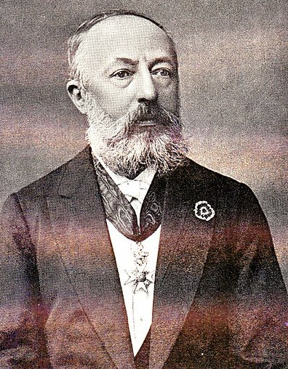
Let’s now put Al Tabari’s extant TA’RIKH/TAFSIR compilations on to a similar TIMELINE:
The edition of Al Tabari which everyone uses today was compiled by Michael Jan De Geoje, the professor of Arabic at Leiden University, Holland, between 1879 – 1901, and is known as the ‘Leiden Edition’.
600 YEARS TOO LATE!
Muhammad dies 632 AD
Istanbul, Koprului 1041 (C) = 1253 AD
Michael Jan De Geoje (1879-1901 AD)
Istanbul, Koprului 1041 (C) = 1244 AD
Yet, De Goeje used two 13th century Arabic manuscripts from Turkey as his model. These were written 600 years too late!
Al Tabari (d. 923 AD)
300 YEARS
600
650
700
750
800
850
900
950
1000
1050
1100
1150
1200
1250
1300
1350
1400
1450
1500
1550
1600
1650
1700
1750
1800
1850
1900
CONCLUSIONS: So, even Al Tabari’s Ta’rikh, and his Tafsir are not 10th century originals, but are much later 13th century compilations which were merely attributed back to Al Tabari 300 years earlier. Yet, they are still 600 years too late! What’s more, it took a Dutch scholar to compile them 1,200 years later!

Slide 33

An Overview of the late dates for the EXTANT MANUSCRIPTS for everything we know about Islam’s Origins
Muslims Claim 200 – 300 years too late
Reality: Between the 11th – 16th centuries. Thus 400 – 900 YEARS TOO LATE!
Sahaba/Tabi’un (7-8 C.) 10th – 13th cent.
Muhammad dies 632 AD
Hadith (9-10 C.)
11th – 15th cent.
Ibn Hisham (d. 833 AD)
Al Waqidi (d. 835 AD)
Sahih Muslim (d.875 AD)
At-Tirmidhi (d.884 AD)
An-Nisa’i (d.915 AD)
Sahifa Hamman B. Munabbih
Sira (9 C.)
11th – 15th cent.
Muwatta ibn Malick (7th c.)
Musnad ibn Hanbal
Muwatta ibn Malik (Partial) (9th century AD = over 200 years)
Musanaf Abdul Razzaq
Sahifa Hamman B. Munabbih (12th century AD = 500 years)
Abi Shaybah (8th century)
Fez (Qarawiyyun mosque) – only partial = 1063 AD (11th)
Musnad al-Tayalisi
Musnad al-Tayalisi (13th century AD = 600 years too late)
Michael Jan De Geoje (1879-1901 AD) (20th)
Musanaf Abdul Razzaq (13th century AD = 600 years)
Musnad Ibn Hanbal (13th century AD = 600 years)
Muwatta ibn Malik (COMPLETE) (11th century AD)
Tafsir & Tarikh (10 C.)
11th – 15th cent.
Chester Beatty Library (Dublin, Ireland) - 1331 AD (14th)
MS 19320 (SOAS Library, London) - 1589 AD (16th)
MS. Arab (Bodleian Library, Oxford) - 1324 AD (14th)
Abi Shaybah (13th century AD = 600 years too late)
Al Bukhari (14th - 15th centuries AD)
Wustenfeld (1860 AD) (19th)
OR 6475 (British Library, London) - 1278 AD (13th)
Sahih Muslim (14th century AD)
Abu Dawud (11th century AD)
Istanbul, Koprului 1041 (C) = 1244 AD (13th)
Abu Dawud (d.899 AD)
At-Tirmidhi (14th century AD)
An-Nisa’i (12th century AD)
Istanbul, Koprului 1041 (C) = 1253 AD (13th)
Ibn Majah (13th century AD)
AL TABARI - 923 AD
BnF (Paris, France) - 1420 AD (15th)
Al Bukhari (d.870 AD)
Ibn Majah (d.887 AD)
600
650
700
750
800
850
900
950
1000
1050
1100
1150
1200
1250
1300
1350
1400
1450
1500
1550
1600
1650
1700
1750
1800
1850
1900
CONCLUSIONS: We’ve been told that the stories surrounding Muhammad’s life were written by those who saw and heard him, thus by eyewitnesses; or by others within a few generations. Yet, we see above that everything we know about Muhammad was originally created 400 – 900 years after he presumably lived; yet not canonized into written texts until 1,200 – 1,270 years later, suggesting it’s ALL fraudulent!

Slide 34
An Overview of the late dates for the EXTANT MANUSCRIPTS for everything we know about Islam’s Origins
Muslims Claim 200 – 300 years too late
Reality: Between the 11th – 16th centuries. Thus 400 – 900 YEARS TOO LATE!
Sahaba/Tabi’un (7-8 C.) 10th – 13th cent.
Muhammad dies 632 AD
Hadith (9-10 C.)
11th – 15th cent.
Ibn Hisham (d. 833 AD)
Al Waqidi (d. 835 AD)
Sahih Muslim (d.875 AD)
At-Tirmidhi (d.884 AD)
An-Nisa’i (d.915 AD)
Sahifa Hamman B. Munabbih
Sira (9 C.)
11th – 15th cent.
Muwatta ibn Malick (7th c.)
Musnad ibn Hanbal
Musanaf Abdul Razzaq
Sahifa Hamman B. Munabbih (12th century AD = 500 years)
Abi Shaybah (8th century)
Fez (Qarawiyyun mosque) – only partial = 1063 AD (11th)
Musnad al-Tayalisi
Musnad al-Tayalisi (13th century AD = 600 years too late)
Michael Jan De Geoje (1879-1901 AD) (20th)
Musanaf Abdul Razzaq (13th century AD = 600 years)
Muwatta ibn Malik (Partial) (9th century AD = over 200 years)
Musnad Ibn Hanbal (13th century AD = 600 years)
Muwatta ibn Malik (COMPLETE) (11th century AD)
Tafsir & Tarikh (10 C.)
11th – 15th cent.
Chester Beatty Library (Dublin, Ireland) - 1331 AD (14th)
MS 19320 (SOAS Library, London) - 1589 AD (16th)
MS. Arab (Bodleian Library, Oxford) - 1324 AD (14th)
Abi Shaybah (13th century AD = 600 years too late)
Al Bukhari (14th - 15th centuries AD)
Wustenfeld (1860 AD) (19th)
OR 6475 (British Library, London) - 1278 AD (13th)
Sahih Muslim (14th century AD)
Abu Dawud (11th century AD)
Istanbul, Koprului 1041 (C) = 1244 AD (13th)
Abu Dawud (d.899 AD)
At-Tirmidhi (14th century AD)
An-Nisa’i (12th century AD)
Istanbul, Koprului 1041 (C) = 1253 AD (13th)
Ibn Majah (13th century AD)
AL TABARI - 923 AD
BnF (Paris, France) - 1420 AD (15th)
Al Bukhari (d.870 AD)
Ibn Majah (d.887 AD)
600
650
700
750
800
850
900
950
1000
1050
1100
1150
1200
1250
1300
1350
1400
1450
1500
1550
1600
1650
1700
1750
1800
1850
1900
CONCLUSIONS: Looking at this timeline above, how can Raymond suggest that “the history of Muhammad is one of the best supported in history”? How can he say that when those who wrote it did so a full 400 – 900 years after he presumably lived? What’s more, what will he do with the fact that much of it was not canonized into written form until 1,200 – 1,270 years later?! Is this the best in history?

Slide 35
A Comparison:
“Christians” have done similar things as well…
The Gnostic Gospels, 52 found in the Nag Hammadi library, Egypt, written in Coptic, purporting to tell us the stories of Jesus’ childhood; yet were all written in the 4th century, and redacted back to the 1st century.
For instance, the ‘Gospel of Thomas’ (a Muslim favorite), and the ‘Gospel of Judas’ were written around the 2nd century AD but are attributed by their authors to have been written by the disciples of Jesus Christ himself.
The 'Gospel of Barnabas’ (the favorite gospel quoted by Muslims today) was written around 1634 AD but was attributed to the companion of Paul in the 1st century.
They were all written in order to give credibility and authority for those works. So, this practice of redactions and attributions is common in every religion.
The difference is that while the later Muslim Traditions are ALL considered authoritative, the later Christian Traditions are ALL considered fraudulent, and not even used today by the church.

Slide 36
What does this all mean?
We’re not suggesting that there never was someone named Ibn Hisham, or Al Waqidi, or al Bukhari, or Muslim, or even al Tabari; or for that matter, any of the other “Traditional Writers”
These men could very well have lived, and in the 9th – 10th centuries where they are attributed
Thomas and Judas and even Barnabas were very real men who were historical characters in the early church, and well respected, and that was why the later compilers attributed their works to them
Similarly, that is why I believe later Muslims attributed the stories to these earlier men
Consequently, what Muslims today contend these Traditional writers wrote, they have no support for historically, since they have little to nothing of what they wrote (outside of the Muwatta, which is not a member of the Islamic Traditions, so it shouldn’t be included in this discussion)
All that Muslims can now be certain of is what the later Abbasids, and even the early Ottomans believed happened in the 7th – 8th centuries, since everything that had been written earlier had been destroyed, and then replaced with completely new stories to fit a new agenda…
Conclusion: when compared to Christianity, which has manuscript evidence within the first century, Islam is much less historically supported; contrary to what Raymond contends. Yet it shouldn’t be, considering how recent it supposedly was created, and all of it written on vellum (animal skins).

Slide 37
Supposition #2
“Muhammad has more historical support than Jesus”

Slide 38
Supposition #2
Muhammad is much more historically supported than Jesus, yet we accept Jesus’s historicity. So, isn’t this hypocritical?
Raymond: “I find it amazing that whereas Christians rightfully cite Josephus, Pliny, and Tacitus as early proof of Christ’s existence [i.e. 1st & 2nd centuries), the non-Muslim references to Muhammad — which, objectively speaking, are even more compelling, since they were written much closer to their subject’s lifetime (i.e. 9th and 10th centuries) — are dismissed as irrelevant by those who would make him a figment of our imagination”.
Raymond, therefore, claims that “since Muhammad is far more historically supported than Jesus Christ, by denying his historicity, we are not only being inconsistent, but possibly dishonest”
So, is he correct; is the historical support for Muhammad greater than that for Jesus Christ? Let’s find out…
My Response:

Slide 39
Supposition #2 = 7th c. Evidence for Muhammad
Both Raymond and I agree that there are many very early 7th century (mostly non-Muslim, and even Christian) references to the word “MHMD” (notice I didn’t say “Muhammad”); the first, only 2 years after he died, whereas the first non-Christian reference to Jesus doesn’t appear until 60 years after he died!
Raymond gives us only 4 Examples, so let’s go through them:
1) The Doctrina Iacobi circa 634 AD, citing a dialog on 7/13/634, where Justice describes what his brother Abraham writes to him regarding a "deceiving prophet" who had appeared amidst the Saracens, and Abraham recalling a conversation with a Jewish scribe who called that prophet a deceiver who comes with swords and chariots... and claims to have the “keys to Paradise”.
2) Thomas the Presbyter (634 AD) citing a battle between the Romans and the followers of “Mhmt”.
3) A Syriac flyleaf fragment (636 AD) which mentions Muhammad by name: "many villages were ravaged by the killing of ‘Mhmd’..."
4) The Coptic Bishop, John of Nikiou (he puts it at 641 AD, but it’s actually 690s) refers to Islam as "the detestable doctrine of the beast, that is ‘Mhmd’."
Note: not one of these references uses the name “Muhammad”, only MHMD, or MHMT!

Slide 40
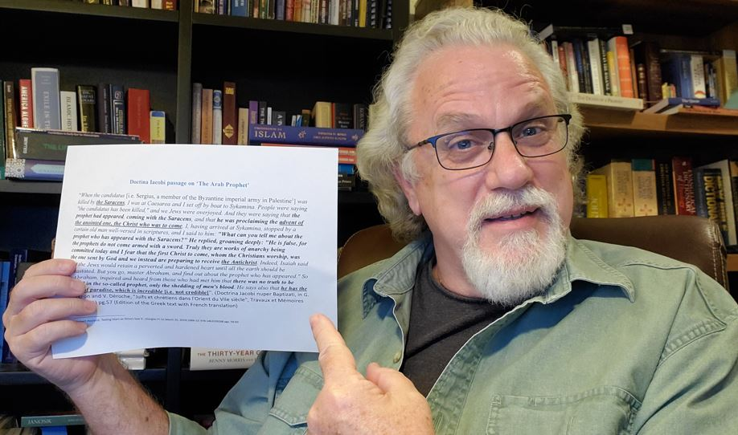
1) The ‘Doctrina Iacobi’
The Doctrina Iacobi: A Greek Christian polemical tract, from Carthage (Tunis), but written in Palestine, by a Christian apologist. It refers to a ‘Saracen’ prophet, with a sword, who has the ‘Keys of Paradise’
Problems:
Saracen prophets can’t say ‘the Christ who was to come’, Surah 33:40, since Muhammad is the last prophet
It assumes ‘Muhammad’ is alive in 634, but the Traditions say he died in 632 AD
This prophet ‘has the keys of paradise’ which confronts the Islamic Traditions
This prophet fits a Judeo-Christian Monotheist background
(This is ‘Christ’ = ‘Christos’ in Greek = ‘Mashiah’ in Hebrew). Who was to come, not Muhammad
He has the ‘Keys of Paradise’ (from Matthew 16:19 – referring to Peter’s papal authority in the Catholic Church)
Spoke Aramaic, not Arabic (Jews wouldn’t know Arabic, and Muhammad wouldn’t have known Aramaic)
Conclusion: There is no reference to the name ‘Muhammad’, no reference to this prophet being a Muslim, or belonging
to the religion of Islam, nor any reference to the city of Mecca, nor of his book the Qur’an. He could be anybody! In fact, he sounds more like an Arab/Christian brigand, employing the status of a prophet to gain for himself more credibility and authority. There’s just nothing Islamic about this “Saracen Prophet”!

Slide 41
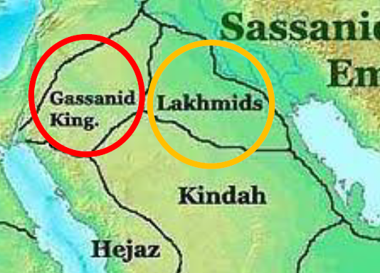
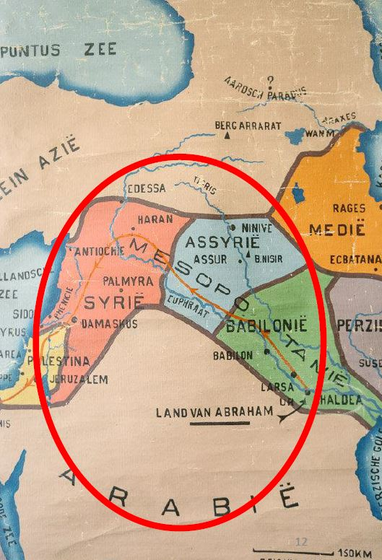
Later revised in the 8th century
2) Thomas the Presbyter (634 AD)
Thomas refers to “a battle between the Romans and the ‘Tayaye d-Mhmt” which happened east of Gaza in 634 AD
Problems: ‘Mhmt’ is the Pahlavi (Persian) way of spelling ‘Mhmd’, thus he would have come from our present-day Iraq, which is 1,200 miles to the north of Mecca
The Tayaye dominated the Lakhmid region so much that the area of Mesopotamia became known as “Tachkastan” in the 7th century, which is the “land of the Tayy”
Note on the map (red circle ) where the Tayaye were located. Too far north to be the “Muhammad” of the Hijaz of Western Central Arabia
He fights in Gaza, yet none of Muhammad’s battles were in Gaza, nor anywhere near that far north
As before, could this be another ‘Mhmd/t’, someone who is referred to as ‘The praised one’, an honorific title for the leader of the Tayaye?

Slide 42
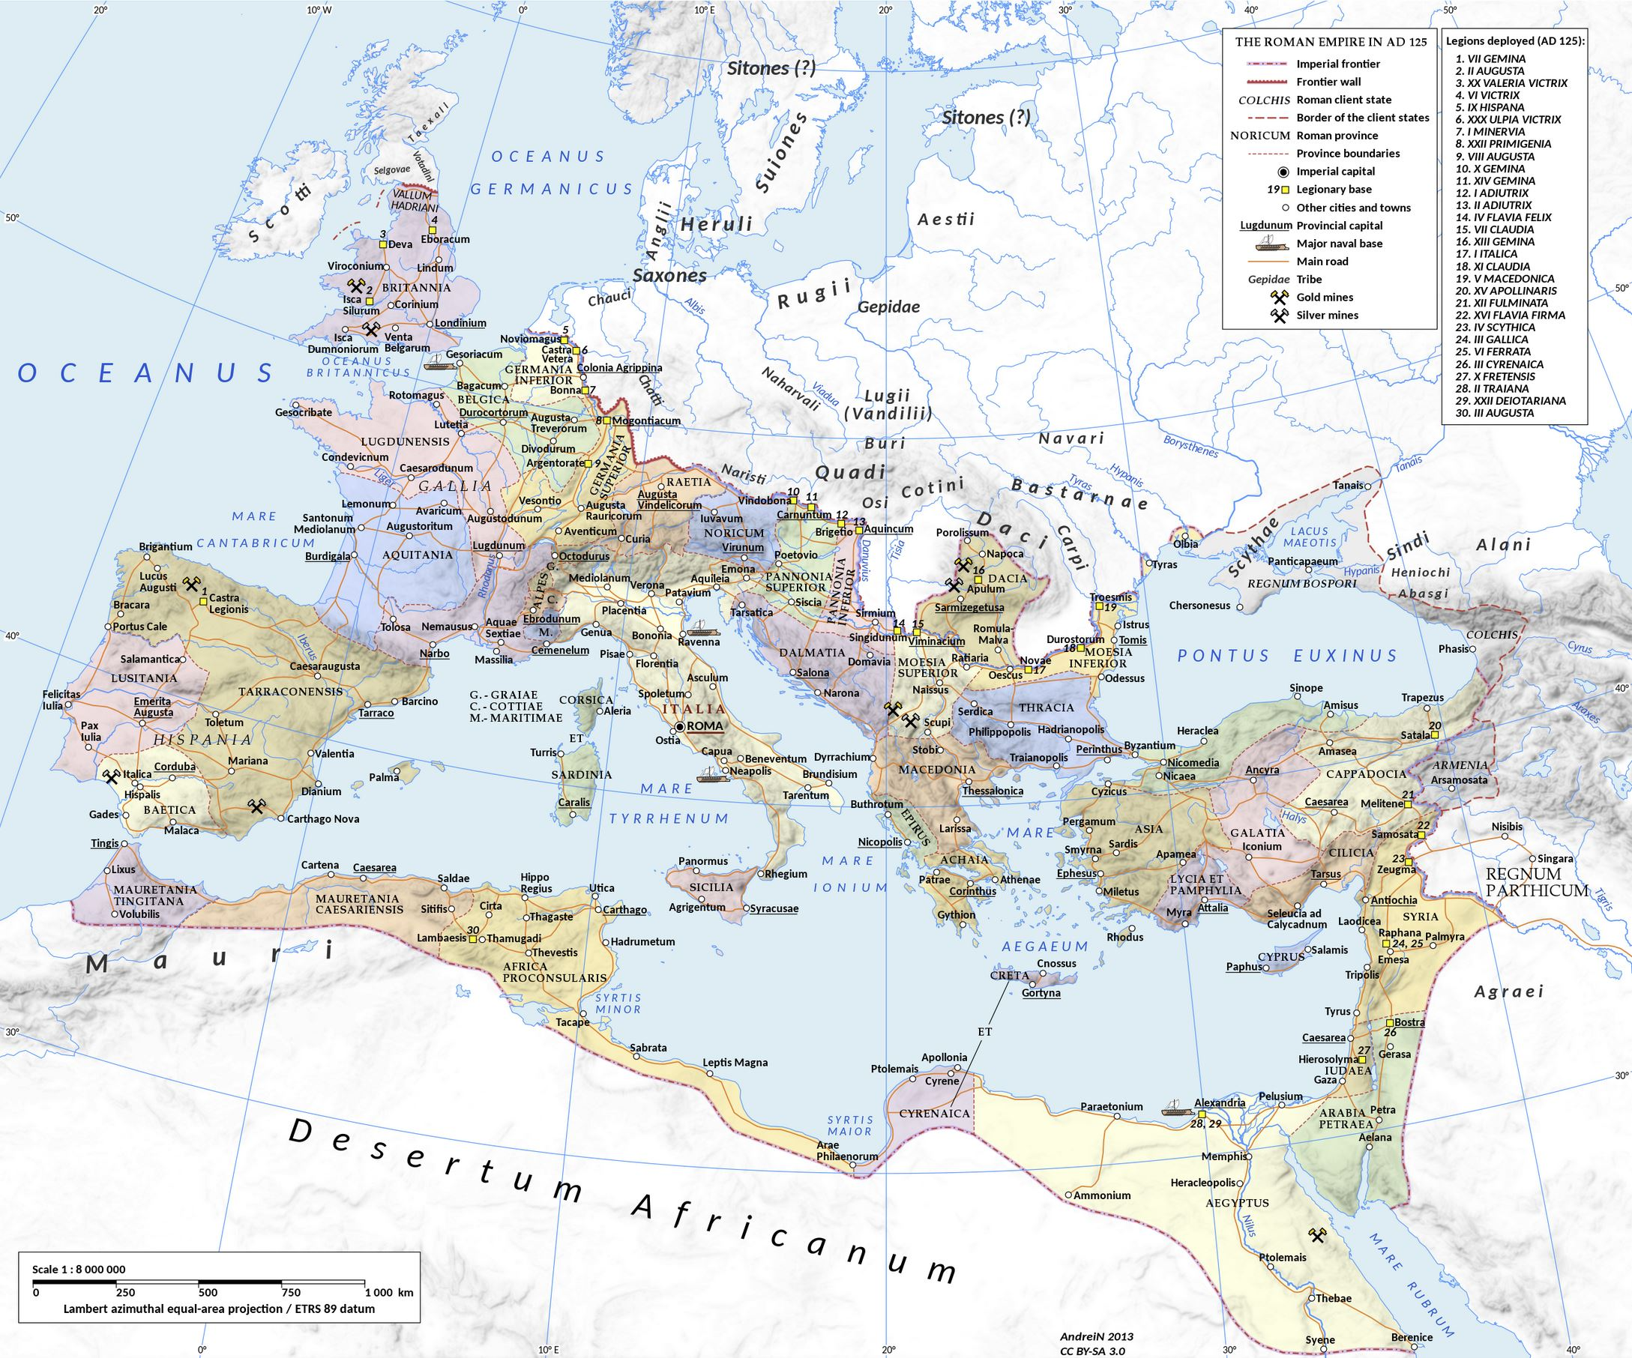
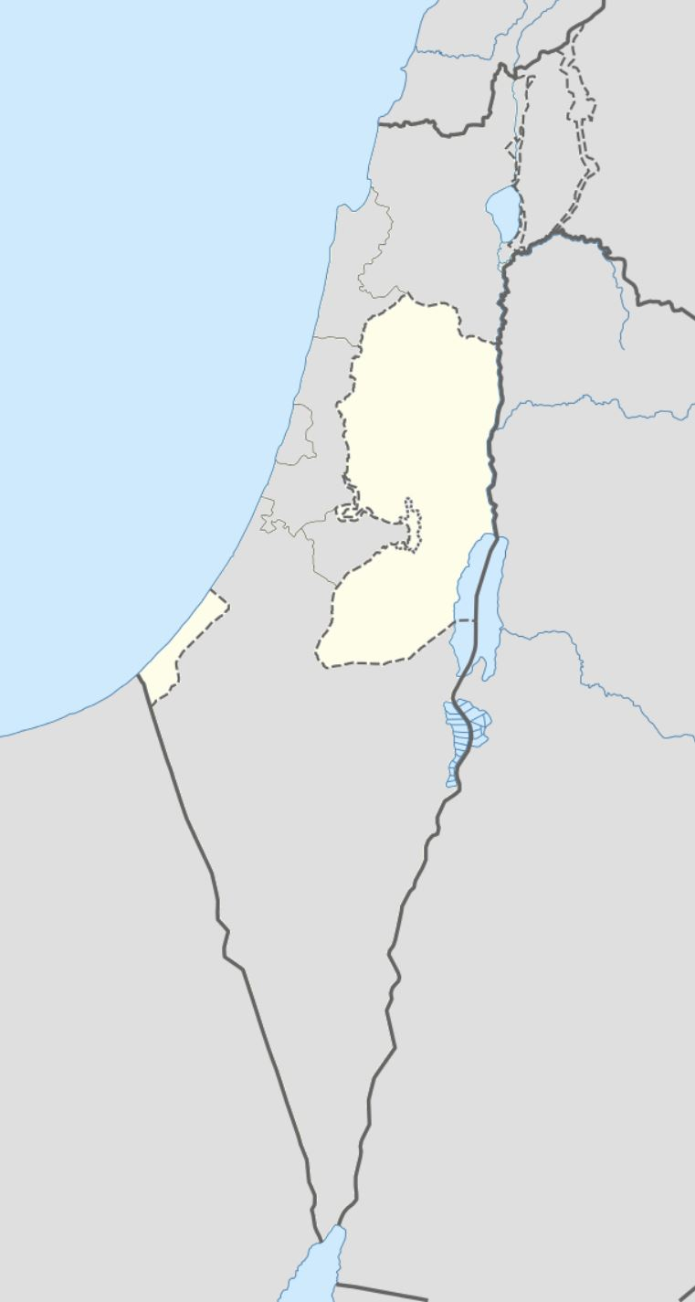
Battle of Yarmuk (636 AD)
3) A Syriac Flyleaf
6th century Syriac copy of Matthew & Marks Gospels
On the 636 AD Flyleaf is written, “In January the people of Homs (Syria) took the word for their lives and many villages were ravaged by the killing of the Arabs of Mhmd…” – Known as the Battle of “Gabitha” or “Yarmuk”
Problems: The battle is well documented but note that it says ‘Arabs’. Who were the 7th c. Arabs? They lived in today’s Jordan and Syria, not down in the Hijaz, so too far north to be the “Muhammad” of Islam
The Arabs defeated the Byzantines at this battle, but according to the S.I.N. Muhammad died in 632 AD, so 4 years earlier, and he certainly never travelled to Syria for any battles
Could this be yet again another 7th century, northern ‘Mhmd’; thus, someone who is simply referred to as an honorific ‘Praised one’?
Arabia 2nd C.
Yarmuk

Slide 43
Coptic Christian Bishop (690s AD)
4) John Nikiou (690s)
The Coptic Christian bishop, John of Nikiou writes, “and now many of the Egyptians who had been false Christians denied the holy Orthodox faith and life-giving baptism, and embraced the religion of the Muslims, the enemies of God, and accepted the detestable doctrine of the beast, that is, Muhammad, and they aired together with those idolaters, and took arms in their hands and fought against the Christians, and one of them… embraced the faith of Islam… and persecuted the Christian.” (Nevo and Koren, Crossroads to Islam, 2003:233-234)
Problems: The earliest manuscript of this quote is from a 1602 AD Ethiopic translation from the Arabic, which was from an earlier Greek translation, none of which exists today, suggesting once again that this is a later redaction to the 7th c.
That is the reason it includes the name “Muhammad” and “Muslims”, which were unknown in the 7th century, and only introduced around 730 AD.

Slide 44
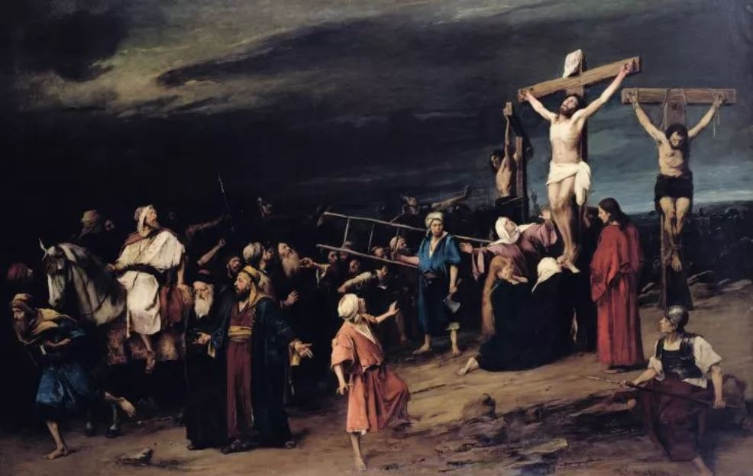
Let’s use the Crucifixion of Jesus as an example
What about Christianity’s historical record?
The Qur’an in 7th-8th c:
S.4:157 And [for] their saying, "Indeed, we have killed the Messiah, Jesus, the son of Mary, the messenger of Allah." And they did not kill him, nor did they crucify him; but [another] was made to resemble him to them. And indeed, those who differ over it are in doubt about it. They have no knowledge of it except the following of assumption. And they did not kill him, for certain”
The Historical Record:
Thallus Greek (Samaritan hist. 52 AD)
Phlegon Greek (Rome writer 1st c.)
Lucian Greek Satirist (2nd c.)
Mara Bar-Serapion’s Letter Pagan (73 AD)
Josephus Jewish (AD 37 to 90)
Tacitus Roman hist. (110 AD)
Greek, Roman, and Jewish Historians from the 1st – 2nd century ALL agree that it was Jesus who was on the Cross
Conclusion: Even with just this example, we can see that Christianity has a better record than Islam historically

Slide 45
What about Christianity’s Textual record?
John
(Sira & Hadith)
90 AD
(57 years)
Christianity’s Emergence, according to our “Traditions”
Note: Most scholars would put the dates for the books of the New Testament in this timeline much earlier. We are using the latest possible dates, to make our point clearer
Matthew & Luke
(Sira & Hadith)
80 AD
(47 years)
Mark
(Sira & Hadith)
70 AD
(37 years)
Paul’s letters (Tafsir)
48 – 65 AD
(15 – 34 years)
Book of Acts (Tahrikh)
52 – 62 AD
(20 – 30 years)
Jesus Dies
33 AD
33 AD
37
41
45
49
53
57
61
65
69
72
76
80
84
88
92
Within 29 – 57 years of Christ’s death for the whole N.T.
Conclusion: All of the New Testament writers lived in the same place Jesus lived, and they either knew him personally, or they got their material from others who saw what he did, and heard what he said

Slide 46
Comparing Christianity vs Islam
When were the earliest biographies and sayings for both faiths written?
Christianity 15 – 60 years later, written by those from the same area
Islam 400 - 900 years later, & hundreds of miles too far north
Which would you guess is more authoritative?
As a comparison: If we had to depend on sources for Jesus, comparable to what Muslims are dependent on for Muhammad, Jesus would not begin to appear until the 3rd – 5th centuries!
With statistics like these, how can Raymond suggest that Muhammad is much more historically supported than Jesus?

Slide 47
Supposition #3
“If Muhammad didn’t exist, how do we understand the Sunni/Shia Divide?”

Slide 48
Supposition #3 = What about the Sunni/Shia Divide?
a) “If Muhammad didn’t exist, then no descendants existed either”.
b) “So, how can we understand the Sunni-Shia divide?”
c) “Why would there be a huge contention involving the blood descendants of a man who had never existed?”

Slide 49
My Response #3a
To begin with, the first we even hear about Ali as Muhammad’s choice is with Sahih al Bukhari vol.5, book 64, hadith 4416, & Sahih Muslim vol.44, hadith 2404a, while the counter argument that Ali was not Muhammad’s choice (due to Aishah) is found in Sahih al Bukhari vol.5, book 64, hadith 4459 (so, just 43 hadith later), proving that his companions didn’t even know this.
Remember, The Canonical version of Sahih Bukhari doesn’t appear until the 14th – 15th centuries, so this is probably a much later story, redacted back.
More importantly, this is a political dispute (between Persians and Arabs), not theological, so it could have been created at any time (i.e. by either the Abbasids, or the Ottomans in the 14th – 15th centuries), and then redacted back, first to al-Bukhari, and then to the person of Muhammad himself, in order to give authority to whichever position (Persian or Arab) you needed the authority for. This isn’t surprising, as movements, both political and religious, often split, and the Sunni/Shia divide could easily have arisen for the same reason as the earlier Abbasid revolt, which at its roots was due to disquiet over the earlier Umayyad dynasty.

Slide 50
My Response #3b
4) An example: King Arthur and Camelot are completely legendary, but don’t tell Henry the VII, or even his son Henry the VIII that. In order to leave Rome, he based his “Ecclesiastical Appeals Act of 1533” on the grounds that since King Arthur had ruled an Empire; he, as his progeny and heir could also rule the empire of Britain. Indeed, Henry’s propagandists went further, and claimed his descent from Brutus, legendary founder of Britain (after whom Britain was supposedly named), and the great-grandson of the legendary Aeneas of Troy, whose progeny, Romulus and Remus, allegedly founded Rome. Yet, no academic historian believes in the historicity of either Aeneas, or Romulus, or Brutus or Arthur; so, the fact that there were people – indeed, Kings – who claimed to be their offspring proves nothing (Dr Pat Andrews 2025)

Slide 51
Supposition #4
“There are NO incontrovertible proofs of Muhammad’s NON-Existence”

Slide 52
Supposition #4 = No Evidence for Muhammad’s Non-Existence
“There are no incontrovertible proofs of Muhammad’s non-existence”.
Response: I don’t have to prove a thing here. The statement makes no sense to begin with…how can someone prove someone who did not exist? It is the person who claims that someone did exist who bears the burden of proof, not me.
b) Raymond admits in his video that he hasn’t looked at any of our evidence.
Response: The fact that he hasn’t even looked at our arguments, suggests that he is either naïve, or simply arrogant, or is being typically Arabic with his ‘one-up-man-ship’ style
c) The theories we have, Raymond believes, “are only out there because those of us who perpetrate them use them simply out of a dislike of Islam”.
Response: While it is true that I dislike Islam, I absolutely love Muslims. They are my favorite people. However, isn’t Raymond just as guilty of disliking Islam, which would invalidate his later arguments for Muhammad’s existence based on the Traditions? Be careful, that argument goes both ways.

Slide 53
Supposition #5
“Since the Traditions about Muhammad are so embarrassing, why write them?”

Slide 54
Supposition #5 = Why is Muhammad so Embarrassing?
“The 200 - 300-year-old Traditions are so embarrassing. Why would they write them for a man who they believed was their paradigm for all time, if he never existed?”
Response:
He is only embarrassing to Raymond when compared to Jesus, because he views Muhammad through a Christian cultural grid.
Remember that Muslims don’t compare Muhammad through the grid of Jesus Christ. Therefore, they love his virility, his violence, and his denigration of others.
In fact, Muslims tell me that when compared to Jesus (who never married, or had a family, never ruled, never went to war, nor stood up to his oppressors, and never owned anything), who then is the more relevant for today as a model? For them, it’s Muhammad!
What’s more, Muhammad’s Depression, attempted Suicide, Demon possession, cross dressing, even homosexual tendencies are all crisis's that every prophet goes through, but were not overcome by them, as they then conquered them, proving that they were true prophets. And the same happened to Muhammad, a true prophet because he surmounted these problems, in their eyes.

Slide 55
Supposition #6
“Mecca is not an argument against Muhammad”

Slide 56
Supposition #6 = Mecca doesn’t confront Muhammad
a) “Mecca is not an argument against Muhammad”.
b) Though Raymond didn’t watch any of our videos on Mecca, his response suggest that we are simply arguing from silence, and “An absence of evidence does not prove the evidence of absence”.
c) “At some point in the future references for Mecca in the 7th century and earlier will appear”.
    An example is the city of Troy, which no one considered historical until Heinrich Shlemin discovered it in the 1800s in Turkey.
Response:
If there was no Mecca, then it doesn’t matter which ”Muhammad” or Mhmd you find, if he isn’t from Mecca, then he isn’t the Muhammad of Islam. So, it absolutely does matter!
In 1995 we had almost no evidence. But today we have all of the evidence (coins, inscriptions, buildings, manuscripts, etc…). So, it is now the Muslims who are arguing from silence.
His example of Troy is a non-sequitur, since we have ample references from ancient history for the existence of Troy; we just didn’t know where it was situated, until now. Conversely, we have no references from ancient history for even the existence of any place called Mecca, in Arabia.

Slide 57
Why is Mecca so important? Because it still exists, & thus can be researched
Islam is dependent on 3 things:
the Book (Qur’an), the Man (Muhammad) and The Place (Mecca)
When you begin to attack the Place (Mecca), the other two begin to wobble
But once you destroy the Place (Mecca), you destroy the other two as well
If we eradicate Mecca, then there is no Islamic Muhammad, nor an Islamic Qur’an
So, let’s begin by looking at what Muslims claim for Mecca

Slide 58
What Muslims Claim
MECCA is the oldest and best-known city in history
Mecca is where Adam and Eve were thrown down to, from the Garden of Eden (Surah 7:24)
Mecca is where Abraham lived when he destroyed the idols within the Ka’aba (Surah 21:51-71)
Mecca is the center of trade North, South, East and West (Montgomery Watt’s ‘Trade Route Theory’)
So, it should be one of the best known and best documented places in history!

Slide 59
Inferences to ‘Mecca’ in the Qur’an
Mecca is the center of Islam, and the center of history
(Note: none of the verses below use the word “Mecca“. It‘s only implied)
“The first sanctuary appointed for mankind was that at Bakkah (Does Bakkah = Mecca)”? (Sura 3:96)
Mecca is the “mother of all settlements.” (Sura 6:92 & 42:7)
Mecca was where Adam & Eve were caste down to (Sura 7:24)
Mecca was where Abraham lived in 1900 BC (Sura 21:51-71)
Mecca was where Muhammad was born and lived until 622
Mecca became the center for the Qibla in 624 (Sura 2:149-150)
The above imply people have lived there from the very beginning
Yet, the only reference to ‘Mecca’ in the Qur’an is in Sura 48:24…Why only once, if it is so important?

Slide 60
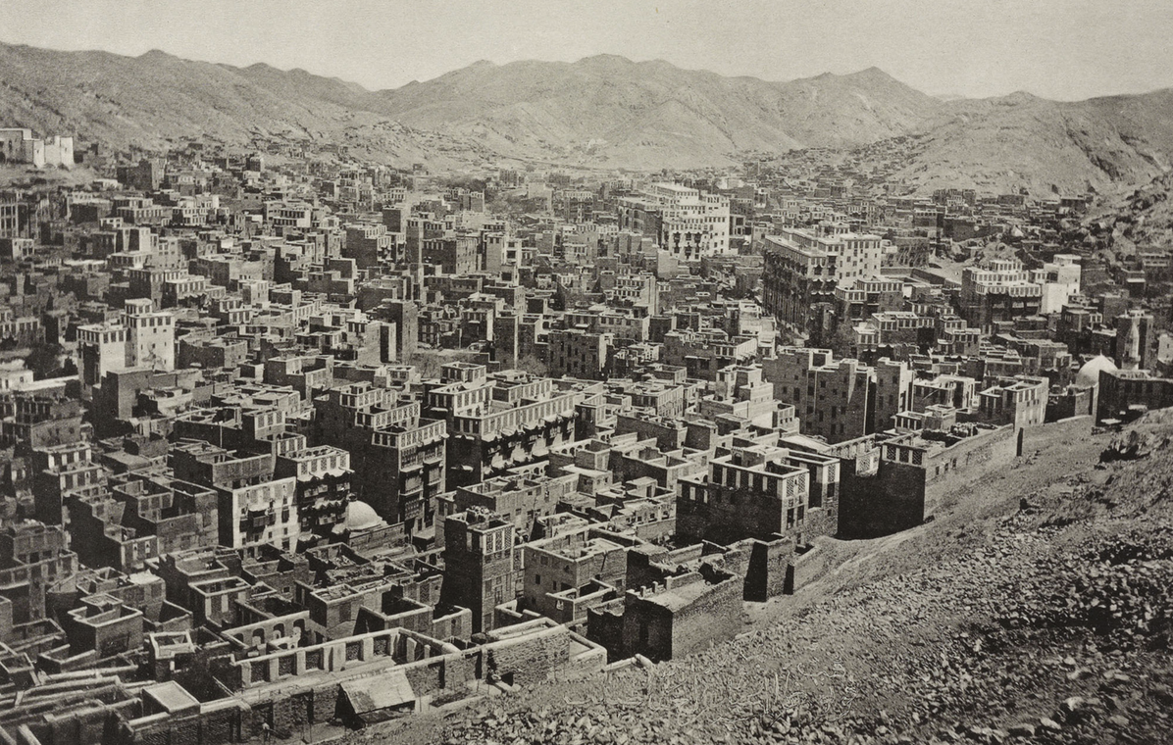
References to Mecca in the 9th & 10th Century Islamic Traditions:
In a valley, & a parallel valley (Ibn Hisham; Al Bukhari 2:645, 2:685, 3:891, 2:815, 2:820, 4:227)
Safa & Marwah had shrines to idols atop them before Islam (Ibn Hisham pg.30)
With a stream (Al Bukhari 2:685)
With fields (Al Bukhari 9:337)
Has Trees (Sahih al-Tirmidhi 1535), Grass (al Bukhari 9:337), fruit (Al Bukhari 4:281), Clay and Loam (Al Tabari VI 1079 p.6), Grapes, Grain, Pomegranates (Surah 6:99)
Has ‘Olive Trees’ (Surah 6:99, 141; Surah 16; Surah 80)
With Mountains overlooking the Kaa’ba (Ibn Hisham; Al Bukhari 2:645, 2:685, 3:891, 2:815, 2:820, 4:227)
Where the Pagans (“Mushrikoun”) raised Livestock (Surah 4:119)
Yet, Mecca is not in a valley, as its nearest mountains are 2 miles away, and it has none of these vegetations listed above, because it’s in a DESERT, so it’s too arid and dry to support any of the above, according to modern soil studies! (Gibson 2011:233)
Conclusion: In the Qur’an Mecca is referred to as `The Place of the Prophet’, but in the 11th-15th c. Traditions the Mecca they portray suggests the author/s lived much further north!

Slide 61
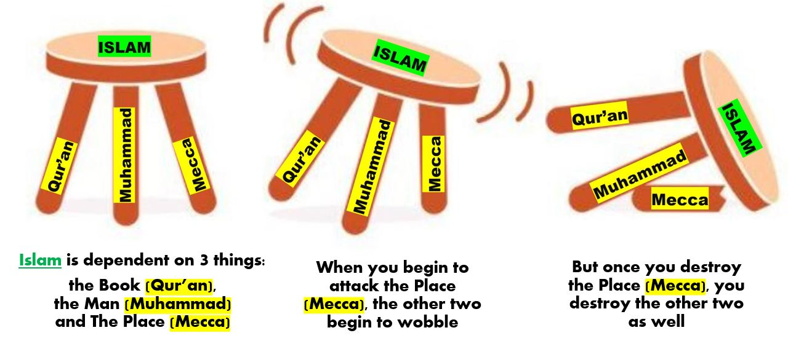
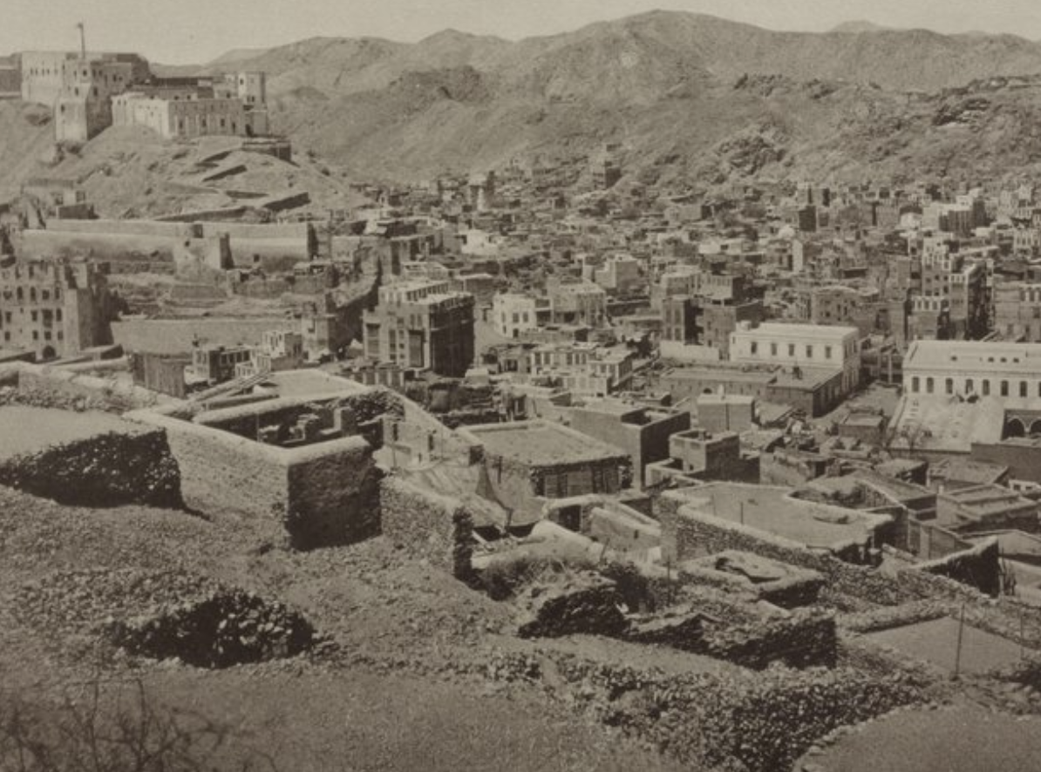
CONCLUSIONS from Mecca #1
We begin with Mecca because it is foundational for both Muhammad and the Qur’an; so, without it, they both fall, because it doesn’t matter which Muhammad or which Qur’an you find, if they are not from Mecca, they are not the Muhammad or the Qur’an of Islam
Since Mecca is the earliest and most important city in the history of Mankind, it has to be the center of the world, and therefore certainly the best known
References suggest that Mecca had lush vegetation, such as fruit trees, grass, grains and streams, which make no sense as Mecca has always been in a desert with bad and depleted desert soil

Slide 62
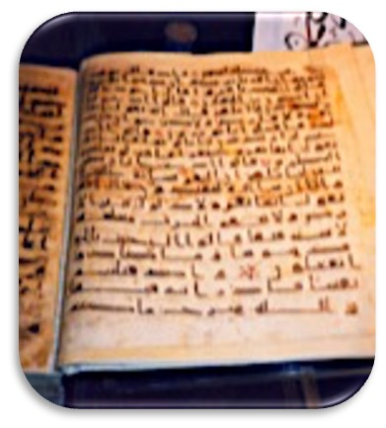
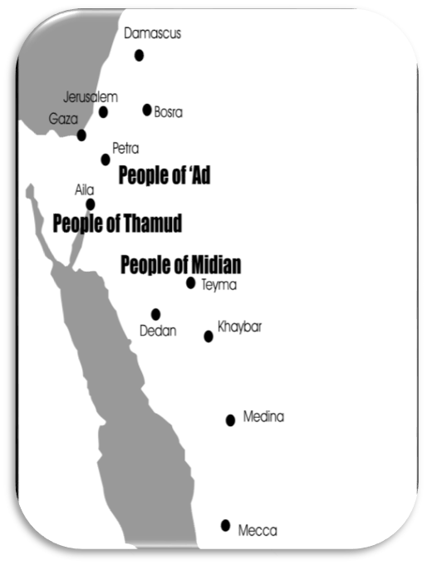
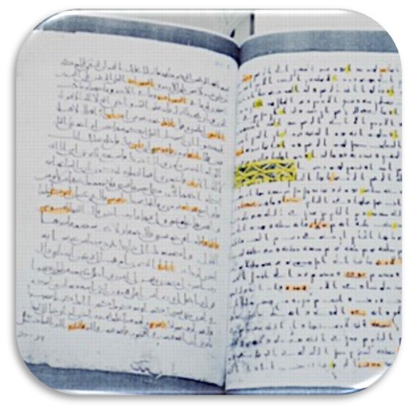
CONCLUSIONS from Mecca #2
Ironically, though it’s claimed to be the greatest city in history, the Qur’an itself only refers to it once (in Surah 48:24), signifying that the authors either didn’t consider it that important, or it only came into existence later on
Even the Arabic word endings used in the Qur’an do not come from Mecca, but from Nabataean Aramaic, which is again situated 600 miles further north
Geographically speaking, the Qur’an places almost all of its sixty-five referenced areas 600 – 1,000 miles further north than Mecca (Ad = 23 times, Thamud = 24 times, and Midian = 7 times) suggesting the authors of the Qur’an came from much further north

Slide 63
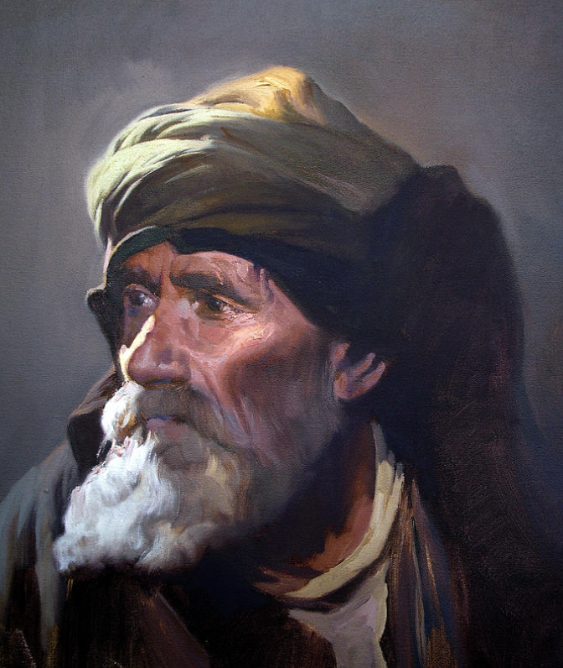
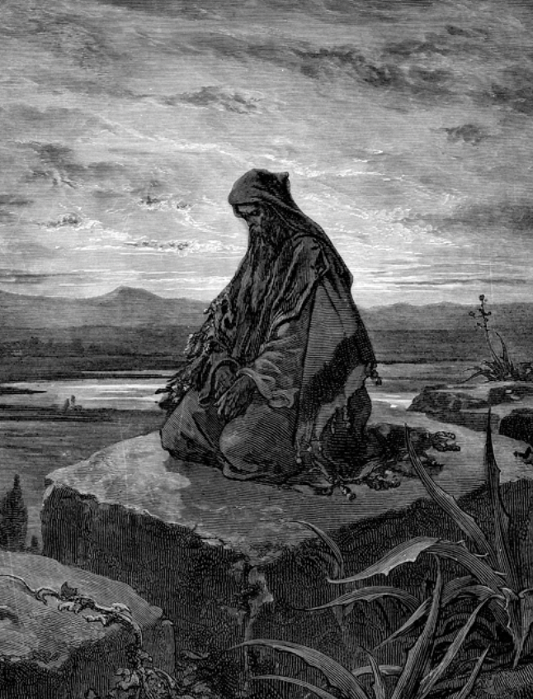
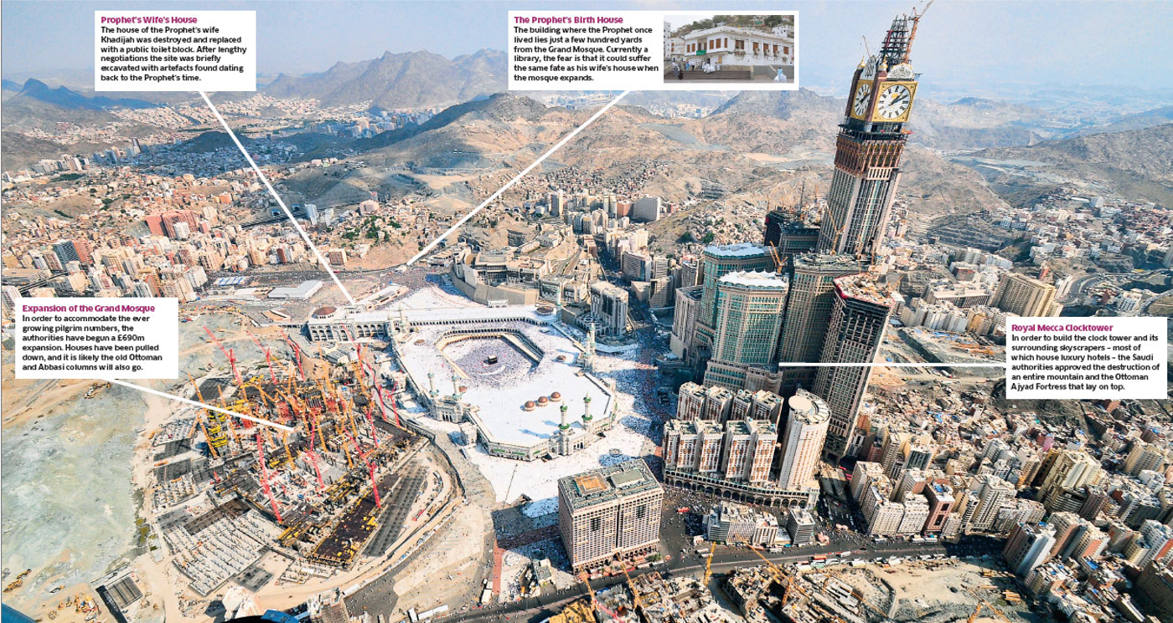
CONCLUSIONS from Mecca #3
Interestingly, the 7th century Arabs called themselves “Ishmaelites”, or “Haggarenes”, ”Muhajirounes”, “Maghrayes” & were called “Saracens”. Nowhere are there any references to anyone called “Muslims”, or to the religion of “Islam” this early
Mecca is where Muslims contend that between 70 – 300 prophets were buried; yet, with all the buildings being constructed there, requiring deep foundations, they have yet to dig up even one
It seems the Saudi Arabians, because of Mecca’s lack of history, are cementing up all the evidence, suggesting even they are either skeptical of its history or they don’t want the rest of the world to find out

Slide 64
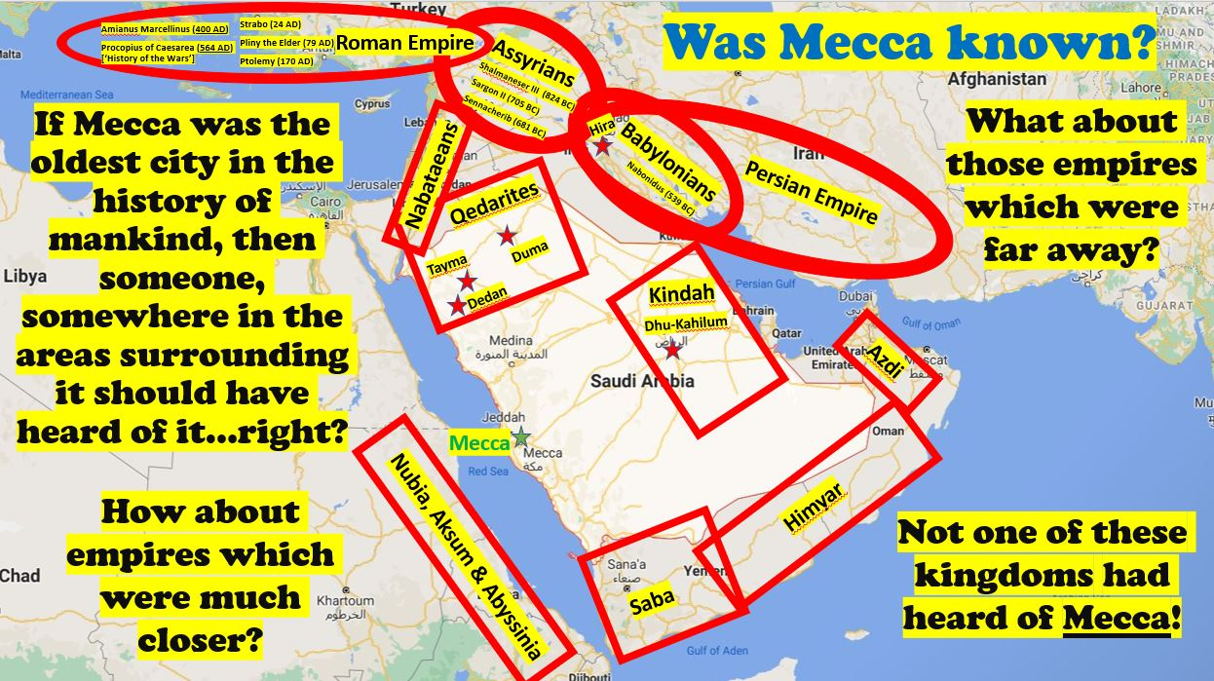
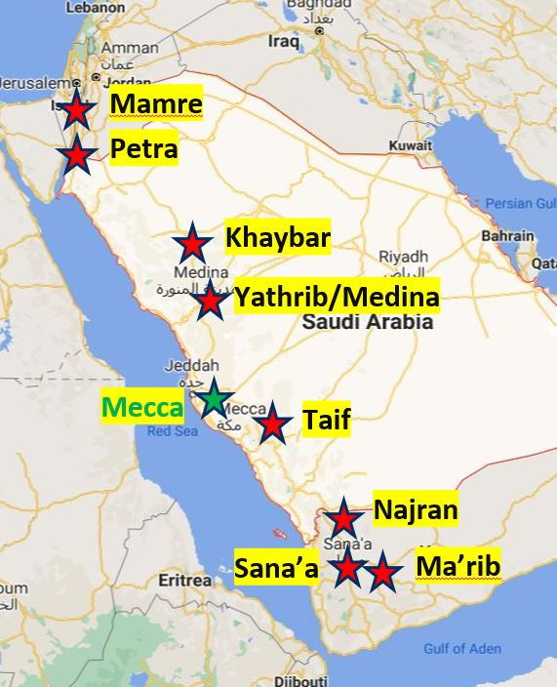
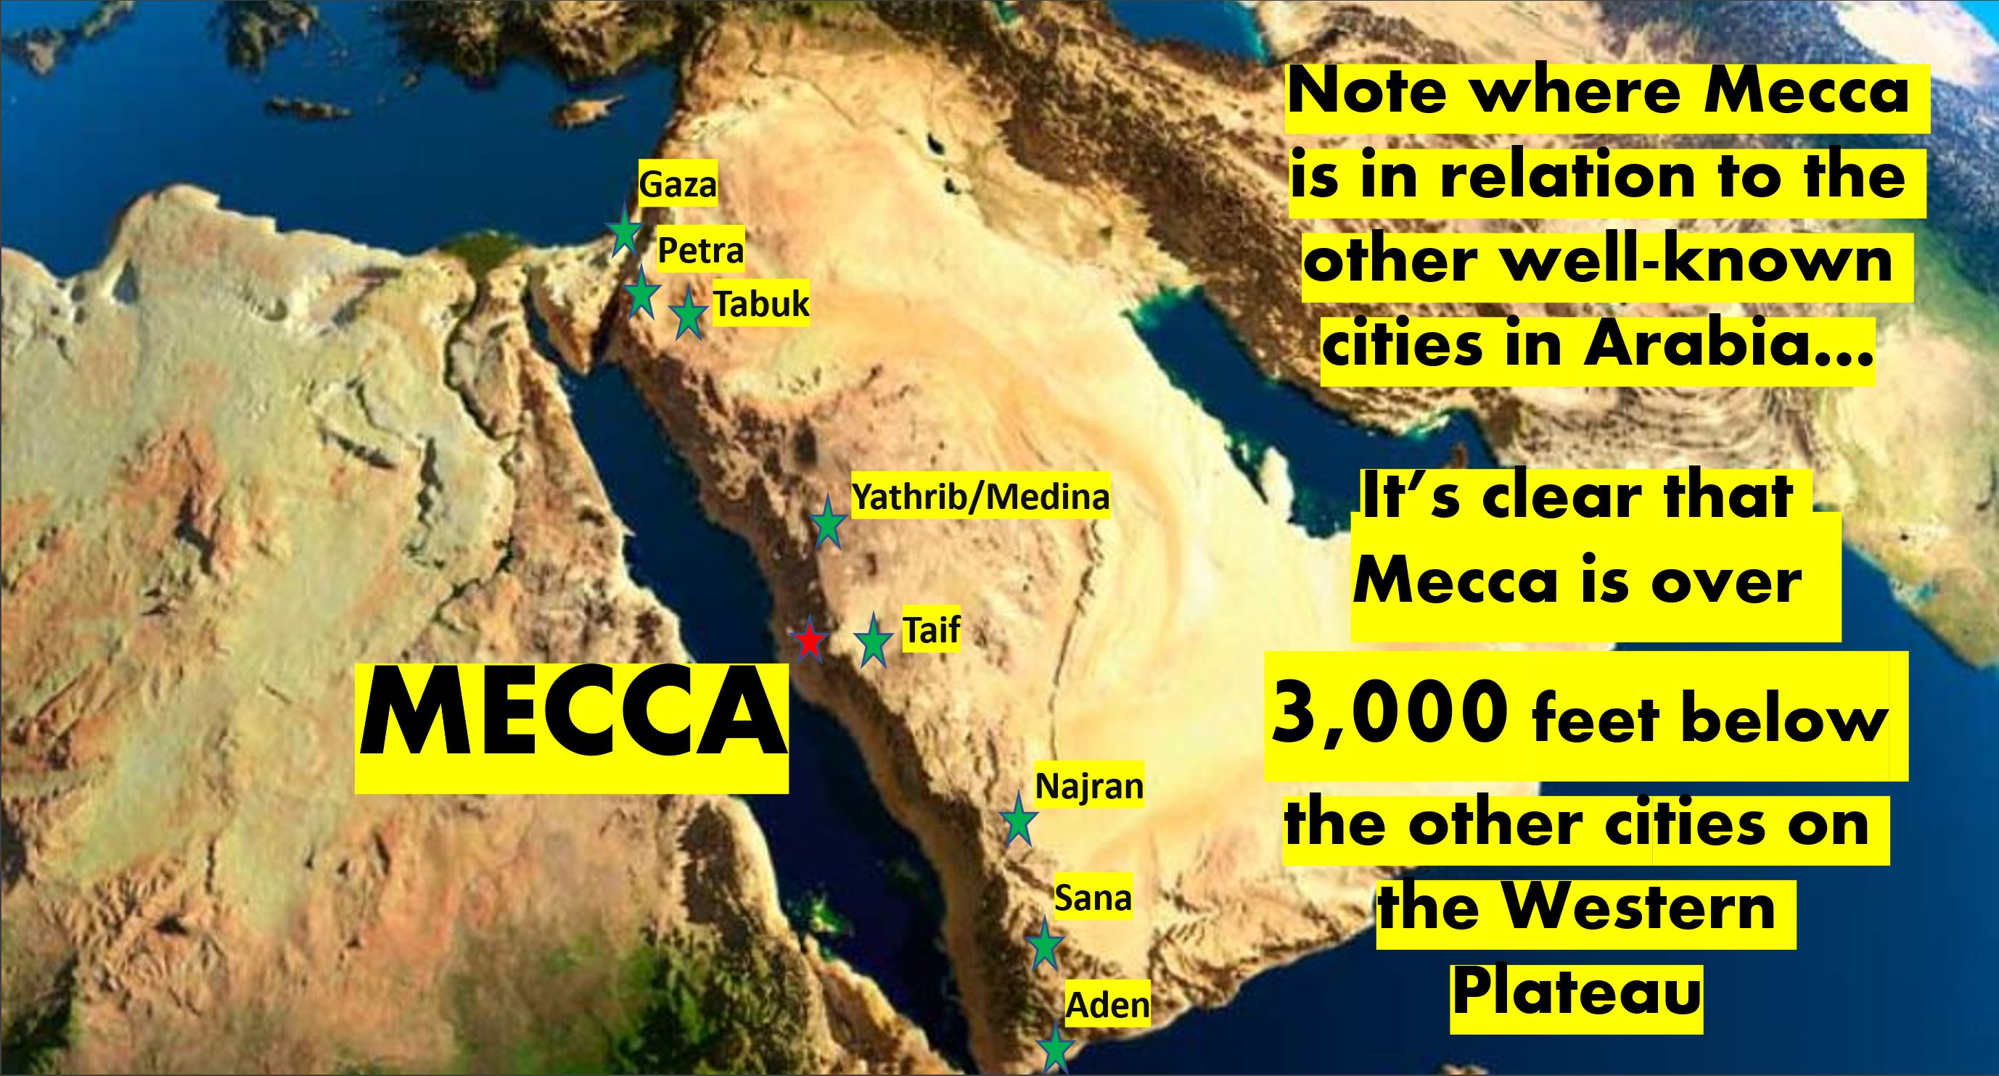
CONCLUSIONS from Mecca #4
When we ask the surrounding civilizations if they have heard of the city of Mecca, not one knows of its existence, including those empires which are situated immediately close by
Yet, other much less significant towns close to Mecca (i.e. Ma’rib, Sana’a, Najran, Taif, Yathrib, Khaybar, Petra and Mamre) are all well-known and well documented; but not Mecca
When noting the trade route through these towns, we find that they are all located on the Western Plateau, while Mecca is over 3,000 feet down below it, proving it was not on any trade route

Slide 65
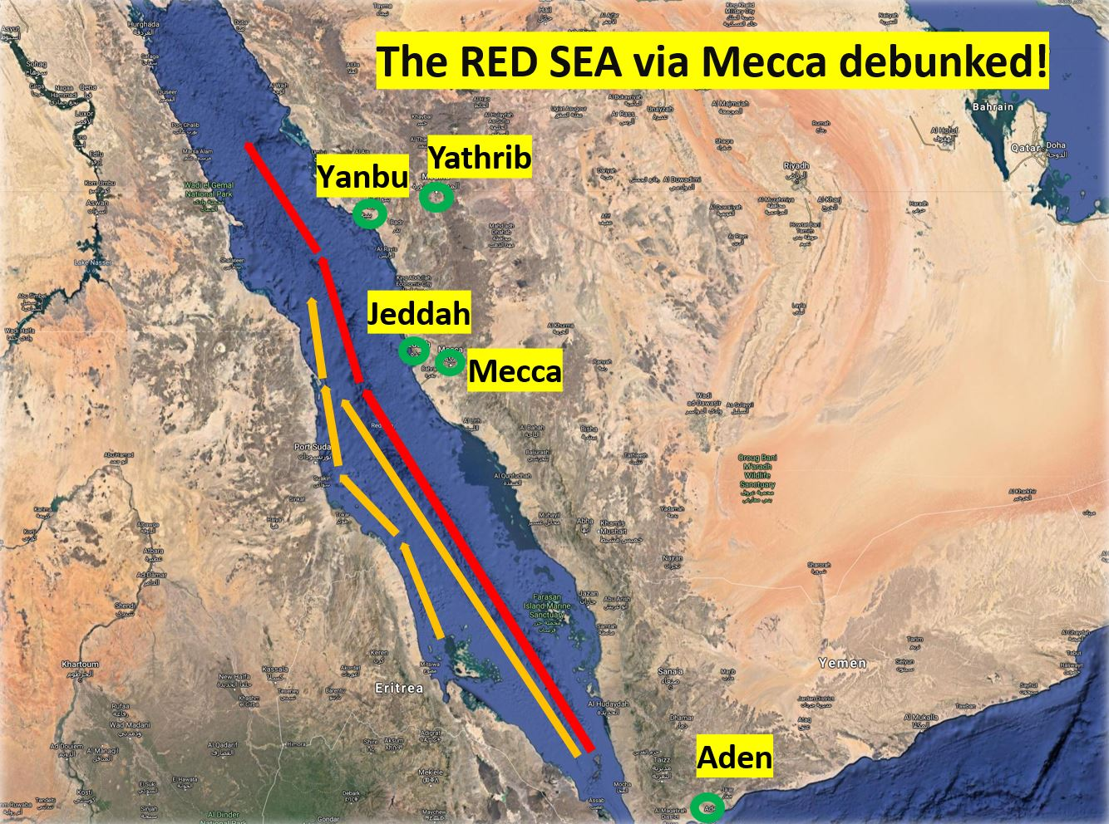
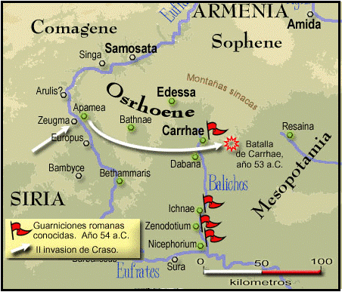

CONCLUSIONS from Mecca #5
Yet, neither the Land trade route (along the Arabian Western plateau), nor the Red Sea trade routes (along the East African coast) supports an early Mecca, proving none of the trade went via Mecca at all, confronting the notion that it was the center of trade
Mecca, before 741 AD (which is considered the earliest documentary evidence for it anywhere), simply has no history, and even that reference is located in Southern Turkey, which is too far north
When Ptolemy in the 2nd c. wrote his book on ‘Arabian Geography’, he never listed Mecca, so that none of the earliest 15th-16th c. European maps of Arabia have Mecca listed on them either

Slide 66




CONCLUSIONS from Mecca #6
The reason? NO WATER: Trade needs people, and people need water, food and towns, all of which never existed in Mecca until the mid 8th century, over 100 years after Islam was supposedly created
Despite Muslim’s claims for the ZamZam well (that Allah provides its “inexhaustible water” for over 1 billion believers), it gets all its water from desalinization plants built by American and European companies
Because of Mecca’s water problem Queen Zubaydah’s Aqueduct was built in 801 AD, which then had to be refurbished 9 times in the subsequent 974 years due to the overbearing need for potable water; and then finally replaced with desalination plants after 1926 AD

Slide 67




CONCLUSIONS from Mecca #7
Muslims have no idea why all of the earliest Qiblas were facing Petra (or Jerusalem) up to 706 AD, nor why none are facing Mecca until 715 AD. This suggests Mecca was chosen in the 8th c. as their final sanctuary
The antecedents for the current Meccan pilgrimage (Circumambulation, Safa & Marwa), are all from Jerusalem, and are only poor copied facsimiles
In Conclusion: Certainly, someone, somewhere, at some time should have known about this city; yet no-one, anywhere, nor at any time has, proving that it never existed at the time of Muhammad, nor during early Islam. So, if Mecca didn’t exist, then what “Muhammad” is Raymond referring to? His Muhammad had to be born, & grow up there until he was 52.

Slide 68
Supposition #7
“No one can prove or disprove historical data”

Slide 69
Supposition #7 = It all comes down to ‘faith’
“Since nothing historical can be really proven or dis-proven, those who love Muhammad (Muslims) will continue to believe his existence, regardless of what we contend”.
“Jesus Christ supposedly didn’t exist either for the last 200 years, yet billions of people still believe he did”.
“No one will investigate the historical claims about Muhammad, just as no Christians did against Jesus Christ’s existence, so it is not worthy of our time”.
Response:
Suggesting that nothing historical can be proven is not academic. His earlier example of Troy suggests that historical claims can be proven; and have.
Raymond is correct; the common ‘person-on-the-street’ won’t investigate Muhammad’s existence, as it is not healthy (i.e. you wouldn’t live very long). This is primarily for the academics, who are the future leaders of Islam, and who can sway many more Muslims against Islam than you-or-me.

Slide 70
Supposition #8
“It all comes down to a matter of Faith”

Slide 71
Supposition #8 = It’s all a matter of faith
“It all comes down to a matter of faith”.
“Why would anyone listen to a [white American] Christian speak about the existence of their beloved prophet, when they have faith that he existed”.
“Muslims will either laugh, or mock anyone trying to say that Muhammad didn’t exist, because it comes across to them as ludicrous and even arrogant”.
Response:
True, most of those who support this material are fellow middle class educated Westerners, like myself. But it is beginning to take traction all over Africa, Asia and even the Americas
In our experience, however, laughing or mocking (using ad hominem) suggests that the person has either no responses, or knows that he has lost the argument, which can lead to confusion, then conviction, followed by conversion. And that has been our experience with the Historical Critique.

Slide 72
Supposition #9
“Claims against Muhammad’s Existence are merely an Academic, or Subjective exercise”

Slide 73
Supposition #9 = This is only an academic exercis
“Since claims against Muhammad cannot be proven, they are merely academic, and subjective”
“You simply dislike Muhammad, and therefore your viewpoint is totally inconsequential, and thus the weakest argument”.
“No one will investigate the historical claims about Muhammad, just as no Christians did against Jesus Christ’s existence, so it is not worthy of our time”.
Response:
The terms “academic” or “subjective” don’t negate the evidence which we have and have nothing to do with the historical proof of Muhammad’s existence.
What’s more, Raymond’s claims against Muhammad’s morality and relevancy are equally academic and subjective, and therefore equally inconsequential.

Slide 74
Supposition #10
“The Best Polemic is to prove how irrelevant Muhammad is for today”

Slide 75
Supposition #10= Just prove how Irrelevant Muhammad is
“The best response to change Muslim’s minds, and convert them, Ibrahim believes, is to show how irrelevant Muhammad and his god are for people today”.
“It is a “Tried and Proven” methodology”
“Everyone uses it”
“You will get many more converts”
Response:
I used it for 30 years, because “everyone used it” since it was the only polemic we had, but with little success (only a few converts)
I felt “dirty” using these arguments (i.e. violence and misogyny)
It causes more anger, resulting in creating walls, and censorship by the Muslims (and Westerners)
People in Muslim dominated countries cannot use the “Internal Polemic against Muhammad”, as that is what causes them anger. Therefore, it’s too dangerous.

Slide 76
Polemics = “Going on the offence”
What do we mean by “Polemics”?
3 Areas of Polemics
Internal Polemics (Ibrahim’s favorite)
Cultural Polemics (His 2nd favorite)
External Polemics (His least favorite)

Slide 77
#3) External Polemics
Confronting the existence of the book, the man, and the place
1) Confronting Mecca Historically
Did it exist in the 7th century, or before?
2) Confronting Muhammad Historically
Did he exist in the 7th century, in Mecca and Medina?
3) Confronting the Qur’an Historically
Did it Exist in the 7th century, and has it been preserved perfectly for 1400 years?
Conclusion: This form of polemics confronts the very foundations of Islam without confronting the people or their revelation, or their prophet, and lowers the anger

Slide 78
Why is this ‘Historical Critique’ so popular?
It is visual: Everything we use has to do with pictures of coins, rocks, buildings, maps, timelines and manuscripts. Even speaking fast, you still got the ‘gist’ of what are saying
You don’t have to know Arabic to understand it, or use it: Arabic frightens Westerners to engage publicly
It is foundational to everything Muslims believe: It features one book, one man, and one place; yet, without any one of the three, Islam “falls to pieces” and is destroyed
We have the Evidence: So, it’s the Muslims who now ‘argue from silence’, and not us
It is Historically neutral, and therefore NOT Islamophobic, or “hate speech”: Thus, everyone can use it
But I really would prefer that only Christians use it…why?
  Because Christians have the only book, the only man and place which have passed these criticisms
  Thus, we understand its power and have the right to use it publicly…but mostly….
  We are the only ones who have a better response, and the only solution = Jesus Christ!

Slide 79
CONCLUSIONS
When all is said and done…

Slide 80
CONCLUSIONS
Our Remit was to investigate Muhammad’s existence
Sources: It is obvious that everything Raymond and the Muslims are dependent on for their ‘book, man and place’ are based on the “Traditions” (SIN) which are 400 – 900 years too late, & 100s of miles too far to the north
Mecca proves probably the biggest problem for both Raymond and for Muslims
  The SIN refers to a place with much vegetation, existing since Adam & Eve, & with 300 prophets buried
  Yet, it’s not referred to until 741 AD, and none of the early maps show Mecca at all
  Patricia Crone debunked Watt’s land based ‘Trade-Route Theory’ going through it back in 1987
  We debunked the Red Sea Trade via Arabia, proving it was all via Africa, because it had water
  All of the 7th century Qiblas were facing Petra or Jerusalem up to 706 AD, and not Mecca until 715 AD
  None of the surrounding empires ever heard of the Mecca, maybe because it lacked WATER
  Most of the stages of the Hajj were simply borrowed from other places, primarily Jerusalem

Slide 81
CONCLUSIONS
Muhammad: The coins prove that the area under “Islam” was either Christian until 692 AD, or later
The Rock inscriptions prove that a nascent Islam didn’t appear until around 730 AD, or later
All of the references for MHMD are too far north, or refer to Jews, & even to Jesus, the ”The anointed one”
This suggests that the earliest references to MHMD are all to the anticipated Messiah, Jesus Christ!
So, why does Raymond believe that this is the weakest Polemic?
  Probably because he has never used it, nor possibly understands its importance or its creditility
  Because he knows that if I’m correct, he will have nothing left to throw at the Muslims
Conclusion: Nonetheless, the onus is now on Raymond Ibrahim to prove to me and to the rest of you that his “Muhammad”, who was born, grew up, and lived in Mecca and Medina (in the Hijaz) between 570 – 632 AD, and received all 114 Suras of the Qur’an before he died; that this Muhammad actually existed. I don’t have to prove any of this, because I’m absolutely sure he did not exist!

Slide 82
Yet, by Casting Doubt on Islam
Our Muslim Friends can Consider a Better Place, a better Book, and a better Man…Jesus, and His Gospel.
So, let’s “bring them home”!

