Slide 1
Balance Sheet

Slide 2
Income Statement

Slide 3
Cashflow Statement

Slide 4
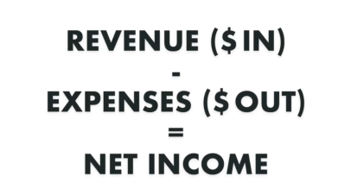
Net Income

Slide 5
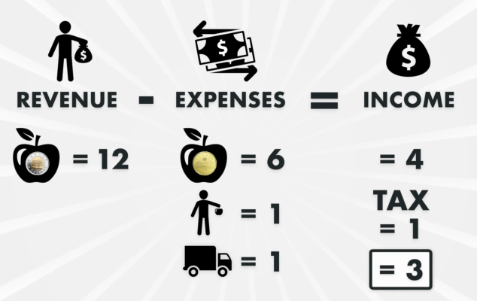

Slide 6
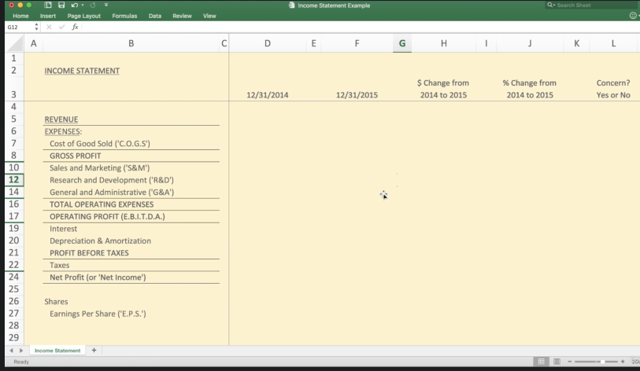

Slide 7
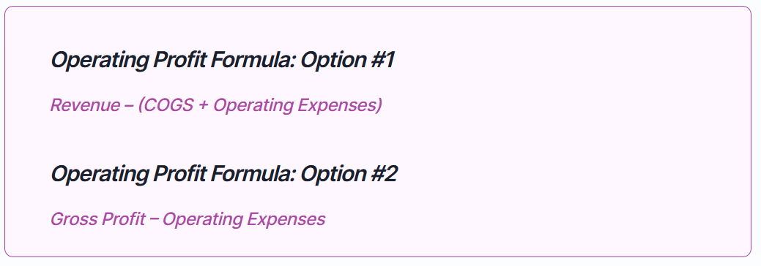
https://finmark.com/glossary/operating-profit/

Slide 8
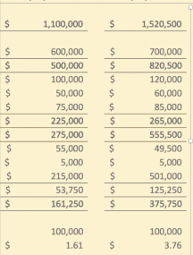
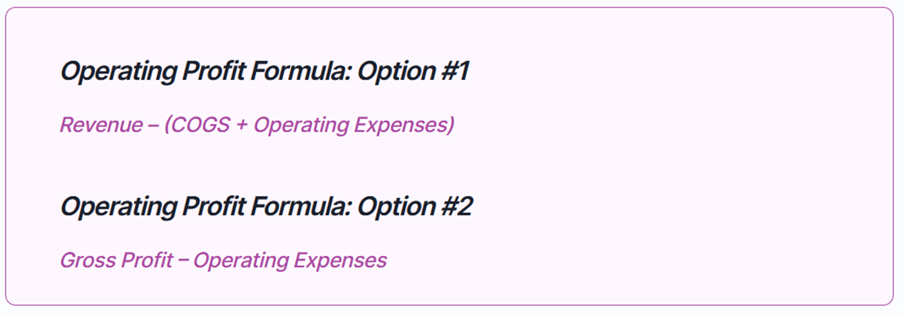
Operating Profit (k)
1100 – (600+ 225) = 257
Video link:

Slide 9
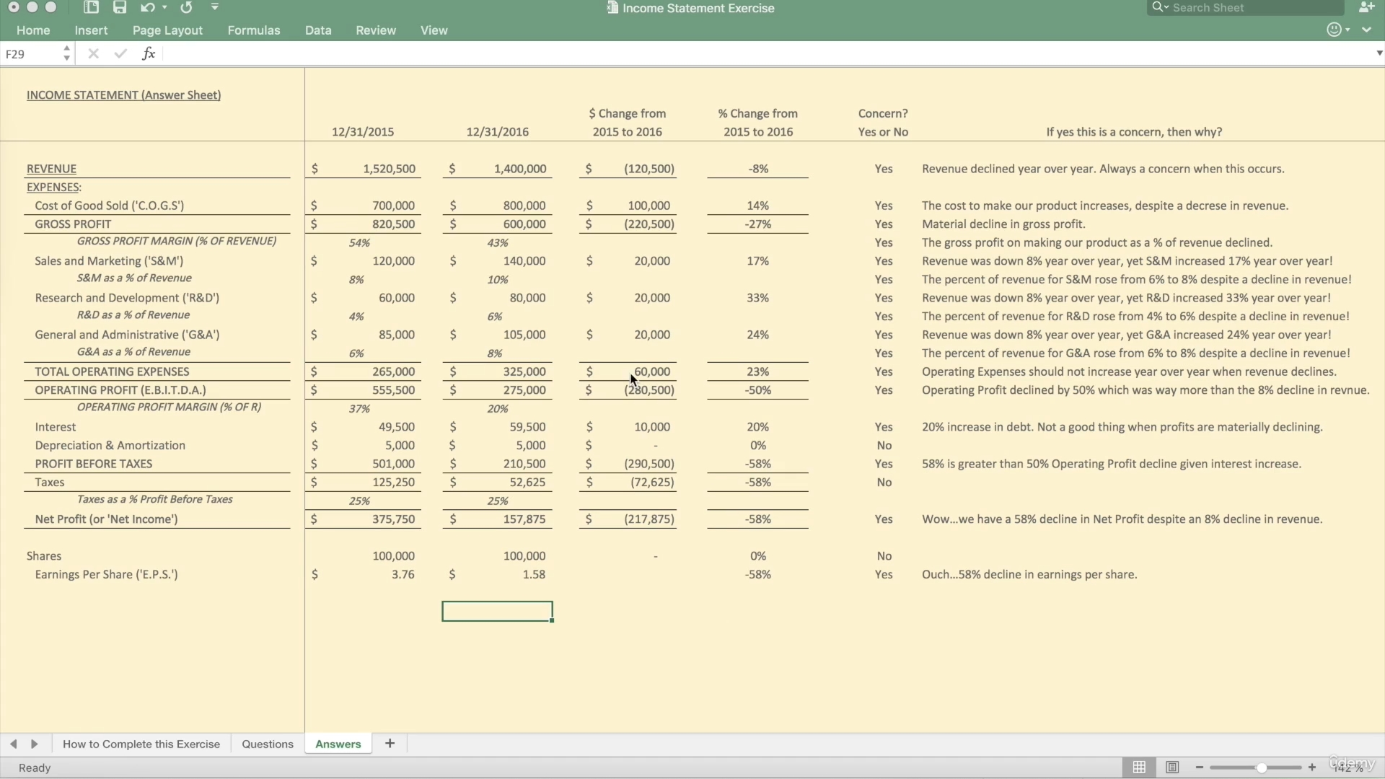

Slide 10
Financial Ratio Explanation

Slide 11
Balance Sheet

Slide 12
Doing the Financial Ratio
Dupont Financial Statement
Types of Financial Ratio
Explanations of Ratio
Calculator

Slide 15
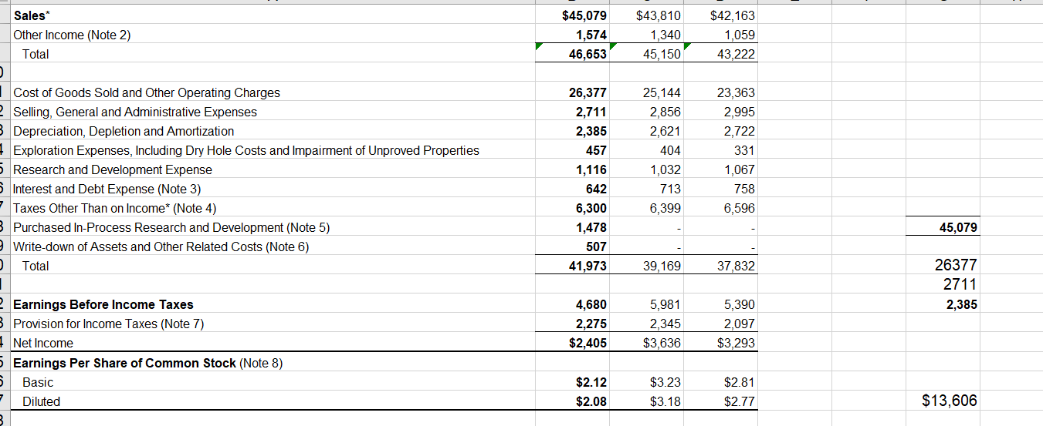

Slide 16
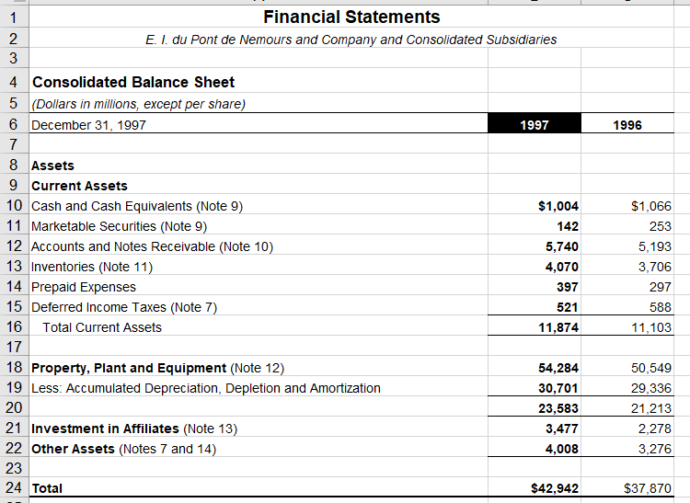
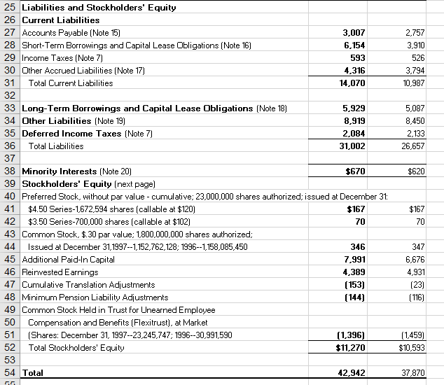

Slide 17
Du Pont
Calculate the following ratios for DuPont for 1997 and 1996:
current ratio
1997: current ratio = $11,874/$14,070 = 0.8439 times
1996: current ratio = $11,103/$10,987 = 1.0106 times
inventory turnover
1997: inventory turnover = $26,377/$4,070 = 6.4808 times
1996: inventory turnover = $25,144/$3,706 = 6.7847 times
total asset turnover
1997: total asset turnover = $46,653/$42,942 = 1.0864 times
1996: total asset turnover = $45,150/$37,870 = 1.1922 times
operating profit margin
Note: operating profit is not provided directly on the income statement, but must be calculated.
1997: operating profit margin = $13,607/$46,653 = 0.2917 or 29.17%
1996: operating profit margin = $13,093/$45,150 = 0.2900 or 29%
net profit margin
1997: net profit margin = $2,405/$46,653 = 0.0516 or 5.16%
1996: net profit margin = $3,636/$45,150 = 0.0805 or 8.05%
debt to equity
1997: debt to equity = $31,002 / $11,270 = 2.7508
1996: debt to equity = $26,657 / $10,593 = 2.5165
Notes:
Current ratio – Ability to repay loan
Liquidity – Current ratio/Inventory turnover
High inventory turnover normally interpreted as strong sales which automatically increases the profitability and return on investment of the company.
Profitability – Net profit margin
It also shows that the company has more to cover for operating, financing, and other costs. Increase in operating profit margin
shows that the company has effectively managed its operating expenses.
Financial leverage – Debt to equity
The debt-to-equity ratio (D/E) is a financial leverage ratio that is frequently calculated and looked at. It is considered to be a gearing ratio.
Gearing ratios are financial ratios that compare the owner's equity or capital to debt, or funds borrowed by the company

