Slide 1
Lesson 5
Budgetary System

Slide 4
Steps in Budgetary Process
Budget Committee
Business Factors
Sales Objectives
Functional department engagement
Negotiation
Review
Final Acceptance

Slide 5
Characteristics of Budget
Planning
Control
Communication
Co-ordination
Evaluation
Motivation
Authorisation

Slide 6
Types of Budgeting
Top down Budgeting
Bottom up Budgeting
Non Participatory Budgeting
Incremental Budgeting
Zero based Budgeting
Continuous (Rolling) Budgeting
Activity Based Budgeting
Fix Budgeting
Flexible Budgeting

Slide 7
Incremental budgeting process
Incremental budgeting is a budgeting approach whereby a new budget is from making minor changes from the current budget. The current budget will adjust and add or subtract from the current amounts to have budgeted new quantities. The incremental budgeting process is a common and practical approach for many people.

Slide 8
Benefits of Budget
Control Money
Financial goals
Aware of saving and deft
Avoid unexpected cost
How much money can be borrowed
Future emergency preparation

Slide 11
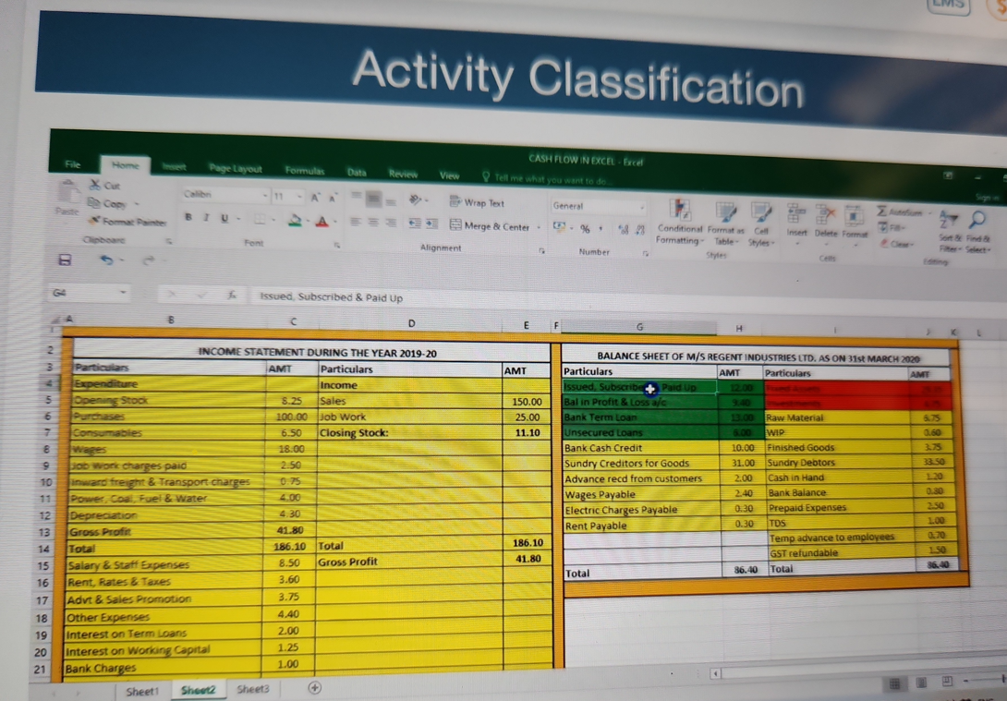

Slide 13
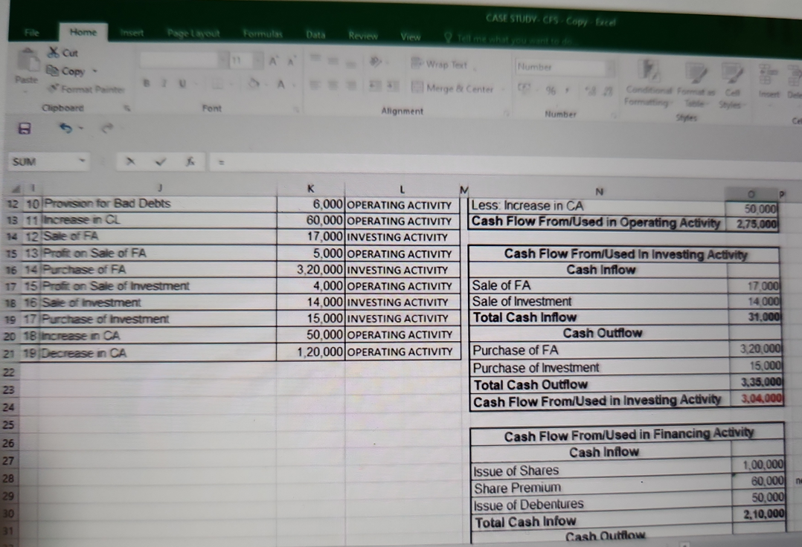

Slide 14
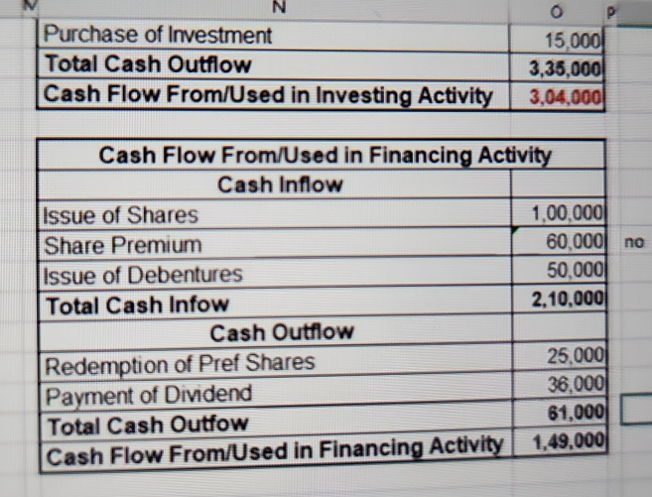

Slide 15
