Slide 1
The Master Budget
Notes:
Chapter 21 explains the master budget and responsibility accounting.

Slide 2
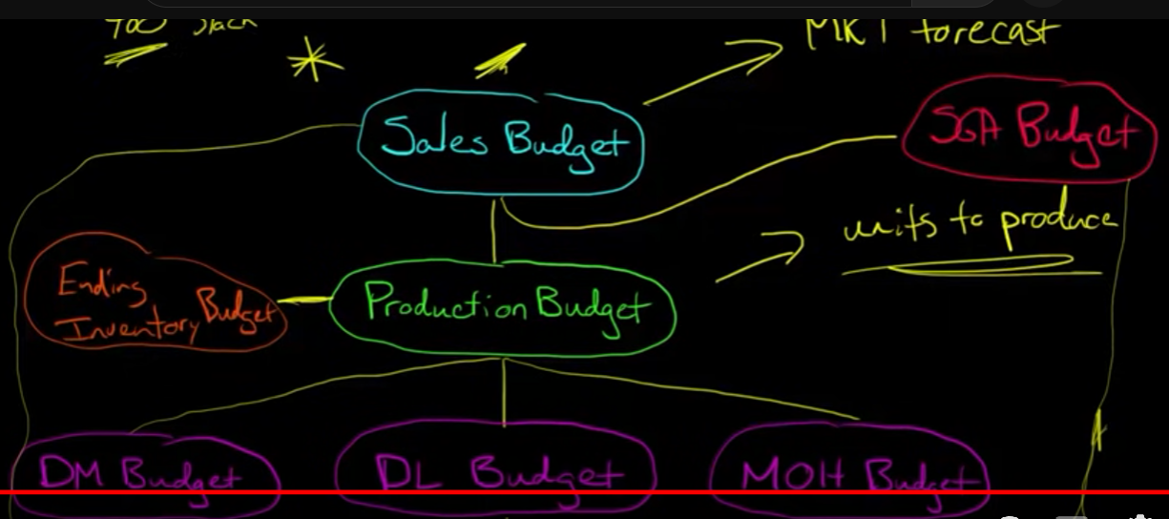

Slide 3
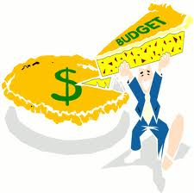
Learning Objective 1
Learn why managers use budgets
Notes:
The first learning objective explains why managers use budgets.

Slide 4
How Managers Use Budgets
Develop strategy
Plan
Act
Control
Notes:
Budgets help managers to plan and control actions and the related revenues and expenses. This diagram shows how managers use budgets in fulfilling their major responsibilities. First, they develop strategies—overall business goals. Companies then plan and budget for specific actions to achieve those goals. The next step is to act. After acting, managers compare actual results with the budget. This feedback allows them to determine what, if any, corrective action may be necessary.

Slide 5
Benefits of Budgeting
Forces managers to plan
Promotes coordination and communication
Provides a benchmark
Notes:
Budgeting forces managers to plan, promotes coordination and communication, and provides a benchmark for evaluating actual performance. The master budget coordinates a company’s activities. It forces managers to consider relationships among operations across the entire value chain. Budgets also communicate a consistent set of plans throughout the company. Budgets provide a benchmark that motivates employees and helps managers evaluate performance. In most companies, part of the managers’ performance evaluation depends on how actual results compare to the budget.

Slide 6
Learning Objective 2
Understand the components of the master budget
Notes:
The second learning objective is to understand the components of the master budget.

Slide 7
Master Budget
Set of budgeted financial statements and supporting schedules
Three types:
Operating
Capital expenditures
Financial
Notes:
The master budget is the set of budgeted financial statements and supporting schedules for the entire organization. The master budget includes three types of budgets:
1. The operating budget
2. The capital expenditures budget
3. The financial budget

Slide 8
Operating Budget
Sales budget
Inventory budget
Purchases and cost of goods sold budget
Operating expenses budget
Budgeted income statement
Notes:
The first component of the operating budget is the sales budget, the cornerstone of the master budget. Why? Because sales affect most other components of the master budget. After projecting sales revenue, cost of goods sold, and operating expenses, management prepares the end result of the operating budget: the budgeted income statement that projects operating income for the period.

Slide 9
Capital Expenditures and Financial Budgets
Budgeted income statement
Capital expenditures budget
Cash budget
Budgeted balance sheet
Budgeted statement of cash flows
Financial budget
Notes:
The second type of budget is the capital expenditures budget. This budget presents the company’s plan for purchasing property, plant, equipment, and other long-term assets.
The third type is the financial budget. Prior components of the master budget, including the budgeted income statement and the capital expenditures budget, along with plans for raising cash and paying debts, provide information for the first element of the financial budget: the cash budget. The cash budget, which projects cash inflows and outflows, feeds into the budgeted period-end balance sheet, which, in turn, feeds into the budgeted statement of cash flows. These budgeted financial statements look exactly like normal financial statements. The only difference is that they list budgeted (projected), rather than actual, amounts.

Slide 10
Learning Objective 3
Prepare an operating budget
Notes:
The third learning objective is to prepare an operating budget.

Slide 11
Sales Budget
Forecast of sales revenues
Cornerstone of master budget
Level of sales affects all elements
Budgeted total sales
Sales price
Expected number of units sold
Notes:
The forecast of sales revenue is the cornerstone of the master budget because the level of sales affects expenses and almost all other elements of the master budget. Budgeted total sales for each product are the sales price multiplied by the expected number of units sold.

Slide 12
Inventory, Purchases, and Cost of Goods Sold Budget
Cost of goods sold = Beginning inventory
+ Purchases – Ending inventory
Purchases = Cost of goods sold +
Ending inventory – Beginning inventory
Notes:
The purchases budget determines cost of goods sold for the budgeted income statement, ending inventory for the budgeted balance sheet, and purchases for the cash budget. The familiar cost of goods sold computation specifies the relations among these items, as shown in the first rectangle here.
Beginning inventory is known from last month’s balance sheet; budgeted cost of goods sold is a percent of sales; and budgeted ending inventory is a computed amount.
You must solve for the budgeted purchases figure. To do this, rearrange the previous equation to isolate purchases on the left side, as shown in the second rectangle on this slide.

Slide 13
Exercise 21-12
SALES BUDGET
 | Quarter ended |  |  | Nine-month total
 | March 31 | June 30 | Sept. 30
Cash sales 30% | $30,000 | $45,000 | $37,500 | $112,500
Credit sales 70% | 70,000 | 105,000 | 87,500 | 262,500
Total sales | $100,000 | $150,000 | $125,000 | $375,000
Notes:
Exercise 21-12 provides practice in preparing an operating budget. Swenson Inc. sells tire rims. Its sales budget for the nine months ended September 30 is shown here. This data will help us complete the purchases budget on the following slide.

Slide 14
Exercise 21-12 (continued)
Inventory, Purchases and Cost of Goods Sold Budget
 | March 31 | June 30 | Sept. 30 | 9-month total
Cost of goods sold
(60% of total sales) | $60,000 | $90,000 | $75,000 | $225,000
+ Desired ending inventory
($25,000 plus 10% next quarter’s cost of goods sold) | 34,000 | 32,500 | 37,000
Total inventory required | 94,000 | 122,500 | 112,000
- Beginning inventory | (11,000) | (34,000) | (32,500)
= Budgeted purchases | $83,000 | $88,500 | $79,500
Notes:
In the past, cost of goods sold has been 60% of total sales. The director of marketing and the financial vice president agree that each quarter’s ending inventory should not be below $25,000 plus 10% of cost of goods sold for the following quarter. The marketing director expects sales of $200,000 during the fourth quarter. The January 1 inventory was $11,000.
The first line of the budget is the cost of goods sold. Multiply the sales from the sales budget by 60%. Next, add desired ending inventory. Management wants to have inventory on hand of $25,000 plus 10% of next quarter’s cost of goods sold. For quarters one and two, we can look to the first line to determine next quarter’s cost of goods sold. For quarter three, multiply the fourth quarter’s estimated sales of $200,000 by 60%. Notice the nine-month total is the third quarter’s ending inventory, not a sum of the three quarters.
The first two lines are added together for the subtotal of total inventory required. From that subtotal, subtract beginning inventory. For the first quarter, it is an actual amount – January 1 inventory that is given in the problem. For quarters two and three, we use the previous quarter’s budget line. For the total column, we use the January 1 inventory again. Once that amount is subtracted, budgeted purchases is the result.

Slide 15
Operating Expense Budget
Expenses can be either fixed or variable
Includes items such as:
Salaries
Rent
Insurance
Advertising
Notes:
The operating expense budget shows estimated expenses for the period. Some expenses are fixed, like rent. Others are variable, like sales commissions.

Slide 16
Learning Objective 4
Prepare a financial budget
Notes:
The fourth learning objective is to prepare a financial budget.

Slide 17
Financial Budget
Cash Budget
Budgeted Balance Sheet
Budgeted Statement of Cash Flows
Notes:
The financial budget includes the cash budget, the budgeted balance sheet, and the budgeted statement of cash flows.

Slide 18
Cash Budget
Details how the business expects to go from the beginning cash balance to the desired ending balance
Four major parts:
Cash collections from customers
Cash payments for purchases
Cash payments for operating expense
Cash payments for capital expenditures
Notes:
The cash budget, or statement of budgeted cash receipts and payments, details how the business expects to go from the beginning cash balance to the desired ending balance. The cash budget has four major parts:
• Cash collections from customers
• Cash payments for purchases
• Cash payments for operating expenses
• Cash payments for capital expenditures
Cash collections and payments depend on revenues and expenses, which appear in the operating budget. This is why you cannot prepare the cash budget until you have finished the operating budget.

Slide 19
Parts of the Cash Budget
Cash collections from customers
Cash sales from the sales budget
Collections of previous month’s credit sales
Accounts receivable
Cash payments for purchases
Payment of current month purchases from the purchases budget
Payment of prior month purchases
Accounts payable
Notes:
Cash collections from customers come from two sources: cash sales and collections of accounts receivable. These amounts can be found on the sales budget. Cash payments for purchases also come from two sources: payments for current month purchases and payments on accounts payable from previous months’ purchases. These amounts can be found on the purchases budget.

Slide 20
Parts of the Cash Budget
Payments for operating expense
Use data from operating expense budget
Do not include noncash expenses such as depreciation
Payments for capital expenditures
Use budgeted data
Notes:
The data for cash payment for operating expenses comes from the operating expense budget. Remember to eliminate any noncash expenses. Cash payments for capital expenditures flows from the budget that is so-named.

Slide 21
Notes:
When all the pieces are put together, it forms a cash budget. The cash collections are added to the beginning balance, and the cash payments are subtracted to determine a preliminary cash balance. At this point, we see if the cash balance is above or below the minimum that management likes to have on hand. If it is below, the budget shows borrowing of the amount to reach the minimum. If it is above, any previous borrowing is paid off.

Slide 22
Exercise 21-14
(a)
Book value of equipment:
Cost | $22,000
Less: Accumulated depreciation | (7,000)
Book value |  | $15,000
Plus: Gain |  | 4,000
Expected cash receipt |  | $19,000
Notes:
Exercise 21-14 demonstrates preparing the financial budget. Agua Ole is a distributor of bottled water. Compute the amount of cash receipts or payments Agua Ole will budget for September.
Management expects to sell equipment that cost $22,000 at a gain of $4,000. Accumulated depreciation on this equipment is $7,000.
To compute the expected cash receipt for the sale of equipment, the gain is added to the book value. The book value is computed by subtracting the accumulated depreciation from the cost.

Slide 23
Exercise 21-14 (continued)
 | August | September
Expected sales in units | 7,800 | 9,100
Selling price | $13 | $13
Expected sales | $101,400 | $118,300
Cash sales (30%) | 30,420 | 35,490
Credit sales (70%) | 70,980 | 82,810
Cash sales |  | $35,490
September credit sales collected | 82,810 x ¾ | 62,108
August credit sales collected | 70,980 x ¼ | 17,745
Expected cash collections in September |  | $115,343
Notes:
b. Management expects to sell 7,800 cases of water in August and 9,100 in September. Each case sells for $13. Cash sales average 30% of total sales, and credit sales make up the rest. Three-fourths of credit sales are collected in the month of the sale, with the balance collected in the following month.
The first schedule starts with a sales budget. Then, the expected sales amounts are divided into cash sales and credit sales. The next schedule uses this information to compute expected cash collections in September. This consists of three items. First, the amount of September cash sales is brought down from the first schedule. Next, three-fourths of September’s credit sales are collected in the month of the sale. Last, one-quarter of August’s credit sales are collected in September.

Slide 24
Exercise 21-14 (continued)
Sales commissions & selling expenses
 | August | September
25% of sales | $25,350 | $29,575
Rent and property taxes | $4,000
Sales commissions & selling expense:
September: (9,100 x 13 x 25%) x 2/3 | 19,717
August: (7,800 x 13 x 25%) x 1/3 | 8,450
Expected cash payments for expenses | $32,167
Notes:
c. The company pays rent and property taxes of $4,000 each month. Commissions and other selling expense average 25% of sales. Agua Ole pays two-thirds of commissions and other selling expense in the month incurred, with the balance paid in the following month.
In the first schedule, the total amount of expected commissions and selling expenses is computed. The second schedule computes the total expected payments for expenses. The amount of rent and property taxes is provided. Sales commissions and selling expenses can be found by multiplying the fraction paid each month by the estimated expense amount from the first schedule.

