Slide 1
Lesson 6
Evaluate budget and
budgetary processes

Slide 2
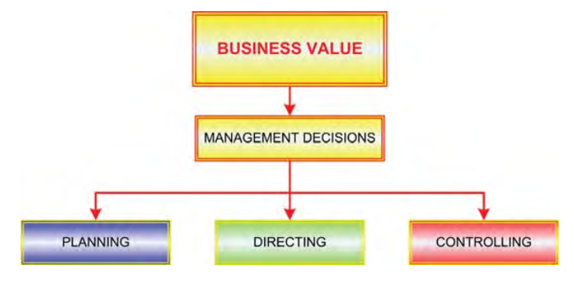
Decision Making
Notes:
The reality is that good decision making is rarely done by intuition. Consistently good decisions can only result from diligent accumulation and evaluation of information.
This is where managerial accounting comes in – providing the information needed to fuel the decision making process.

Slide 3
Business Process
Decision Making
Planning
Strategy
Positioning
Budgeting
Directing
Controlling
Notes:
The central theme to focus on is this:
(1) business value results from good management decisions, (2) decisions must occur across a spectrum of activities (planning, directing, and controlling), and (3) quality decision making can only consistently occur by reliance on information.

Slide 4
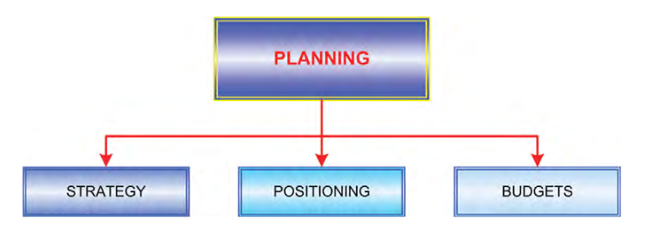
Planning
Notes:
A business must plan for success. What does it mean to plan? It is about thinking ahead – to decide on a course of action to reach desired outcomes. Planning must occur at all levels. First, it occurs at the high level of setting strategy. It then moves to broad-based thought about how to establish an optimum “position” to maximize the potential for realization of goals. Finally, planning must be undertaken from the perspective of thoughtful consideration of financial realities/constraints and anticipated monetary outcomes (budgets)

Slide 5
Strategy
Core Values
Mission
Notes:
It is difficult to see the linkage between strategic endeavors and the day-to-day corporate activities associated with delivering goods and services to customers. But, this strategic planning ultimately defines the organization. Specific strategy setting can take many forms, but generally, includes elements pertaining to the definition of core values, mission, and objectives.

Slide 6
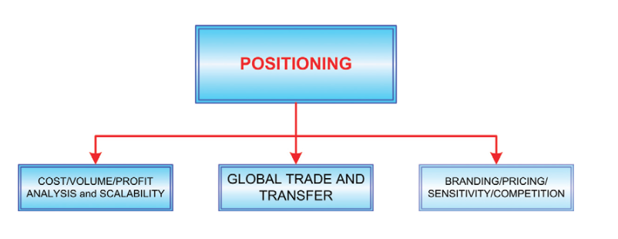
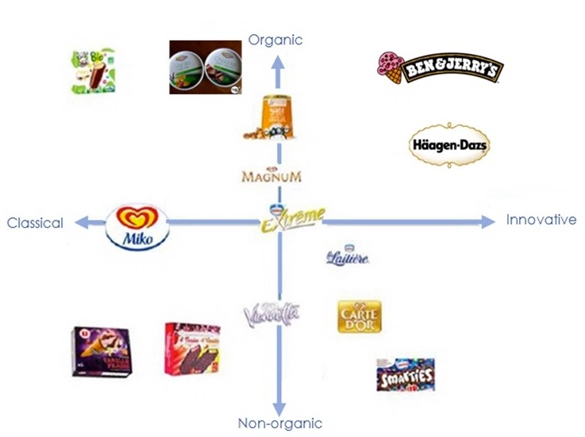
Positioning
Notes:
An important part of the planning process is positioning the organization to achieve its goals. Positioning
is a broad concept and depends on gathering and evaluating accounting information.
CVP - You will learn about calculating break-even points and how to manage to achieve target income levels.
Global Trade - The management accountant frequently performs significant and complex analysis related to global business activities. This requires in-depth research into laws about tariffs, taxes, and shipping.
Brand - To build a brand requires considerable investment with an uncertain payback. Frequently, the same product can be “positioned” as an elite brand via a large investment in up-front advertising, or as a basic consumer product that will depend upon low price to drive sales.

Slide 7
Budgets
Operating Budgets – A plan must provide definition of the anticipated revenues and expenses of an organization and more.
Capital Budgets – Operating budgets will also reveal the need for capital expenditures relating to new facilities and equipment.
Financial Budgets – A company must assess financing needs, including an evaluation of potential cash shortages. These tools enable companies to meet with lenders and demonstrate why and when additional support may be needed.

Slide 8
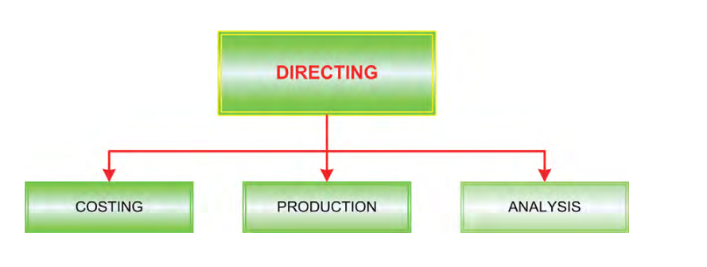
Directing
Notes:
Directing There are many good plans that are never realized. To realize a plan requires the initiation and direction of numerous actions. Often, these actions must be well coordinated and timed. Resources must be ready, and authorizations need to be in place to enable persons to act according to the plan. By analogy, imagine that a composer has written a beautiful score of music – the “plan.” For it to come to life requires all members of the orchestra, and a conductor who can bring the orchestra into synchronization and harmony. Likewise, the managerial accountant has a major role in putting business plans into action. Information systems must be developed to allow management to orchestrate the organization

Slide 9
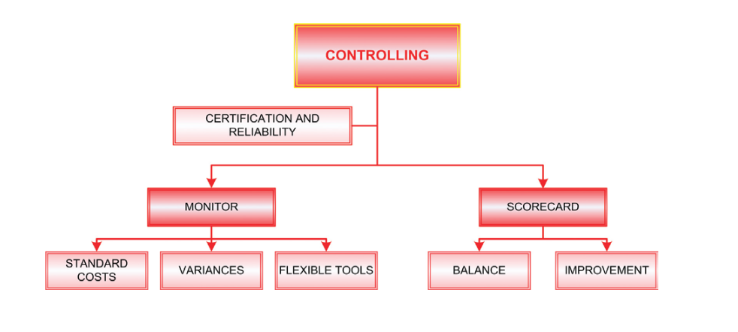
Controlling
Notes:
Certification - In addition, a recent trend (brought about in the USA by financial legislation most commonly known as Sarbanes-Oxley or SOX)
The controller - is primarily responsible for the control task; providing leadership for the entire cost and managerial accounting functions. In contrast, the chief financial officer (CFO) is usually responsible for external reporting, the treasury function, and general cash flow and financing management. In some organizations, one person may serve a dual role as both the CFO and controller.

Slide 10
Monitor
Let’s begin by having you think about controlling your car (aka “driving”)! Your steering, acceleration, and braking are not random; they are careful corrective responses to constant monitoring of many variables – other traffic, road conditions, destination, and so forth.
Clearly, each action on your part is in response to you having monitored conditions and adopted an adjusting response. Likewise, business managers must rely on systematic monitoring tools to maintain awareness of where the business is headed. Managerial accounting provides these monitoring tools, and establishes a logical basis for making adjustments to business operations.

Slide 11
Variances
Variances – Managers will focus on standards, keeping a particularly sharp eye out for significant deviations from the norm. These deviations, or “variances,” may provide warning signs of situations requiring corrective action by managers. Accountants help managers focus on the exceptions by providing the results of variance analysis. This process of focusing on variances is also known as “management by exception.”

Slide 12
Flexible tools
Flexible tools – Great care must be taken in monitoring variances. For instance, a business may have a large increase in customer demand. To meet demand, a manager may prudently authorize significant overtime. This overtime may result in higher than expected wage rates and hours. As a result, a variance analysis could result in certain unfavorable variances.

Slide 13
Standard Costing
Standard Costs – To assist in monitoring productive efficiency and cost control, managerial accountants may develop “standards.” These standards represent benchmarks against which actual productive activity is compared. Importantly, standards can be developed for labor costs and efficiency, materials cost and utilization, and more general assessments of the overall deployment of facilities and equipment (the overhead).

Slide 14
Scorecard
The traditional approach to monitoring organizational performance has focused on financial measures and outcomes. Increasingly, companies are realizing that such measures alone are not sufficient. For one thing, such measures report on what has occurred and may not provide timely data to respond aggressively to changing conditions. In addition, lower-level personnel may be too far removed from an organization’s financial outcomes to care. As a result, many companies have developed more involved scoring systems.

Slide 15
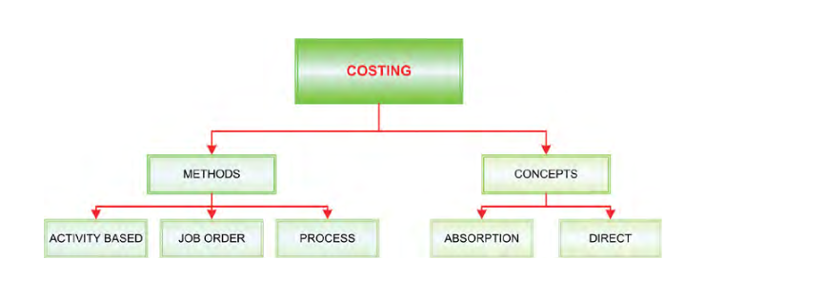
Costing
Notes:
Cost accounting can be defined as the collection, assignment, and interpretation of cost. In subsequent chapters, you will learn about alternative costing methods. It is important to know what products and services cost to produce. The ideal approach to capturing costs is dependent on what is being produced.
Costing Methods – In some settings, costs may be captured by the “job costing method.”
For example, a custom home builder would likely capture costs for each house constructed. The actual labor and material that goes into each house would be tracked and assigned to that specific home (along with some matching amount of overhead), and the cost of each home can be expected to vary considerably.

