Slide 1
Analysis of Task 3
Budgeting System

Slide 2
Case study – ExciteCo Task 3
Analysis 1
Analysis 2
Solution 1 (Student answer)
Solution 1 v2
Solution 2 (Student answer)
5 ways to be a good Financial Manager
Assignment Brief
Master Budget
Architechure

Slide 3
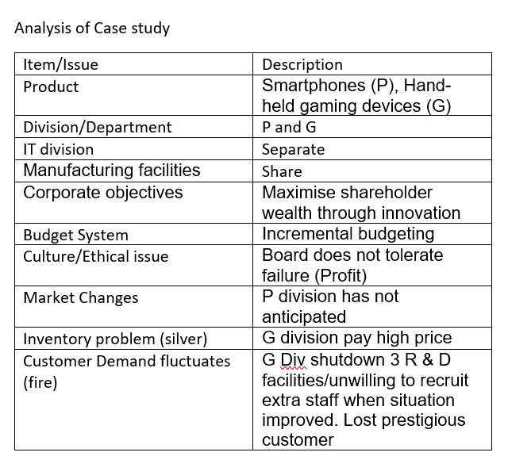

Slide 4
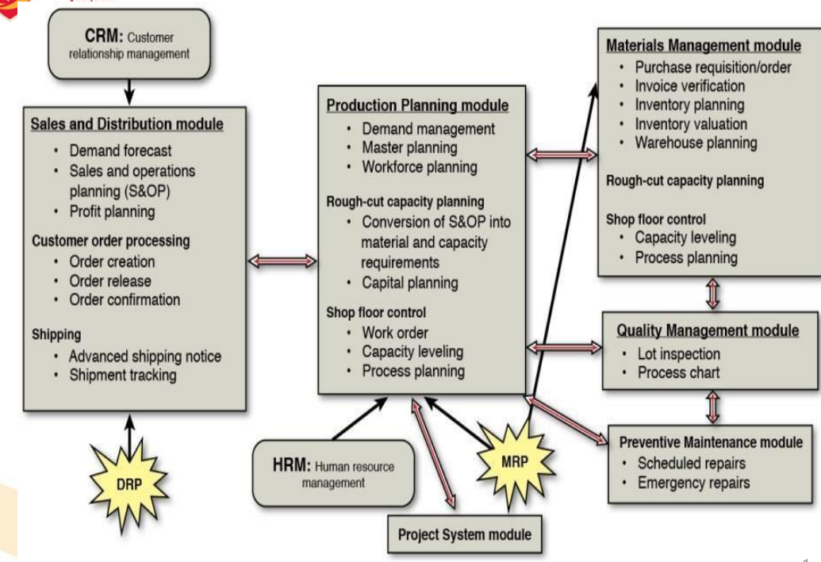
ERP Architechure

