Slide 1
Data Collection METHOD
Interviews

Slide 2
Introduction
Interviewing = verbal questioning
One of the most common methods of data collection
Interviews & Questionnaires together make up the Survey Method
Quantitative Researcher employ mostly standardised or semi-standardised forms
Qualitative Researcher employ mostly un-standardised forms such as intensive & focus interviewing

Slide 3
Types of Interviews
Structured & Unstructured
  Structured interviews employ structured questionnaires which are verbally presented to respondents, with answers recorded in the questionnaire by the interviewer.
  Strict adherence to the order & wording of the questions & the instructions is required.
  Interviewer is expected to perform “like a robot”.
  Response categories are fixed and prescriptive.
  Serves to reduce interviewer bias to a minimum & achieve the highest degree of objectivity & uniformity in procedure.
  This form of interview is employed in quantitative research.
  Unstructured interviews employ unstructured questionnaires containing a number of open-ended questions, whose wording & order can be changed at will.

Slide 4
Types of Interviews
Structured & Unstructured - cont
  Interviewer acts freely in this context.
  Structure of the interview is flexible & the restrictions minimal, in most cases taking the form of guides rather than rules.
  This form of interview is mostly used in qualitative and feminist research.
  Semi-structured interviews lie in between the two above types.
  Contain elements of both.
  The degree to which interviews are structured depends on the research topic and purpose.
  This form can be employed in qualitative, feminist or quantitative research.

Slide 5
Types of Interviews
Delphi interviews
  A version of ethnographic interview, employing a multi-stage ethnographic approach
  Interviewer questions persons who are experts in the area of study
  In such interview, respondents are asked to offer information, pass judgments on the issue in question, & make relevant predictions.
  The interviewer summarises this information in a logical & sociological context & offers a written summary to the experts for comments & discussion.
  This process is continued until the differences of opinion among the experts are reduced significantly.

Slide 6
Types of Interviews
Other Types
  Analytic interviews
  Biographical interviews
  Convergent interviews
  Diagnostic interviews
  Dilemma interviews
  Elite interviews
  Group interviews
  “Hard” interviews
  Telephone interviews

Slide 7
Interviews in Qualitative Research
Methodological parameters & technical elements are;
  Reflexivity
    Researchers reflect upon their subjective approach to the world
    Consider the implications of the knowledge they produce
  Naturalism
    Directed towards studying reality as it really is
  Primacy of the respondent
    Respondents are experts who provide valuable information.
  Absence of standardisation
    This allow freedom to respondents to express their views without external limitations

Slide 8
Interviews in Qualitative Research - cont
Methodological parameters & technical elements are;
  Openness
    Employ a readiness to change, to correct & adjust the course of study
  Flexibility
    Researcher follows the course that emerges through the interview
  Explication
    Findings emerge through the study & are interpreted during the process of interviewing

Slide 9
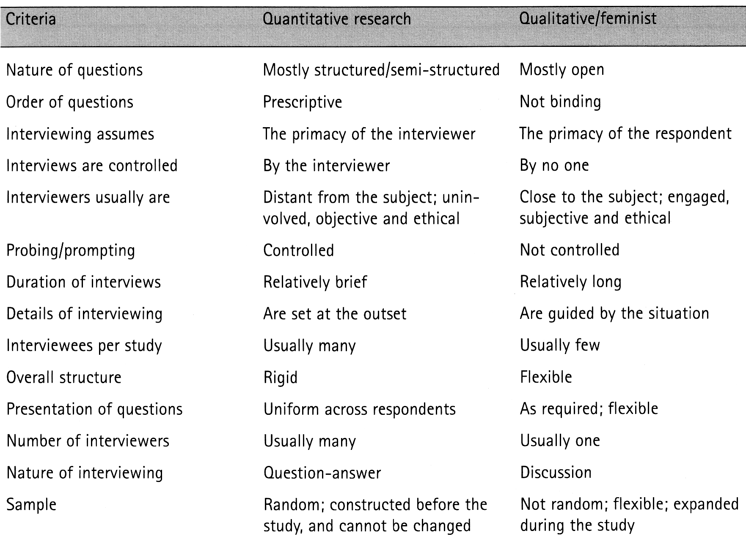
Comparison of Quantitative & Qualitative Interviews

Slide 10
The Interviewer - Tasks
Approach respondent & arrange time & date of interview
Conduct the interview
Control/guide the interview
Record the answer accurately
Observe ethical standards

Slide 11
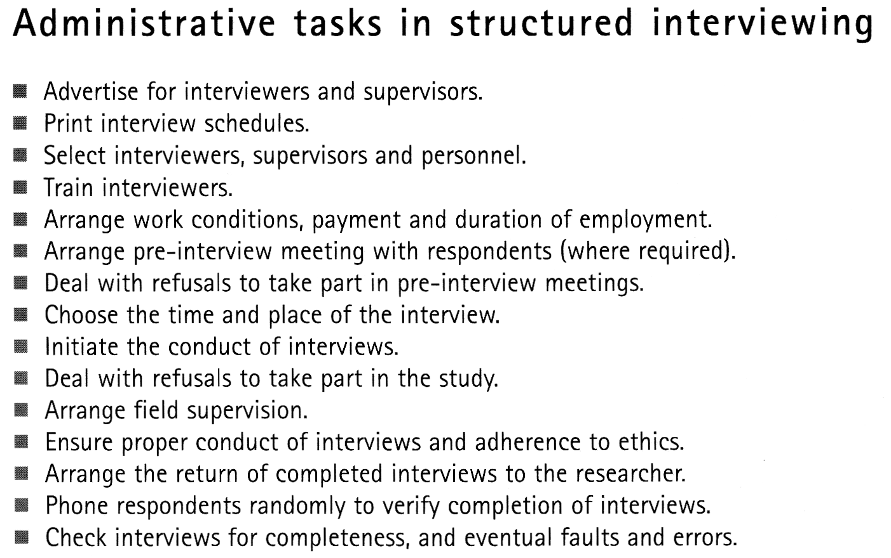

Slide 12
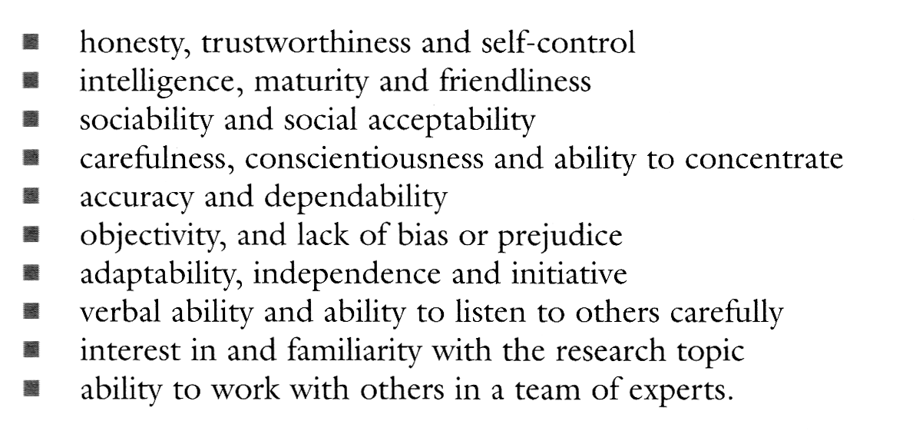
Interviewer Selection

Slide 13
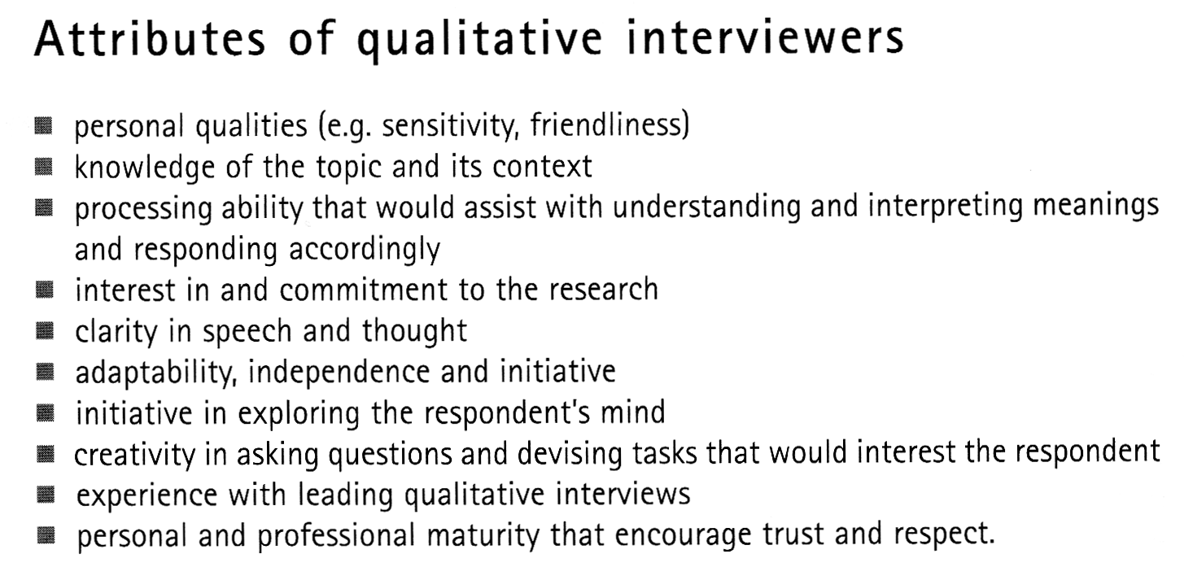

Slide 14
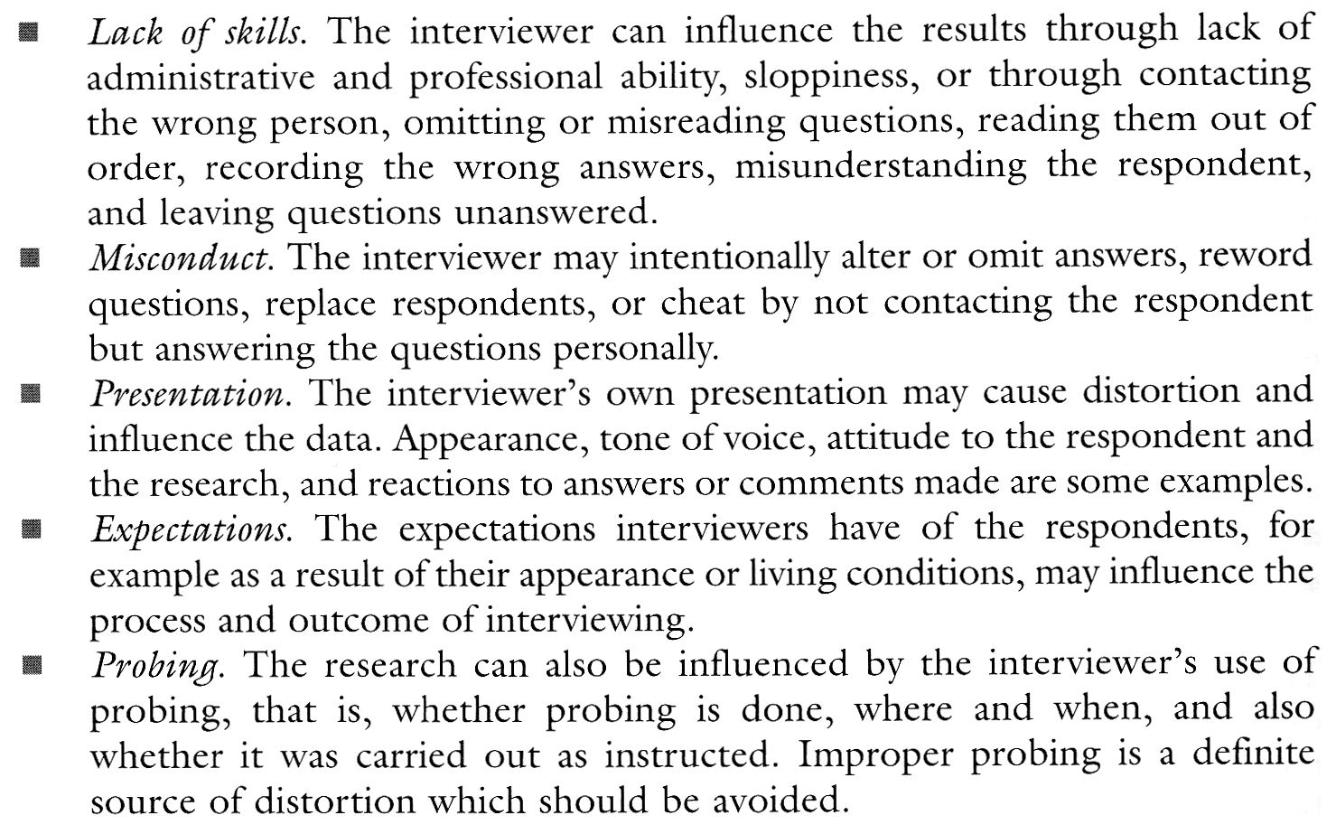
Interviewer Training – Factors to Address

Slide 15
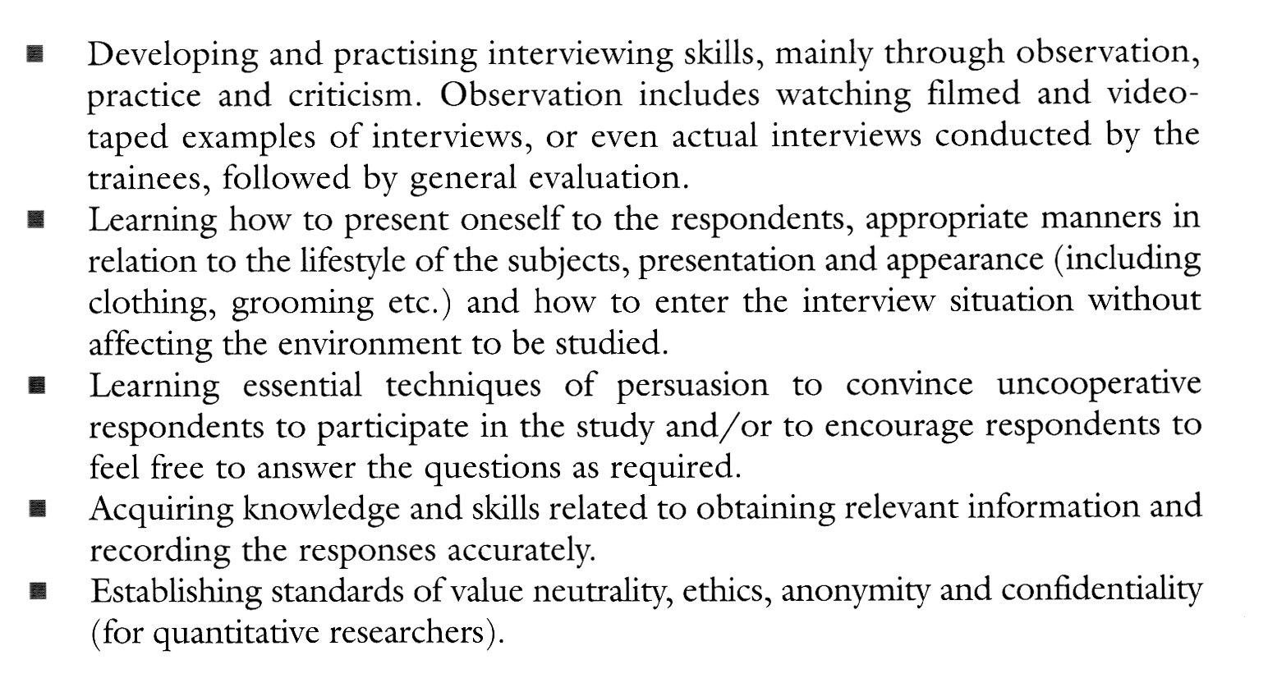
Interviewer Training Features

Slide 16
The Process of Interviewing
Finding Respondent
Conducting the Interview
  Always ensure session is within research scope
Ending the Interview
  Provide respondent with a feel that the contribution is highly appreciated.
Field Supervision and Checks
  Checks for bias, honesty, politeness, objectivity, ethics and interviewer-respondent relationships.

Slide 17
Probing and Prompting
Prompts = a part of a question that offers a list of possibilities
Probes = questions or neutral statements that encourage the respondents to extend or amplify a partial response
  “That’s interesting, tell me more about it!”
  “What do you mean by that?”
  “OK, this was you’re the first step …,”

Slide 18
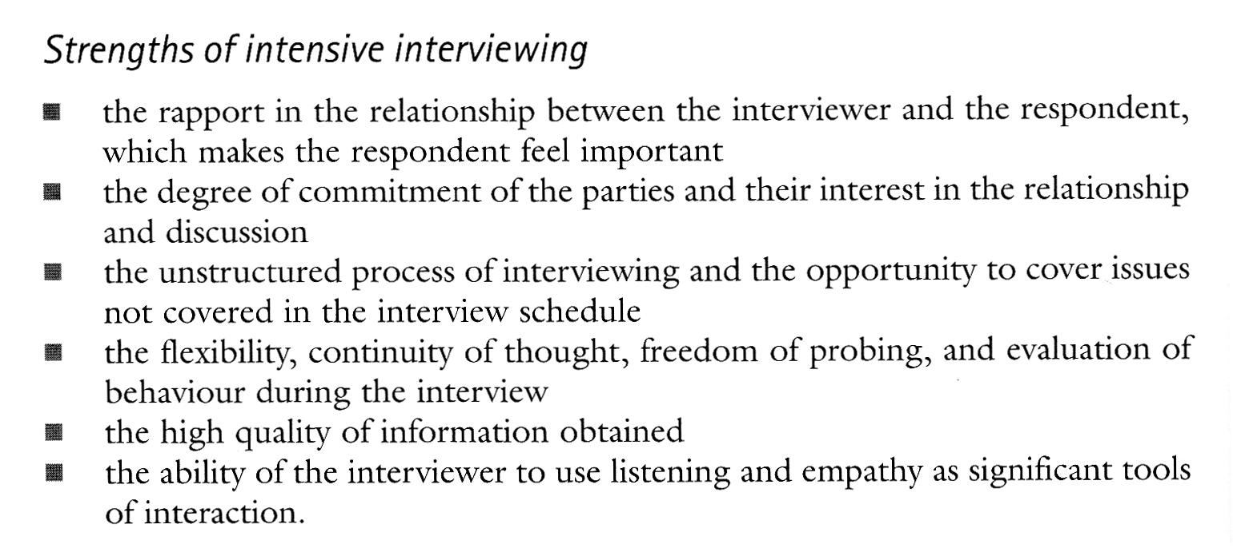

Slide 19
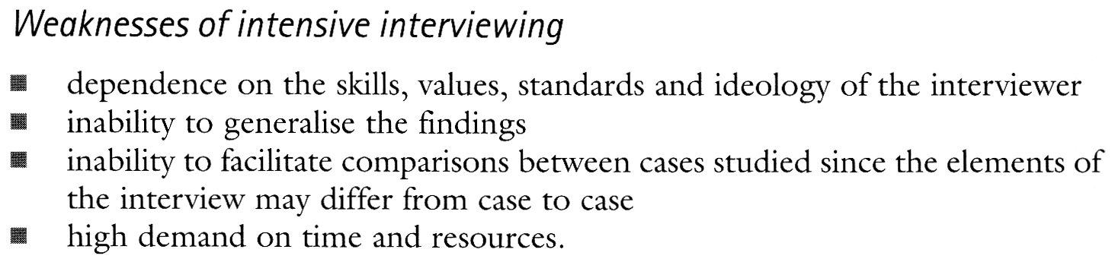

Slide 20
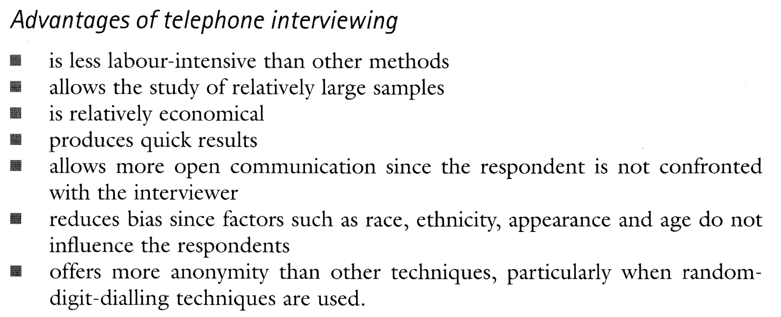

Slide 21
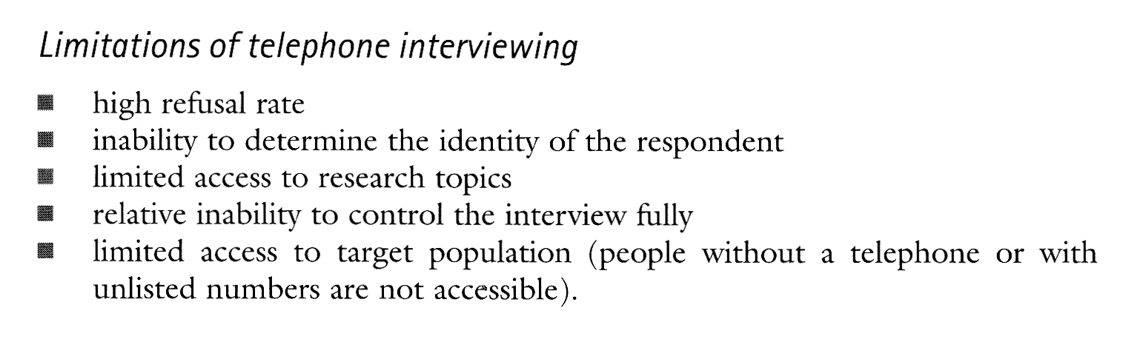

Slide 22
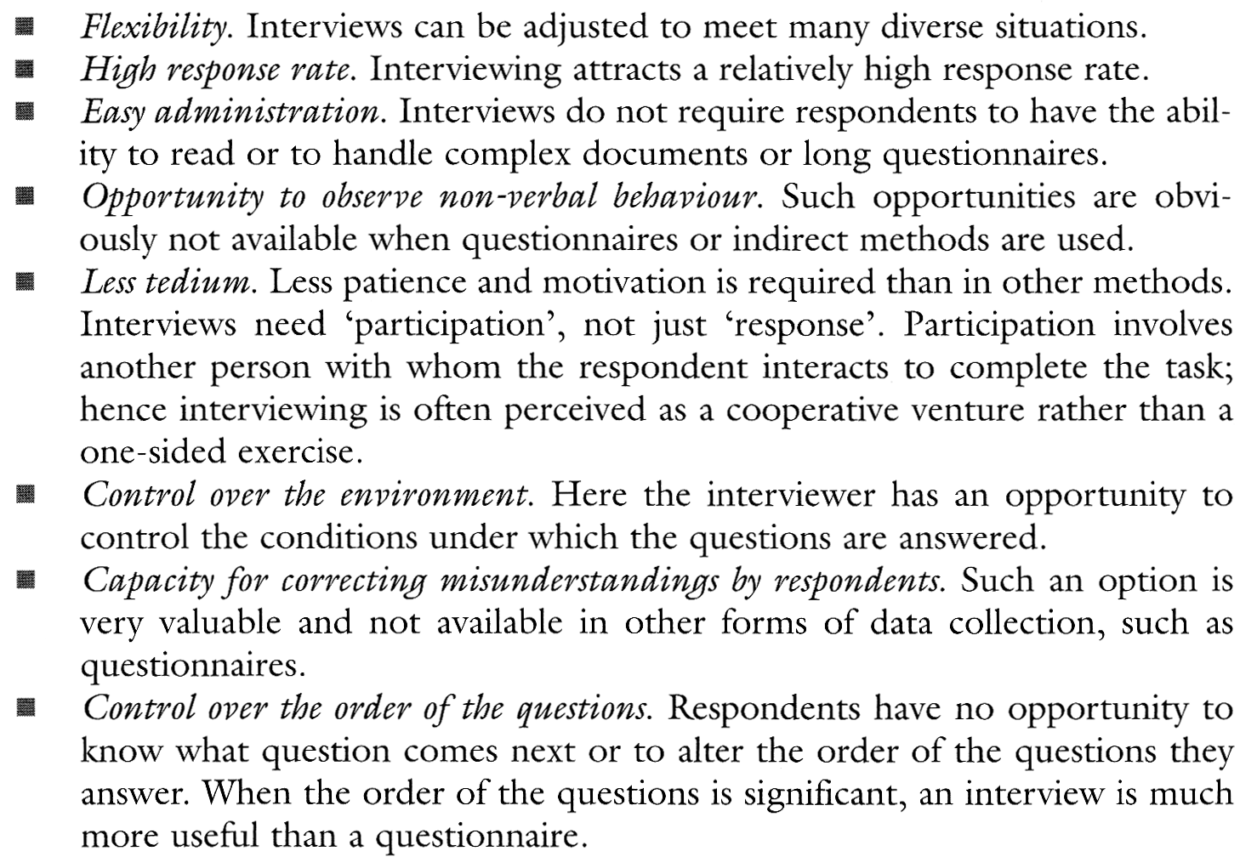
Advantages of Interviewing

Slide 23
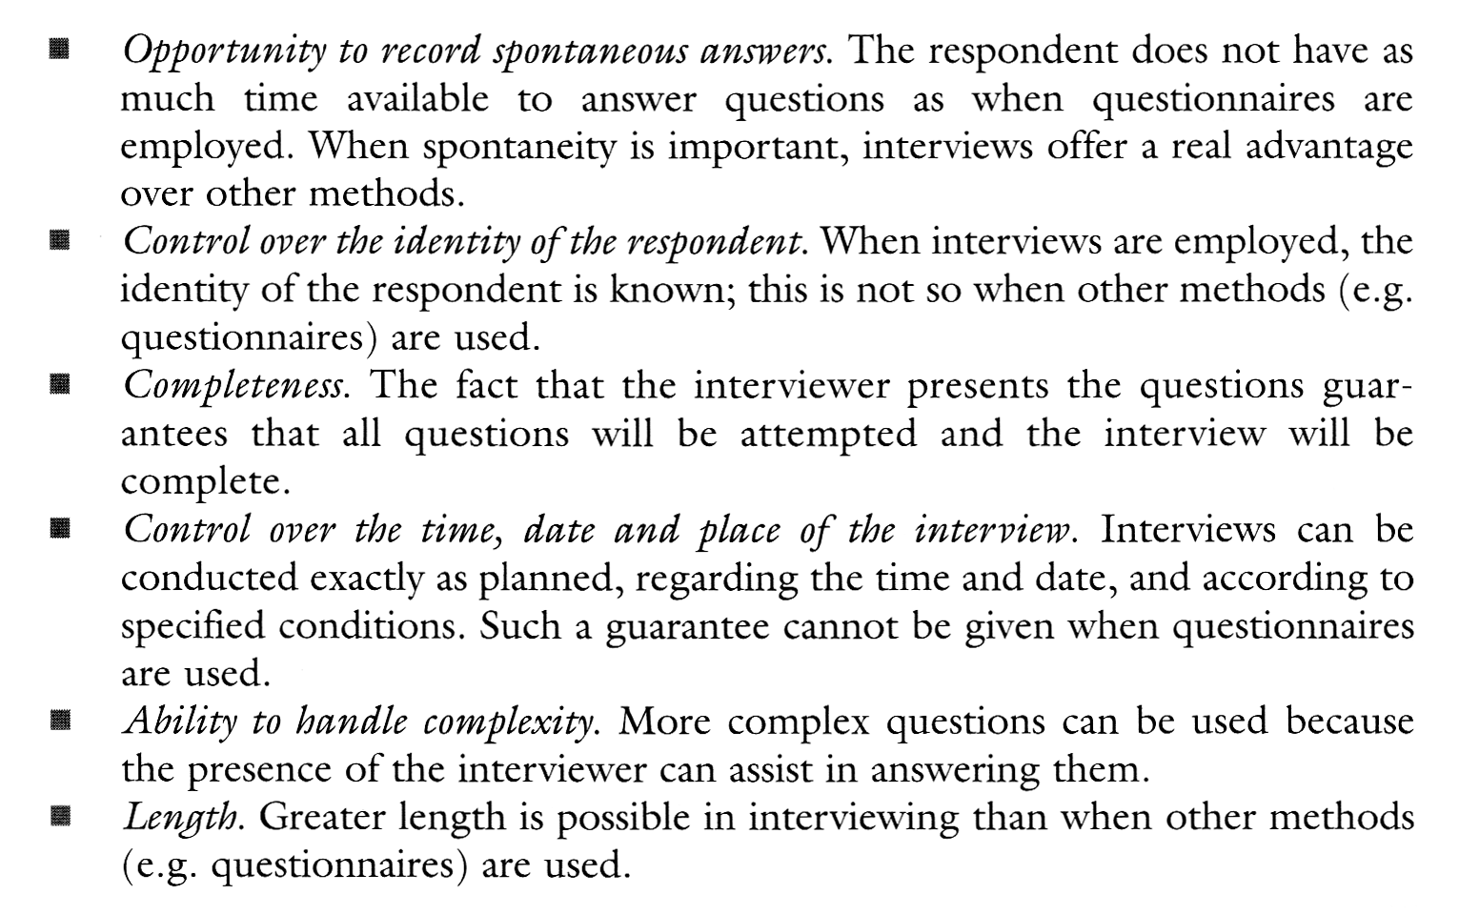
Advantages of Interviewing

Slide 24
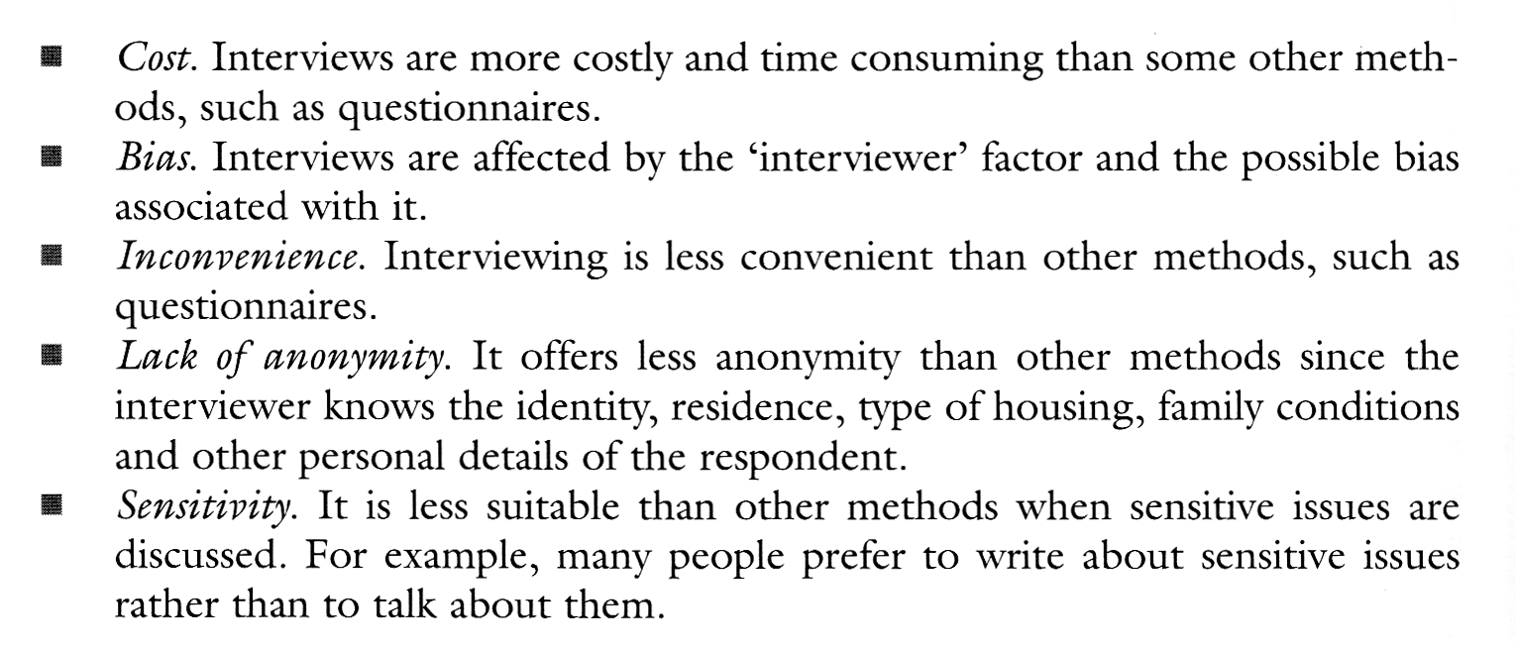
Disadvantages of Interviewing

Slide 25
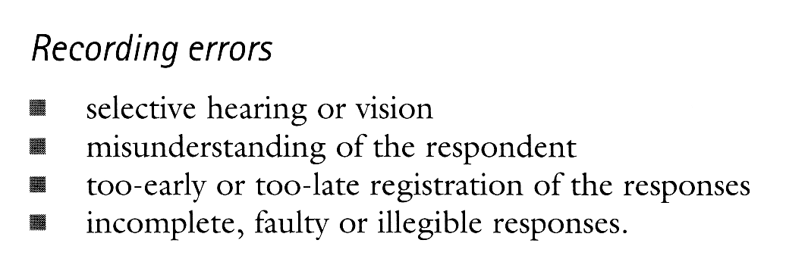
Problems & Errors in Interviewing

Slide 26
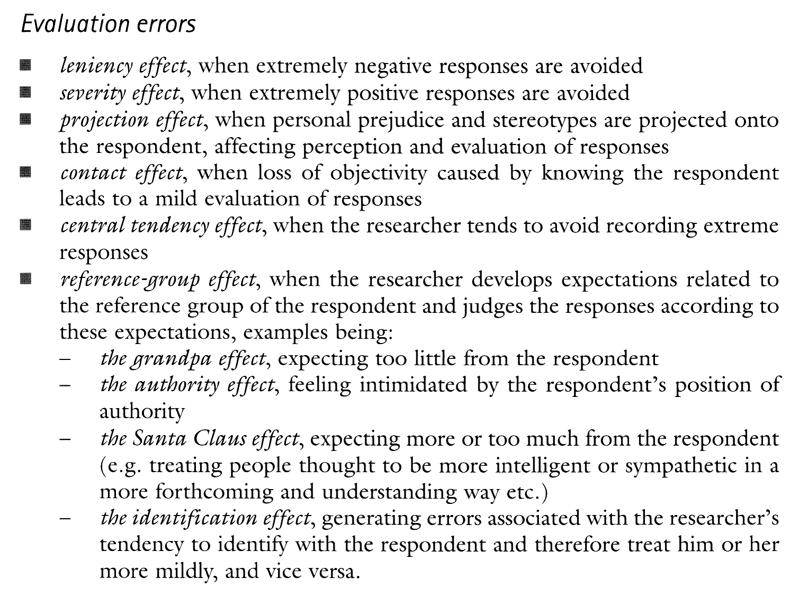
Problems & Errors in Interviewing

Slide 27
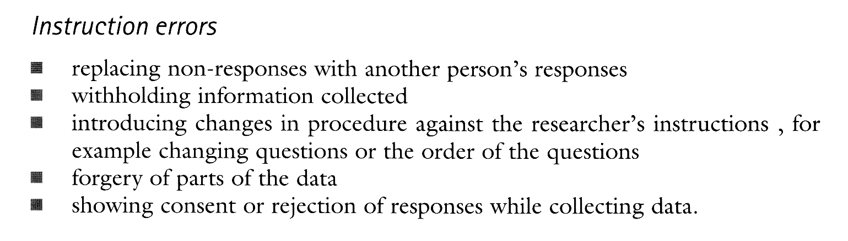
Problems & Errors in Interviewing

Slide 28
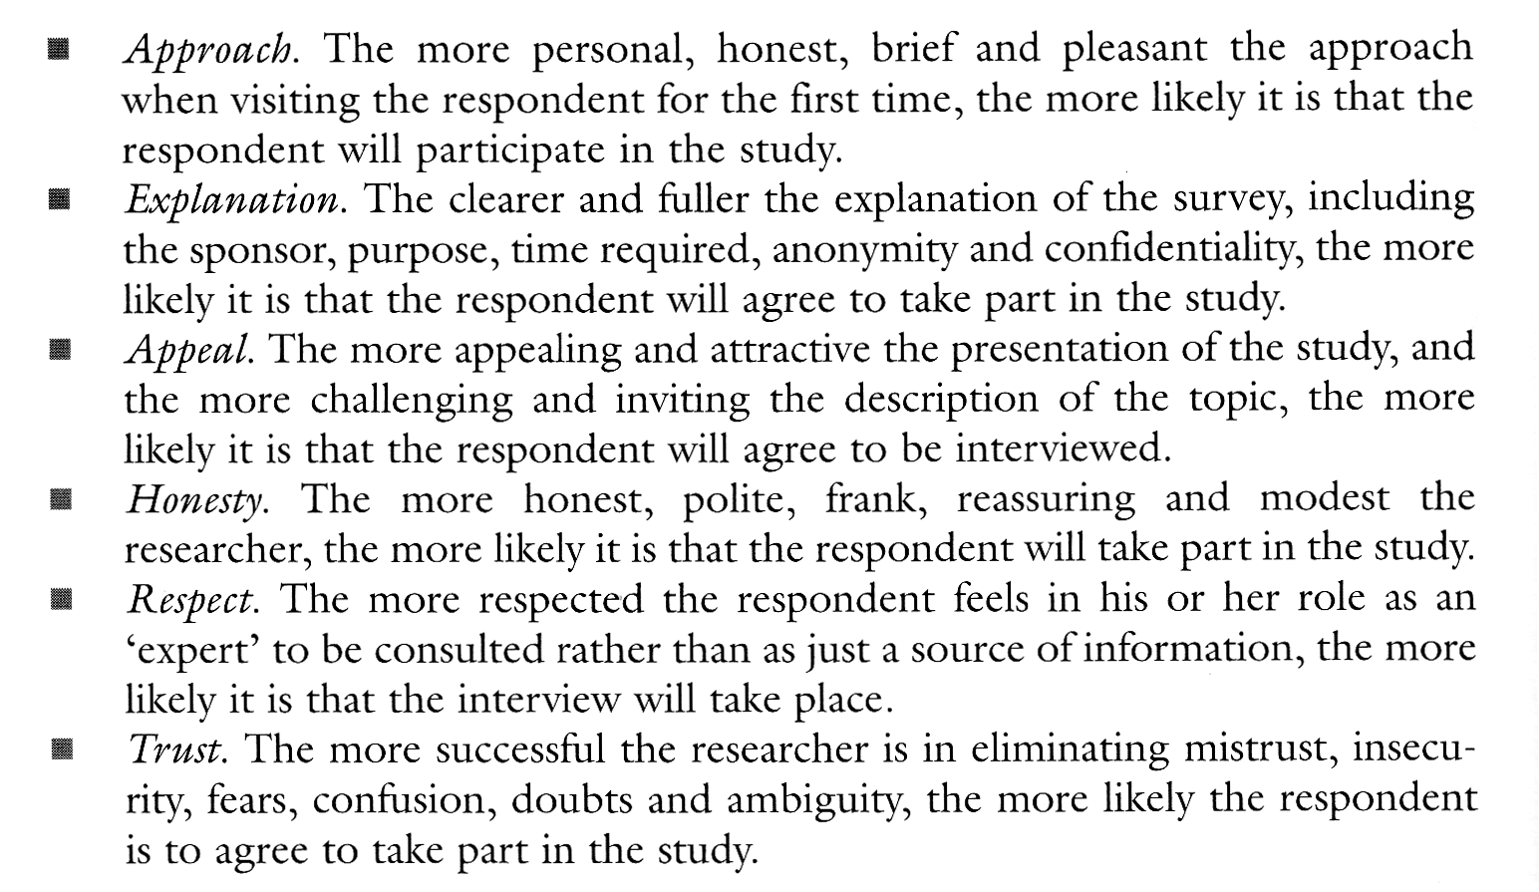
Non-Response in Interviewing

Slide 29
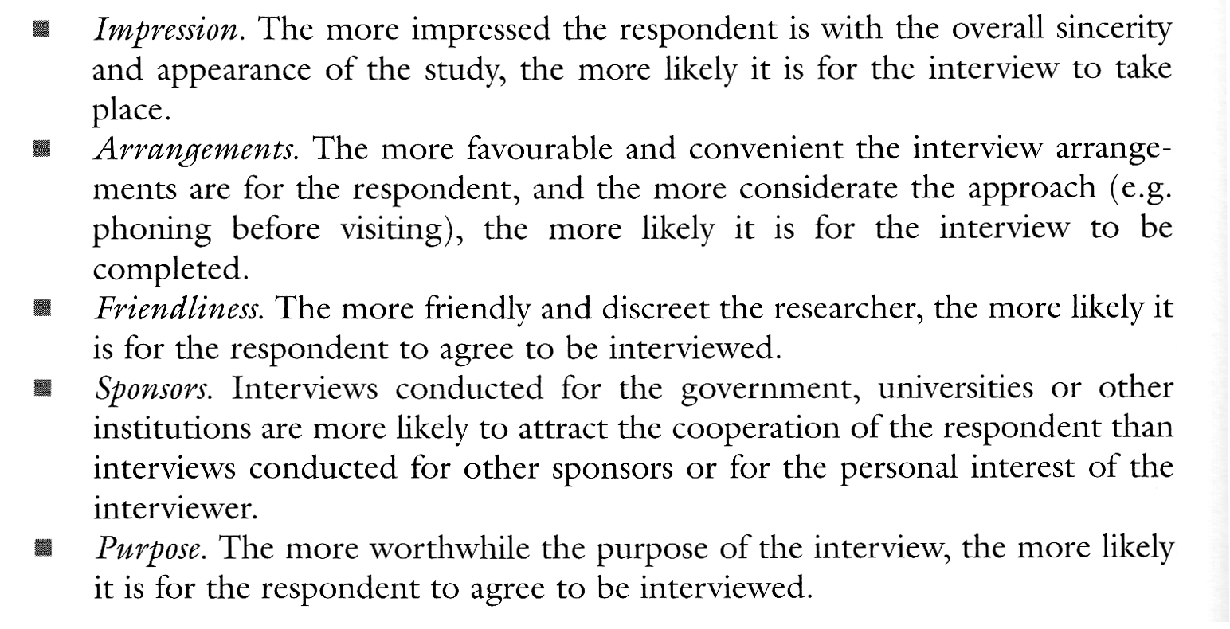
Non-Response in Interviewing

Slide 30
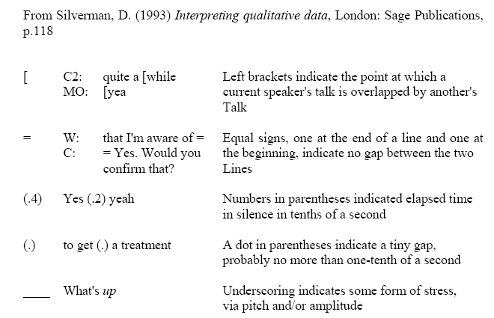
Transcription symbols

Slide 31
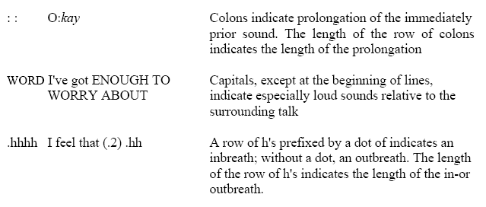
Transcription symbols

Slide 32
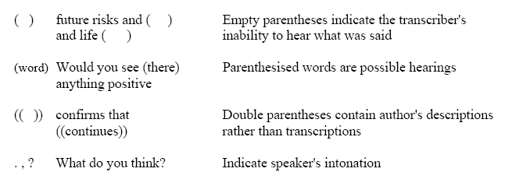
Transcription symbols

Slide 33
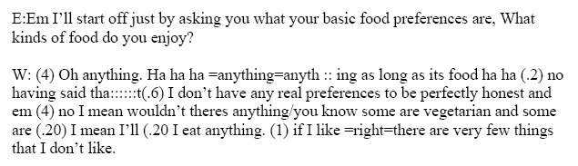
Transcription Example

Slide 34
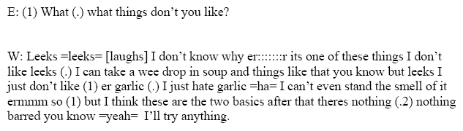
Transcription Example

Slide 35
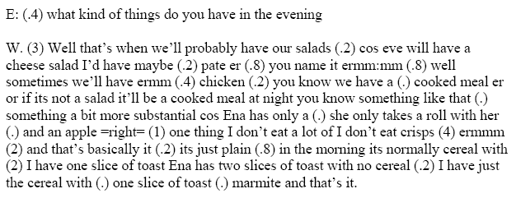
Transcription Example

Slide 36
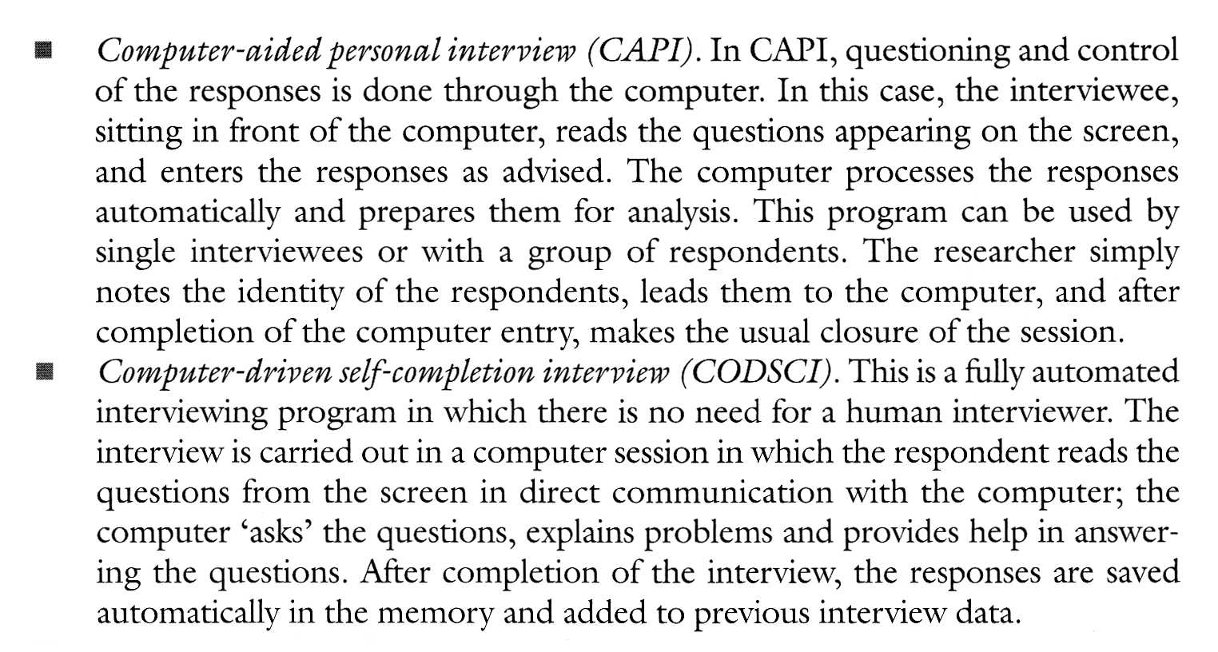
Interviewing in Computer Age

Slide 37
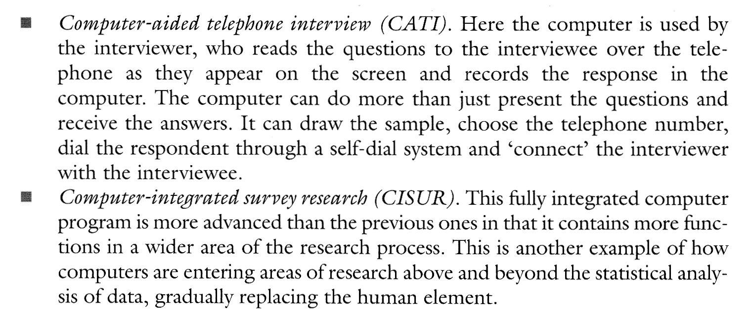
Interviewing in Computer Age

Slide 38
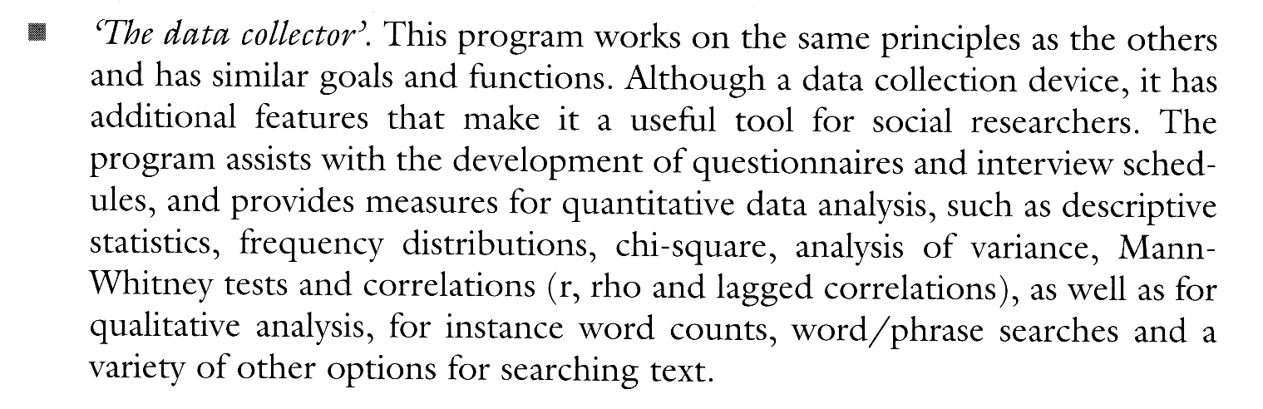
Interviewing in Computer Age

Slide 39
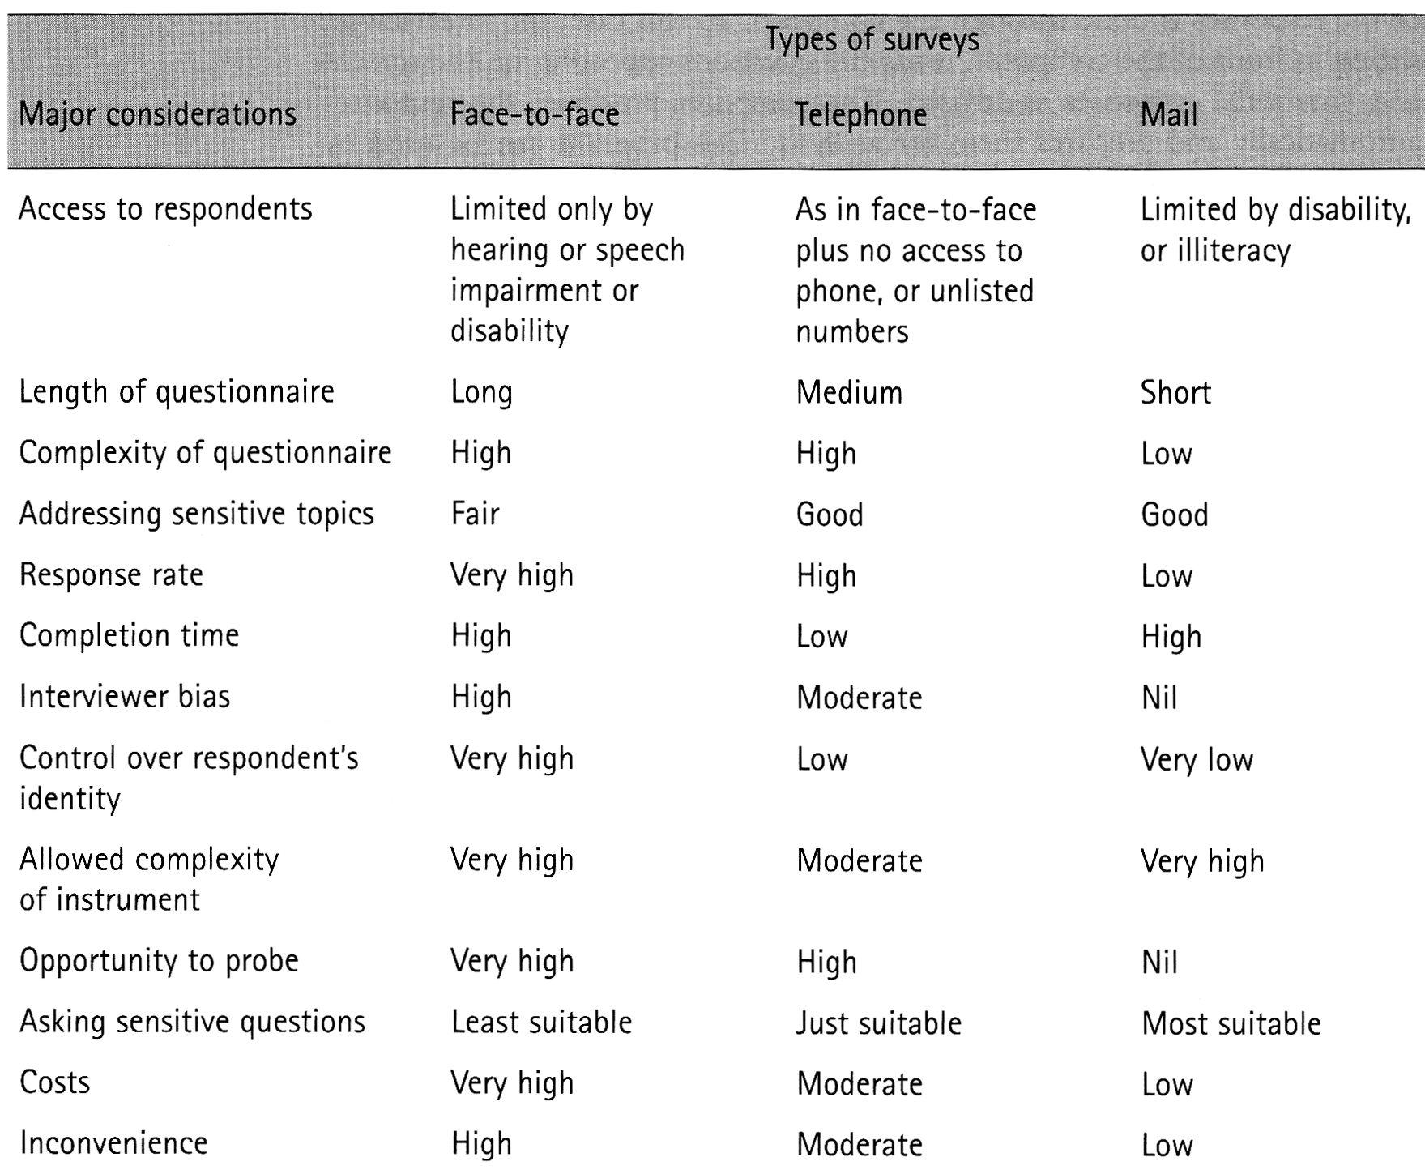
Survey Methods - Comparison

Slide 40
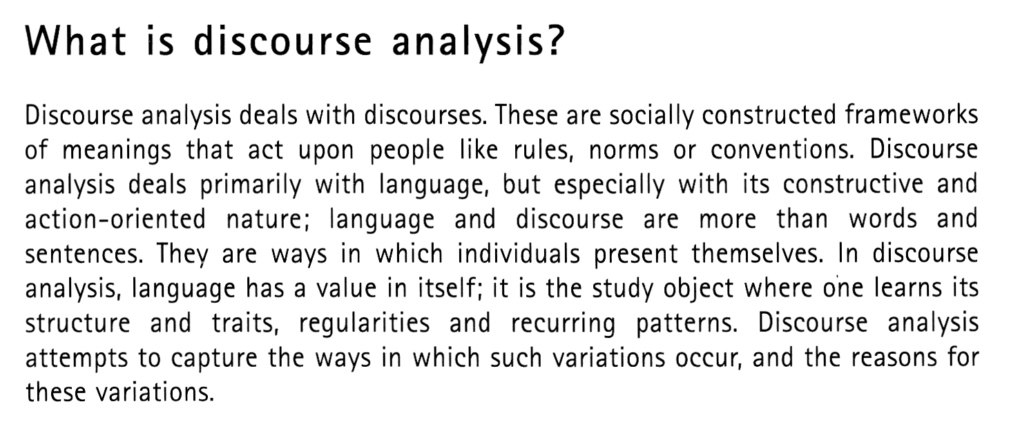

Slide 41
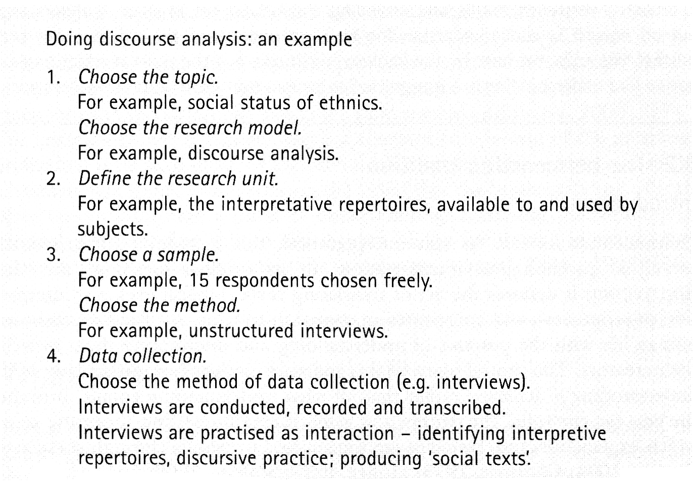

Slide 42
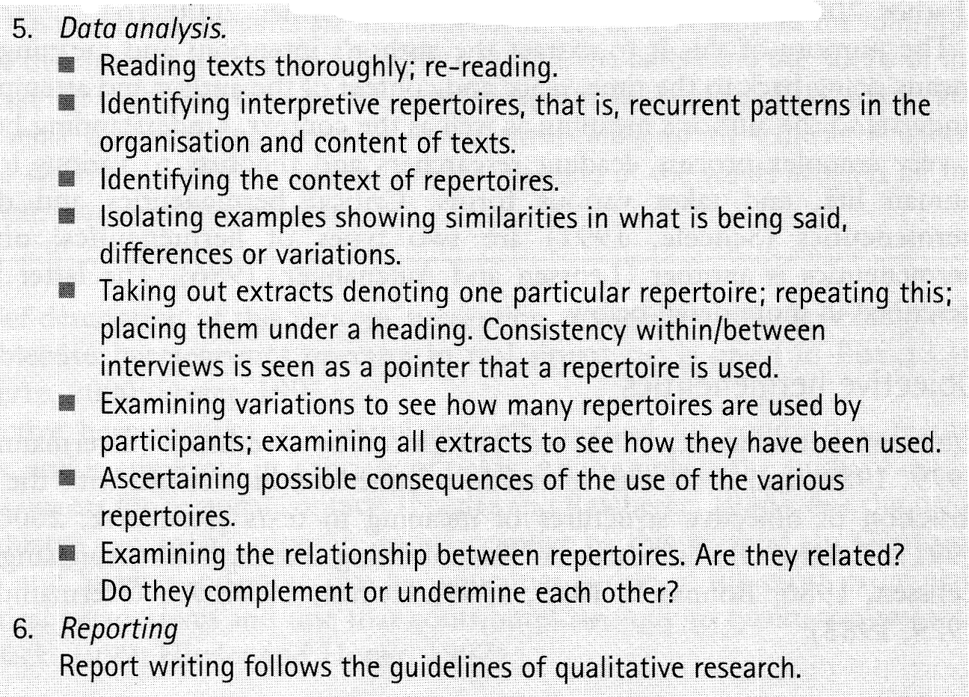

Slide 43
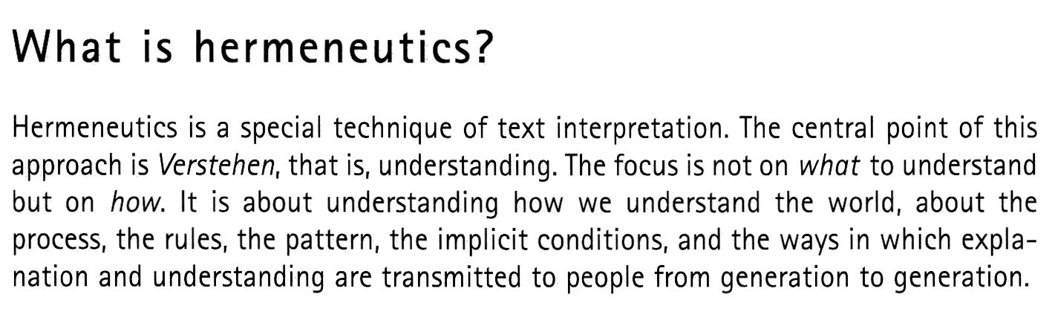

Slide 44
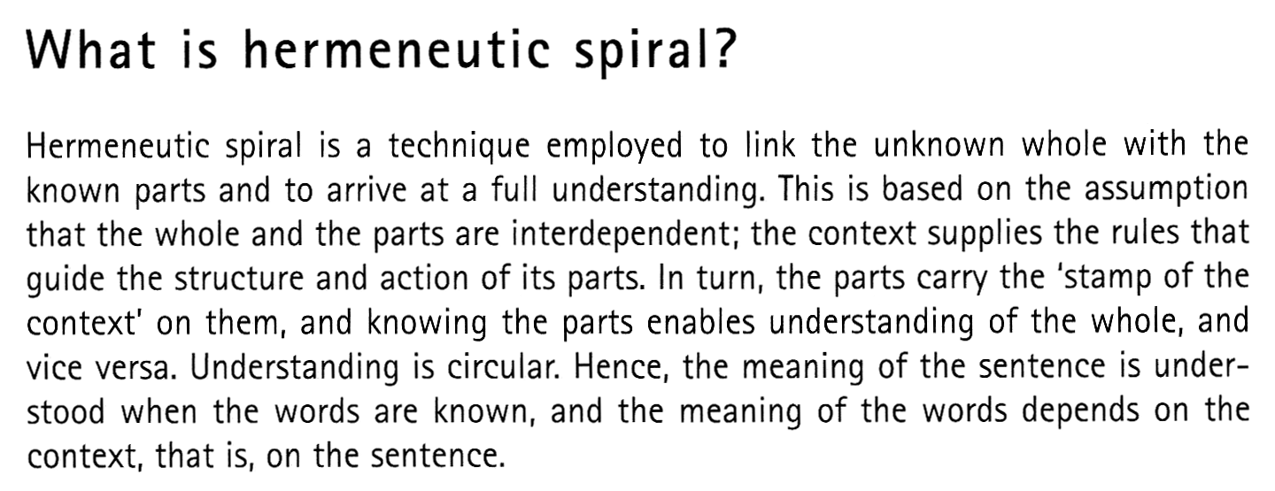

Slide 45
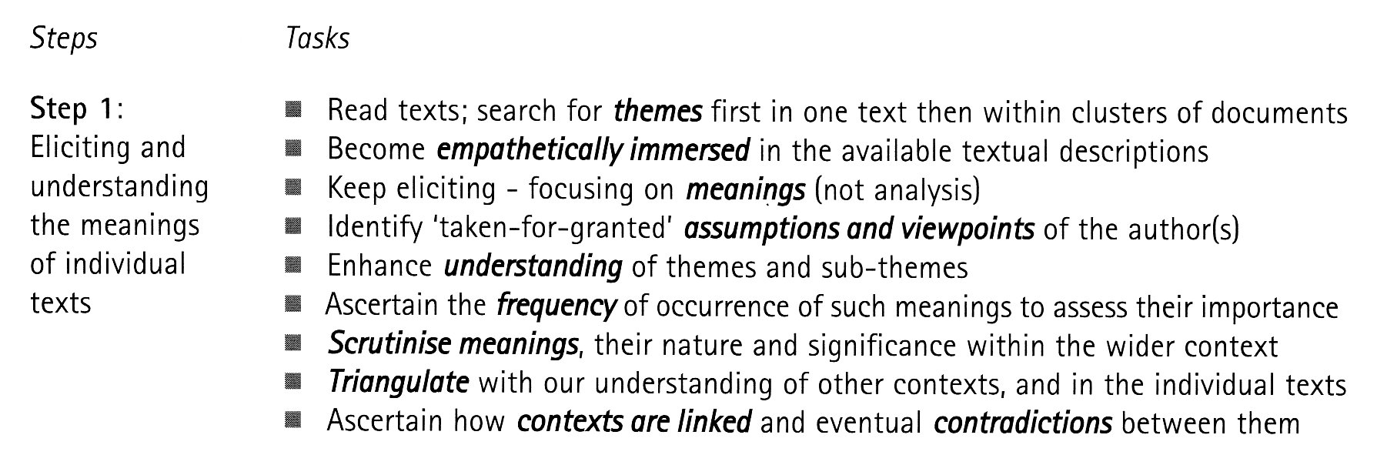
Hermeneutic Spiral

Slide 46
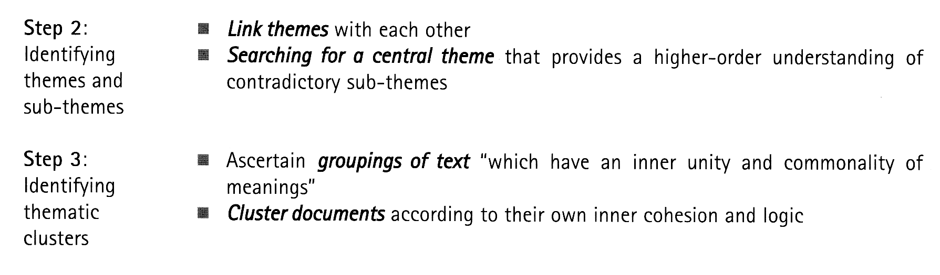
Hermeneutic Spiral

Slide 47
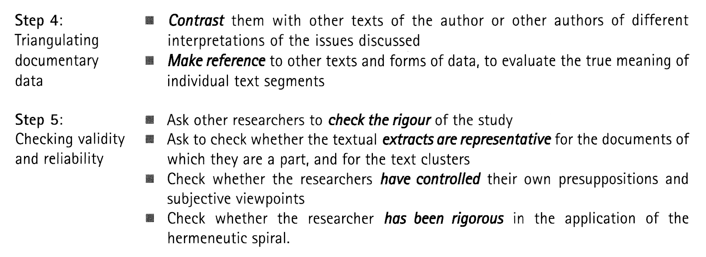
Hermeneutic Spiral

Slide 48
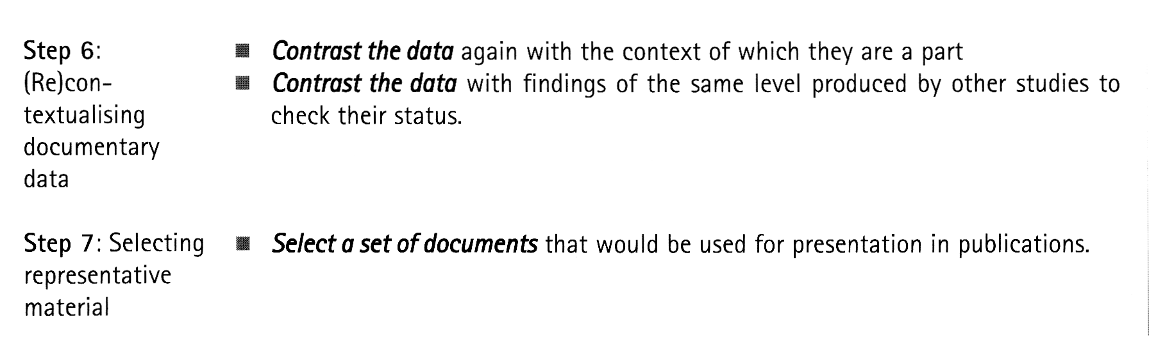
Hermeneutic Spiral

