Slide 1
Downloading SPSS
Step by Step
Using
Xunlei & Internet Download Manager

Slide 2
Download Process for chinese speaking students
Search Engine: Gougou.com
Download Client: Thunder (Xunlei)
Browser: Firefox 2.0

Slide 4
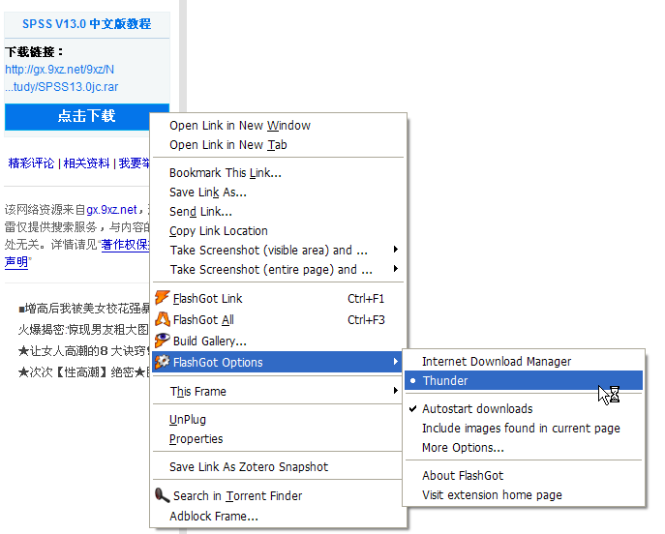
Step 3: Select your download client here

Slide 5
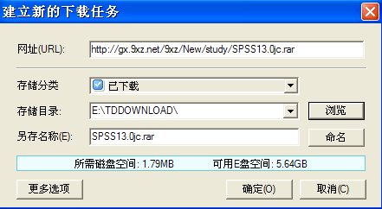
Step 4: Fire up your Thunder client to download

Slide 6
Download Process for non-chinese speaking students
Browser : Firefox 2.0
Firefox Add-on: Torrent Finder
Download Client: Internet Download Manager
Assumption: Firefox 2.0 is installed

Slide 7
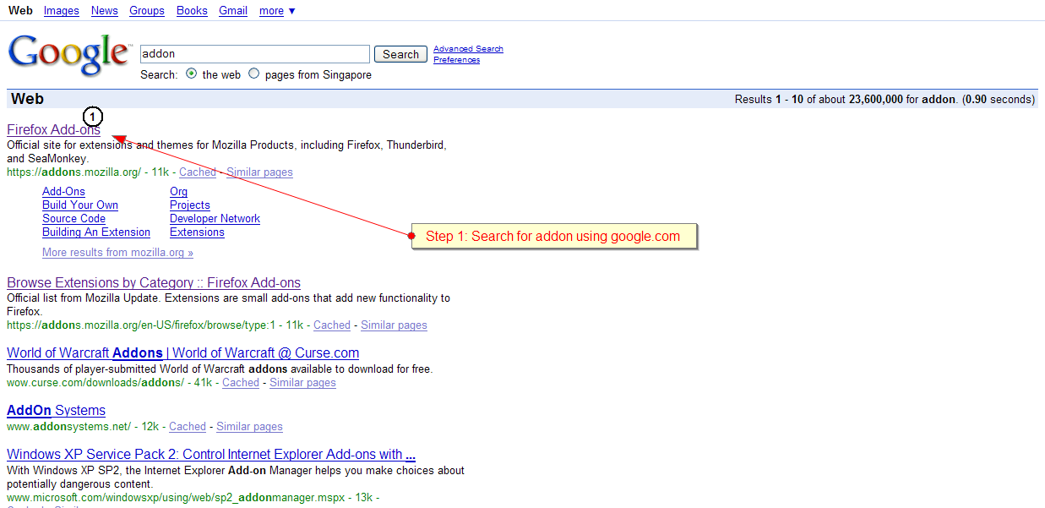

Slide 8
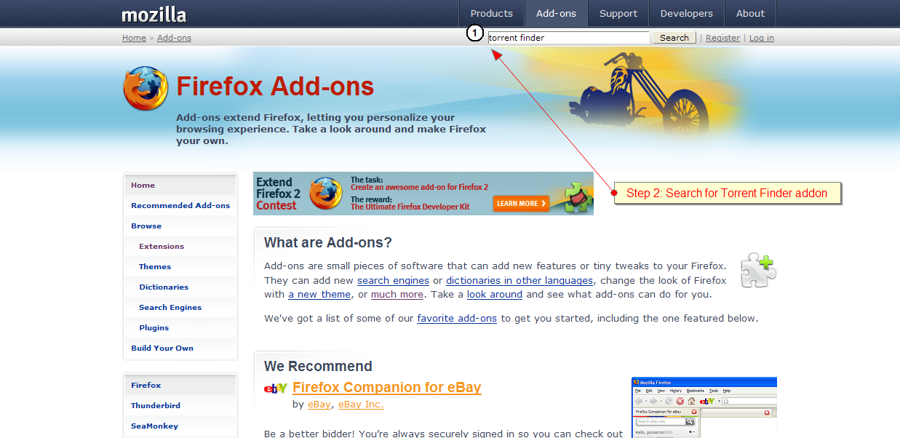

Slide 9
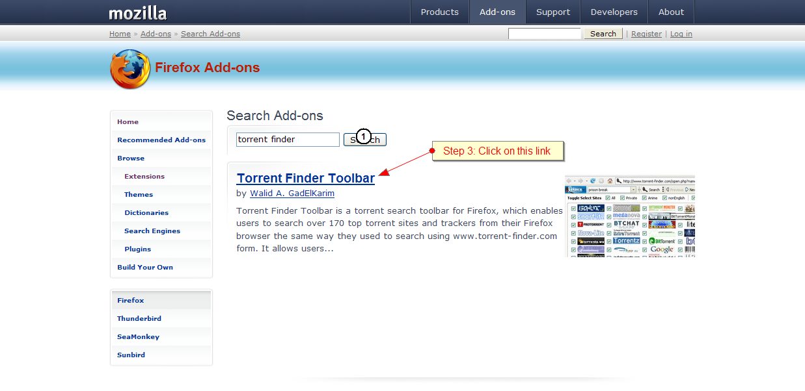

Slide 10
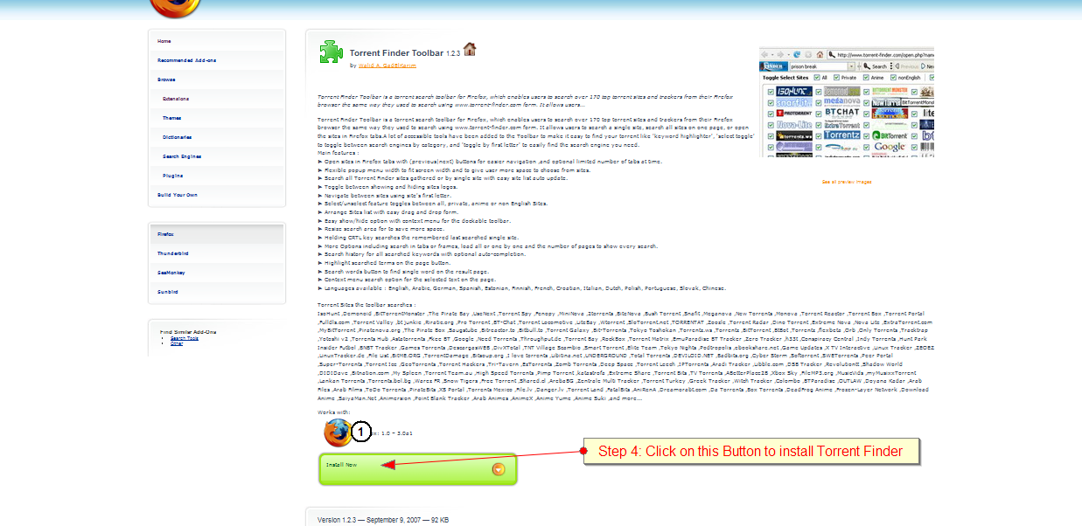

Slide 11
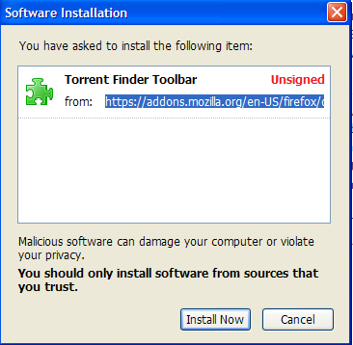
Step 5: Click here to install

Slide 12
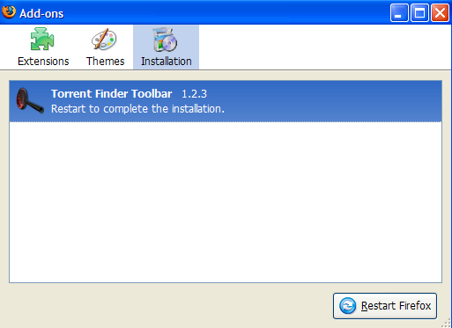
Click to restart firefox browser

Slide 13
Torrent Finder bar is installed

Slide 14
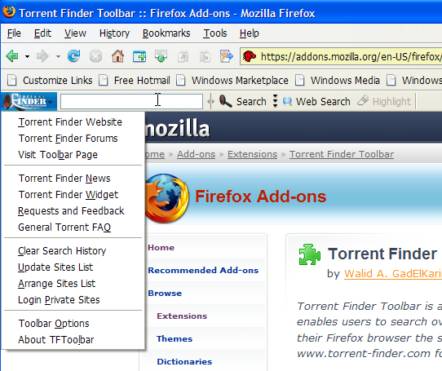
Step 6: Select Torrent Finder Website

Slide 15
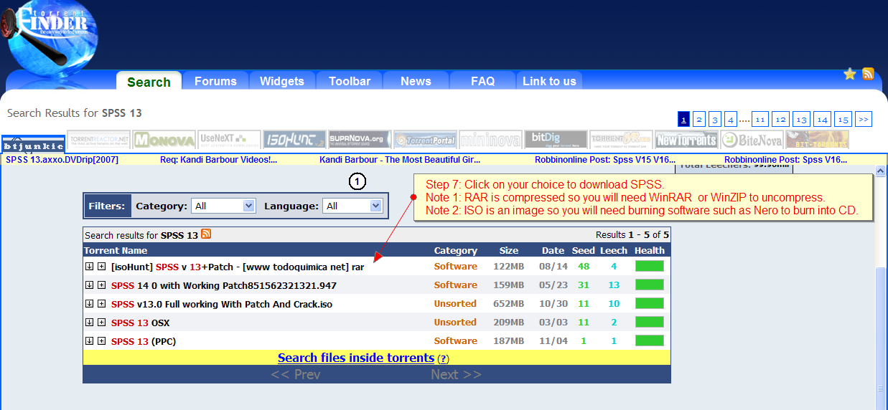

Slide 16
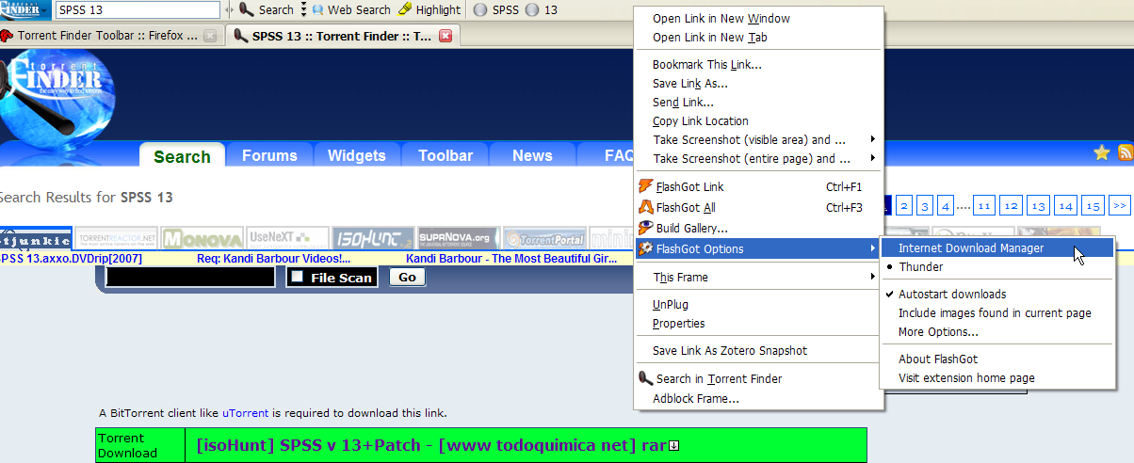
Step 8: Select IDM

Slide 17
Using Internet Download Manager
Step 9: Click here to start download

