Slide 1
Research Methods Tutorial 3
Data Validity & Reliability
Survey Ethics

Slide 2
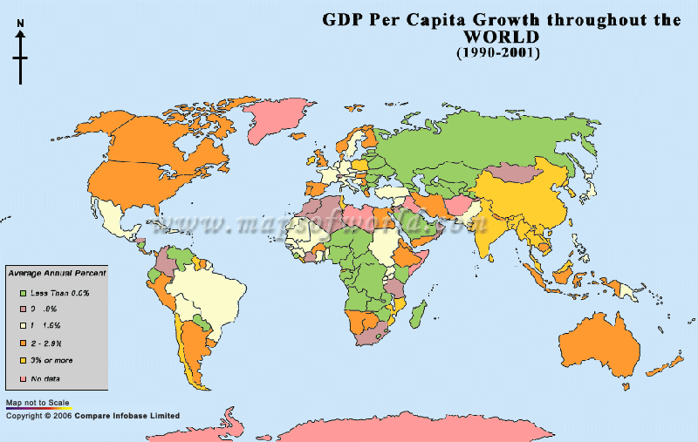
Show the class where is ….

Slide 3
Now see this survey. Is the data collection valid & reliable?

