Slide 1
Personality Test
John Holland
Self Directed Search

Slide 2
6 Personalities (Career Clusters)

Slide 3
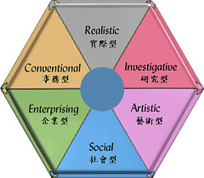
RIASEC

Slide 4
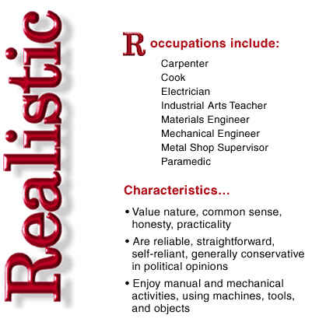
Realistic – Do-ers

Slide 5
Realistic – Do-ers
Doers describe themselves as:
reliable, self-reliant, competent, stable, straightforward, honest, natural, practical and thrifty.
Their working style:
in interactions with others they prefer to get to the point, do not like lengthy negotiations, want to know what needs to be done and be left alone to do the job and do it right the first time.

Slide 6
Investigative - Thinkers

Slide 7
Investigative - Thinkers
Thinkers describe themselves as:
self-determined, intelligent, curious, logical, precise, analytical, reserved, independent and rational.
Their working style:
prefer to work alone, ask for and provide a lot of detail before coming to a conclusion, want to know the reasons behind decisions and prefer information to be presented in a logical and linear fashion.

Slide 8
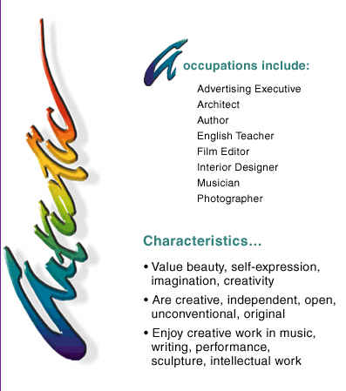
Artistic - Creators

Slide 9
Artistic - Creators
Creators describe themselves as:
creative, emotional, expressive, imaginative, independent, idealistic, open, original, unconventional and tolerant.
Their working style:
prefers a creative approach to problem solving and planning, rely heavily on intuition and imagination and enjoy being given a free reign to discover possible solutions to problems.

Slide 10
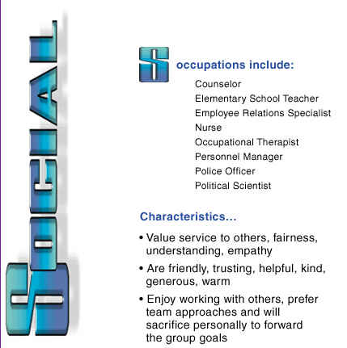
Social - Helpers

Slide 11
Social - Helpers
Helpers describe themselves as:
helpful, warm, cooperative, sociable, tactful, friendly, kind, generous, patient and understanding.
Their working style:
prefer to network to gather information before creating a plan of action, excel at networking to gather information, create solutions and prefer a team approach.

Slide 12
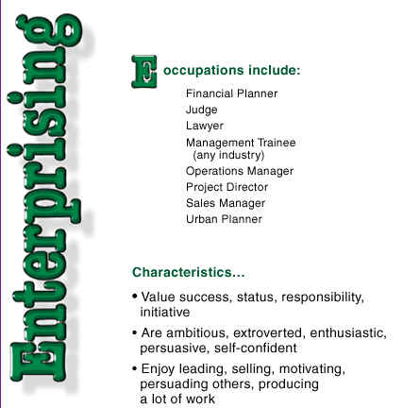
Enterprising - Persuaders

Slide 13
Enterprising - Persuaders
Persuaders describe themselves as:
adventurous, energetic, optimistic, agreeable, extroverted, popular, sociable, self-confident and ambitious.
Their working style:
prefer to lead a team to achieve a goal, like to learn to focus on the bigger picture and get others to commit to pieces of the plan and are comfortable delegating work.

Slide 14
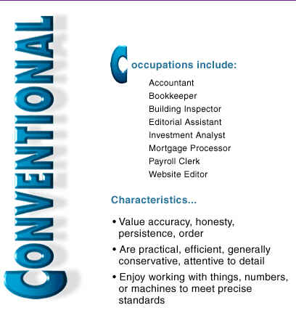
Conventional - Organisers

Slide 15
Conventional - Organisers
Organizers describe themselves as:
conforming, practical, careful, obedient, efficient, orderly, conscientious, persistent, reserved and structured.
Their working style:
prefer to have a clear and structured plan and to follow it, pay attention to detail and take pleasure in putting the pieces of the plan together.

Slide 16
RIASEC -興趣六型特徵
1. 實用型：
需要動手環境中從事明確固定的工作，依既定的規則一步一步地製造完成有實際用途的物品。喜歡從事機械、電子、土木建築、農業等工作。
2. 研究型：
善於觀察、思考、分析、推理 喜歡用頭腦依自己的步調解決問題，並追根究底。

Slide 17
RIASEC -興趣六型特徵
3. 藝術型：
直覺敏銳、善於表達和創新。希望藉文字、聲音等形式來表達創造力和感受。
4. 社會型：
關心自己和別人的感受，喜歡傾聽和瞭解別人，也願意付出時間和精力去解決別人的衝突，喜歡教導別人，並幫助他人成長。本類型標準職業：教師！牧師、社工.....

Slide 18
RIASEC -興趣六型特徵
5. 企業型：
希望擁有權力去改善不合理的事。善用說服力和組織能力。適合管理、銷售、司法、從政等工作。
6. 事務型：
喜歡在有清楚規範的環境下工作。做事按部就班、精打細算，給人的感覺是有效率、精確、仔細、可靠而又有信用。適合從事銀行、金融、會計、秘書等相關工作。

