Slide 1
Research Methods Tutorial 2
Introduction
to
Invisible Web

Slide 2
Why Invisible?
Deep
If a web page is very far down in a directory structure (such as http://www.example.com/dir/sub/001/jan/mon/10.html), then a search engine may decided not to go that deep.
Big
Many search engines only include the first 100 kb or so of a web page. If it is longer, the rest of the page may not be included. Google goes 101 kb deep; Yahoo! goes to 500 kb.
Too New
Search engines recrawl web pages at different rates: some once a month (and some less often), and some every few minutes. Even if a certain page is included in a search engine, it may not have the most recent content added to that page. If you’re looking for really recent information, try searching through Weblogs and News. Some tools, especially some of the blog search engines, may include content that was published online just minutes ago.
No Links
Most search engines find web pages by following links; If there are no links to a page it may never be found.
Robots Excluded
Webmasters can specify in a file called robots.txt or using meta tags that they do not want certain pages to be indexed. Responsible robots (the software that search engines use to download web pages) don’t index it.
Protected & Fee
Some pages require a username and password to view (often money is required); search engines can’t get past this.
Non-HTML
Once upon a time, search engines only included web content that was in HTML format. Today, the major search engines do include some content in other formats. These formats include Microsoft Office and Adobe Portable Document Format documents. For more information about what engines include what type of content (and to search through it), see Fagan Finder’s Search by File Format.
Dynamic
Dynamic, database-driven pages (such as those that include characters like ? in the URL) scare many search engines, for fear of getting caught in an endless loop of pages on the same website. Some search engines include dynamic content somewhat, such as Google.

Slide 3
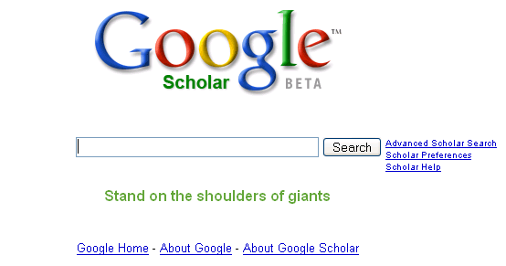
Simplest – Google Advanced Search: Scholar

Slide 4
Deep Web Search Engines
www.completeplanet.com
http://eric.ed.gov
http://lii.org
http://infomine.ucr.edu
www.incywincy.com

Slide 5
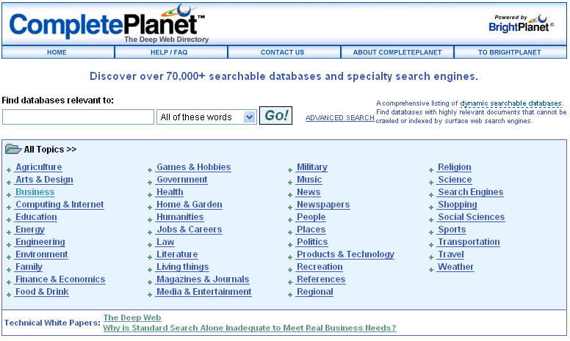
CompletePlanet.com

Slide 6
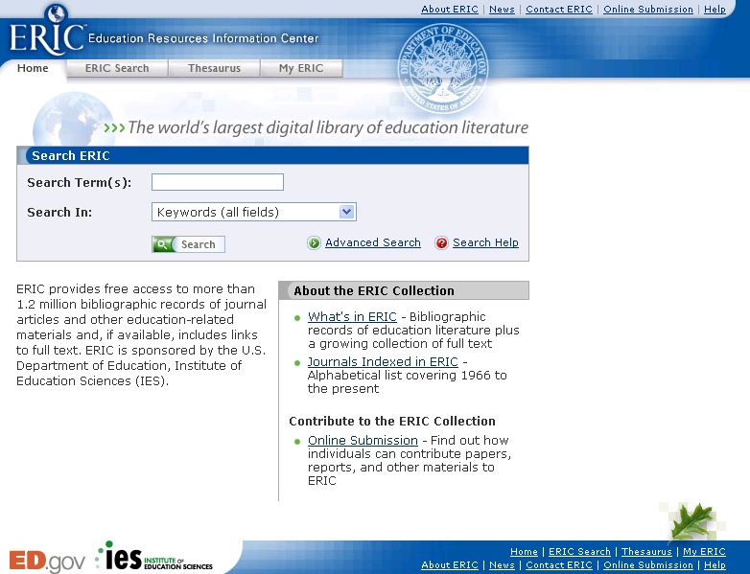
Eric.ed.gov

Slide 7
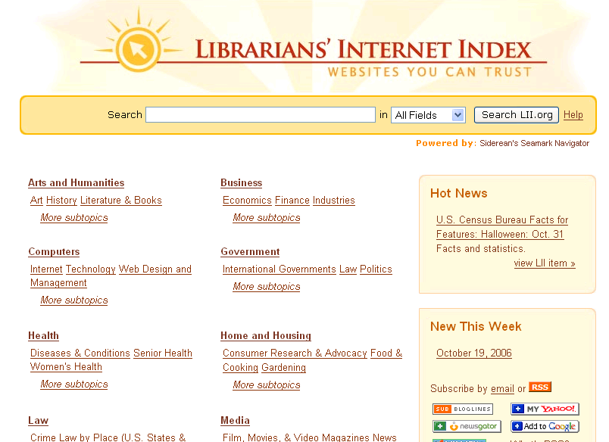
Librarian’s Internet Index

Slide 8
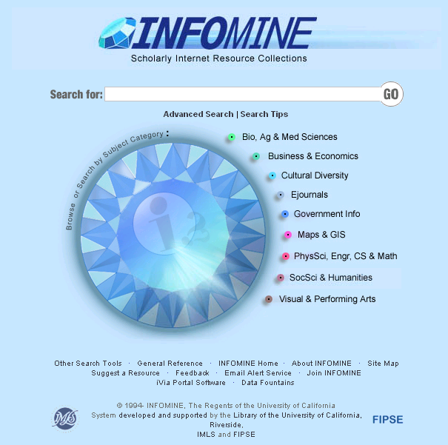
Infomine.ucr.edu

Slide 9
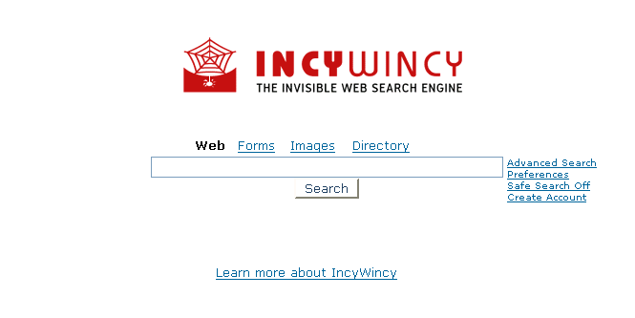
Incywincy.com

