Slide 1
Research Methods Tutorial 2 - b
Literature Review Article Search
Actual Examples

Slide 2
Example 1
Research Topic: Impact of Body Tattoo
Search Engine: Google Scholar
Keywords: IMPACT of BODY TATTOO

Slide 3
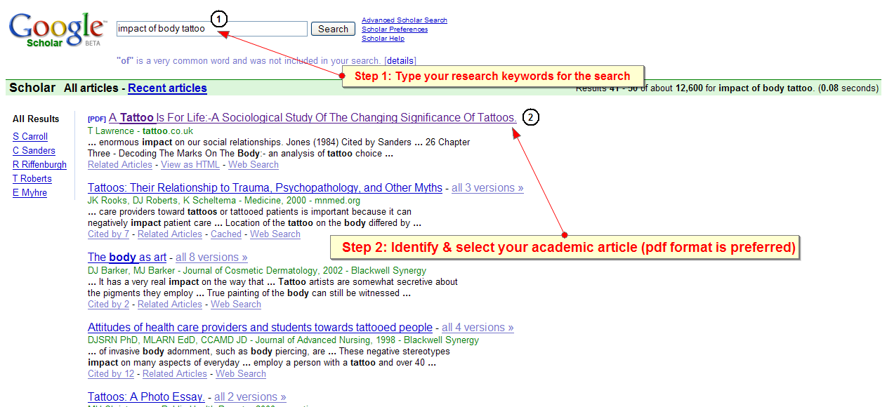
Using Google scholar

Slide 4
Example 2
Research Topic: Impact of Smoking – Student’s Perspective
Search Engine: ERIC
Keywords: SMOKING in STUDENTS

Slide 5
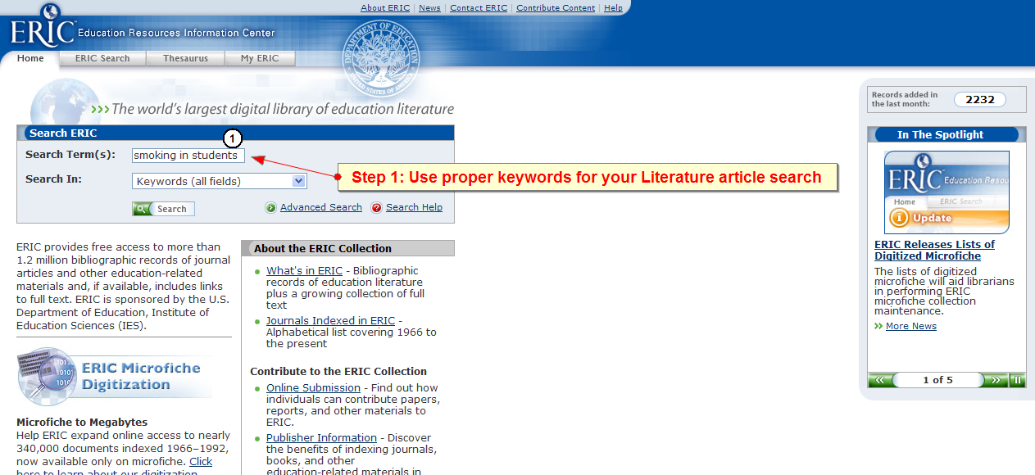
Using eric.ed.gov

Slide 6
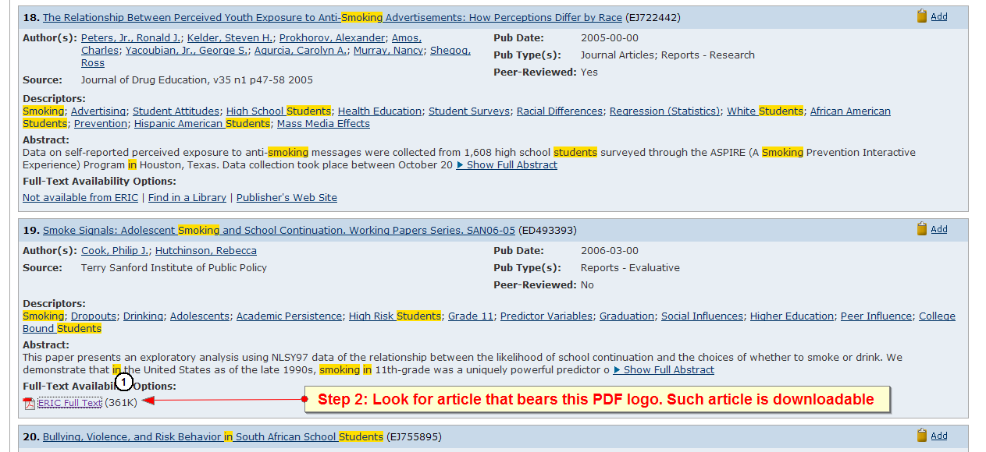
Using eric.ed.gov

