Slide 1
Research Methods
Research Topic
Selection & Refinement

Slide 2
Start with a general topic
Say Beverage
Many types of beverages
Coffee
Tea
Soya
Bubble Tea
Try to narrow down

Slide 3
Narrow down to Coffee Drinking
Many types of coffee too
Lifestyle type (freshly brewed)
Starbucks
Coffee Bean
Far Coast
CoffeeXpress
TCC
Spinelli
Local Style (coffee shop)
Local Kopi
Yakun Kaya Toast
Toast Box
Kiliney

Slide 4
Narrow further to Lifestyle Type
Say your team wanted to bring in Trung Nguyen coffee to Singapore
This is either Evaluation Research or Applied Research Type (depending how you address the research)
Apply either
Questioning or
Concept Mapping technique here

Slide 5
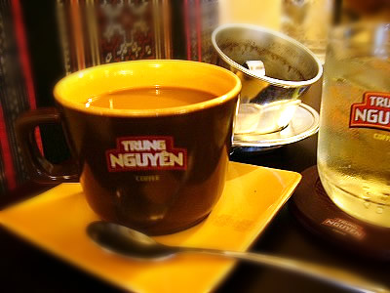
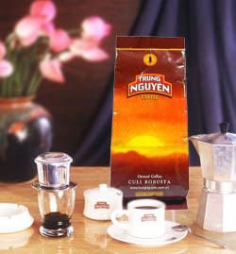
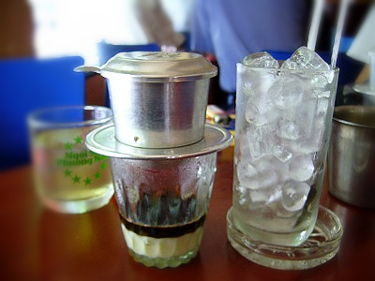
Trung Nguyen

Slide 6
Apply Questioning Technique
Management Dilemma/Issue
Bring in Trung Nguyen coffee to Singapore
Management Question
Can we successfully launch Trung Nguyen coffee to Singapore?
Research Question
What is the best way to launch this Trung Nguyen coffee?
Investigative Question > who are here?
Will such coffee be accepted by the local society?
Investigative Question > Is the taste ok? Brand?

Slide 7
Discuss & Explore further … (players)

Slide 8
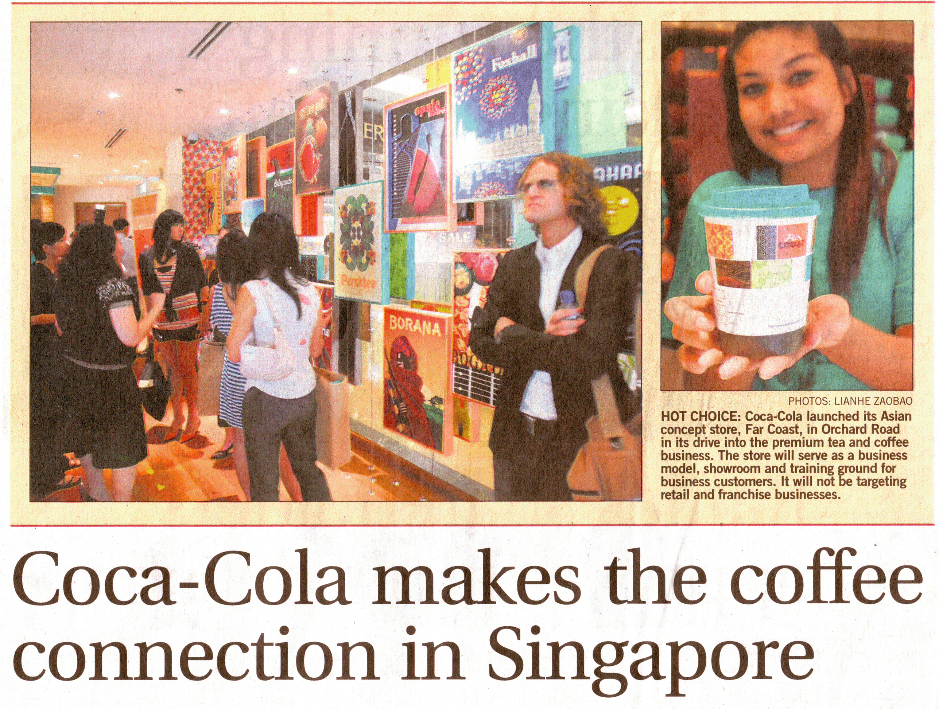
Discuss & Explore further … (new entry)

Slide 9
Discuss & Explore further … (copy cats)

Slide 10
Discuss & Explore further … (substitutes)

Slide 11
Environment - Market Forces

Slide 12
Environment - Market Forces

Slide 13
Research Question
What are the course of actions that the management can undertake to make sure this product launch (Trung Nguyen) in Singapore is a success?

Slide 14
Investigative Questions needed
Taste & Liking
Is vietnamese coffee suited for the local taste?
What are the local taste for coffee?
Brand Awareness
Are the public aware of the various coffee outlet brands?
Do the public drink because of the brand/image?
Consumption Frequency
How frequent do the public drink coffee?

