Slide 1
Research Methods
Different People Different Perspective

Slide 2
Tell me what you see …

Slide 3
Tell me what you see …

Slide 4
Tell me what you see …

Slide 5
Tell me what you see …

Slide 6
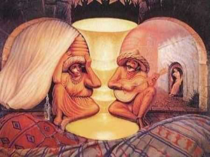
Tell me what you see …

Slide 7
Tell me what you see …

Slide 8
Tell me what you see …

Slide 9
The answer for the previous

Slide 10
The Rationale
Within your team
Different Team member will see your chosen topic from a different perspective
Nothing wrong
Just need to compromise and decide a common perspective that is agreed upon by all members

