Slide 1
Research Methods Tutorial 1 – Part B
Research Topic
Discussion

Slide 2
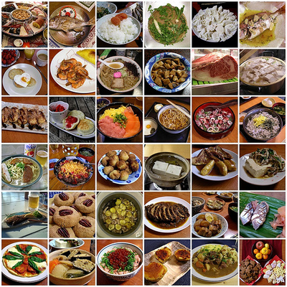
Food Culture – Foreign food acceptance in society

Slide 3
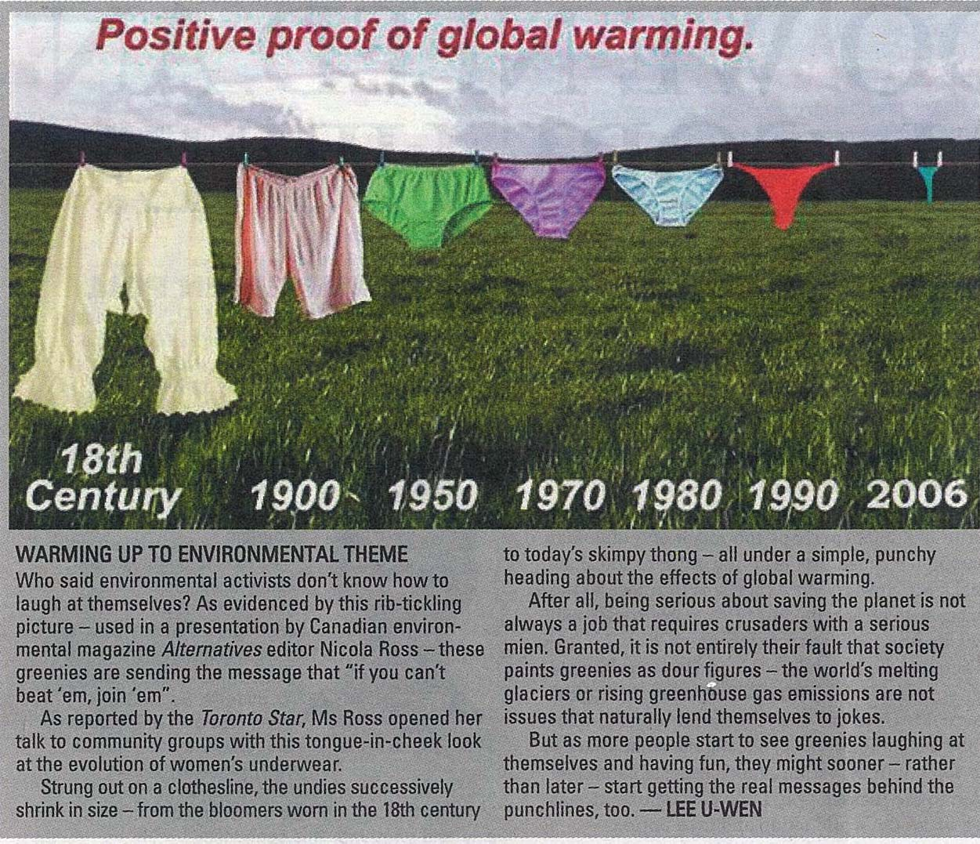
Global Warming and Society

Slide 4
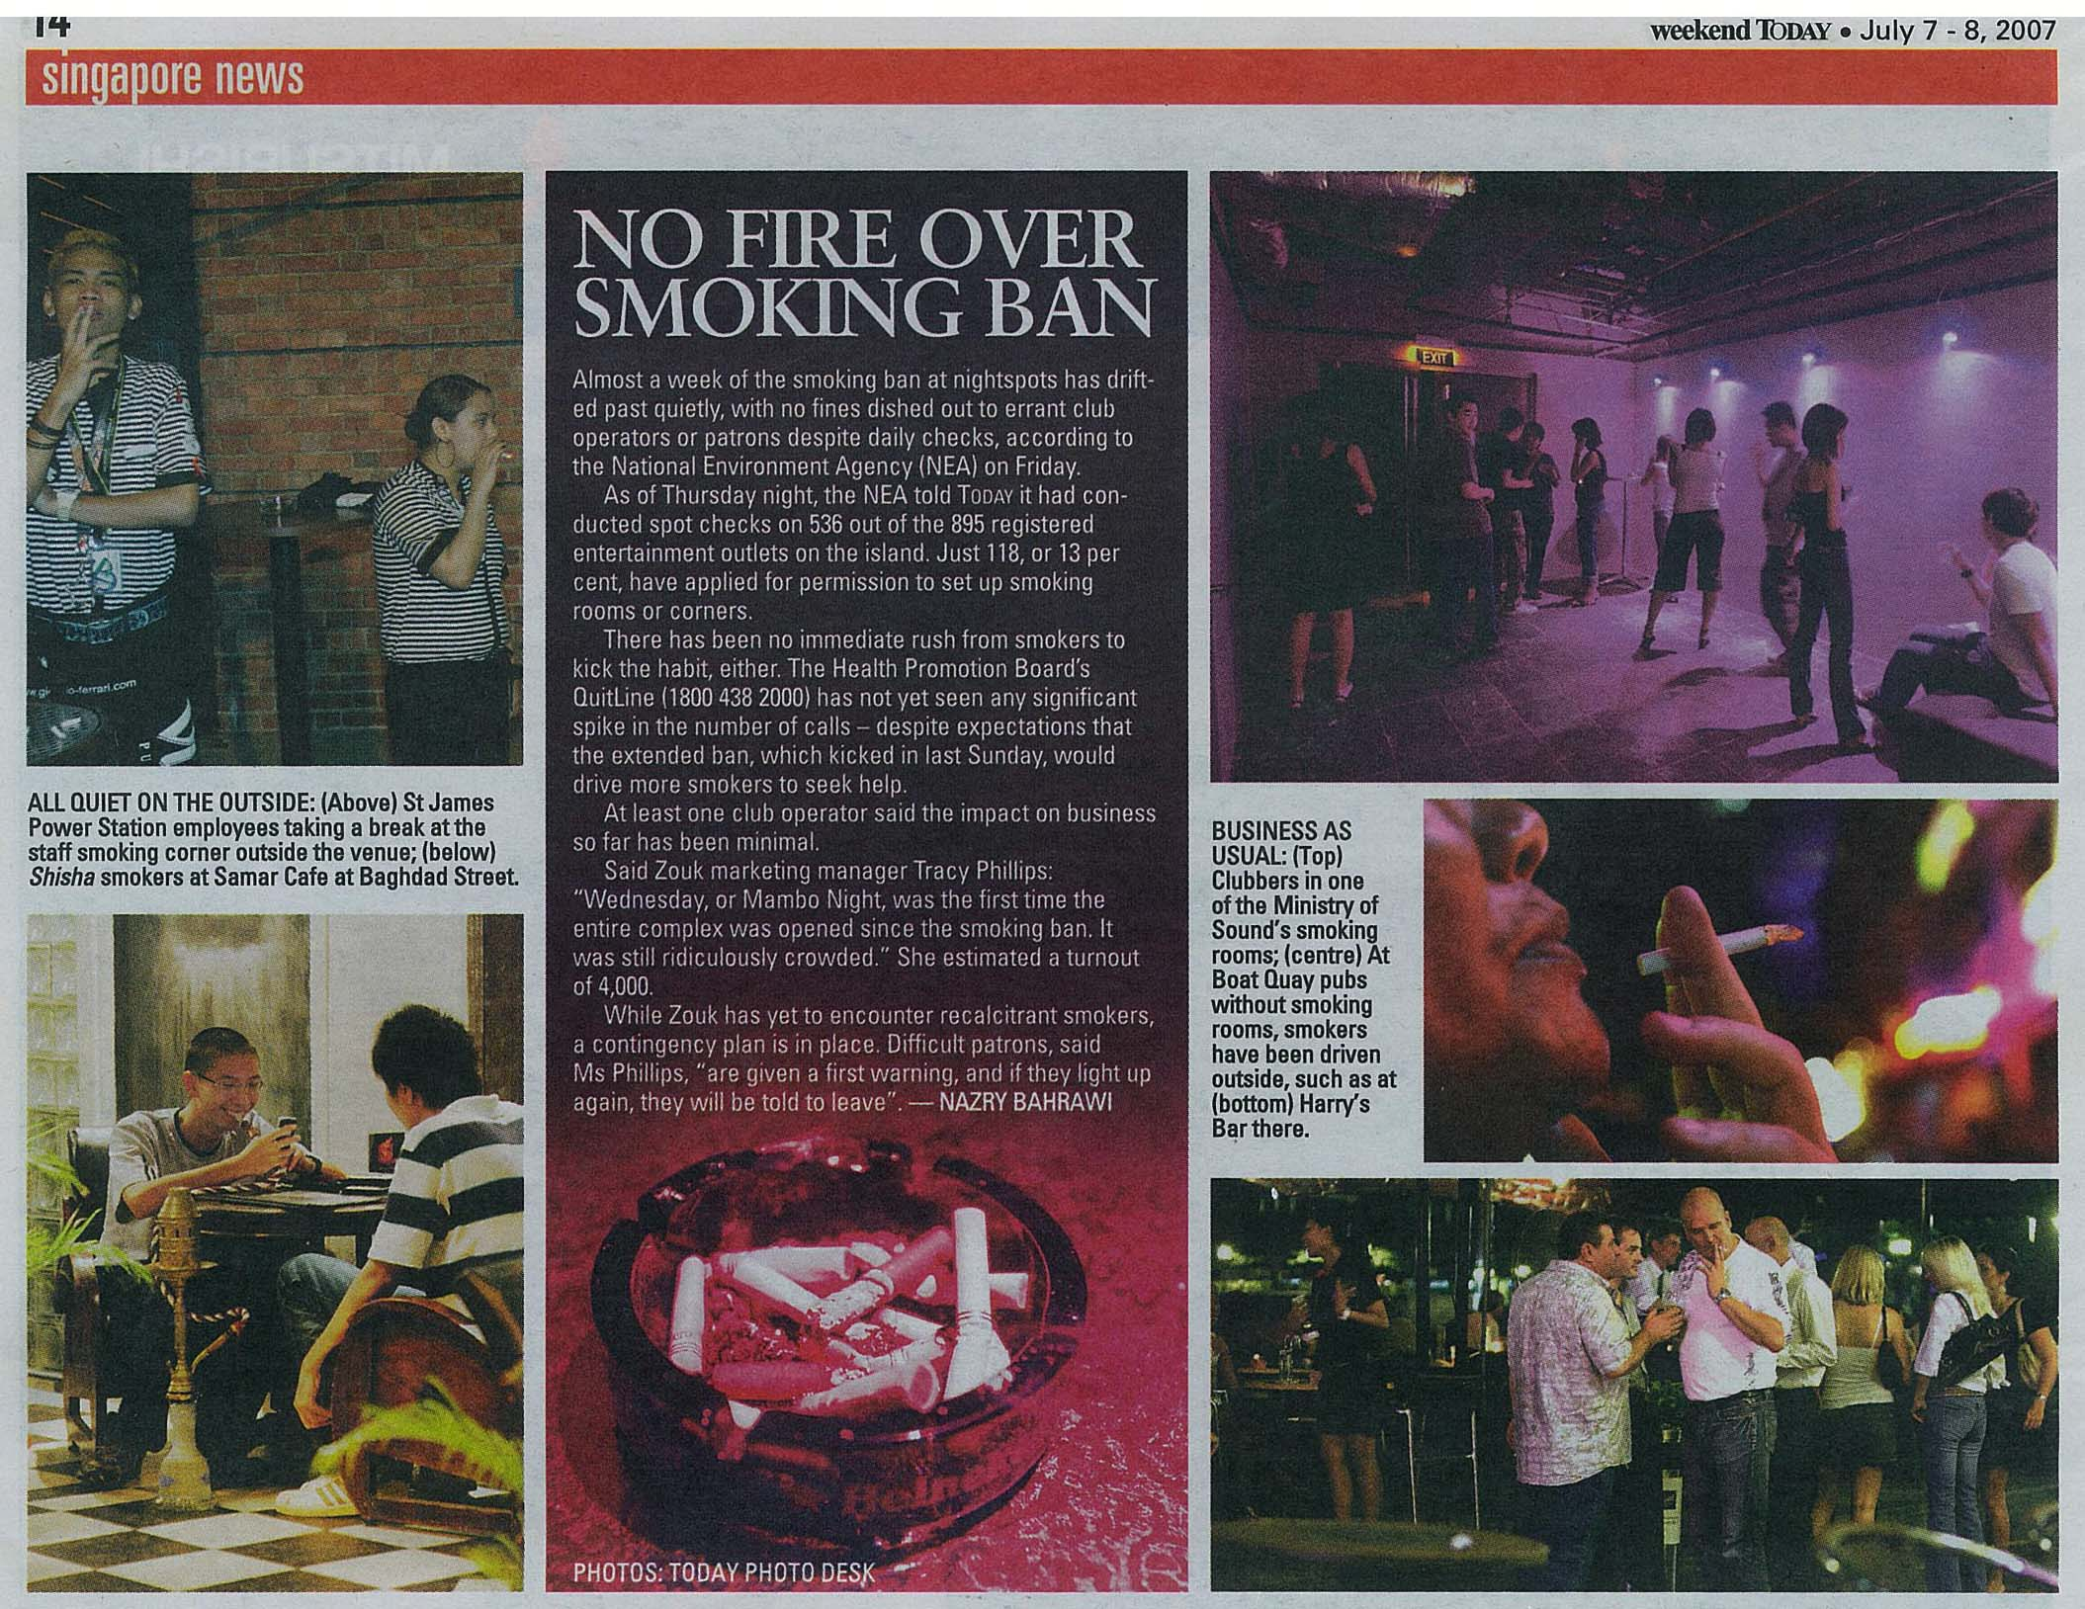
Consequences of Smoking Ban

Slide 5
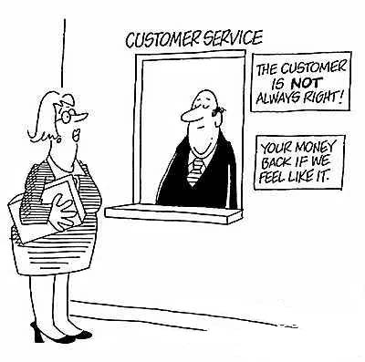
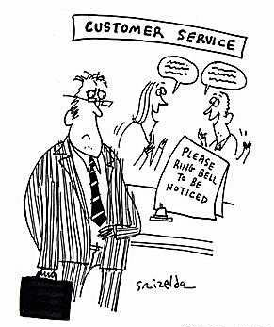
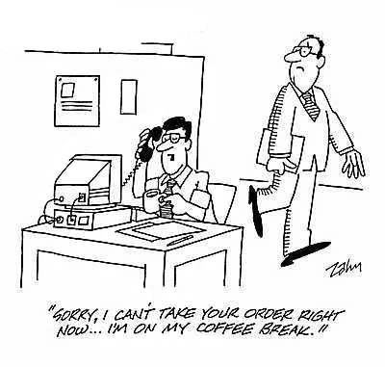
Customer Service

Slide 6
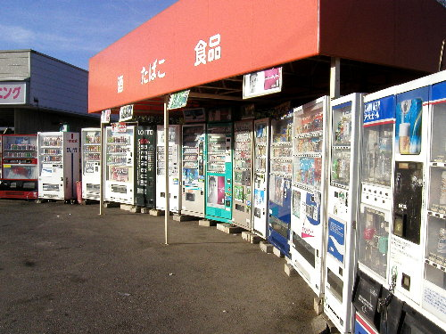
Impact of Fast-food Culture

Slide 7
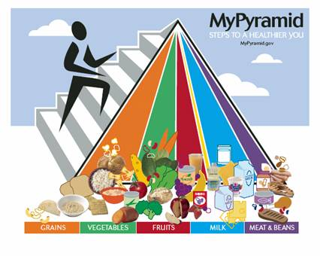
Food and Nutrition

Slide 8
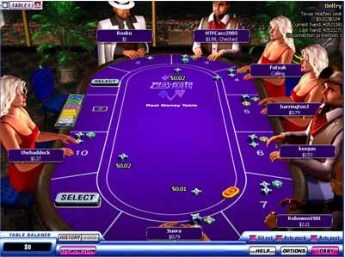
Impact of Online Gaming

Slide 9
Console Game causes Anti-Social Behaviour

Slide 10
Console Game causes Anti-Social Behaviour

Slide 11
FAKE BRANDS and its implications

Slide 12
Impact of Innovation on business

Slide 13
Consequences of working long hours

Slide 14
Miscommunication in business
Italian English
Korean Clock Store

Slide 15
TV VIEWING (Joost.com) – A PARADIGM SHIFT

