Slide 1
Research Methods Tutorial 1 – Part A
Research Topic
Selection & Refinement

Slide 2
Technique
Concept Mapping
FreeMind
http://freemind.sourceforge.net/wiki/index.php/Download
Questioning

Slide 3
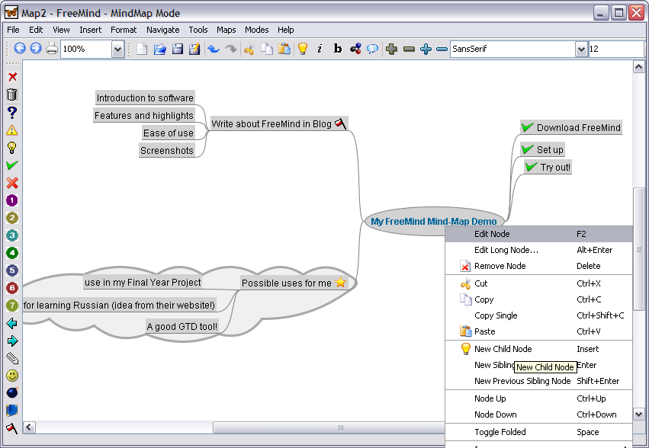
Concept Mapping – FreeMind Software

Slide 4
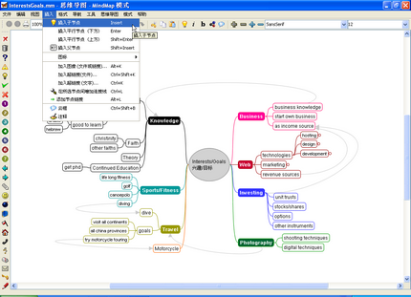
Concept Mapping – FreeMind Software

Slide 5
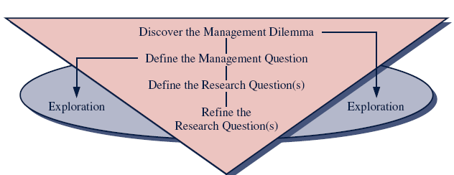
Questioning Technique

Slide 6
Questioning – The Process

Slide 7
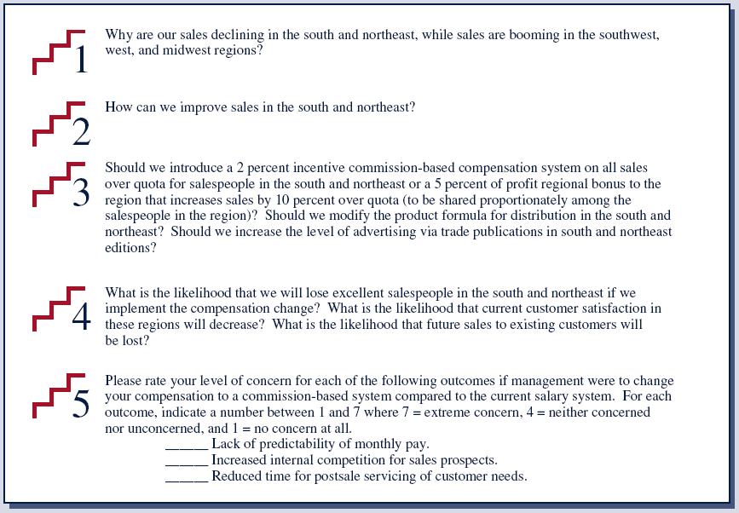
Questioning – The Process (E.g.)

Slide 8
Questioning – The Process
Step 1 (Management Problem):
Know your problem or dilemma
Step 2 (Management Question):
Convert the problem into a Question Format (Start with General Question)
Step 3 (Research Questions):
Breakdown and re-focus your General Question into various Research Questions
Step 4 (Investigative Questions):
Re-define the Question Format in Step 3 into Investigative Question(s)
Step 5 (Measurable Questions):
Convert Investigative Question(s) in Step 4 into Measurable Question(s)
(Note: This is in fact the Survey Questions if Survey Method for data collection is used)

Slide 9
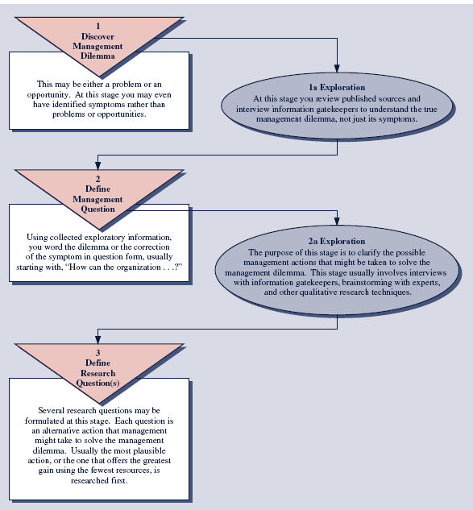

Slide 10
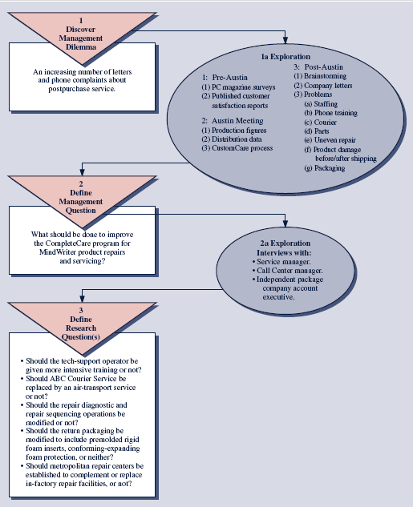

Slide 11
Questioning – Example 1
Step 1: Staff Turnover in Organisation
Step 2: Why are there high staff turnover in organizations?
Step 3: How to minimise staff turnover in organisations
What are the course of action to stop staff turnover?
Step 4: a. Is it due to low salary?
b. Is it due to insecure security in career advancement?
c. Can it due to conflicts in workplace?

Slide 12
Questioning – Example 1
Step 5: Can combine all questions in Step 4 in the following manner;
Rank the following in a scale of 5 where 1 = very important and 5 = least important
Conflicts in workplace [ ]
Salary Issue [ ]
No career advancement [ ]
A. What is your comment on the salary bracket in your organization?
Below market rate [ ]
Same as market rate [ ]
Above market rate [ ]
B. Does your organization offer other pay incentives?
Commission [ ]
Overtime [ ]
Bonus [ ]

Slide 13
Questioning – Example 2
Step 1: Occupancy Rates in Hotels
Step 2: How to increase occupancy rate in hotels?
Step 3: What steps should the Hotels undertake to boost Occupancy Rates?
In what ways can the hotel staff help to increase Occupancy Rates?
Step 4: a. Is it affected by hotel staff attitude?
b. Is it due to lack of hotel facilities?
c. Is it due to room rates?

Slide 14
Questioning – Example 2
Step 5:
From Step 4(a); [from the hotel management perspective]
A. Does this hotel provide staff training? Yes [ ] No [ ]
If Yes, what kind of training?
Grooming [ ]
Mannerism [ ]
Etiquette [ ]
From Step 4(a); [from the hotel guest perspective]
B. Rank the following in a scale of 3 where 1 = very courteous & polite and 3 = very rude
Front Desk [ ]
Food & Beverage [ ]
Concierge [ ]
Room Service/Housekeeping [ ]

