Slide 1
Non-Experimental Quantitative Research
Lecture 8

Slide 2
Non-Experimental Research
is needed because there are many independent variables that we cannot manipulate for one reason or the other (e.g., for ethical reasons, for practical reasons, and for literal reasons such as it is impossible to manipulate some variables).
are interested in cause and effect.
IV=Independent variable
DV=Dependent variable

Slide 3
Steps in Non-Experimental Research
Determine the research problem and hypotheses to be tested.
interested in making any claims of cause and effect.
Select the variables to be used in the study.
need to include some control variables (i.e., variables in addition to your IV and DV that measure key extraneous variables).
help rule out some alternative explanations.

Slide 4
Steps in Non-Experimental Research
Collect the data.
collecting longitudinal data (i.e., collection of data at more than one time point) is helpful to establish the time ordering of your IV and DV if you are interested in cause and effect.
Analyze the data.
statistical control techniques will be needed because of the problem of alternative explanations in non-experimental research.

Slide 5
Steps in Non-Experimental Research
Interpret the results.
conclusions of cause and effect will be much weaker in non-experimental research as compared to strong experimental and quasi-experimental research because the researcher cannot manipulate the independent variable in non-experimental research.
important to watch out for the post hoc fallacy (i.e., arguing, after the fact, that A must have caused B simply because you have observed in the past that A preceded B).

Slide 6
Post Hoc Fallacy Examples
Rice is food
Food is delicious
Therefore, rice is delicious
Cutting people is a crime
Surgeons cut people
Therefore, surgeons are criminals

Slide 7
Independent Variable (IV)
examples of categorical independent variables (IVs) that cannot be manipulated—gender, parenting style, learning style, ethnicity, retention in grade, personality type, drug use.
examples of quantitative IVs that cannot be manipulated—intelligence, age, GPA, any personality trait that is operationalized as a quantitative variable (e.g., level of self-esteem).
recommended that researchers should not turn quantitative independent variables into categorical variables.

Slide 8
Simple Cases of Causal-Comparative and Correlational Research
In the simple case of causal-comparative research you have one categorical IV (e.g., gender) and one quantitative DV (e.g., performance on a math test).
The researcher checks to see if the observed difference between the groups is statistically significant (i.e., not just due to chance) using a "t-test" or an "ANOVA" .

Slide 9
Simple Cases of Causal-Comparative and Correlational Research
In the simple case of correlational research you have one quantitative IV (e.g., level of motivation) and one quantitative DV (performance on math test).
The researcher checks to see if the observed correlation is statistically significant (i.e., not due to chance) using the "t-test for correlation coefficients" .
Remember that the commonly used correlation coefficient (i.e., the Pearson correlation) only detects linear relationships.

Slide 10
Simple Cases of Causal-Comparative and Correlational Research
It is essential that you remember this point: Both of the simple cases of non-experimental research are seriously flawed if you are interested in concluding that an observed relationship is a causal relationship.
That's because "observing a relationship between two variables is not sufficient grounds for concluding that the relationship is a causal relationship." (Remember this important point!)

Slide 11
Simple Cases of Causal-Comparative and Correlational Research
You can improve on the simple cases by controlling for extraneous variables and designing longitudinal studies (discussed below).
And once you move on to these improved non-experimental designs, you should drop the “correlational” and “causal-comparative” terminology and, instead, talk about the design in terms of the research objective and the time dimension

Slide 12
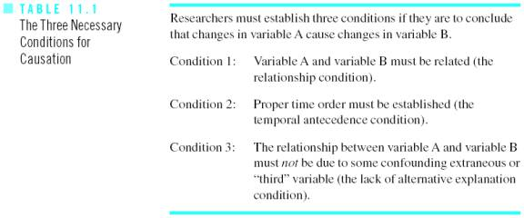
3 Conditions for Causation

Slide 13
Condition 3
Condition 3 is a serious problem in non-experimental research because it is always possible that an observed relationship is "spurious" (i.e., due to some confounding extraneous variable or "third variable").
When attempting to establish condition 3, researchers use logic and theory (e.g., make a list of extraneous variables that you want to measure in your research study), control techniques (such as statistical control and matching), and design approaches (such as using a longitudinal design rather than a cross-sectional design).

Slide 14
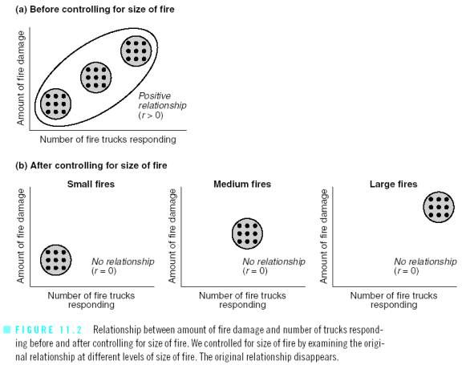
Idea of Controlling a Variable

Slide 15
Techniques of Control
Matching
Holding the extraneous variable constant
Statistical control
Partial correlation
ANCOVA (or analysis of covariance).

Slide 16
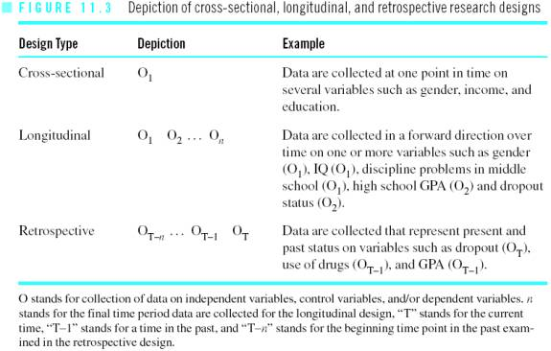
Time Dimension in Design

Slide 17
Classification
Descriptive
used to provide a picture of the status or characteristics of a situation or phenomenon (e.g., what kind of personality do teachers tend to have based on the Myers-Briggs test?)
Predictive
used to predict the future status of one or more dependent variables (e.g., What variables predict who will drop out of high school?).
Explanatory
used to explain how and why a phenomenon operates as it does. Interest is in cause-and-effect relationships.

Slide 18
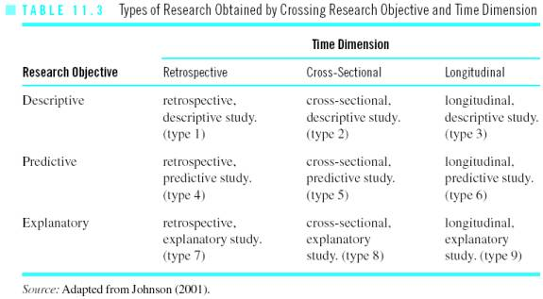
Classification + Time Dimension

Slide 19
End of Lecture 8

