Slide 1
Sampling
Lecture 7

Slide 2
Sampling - Definition
Drawing a sample (a subset) from a population (the full set)
Goal in sampling is to produce a representative image of the population to be research

Slide 3
Terminology
A sample is a set of data taken from a larger population
The sample is a subset of the population
A statistic is a numerical characteristic of a sample, but a parameter is a numerical characteristic of population
Sampling error refers to the difference between the value of a sample statistic and the true value of the population parameter

Slide 4
Terminology
The response rate is the percentage of people in the sample selected for the study who actually participate in the study
A sampling frame is a list of all the people that are in the population

Slide 5
Random Sampling Techniques
Simple Random Sampling
equal probability sampling method (which is abbreviated by EPSEM)
everyone in the sampling frame has an equal chance of being selected

Slide 6
Random Sampling Techniques
Systematic Random Sampling
determine the sampling interval, which is symbolized by "k," (it is the population size divided by the desired sample size).
randomly select a number between 1 and k, and include that person in your sample.
also include each k^{th} element in your sample. For example if k is 10 and your randomly selected number between 1 and 10 was 5, then you will select persons 5, 15, 25, 35, 45, etc.

Slide 7
Random Sampling Techniques
Stratified Random Sampling
stratify your sampling frame (e.g., divide it into the males and the females if you are using gender as your stratification variable).
take a random sample from each group (i.e., take a random sample of males and a random sample of females). Put these two sets of people together and you now have your final sample.
Note that you could also take a systematic sample from the joined lists if that’s easier.

Slide 8
Proportional Stratified Sampling
Must make sure the subsamples (e.g., the samples of males and females) are proportional to their sizes in the population.
Note that proportional stratified sampling is an equal probability sampling method (i.e., it is EPSEM).
Samples in each strata is homogeneous

Slide 9
Disproportional Stratified Sampling
The subsamples are not proportional to their sizes in the population.

Slide 10
Cluster Random Sampling
Cluster Random Sampling
select clusters rather than individual type units in the first stage of sampling.
has more than one unit in it (e.g., a school, a classroom, a team).
Samples in each cluster is Heterogeneous

Slide 11
1-Stage Cluster Sampling
First select a random sample of clusters.
Then you include in your final sample all of the individual units that are in the selected clusters.

Slide 12
2-Stage Cluster Sampling
In the first stage you take a random sample of clusters (i.e., just like you did in one-stage cluster sampling).
In the second stage, you take a random sample of elements from each of the clusters you selected in stage one (e.g., in stage two you might randomly select 10 students from each of the 15 classrooms you selected in stage one).

Slide 13
Nonrandom Sampling Techniques
Convenience Sampling
involves using the people who are the most available
Quota Sampling
involves setting quotas
Purposive Sampling
specifies the characteristics of the population of interest and then locates individuals who match those characteristics
Snowball Sampling
each research participant is asked to identify other potential research participants who have a certain characteristic

Slide 14
Determining Sample Size
Try to get as big of a sample as you can for your study (i.e., because the bigger the sample the better).
If your population is size 100 or less, then include the whole population rather than taking a sample (i.e., don't take a sample; include the whole population).
Look at other studies in the research literature and see how many they are selecting.
There are many sample size calculators on the web but they generally require you to learn a little bit of statistics first. Here is one; http://www.surveysystem.com/sscalc.htm

Slide 15
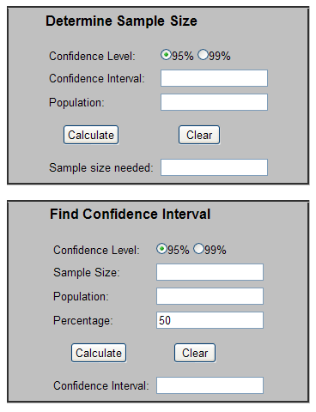
http://www.surveysystem.com/sscalc.htm

Slide 16
Larger Sample Size is needed when..
When the population is very heterogeneous.
When you want to breakdown the data into multiple categories.
When you want a relatively narrow confidence interval (e.g., note that the estimate that 75% of teachers support a policy plus or minus 4% is more narrow than the estimate of 75% plus or minus 5%).
When you expect a weak relationship or a small effect.
When you use a less efficient technique of random sampling (e.g., cluster sampling is less efficient than proportional stratified sampling).
When you expect to have a low response rate. The response rate is the percentage of people in your sample who agree to be in your study.

Slide 17
End of Lecture 7

