Slide 1
Lecture 6

Slide 2
Collection Methods - Questionnaires
Is a self-report data collection instrument that is filled out by research participants.
Questionnaires are usually hand-filled instruments, but they can also be ‘online’
Questionnaires are sometimes called survey instruments, which is fine, but the actual questionnaire should not be called “the survey.”
The word “survey” refers to the process of using a questionnaire or interview protocol to collect data.

Slide 3
Questionnaires
Is a self-report data collection instrument that is filled out by research participants.
Paper-and-Pencil Instruments

Slide 4
Questionnaires and Survey
Questionnaires are sometimes called survey instruments,
which is fine,
but the actual questionnaire should not be called “the survey.”

Slide 5
Questionnaires and Survey
Example:
Do a survey of smoking behavior of the student
the instrument of data collection - Questionnaire

Slide 6
Questionnaires
Composed of questions and/or statements
How to learn to write Questionnaire
Is look at other questionnaires

Slide 7
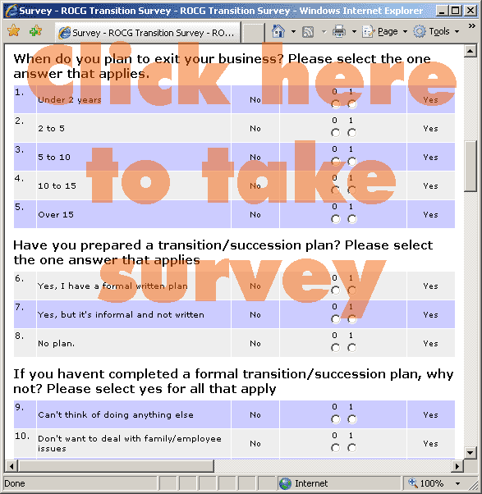
Survey Questionnaire

Slide 8
Questionnaires’ 15 Principles
1. Ensure the questionnaire items match your research objectives.
2. Know your research participants.
Your participants (not you) filling out the questionnaire – demographic and cultural characteristics

Slide 9
3. Use natural and familiar language.
Easy and familiar ……..
4. Be clear, precise, and relatively short.
if participants not understand – data not valid. Long question stressful!!!!!!!!!!!!

Slide 10
5. Do not use "leading" or "loaded" questions.
Don’t lead participants where you want to be
Loaded word – create an emotional reaction or respond
Use Neutral Wording --------- UNBIAS DATA

Slide 11
6. Avoid double-barreled questions.
Example Do you think professors should have more contact with university staff and university administrators?
“AND” – might be double-barreled question

Slide 12
7. Avoid double negatives.
Example :
I disagree that teachers should not be required to supervise their students during library time

Slide 13
8. Determine whether an open-ended or a closed ended question is needed.
Open-ended questions – qualitative data – own word
How can your principle improve the morale at your school? _____________________

Slide 14
8. Determine whether an open-ended or a closed ended question is needed.
Closed-ended questions:
How difficult do you find this class?
Very difficult, somewhat difficult, not very difficult ……………………………………..

Slide 15
9. Use mutually exclusive and exhaustive response categories for closed-ended questions.
Mutually exclusive categories do not overlap :
0-10, 10-20, 20-30 … not mutually exclusive
Less than 10, 10-19, 20-29 ...... Mutually exclusive

Slide 16
9. Use mutually exclusive and exhaustive response categories for closed-ended questions.
Exhaustive categories include all possible responses. Survey of adult citizen (18-19, 20-29 ……..60-69)
Where to put someone who is over 70 years old?

Slide 17
10. Include the different types of response categories available for closed-ended questionnaire items.
Example: rating scale : 1 2 3 4 5 6 7
Fully anchored rating scale : strongly agree agree neutral ……………….

Slide 18
11. Use multiple items to measure abstract constructs.
- want to measures to have high reliability and validity

Slide 19
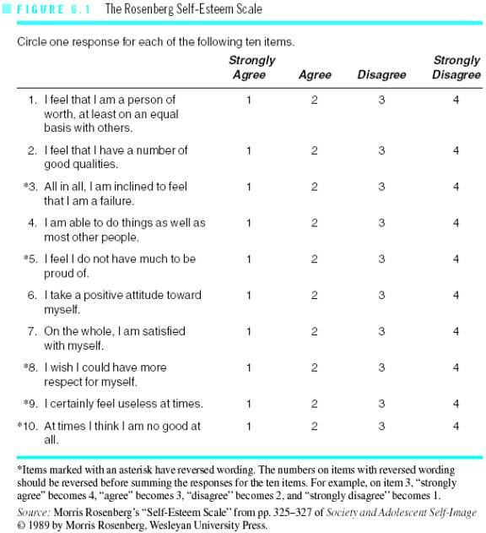
Rosenberg Self-Esteem Scale
Research Methods - Dr Eric Lim
19

Slide 20
12. Consider using multiple methods when measuring abstract constructs.
only use one method of measurement, then your measurement may be an artifact of that method of measurement.
Two or more methods, you will be able to see whether the answers depend on the method

Slide 21
13. Use caution if you reverse the wording in some of the items to prevent response sets.
A response set is the tendency of a participant to respond in a specific direction to items regardless of the item content.
Reverse wording forces the respondent to think about the answer to each item. BUT
Reverse wording reduces the relibility and validity

Slide 22
14. Develop a questionnaire that is easy for the participant to use.
- not get to confused or lost
- direction are clear

Slide 23
15. Always pilot test your questionnaire.
- some problems that you have overlooked
- after pilot testing, revise it and pilot test it again, until it works correctly

Slide 24
Questionnaires : Strengths
Good for measuring attitudes and eliciting other content from research participants.
Inexpensive (especially mail questionnaires and group administered questionnaires).
Can provide information about participants’ internal meanings and ways of thinking.
Can administer to probability samples.
Quick turnaround.
Can be administered to groups.
Perceived anonymity by respondent may be high.
Moderately high measurement validity (i.e., high reliability and validity) for well constructed and validated questionnaires.
Closed-ended items can provide exact information needed by researcher.
Open-ended items can provide detailed information in respondents’ own words.
Ease of data analysis for closed-ended items.
Useful for exploration as well as confirmation.

Slide 25
Questionnaires : Weaknesses
Usually must be kept short.
Reactive effects may occur (e.g., interviewees may try to show only what is socially desirable).
Non-response to selective items.
People filling out questionnaires may not recall important information and may lack self-awareness.
Response rate may be low for mail and email questionnaires.
Open-ended items may reflect differences in verbal ability, obscuring the issues of interest.
Data analysis can be time consuming for open-ended items.
Measures need validation.

Slide 26
End of Lecture 6

