Slide 1
Data Collection Methods
Lecture 6

Slide 2
Collection Methods
Tests (i.e., includes standardized tests that usually include information on reliability, validity, and norms as well as tests constructed by researchers for specific purposes, skills tests, etc).
Questionnaires (i.e., self-report instruments).
Interviews (i.e., situations where the researcher interviews the participants).
Focus groups (i.e., a small group discussion with a group moderator present to keep the discussion focused).
Observation (i.e., looking at what people actually do).
Existing or Secondary data (i.e., using data that are originally collected and then archived or any other kind of “data” that was simply left behind at an earlier time for some other purpose).

Slide 3
Collection Methods - Tests
Commonly used in research to measure personality, aptitude, achievement, and performance

Slide 4
Tests : Strengths
Can provide measures of many characteristics of people.
Often standardized (i.e., the same stimulus is provided to all participants).
Allows comparability of common measures across research populations.
Strong psychometric properties (high measurement validity).
Availability of reference group data.
Many tests can be administered to groups which saves time.
Can provide “hard,” quantitative data.
Tests are usually already developed.
A wide range of tests is available (most content can be tapped).
Response rate is high for group administered tests.
Ease of data analysis because of quantitative nature of data.

Slide 5
Tests : Weaknesses
Can be expensive if test must be purchased for each research participant.
Reactive effects such as social desirability can occur.
Test may not be appropriate for a local or unique population.
Open-ended questions and probing not available.
Tests are sometimes biased against certain groups of people.
Non-response to selected items on the test.
Some tests lack psychometric data.

Slide 6
Collection Methods - Questionnaires
Is a self-report data collection instrument that is filled out by research participants.
Questionnaires are usually hand-filled instruments, but they can also be ‘online’
Questionnaires are sometimes called survey instruments, which is fine, but the actual questionnaire should not be called “the survey.”
The word “survey” refers to the process of using a questionnaire or interview protocol to collect data.

Slide 7
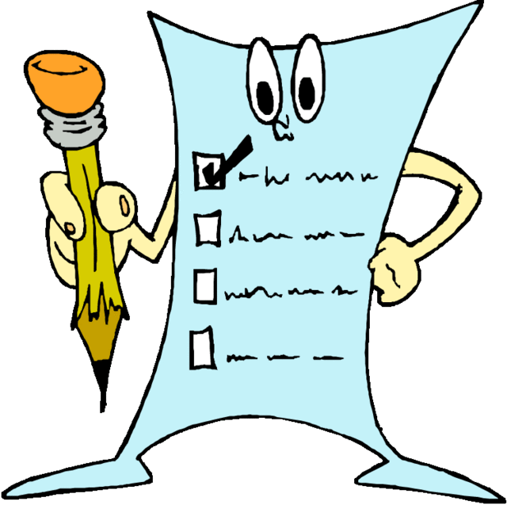
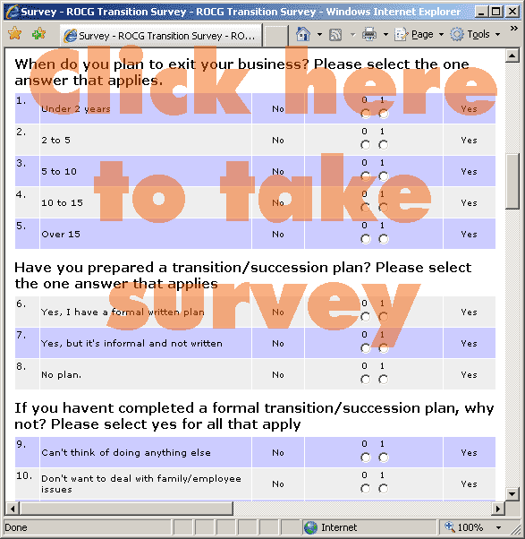
Survey Questionnaire

Slide 8
Questionnaires’ 15 Principles
Ensure the questionnaire items match your research objectives.
Know your research participants.
Use natural and familiar language.
Be clear, precise, and concise.
Do not use "leading" or "loaded" questions.
Avoid double-barreled questions.
Avoid double negatives.
Determine whether an open-ended or a closed ended question is needed.

Slide 9
Questionnaires’ 15 Principles
Use mutually exclusive and exhaustive response categories for closed-ended questions.
Include the different types of response categories available for closed-ended questionnaire items.
Use multiple items to measure abstract constructs.

Slide 10
Questionnaires’ 15 Principles
Consider using multiple methods when measuring abstract constructs.
Use caution if you reverse the wording in some of the items to prevent response sets.
A response set is the tendency of a participant to respond in a specific direction to items regardless of the item content.
Develop a questionnaire that is easy for the participant to use.
Always pilot test your questionnaire.

Slide 11
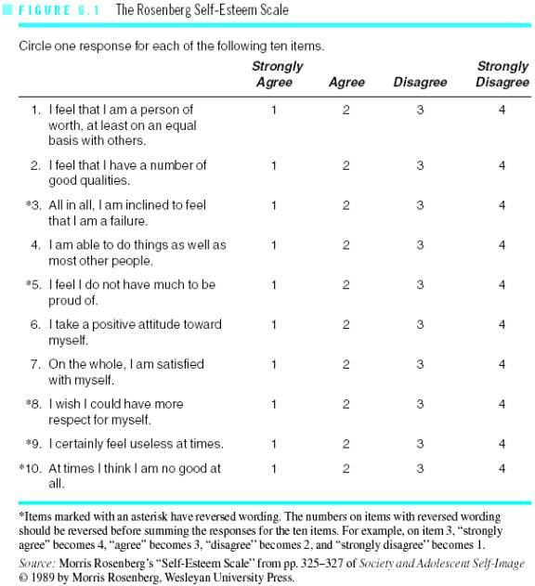
Rosenberg Self-Esteem Scale

Slide 12
Questionnaires : Strengths
Good for measuring attitudes and eliciting other content from research participants.
Inexpensive (especially mail questionnaires and group administered questionnaires).
Can provide information about participants’ internal meanings and ways of thinking.
Can administer to probability samples.
Quick turnaround.
Can be administered to groups.
Perceived anonymity by respondent may be high.
Moderately high measurement validity (i.e., high reliability and validity) for well constructed and validated questionnaires.
Closed-ended items can provide exact information needed by researcher.
Open-ended items can provide detailed information in respondents’ own words.
Ease of data analysis for closed-ended items.
Useful for exploration as well as confirmation.

Slide 13
Questionnaires : Weaknesses
Usually must be kept short.
Reactive effects may occur (e.g., interviewees may try to show only what is socially desirable).
Non-response to selective items.
People filling out questionnaires may not recall important information and may lack self-awareness.
Response rate may be low for mail and email questionnaires.
Open-ended items may reflect differences in verbal ability, obscuring the issues of interest.
Data analysis can be time consuming for open-ended items.
Measures need validation.

Slide 14
Collection Methods - Interviews
The interviewer asks the interviewee questions (in-person or over the telephone).
Trust and rapport are important.
Probing is available (unlike in paper-and-pencil questionnaires) and is used to reach clarity or gain additional information
Here are some examples of standard probes:
- Anything else?
- Any other reason?
- What do you mean?
Interviews may be quantitative or qualitative.

Slide 15
Quantitative Interviews
Are standardized (i.e., the same information is provided to everyone).
Use closed-ended questions.

Slide 16
Qualitative Interviews
They are based on open-ended questions.
There are three types of qualitative interviews.
Informal Conversational
Interview Guide Approach
Standardised Open-Ended

Slide 17
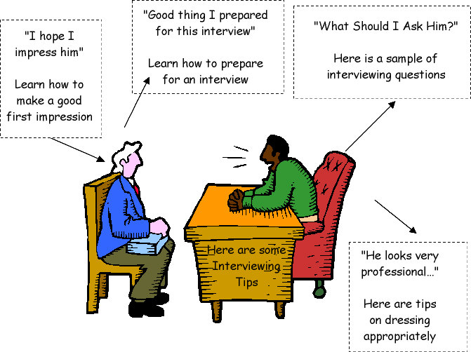
Interview

Slide 18
Interviews - Strengths
Good for measuring attitudes and most other content of interest.
Allows probing and posing of follow-up questions by the interviewer.
Can provide in-depth information.
Can provide information about participants’ internal meanings and ways of thinking.
Closed-ended interviews provide exact information needed by researcher.
Telephone and e-mail interviews provide very quick turnaround.
Moderately high measurement validity (i.e., high reliability and validity) for well constructed and tested interview protocols.
Can use with probability samples.
Relatively high response rates are often attainable.
Useful for exploration as well as confirmation.

Slide 19
Interviews - Weaknesses
In-person interviews usually are expensive and time consuming.
Reactive effects (e.g., interviewees may try to show only what is socially desirable).
Investigator effects may occur (e.g., untrained interviewers may distort data because of personal biases and poor interviewing skills).
Interviewees may not recall important information and may lack self-awareness.
Perceived anonymity by respondents may be low.
Data analysis can be time consuming for open-ended items.
Measures need validation.

Slide 20
Collection Methods – Focus Groups
Is a situation where a focus group moderator keeps a small and homogeneous group (of 6-12 people) focused on the discussion of a research topic or issue.
Focus group sessions generally last between one and three hours and they are recorded using audio and/or videotapes.
Focus groups are useful for exploring ideas and obtaining in-depth information about how people think about an issue.

Slide 21
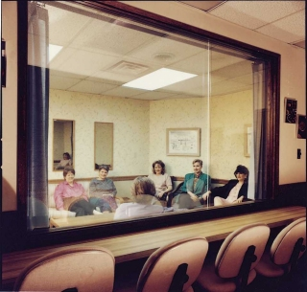
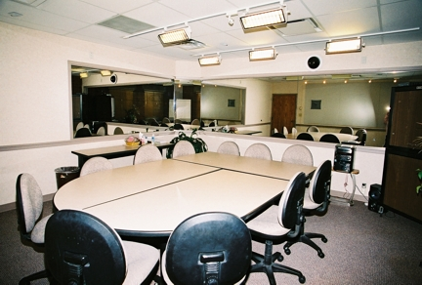
Focus Group - Settings

Slide 22
Focus Groups - Strengths
Useful for exploring ideas and concepts.
Provides window into participants’ internal thinking.
Can obtain in-depth information.
Can examine how participants react to each other.
Allows probing.
Most content can be tapped.
Allows quick turnaround.

Slide 23
Focus Groups - Weaknesses
Sometimes expensive.
May be difficult to find a focus group moderator with good facilitative and rapport building skills.
Reactive and investigator effects may occur if participants feel they are being watched or studied.
May be dominated by one or two participants.
Difficult to generalize results if small, unrepresentative samples of participants are used.
May include large amount of extra or unnecessary information.
Measurement validity may be low.
Usually should not be the only data collection methods used in a study.
Data analysis can be time consuming because of the open-ended nature of the data.

Slide 24
Collection Methods - Observations
Observes participants in natural and/or structured environments.
It is important to collect observational data because what people say is not always what they do!
Observation can be carried out in two types of environments:
Laboratory observation (which is done in a lab set up by the researcher).
Naturalistic observation (which is done in real-world settings).
There are two important forms of observation: quantitative observation and qualitative observation.

Slide 25
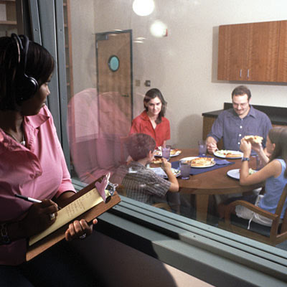
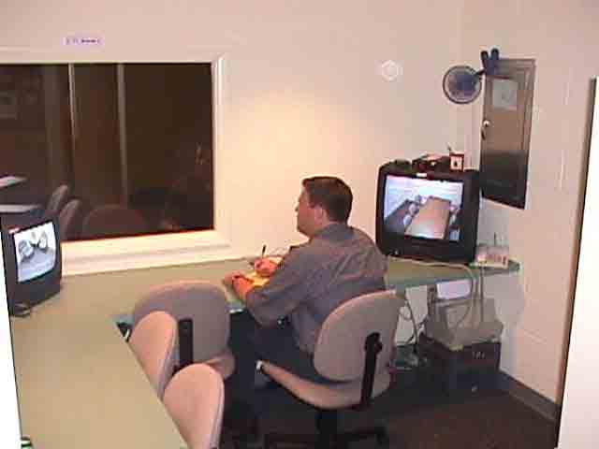
Observation – Lab Setting

Slide 26
Quantitative & Qualitative Observations
Quantitative observation involves standardization procedures, and it produces quantitative data.
Qualitative observation is exploratory and open- ended, and the researcher takes extensive field notes.

Slide 27
Observations - Strengths
Allows one to directly see what people do without having to rely on what they say they do.
Provides firsthand experience, especially if the observer participates in activities.
Can provide relatively objective measurement of behavior (especially for standardized observations).
Observer can determine what does not occur.
Observer may see things that escape the awareness of people in the setting.
Excellent way to discover what is occurring in a setting.
Helps in understanding importance of contextual factors.
Can be used with participants with weak verbal skills.
May provide information on things people would otherwise be unwilling to talk about.
Observer may move beyond selective perceptions of people in the setting.
Good for description.
Provides moderate degree of realism (when done outside of the laboratory).

Slide 28
Observations - Weaknesses
Reasons for observed behavior may be unclear.
Reactive effects may occur when respondents know they are being observed.
Investigator effects.
Observer may “go native” (i.e., over-identifying with the group being studied).
Sampling of observed people and settings may be limited.
Cannot observe large or dispersed populations.
Some settings and content of interest cannot be observed.
Collection of unimportant material may be moderately high.
More expensive to conduct than questionnaires and tests.
Data analysis can be time consuming.

Slide 29
Collection Methods - Secondary/Existing Data
Secondary data (i.e., data originally used for a different purpose) are contrasted with primary data (i.e., original data collected for the new research study).
Documents
Personal documents
Official documents
Physical data
Archived research data

Slide 30
Secondary data - Strengths
Can provide insight into what people think and what they do.
Unobtrusive, making reactive and investigator effects very unlikely.
Can be collected for time periods occurring in the past (e.g., historical data).
Provides useful background and historical data on people, groups, and organizations.
Useful for corroboration.
Grounded in local setting.
Useful for exploration.

Slide 31
Secondary Data (Archived) - Strengths
Archived research data are available on a wide variety of topics.
Inexpensive.
Often are reliable and valid (high measurement validity).
Can study trends.
Ease of data analysis.
Often based on high quality or large probability samples.

Slide 32
Secondary Data - Weaknesses
May be incomplete.
May be representative only of one perspective.
Access to some types of content is limited.
May not provide insight into participants’ personal thinking for physical data.
May not apply to general populations.

Slide 33
Secondary Data (Archived) - Weaknesses
May not be available for the population of interest to you.
May not be available for the research questions of interest to you.
Data may be dated.
Open-ended or qualitative data usually not available.
Many of the most important findings have already been mined from the data.

Slide 34
End of Lecture 6

