Slide 1
Standardised Measurement & Assessment
Lecture 5

Slide 2
Measurement- Definition
Defined as the act of measuring by assigning symbols or numbers to something according to a specific set of rules

Slide 3
Scales of Measurement
Nominal
Ordinal
Interval
Ratio

Slide 4
Nominal Scale
Can categorize, name or label
Can use numbers to label
‘answer’ with 1=yes and 2=no
‘gender’ with 1=female and 2=male

Slide 5
Ordinal Scale
Can categorize, name or label
Can use numbers to label
Can make judgment on rank order
Can be ranked, or ordered
‘size’ with 1=small, 2=medium and 3=large

Slide 6
Interval Scale
Inherit the attributes of nominal and ordinal scales
Has rank order and equal intervals
distance between attributes has meaning
for example, temperature (in Fahrenheit) - distance from 30-40 is same as distance from 70-80
Does not possess absolute zero point (zero value does not mean no value)
0 ̊ Celsius ≠ zero temperature
Note that ratios don’t make any sense - 80 degrees is not twice as hot as 40 degrees (although the attribute values are)

Slide 7
Ratio Scale
Inherit the attributes of nominal, ordinal and interval scales
Has a true zero point that is meaningful
can construct a meaningful ratio (fraction)
Examples are
Weight
Height
Annual income
It is meaningful to say that “...we had twice as much revenue in this period as we did in the previous six months

Slide 8
Why is Level of Measurement Important?
helps you decide what statistical analysis is appropriate on the values that were assigned
helps you decide how to interpret the data from that variable

Slide 9
The Hierarchy of Levels
Nominal

Slide 10
The Hierarchy of Levels
Nominal
Attributes are only named; weakest

Slide 11
The Hierarchy of Levels
Ordinal
Nominal
Attributes are only named; weakest

Slide 12
The Hierarchy of Levels
Ordinal
Attributes can be ordered
Nominal
Attributes are only named; weakest

Slide 13
The Hierarchy of Levels
Interval
Ordinal
Attributes can be ordered
Nominal
Attributes are only named; weakest

Slide 14
The Hierarchy of Levels
Interval
Distance is meaningful
Ordinal
Attributes can be ordered
Nominal
Attributes are only named; weakest

Slide 15
The Hierarchy of Levels
Ratio
Interval
Distance is meaningful
Ordinal
Attributes can be ordered
Nominal
Attributes are only named; weakest

Slide 16
The Hierarchy of Levels
Ratio
Absolute zero
Interval
Distance is meaningful
Ordinal
Attributes can be ordered
Nominal
Attributes are only named; weakest

Slide 17
Testing versus Assessment
Testing
Process of measuring variables by means of devices or procedures designed to obtain a sample of behaviour
Assessment
Gathering and integration of data for the purpose of making an educational evaluation, accomplished through the use of tools such as tests, interviews, case studies, behavioural observation, & specially designed apparatus and measurement procedures

Slide 18
Identifying a Good Test or Assessment procedure
Characterized by
High reliability
High validity

Slide 19
Reliability
Consistency or stability of data values
Is a necessary but not sufficient condition for validity
Usually determined using a correlation coefficient called Reliability Coefficient
0 = no reliability
+1 = perfect reliabity
Interested in values from 0 to 1
Acceptable values for 0.7 and higher

Slide 20
4 ways to measure Reliability
Test-retest
Equivalent forms
Internal consistency
Inter-scorer

Slide 21
Measuring Reliability – Test-Retest
Refers to consistency of data values over time
Measured by correlating the data values obtained at 1 point in time with data values obtained at a later point in time
Issue is identifying the time interval
Longer time interval leads to lower reliability coefficient
Obtained by administering the same instrument (e.g. survey) to the same group of people at two different points in time.

Slide 22
Measuring Reliability – Equivalent Forms
Refers to consistency of data values obtained on 2 equivalent forms of a test designed to measure the same thing
Measured by correlating the data values obtained by giving 2 forms of the same test to a group of people
The researcher creates two different instruments (e.g. 2 different survey questions) designed to measure identical constructs

Slide 23
Measuring Reliability – Internal Consistency
Only requires 1 test administration
Split-half reliability is 1 type
Involves splitting test into 2 equivalent halves and checking consistency of values obtained from both halves
Measured by coefficient alpha (cronbach’s)
High alpha (>0.7) => data values are correlated
More data values (high N) => higher alpha

Slide 24
Measuring Reliability – Internal Consistency (cont)
When an instrument includes a series of questions designed to examine the same construct, the questions can be arbitrarily split into two groups. The correlation between the two subsets of questions is called the split-half reliability.
A better statistic, known as Cronbach's alpha, is based on the mean (absolute value) inter-item correlation for all possible variable pairs. It provides a conservative estimate of reliability, and generally represents the lower bound to the reliability of a scale of items.
For dichotomous nominal data, the KR-20 (Kuder-Richardson) is used instead of Cronbach's alpha.

Slide 25
Measuring Reliability – Inter-scorer
Refers to degree of agreement between 2 or more scorers, judges, or raters
2 judges can rate 1 set of test. Then correlate their 2 sets of ratings to obtain the inter-scorer reliability coefficient

Slide 26
Validity
Refers to the accuracy of the inferences, interpretations, or actions made on the basis of data values
Refers to the accuracy or truthfulness of a measurement.

Slide 27
Validation
Refers to gathering evidence supporting some inference made on the basis of data values
3 methods
Evidence based on Content
Evidence based on Internal Structure
Factor Analysis (grouping of survey questions asking the same theme)
Test of Homogeneity
Item-to-Total Correlation
Coefficient Alpha
Evidence based on Relations to Other Variables

Slide 28
Evidence Based on Relations to Other Variables - Kinds
Criterion-Related Evidence
Based on extent to which data values from a test can be used to predict performance on some criterion
Concurrent Evidence (based on relationship)
Predictive Evidence (based on relationship between data values)
Convergent Evidence
Divergent Evidence
Known Groups Evidence

Slide 29
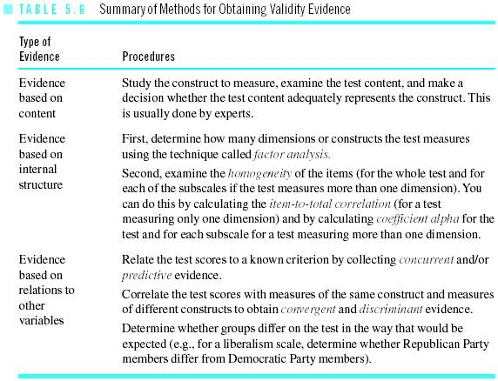
Methods for Obtaining Validity Evidence

Slide 30
Educational & Psychological Tests
Intelligence Tests (eg IQ Test)
Personality Tests (eg Holland’s SDS)
Educational Assessment Tests
Preschool Assessment Tests
Achievement Tests
Aptitude Tests
Diagnostic Tests

Slide 31
Internet Sources - Tests

Slide 32
End of Lecture 5

