Slide 1
Research Ethics
Lecture 4

Slide 2
Research Ethics - Definition
Defined as the principles and guidelines that help us uphold the things we value

Slide 3
Research Ethics – 3 Approaches
Deontological
Use a Universal code when making ethical decisions
Ethical Skepticism
Ethical standards are not universal but are relative to one’s particular culture, time, and even individual
Utilitarianism
Decisions should be based on an examination & comparison of the costs & benefits that may arise from an action

Slide 4
Ethical Concerns
The relationship between society and science
Professional Issues
Duplicate publication
Partial publication
Treatment of Research participants

Slide 5
Ethical Guidelines with Humans
Informed Consent
Informed Consent with Minors
Passive versus Active Consent
Deception
Follow by Debriefing
Dehoaxing
Desensitizing
Freedom to Withdraw
Protection from mental and physical harm
Confidentiality and Anonymity

Slide 6
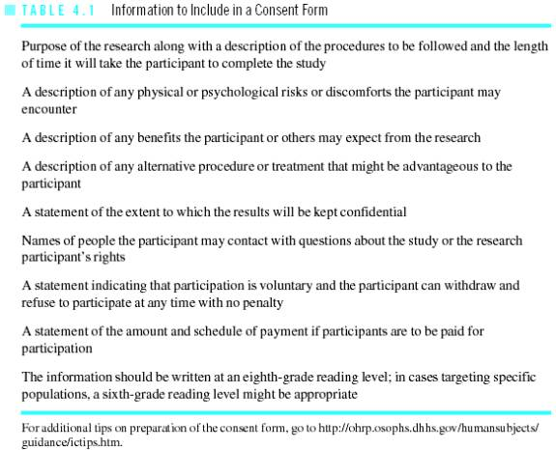
Contents of a Consent Form

Slide 7
End of Lecture 4

