Slide 1
Problem Identification and Hypothesis Formation
Lecture 3

Slide 2
Sources of Research Ideas
Everyday Life
Practical Issues
Past Research
Theory
Caution:
Empirical Research cannot provide answers to ‘ultimate’, ‘metaphysical’, or ‘ethical’ questions

Slide 3
Literature Review – The Need
Research Idea
Identification of a General Problem
Conduct a Literature Review
Check if your topic has been researched
Help to revise your research idea
Provide guide to methodological techniques & problems specific to your research
Help you design your research

Slide 4
Literature Review – The Sources
Books
Journals
Computer Databases
ERIC - http://www.eric.ed.gov/
Emerald
Ingenta
Proquest
Caution: Avoid non-academic Internet materials

Slide 5
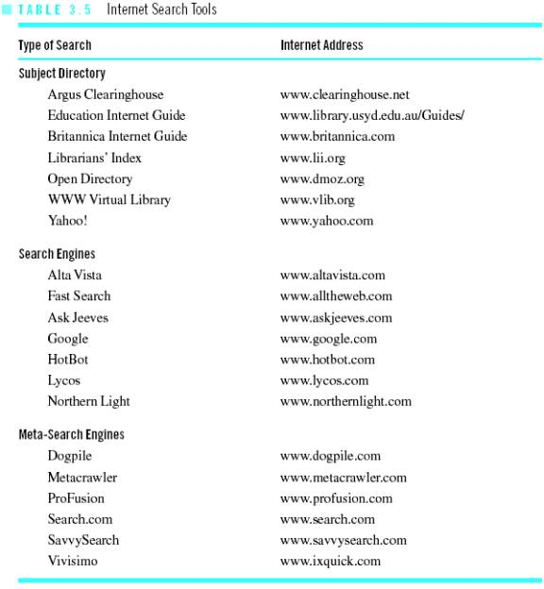
Literature Review – Search Tools

Slide 6
Development of a Research Idea
Research Topic – the broad subject matter area to be investigated
Research Problem – the educational issue or problem within a broad topic area
Research Purpose – a statement of the intent or objective of the study
Research Question – an interrogative sentence that asks a question about the relation between 2 variables (Quantitative)
- An interrogative sentence that asks a question about some process, issue, or phenomenon to be explored (Qualitative)
Hypothesis – a prediction or best guess of the relation that exists among the variables being investigated

Slide 7
Research Proposal
Serves as a framework to guide your research study
Comprise of
Title Page
Abstract
Introduction
Method
Data Analysis
References

Slide 8
End of Lecture 3

