Slide 1
Quantitative, Qualitative, and Mixed Research
Lecture 2

Slide 2
3 Research Paradigms - Characteristics
Quantitative
Relies on the collection of numerical data
Qualitative
Relies on the collection of non-numerical data
Mixed
Blending of the quantitative and qualitative data collection
Refer to Table 2.1 on the Emphasis

Slide 3
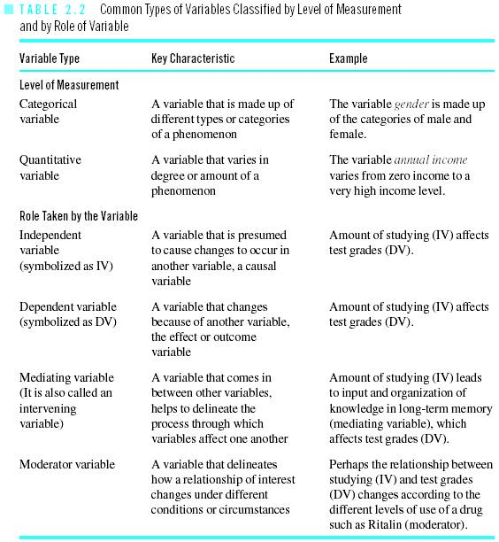
Variables – the building block

Slide 4
Quantitative Research - Experimental
Purpose is to study Cause and Effect relationships
Defining attribute is active manipulation of an independent variable
Random assignment of participants to groups
Refer to your study guide for example

Slide 5
Quantitative Research – Non-Experimental
There is no manipulation of the independent variable
There is also no random assignment of participants to groups
Therefore, if relationship occurs here, we cannot jump to a conclusion of cause and effect due to many alternative explanations for the relationship

Slide 6
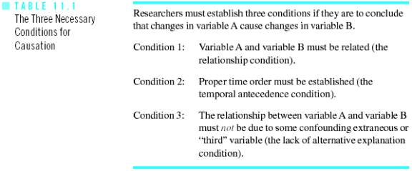
3 conditions for Causal Relationship

Slide 7
3 conditions for Causal Relationship – In Simple Terms
Relationship
Temporal order (arrangement of events in time)
Lack of alternative explanations

Slide 8
Qualitative Research – 5 Types
Phenomenology
Attempts to understand how 1 or more individuals experience a phenomenon
Ethnography
Focuses on describing the culture of a group of people
Case study
Focuses on providing a detailed account of a case
Grounded theory
Attempts to formulate a theory from data collected
Historical
Researches on past events

Slide 9
Mixed research – 2 Types
Mixed method
Uses the qualitative research paradigm for 1 phase and quantitative research paradigm on another phase
Mixed model
Mixes both qualitative and quantitative research approaches within a stage of the study or across 2 of the stages

Slide 10
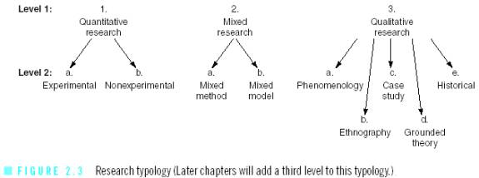
Research Topology - Conclusion

Slide 11
End of Lecture 2

