Slide 1
Introduction to Educational Research
Lecture 1

Slide 2
Why study Educational Research?
To become "research literate."
Because we live in a society that's driven by research.
To improve your critical thinking skills.
To learn how to read and critically evaluate published research.
To learn how to design and conduct research in case the need arises one day.

Slide 3
Example 1: Are you surprised too?

Slide 4
Example 2: Is this true?

Slide 5
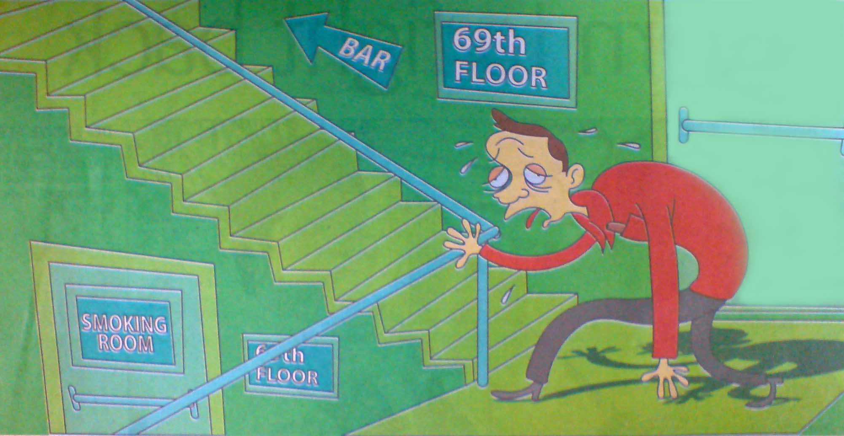
Example 3: Impact of Smoking Ban!

Slide 6
Five General Types of Research
Basic
Applied
Evaluation
Action
Orientational

Slide 7
Basic and Applied research
Basic research aims to generate fundamental knowledge & theoretical understanding about basic human & other natural processes
Two extremes
Applied research focuses on answering practical questions to provide relatively immediate solutions

Slide 8
Evaluation Research
Evaluation Research involves determining the worth, merit, or quality of an evaluation object
Can be classify into 5 types;
Needs assessment (Is there a need?)
Theory assessment (Is it conceptualised?)
Implementation assessment (Is it done properly)
Impact assessment (Is there an impact?)
Efficiency assessment (Is it cost effective?)

Slide 9
Action Research
Action research focuses on solving practitioner’s local problems.
It is also a state of mind.

Slide 10
Orientational Research
Orientational Research is focused on some form of inequality, discrimination, or stratification in society such as differences in wealth, occupation, income, etc.
Interest areas are;
Gender Stratification
Inequality resulting from one’s gender
Ethnic Stratification
Inequality resulting from one’s ethnic or racial grouping

Slide 11
Orientational Research - Example

Slide 12
Sources of knowledge
Classified into
Experience
Expert opinion
Reasoning

Slide 13
Sources of knowledge - Experience
Comes from experience
This view is called Empiricism (i.e. original knowledge comes from experience)

Slide 14
Sources of knowledge – Expert Opinion
When time is a constraint in conducting research work
Knowledge will be based on Experts in the specific areas

Slide 15
Sources of knowledge – Reasoning
This idea is also called Rationalism
Comes in 2 forms;
Deductive
Process of drawing a specific conclusion from a set of premises
Theory Testing
Deduce hypothesis (testable proposition) or hypotheses from the theory
Inductive
Reasoning from the particular to the general
Theory Building (theory follows data)

Slide 16
Knowledge generation – Scientific Approach (Assumptions)

Slide 17
Scientific Methods - Deductive
State the hypothesis
Collect data to test the hypothesis
Make decision to accept or reject the hypothesis
Theory Testing – a top-down method

Slide 18
Scientific Methods - Inductive
Observe the world
Search for a pattern in what is observed
Make a generalization about what is occurring
Theory Building – a bottom-up method

Slide 19
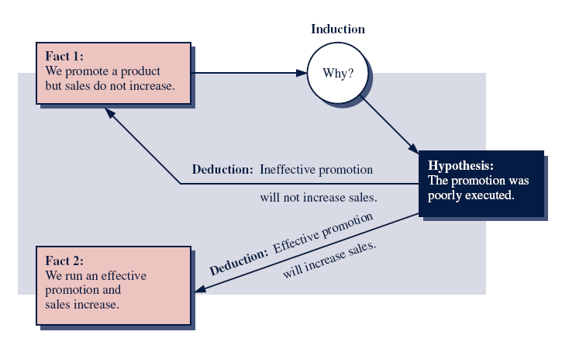
Induction versus Deduction

Slide 20
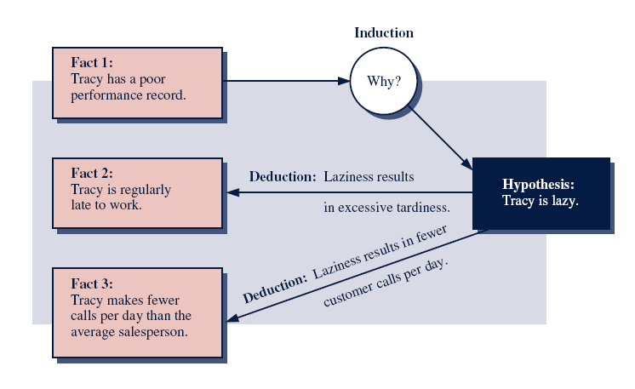
Induction - Example

Slide 21
5 Major Objectives of Research
Exploration
Description
Explanation
Prediction
Influence

Slide 22
End of Lecture 1

