Slide 1
Research Methods
Requirements & Expectation – Q408

Slide 2
Research Methods
Tutor: Dr Eric Lim
Email: eric_lim@easb.edu.sg

Slide 3
Assessment
5 assignments to be done in teams
No Exam
Assignment No: | Submission Date (End of Week): | Weight: | Requirement
1 | 1 | 0 % | 1 page
2 | 3 | 0 % | 1 page
3 | 5 | 15 % | 1000 words (± 10 %)
4 | 10 | 30 % | 20 slides (max) & 20 minutes (max)
5 | 11 | 55 % | 2000 words (± 10 %)

Slide 4
Assessment Structure
..\..\Assignment\RM2090Assignment Structure_Q408.pdf

Slide 5
Example of Literature Article
Research Topic: Impact of Tipping in Restaurant
Article: Tipping in Restaurants
A good literature review article can serves as a guide to your Research Design & Implementation

Slide 6
Requirement & Expectation
Form into teams
Maximum 6 students
Decide a Research Topic
Design your Research
Perform Fieldwork research (Data Collection)
Analyse your collected data
3 SPSS lab sessions
Present your findings
Your presentation will be recorded

Slide 7
Requirement & Expectation
Actions to be captured ;
Research Topic Exploration
Concept Mapping (using FreeMind software)
Questioning Technique
Data Analysis (using SPSS software)
SPSS Data Entry
SPSS Lab Sessions
Fieldwork
Data Collection – Interview or Survey
Evidence (images and video-clips)

Slide 8
Past Student Work
Assignment 4
Assignment 4 – Set 2

Slide 9
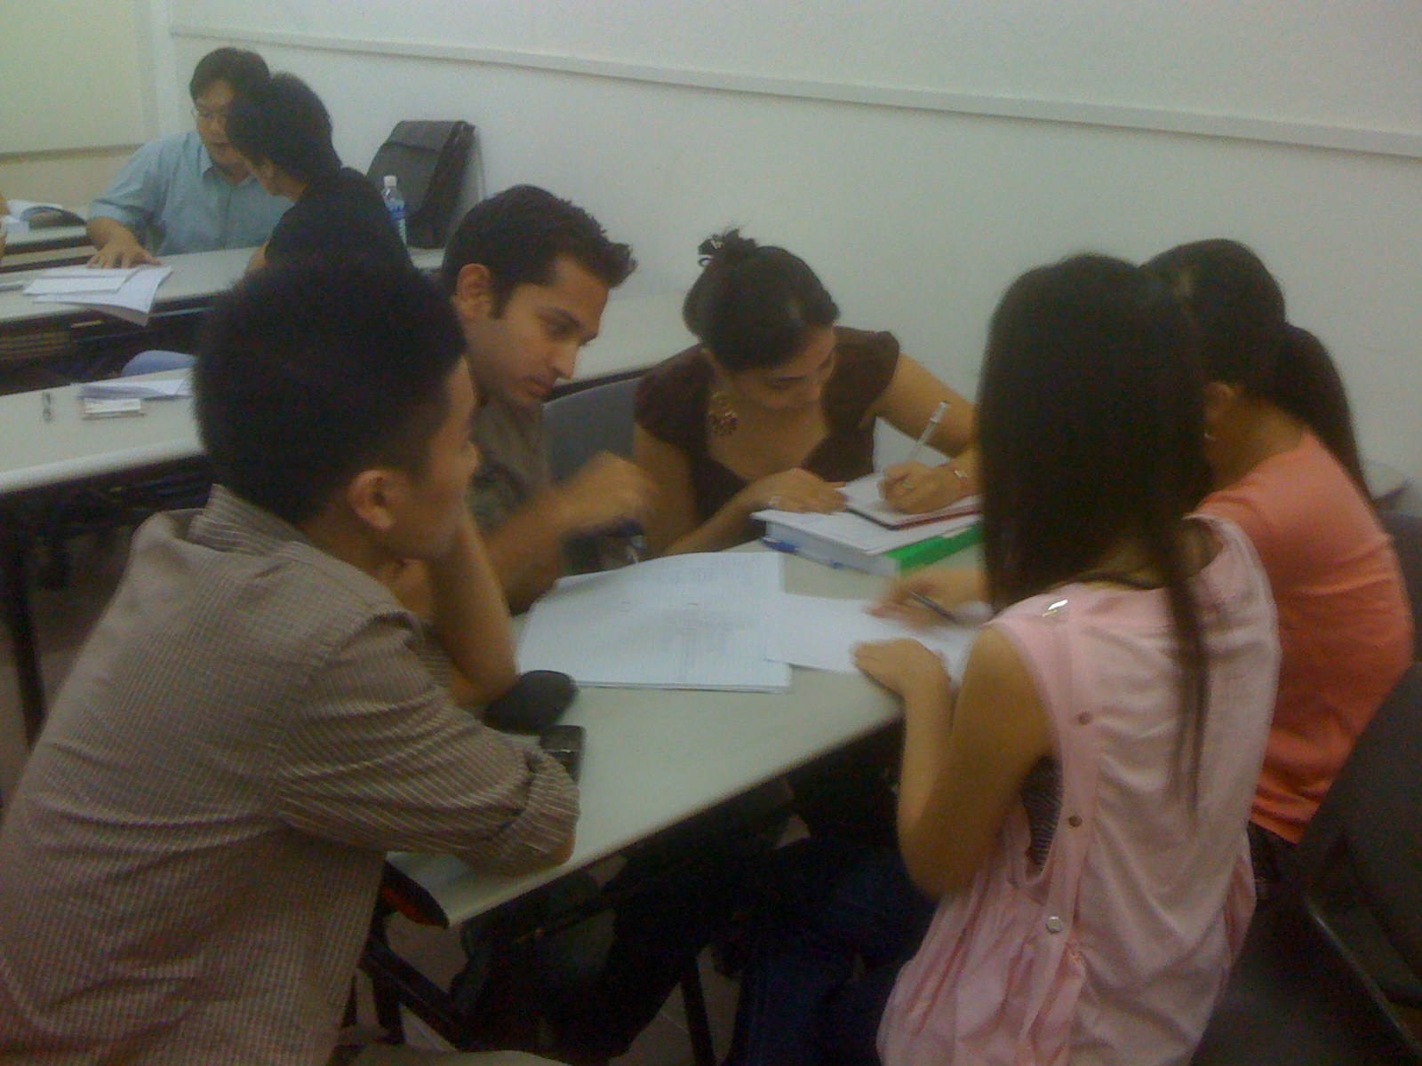
Brainstorming

Slide 10
Brainstorming

Slide 11
Fieldwork Action

Slide 12
Fieldwork Action

Slide 13
Fieldwork Action

Slide 14
Fieldwork Action

Slide 15
SPSS Data Entry

Slide 16
SPSS Data Entry

Slide 17
Past Student Presentation – Assignment 4

Slide 18
Past Student Presentation – Assignment 4

Slide 19
Questions?

Slide 20
Lets get to know each other..
Tell us your name
Where do you come from?
Country and Province
What program you are in (ADHT, ADIHM,ADBM)?

Slide 21
Your Task for this week
Form your team
Provide me with name-list and team leader
Get together and discuss on Research Topic

