Slide 1
Bodylight.js 2.0 - In-browser Web Simulators using Standard Web Components
Tomáš Kulhánek and Jiří Kofránek
Laboratory of Biocybernetics and Computer Aided Learning, First Faculty of Medicine, Charles University, Praha
Creative Connections, s.r.o.

Slide 2


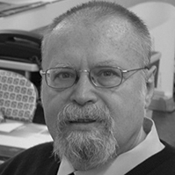
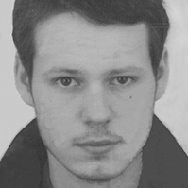


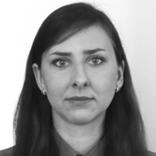
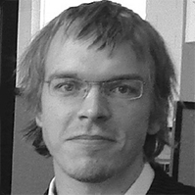
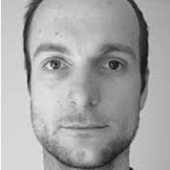

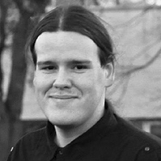

Team
Laboratory of Biocybernetics, Charles University in Prague
We teach for Czech Technical University
We teach for high school of art and design, SOŠ, VOŠ Václava Hollara
Creative connections s.r.o.
spin off company
Mgr. Martin Feber
Martin Brož, DiS
Doc. MUDr. Jiří Kofránek, CSc.
RNDr. Mgr. et Mgr. Arnošt Mládek, Ph.D.
Mgr. Tomáš Kulhánek, Ph.D.
MUDr. Jitka Feberová, Ph.D.
Klára Ulčová, DiS.
Mgr. Marek Mateják, Ph.D.
Ing. Jan Šilar, Ph.D.
Ing. Filip Ježek, Ph.D.
Bc. David Polák
Bc. Veronika Sýkorová, DiS.

Slide 3
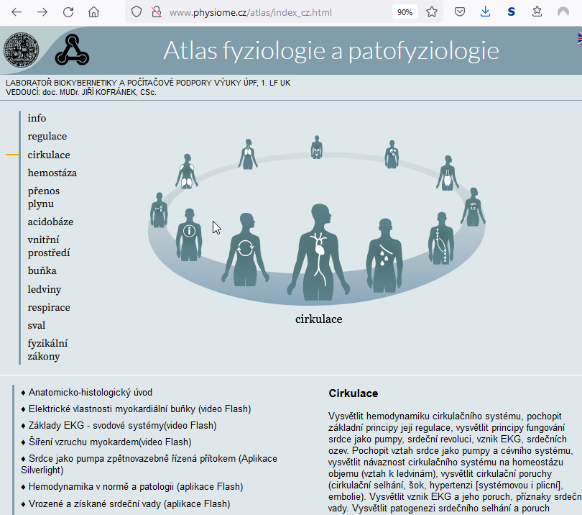
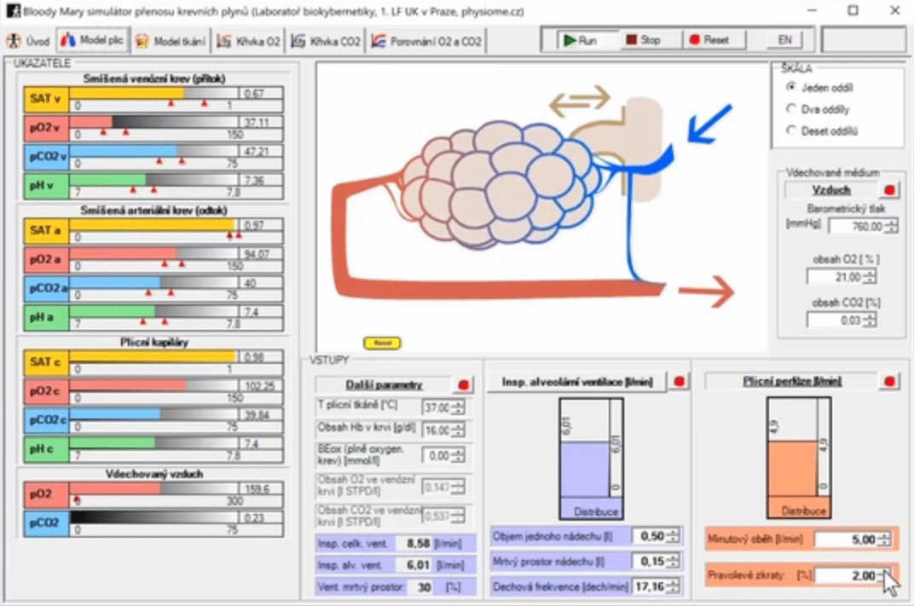
Evolution of web simulators
>10 years ago
Kofránek Jiří, Matoušek Stanislav, Rusz Jan, Stodulka Petr, Privitzer Pavol, Mateják Marek, Tribula Martin: The Atlas of Physiology and Pathophysiology:Web-based multimedia enabled interactive simulations, Computer Methods and Programs in Biomedicine (2011),doi:10.1016/j.cmpb.2010.12.007, 2011 Jan 11.
Models programmed in .NET and Adobe FLASH, .NET, WPF (XAML),
Direct manipulation of graphics.

Slide 4
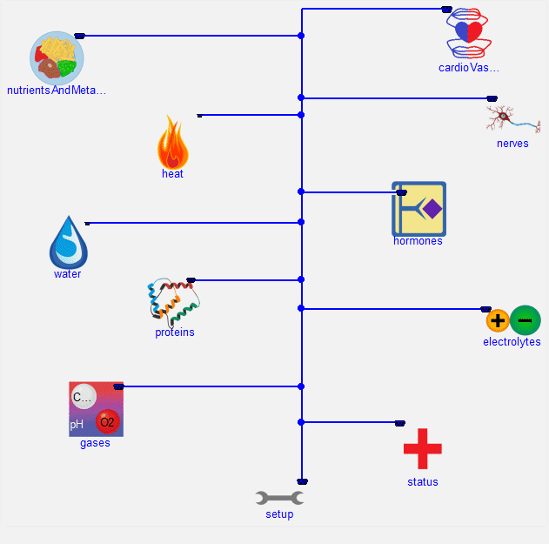
Evolution of web simulators
We have learned Modelica
We implemented and enhanced HumMod model
https://www.physiomodel.org
And library to support modeling physiology
https://www.physiolibrary.org

Slide 5
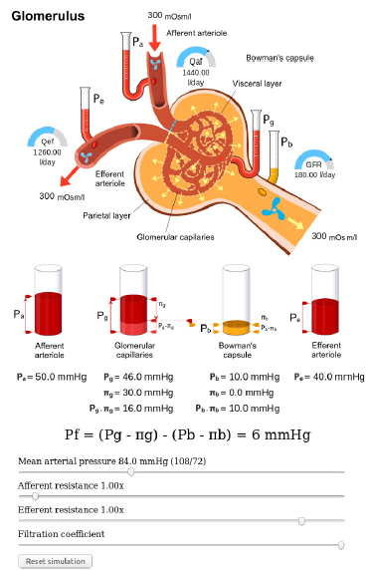
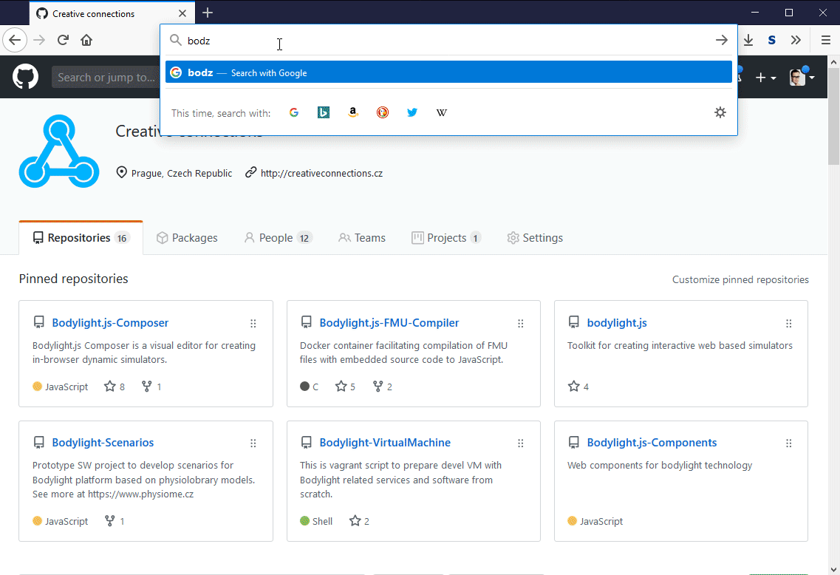
Evolution of web simulators
2019-now
Kofránek Jiří, Matoušek Stanislav, Rusz Jan, Stodulka Petr, Privitzer Pavol, Mateják Marek, Tribula Martin: The Atlas of Physiology and Pathophysiology:Web-based multimedia enabled interactive simulations, Computer Methods and Programs in Biomedicine (2011),doi:10.1016/j.cmpb.2010.12.007, 2011 Jan 11.
ŠILAR, Jan, David POLÁK, Arnošt MLÁDEK, Filip JEŽEK, Theodore W KURTZ, Stephen E DICARLO, Jan ŽIVNÝ a Jiri KOFRANEK. Development of In-Browser Simulators for Medical Education: Introduction of a Novel Software Toolchain. Journal of Medical Internet Research [online]. 2019, 21(7) [cit. 2019-11-25]. DOI: 10.2196/14160. https://www.jmir.org/2019/7/e14160
Jan Šilar, Filip Ježek, Arnošt Mládek, David Polák, Jirí Kofránek,Model visualization for e-learning, Kidney simulator for medical students, Modelica conference 2019
Models in Modelica, exported to FMU, compiled to WebAssembly, and integrated into web application with 2D, 3D and immersive graphics (WEBGL, WEBXR)

Slide 6
Workflow to develop web simulators
Export Modelica model to FMU with source codes
Compile source code of FMU to WebAssembly
Design and code web simulator
  HTML, CSS and other components in web app
  Javascript to call FMU functions
  Javascript to bind variables from FMU to charts
  bind variables from FMU to animation
  bind HTML controls (buttons, inputs) to actions (start/stop simulation, set FMU values)
  use prepared web-components (Bodylight.js 2.x)

Slide 7
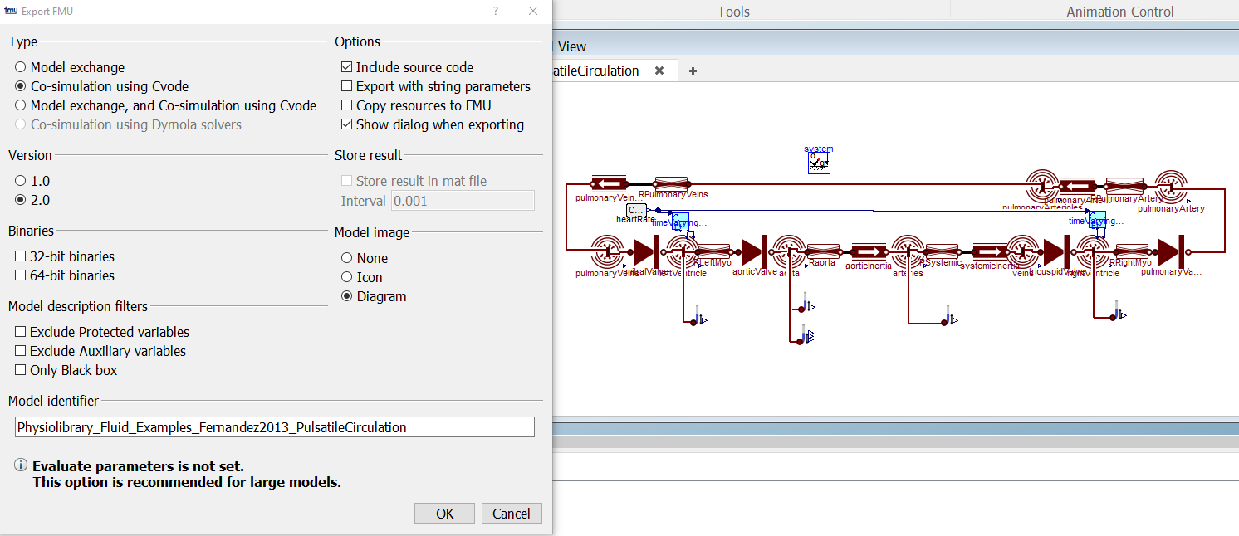
Workflow – 1. export FMU with source codes

Slide 8
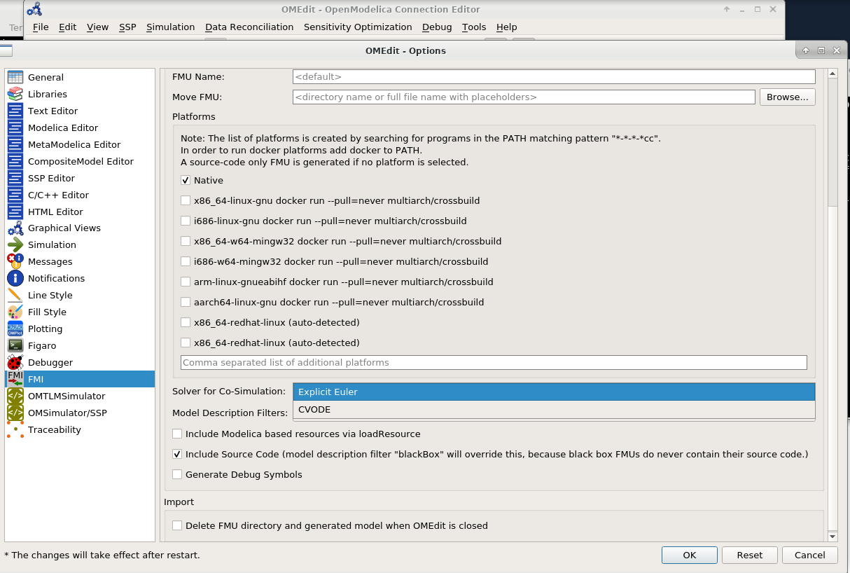
Workflow – 1. export FMU with source codes

Slide 9
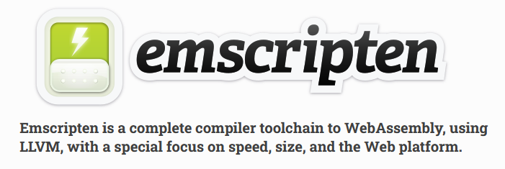
Workflow – 2. compile source codes of FMU to WebAssembly
Using emscripten
Prepared Bodylight.js-FMU-Compiler
  Configuration and scripts to facilitate compilation with emscripten
  emcc … -O3 –closure 0 …
  https://github.com/creative-connections/Bodylight.js-FMU-Compiler
  works with FMU with CVODE generated from Dymola and FMU with Euler solver generated from OpenModelica
  open issue to support FMUs with CVODE from OpenModelica

Slide 10



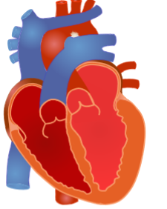
Workflow – 3. design and code web simulator
HTML tag for link
  <a href=“link”>odkaz</a>
HTML tag for button
  <button>tlačítko</button>
HTML tag for input range
  <input type="range" min="0" max="10" value="1" step="1"/>
HTML tag for image
  <img src=“heartschema.jpg" alt=“image"/>

Slide 11
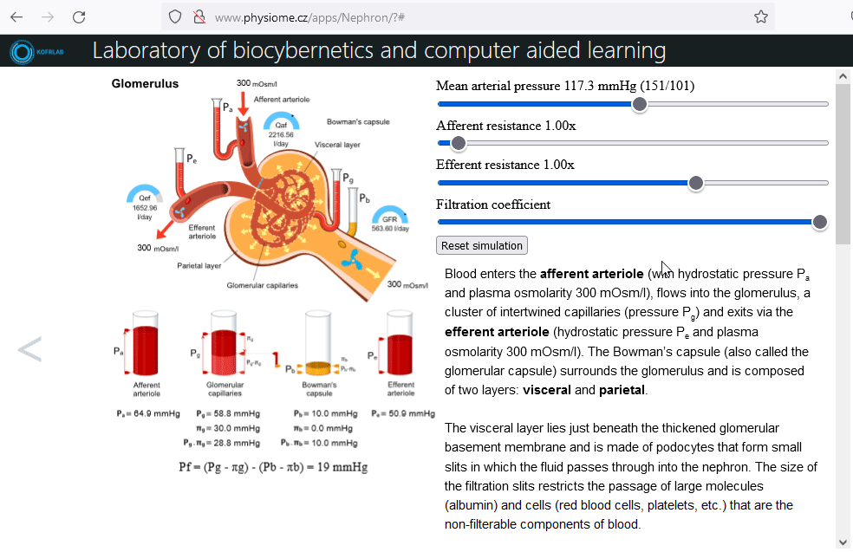
Workflow – 3. design and code web simulator
Javascript code to bind
  FMU variables and charts
  FMU variables with animatable objects
  HTML buttons and inputs to manipulate FMU input variables and parameters
Bodylight-Composer
  Prototype – based on grapes.js user can choose HTML and other components to connect FMU with animation and controls

Slide 12
Workflow – 3. design and code web simulator
Web-components
  Bodylight.js 2.x
  Library
  Source codes at
  https://github.com/creative-connections/Bodylight.js-Components
  https://github.com/creative-connections/aurelia-bodylight-plugin

Slide 13



Web Components
enhance vocabulary of tags by custom tags, custom-elements
Standard – supported by modern browsers (Firefox,Chrome,Safari,MS Edge) https://webcomponents.org
  Define component
  Use component

Slide 14
Web Components
enhance vocabulary of tags by custom tags, custom-elements
Standard – supported by modern browsers (Firefox,Chrome,Safari,MS Edge) https://webcomponents.org
  Define component
  Use component
Define components of Bodylight.js:
Use component from Bodylight.js library (with bdl- prefix)

Slide 15
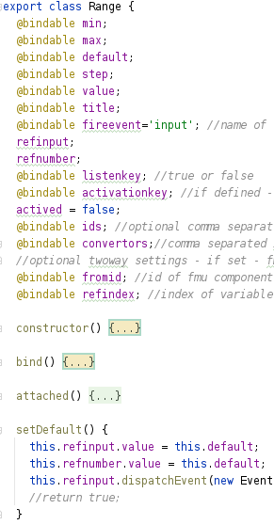
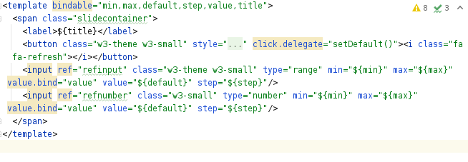

Bodylight.js - web Components
Range component <bdl-range></bdl-range>
Definition (in library) – html + js
Used in source code:
Rendered in browser:

Slide 16
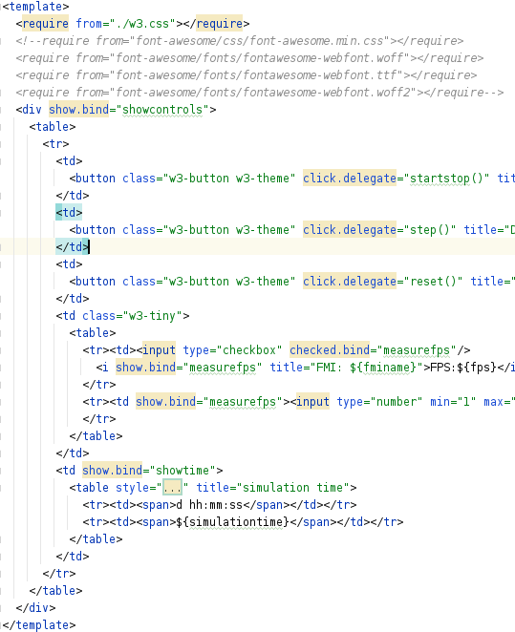
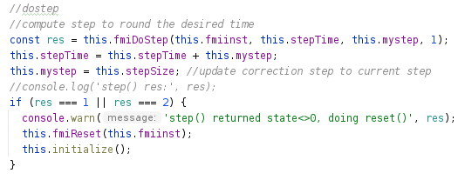
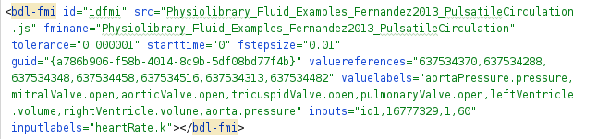

Bodylight.js - web Components
FMI component <bdl-fmi></bdl-fmi>
Definition (in library) – html + js
Used in source code:
Rendered in browser:

Slide 17
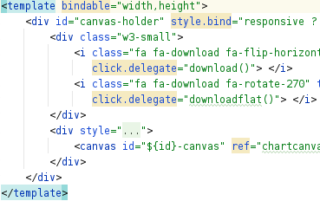
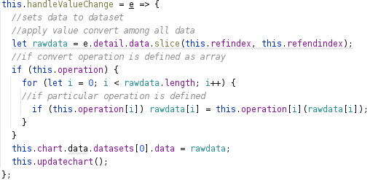
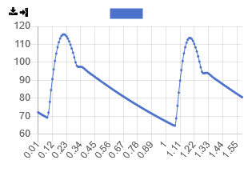
Bodylight.js - web Components
Charts component <bdl-chartjs></bdl-chartjs>
Definition (in library) – html + js
Used in source code:
Rendered in browser:

Slide 18
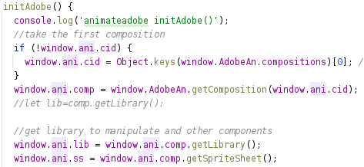
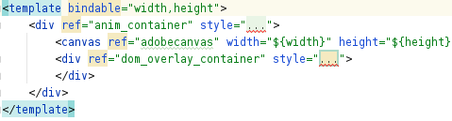
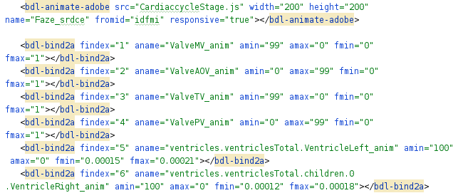
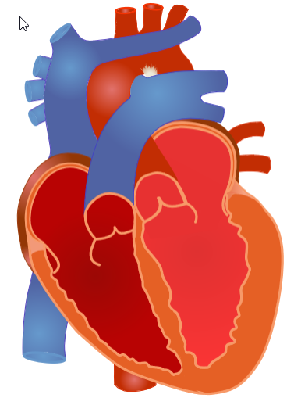
Bodylight.js - web Components
Animation component <bdl-animate-adobe></bdl-animate-adobe>
Definition (in library) – html + js
Used in source code:
Rendered in browser:

Slide 19
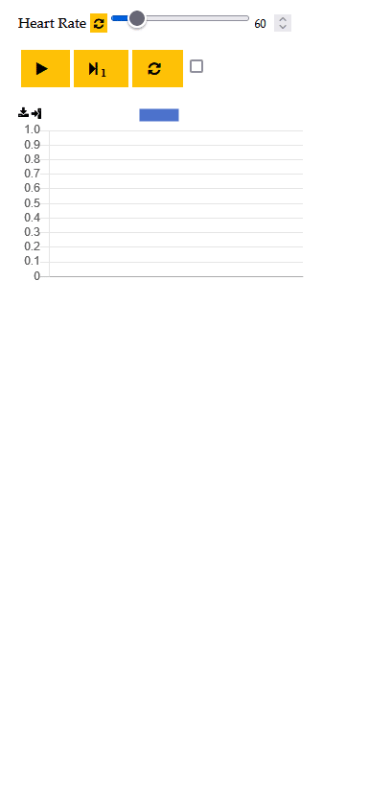
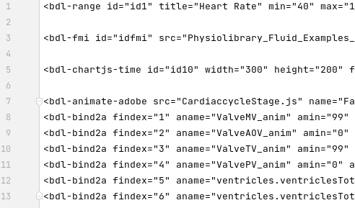
Web simulator of hemodynamics

Slide 20
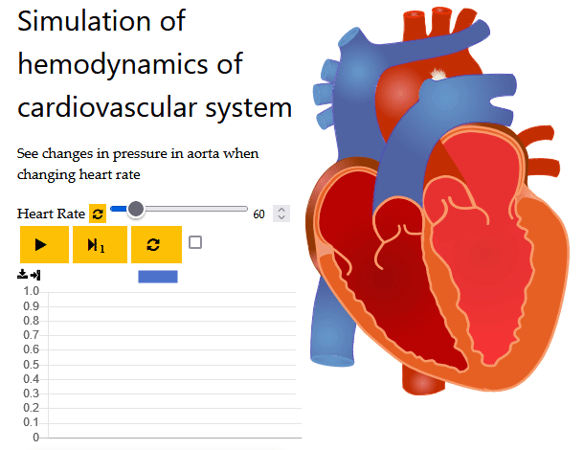
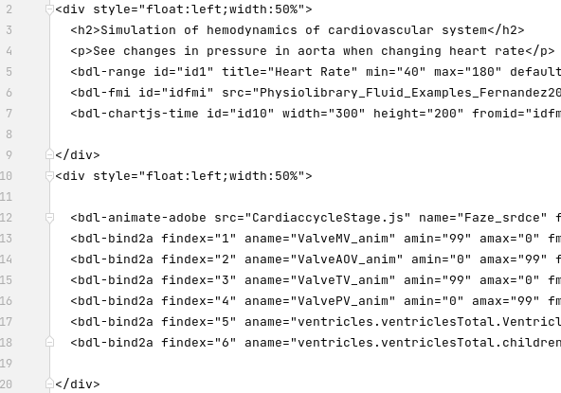
Web simulator of hemodynamics, different layout

Slide 21
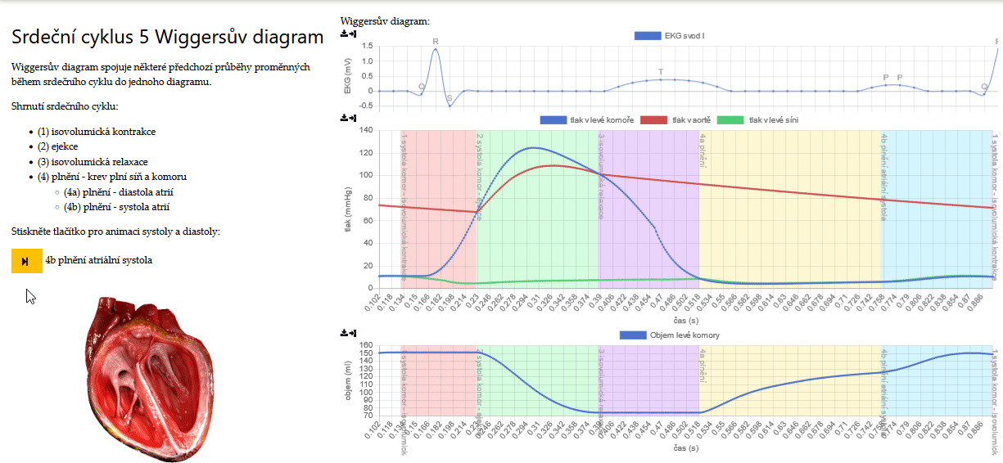
Web simulator of hemodynamics

Slide 22
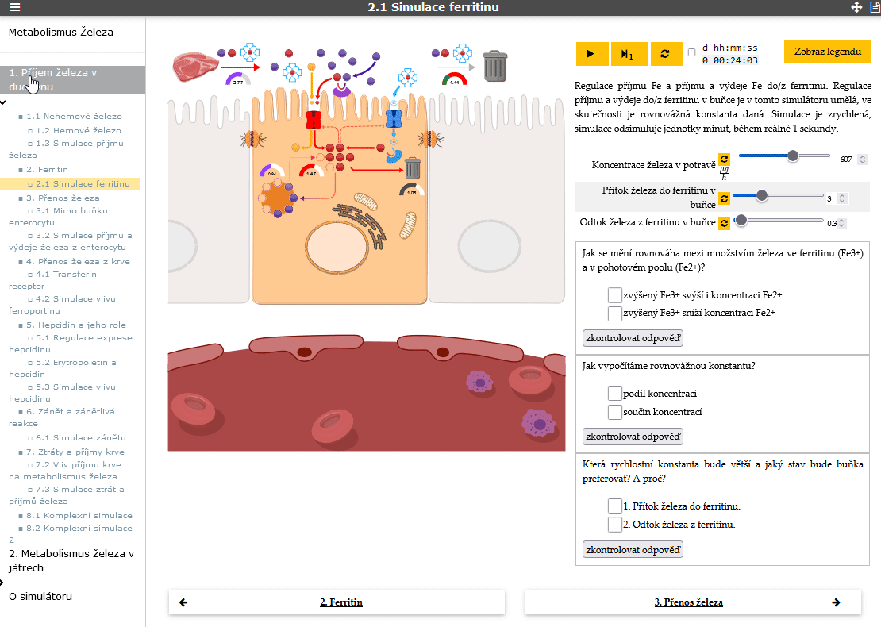
Web simulator of iron metabolism

Slide 23
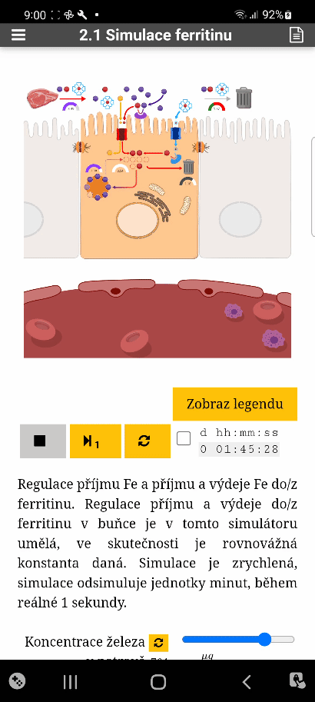
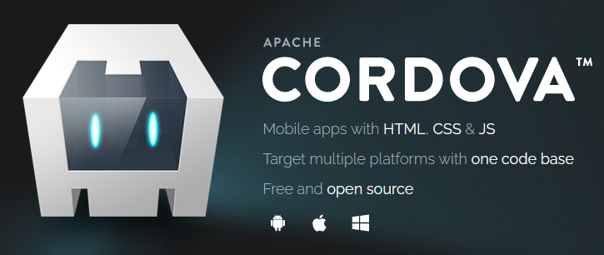
Web simulator as native app in mobile devices
Apache Cordova

Slide 24
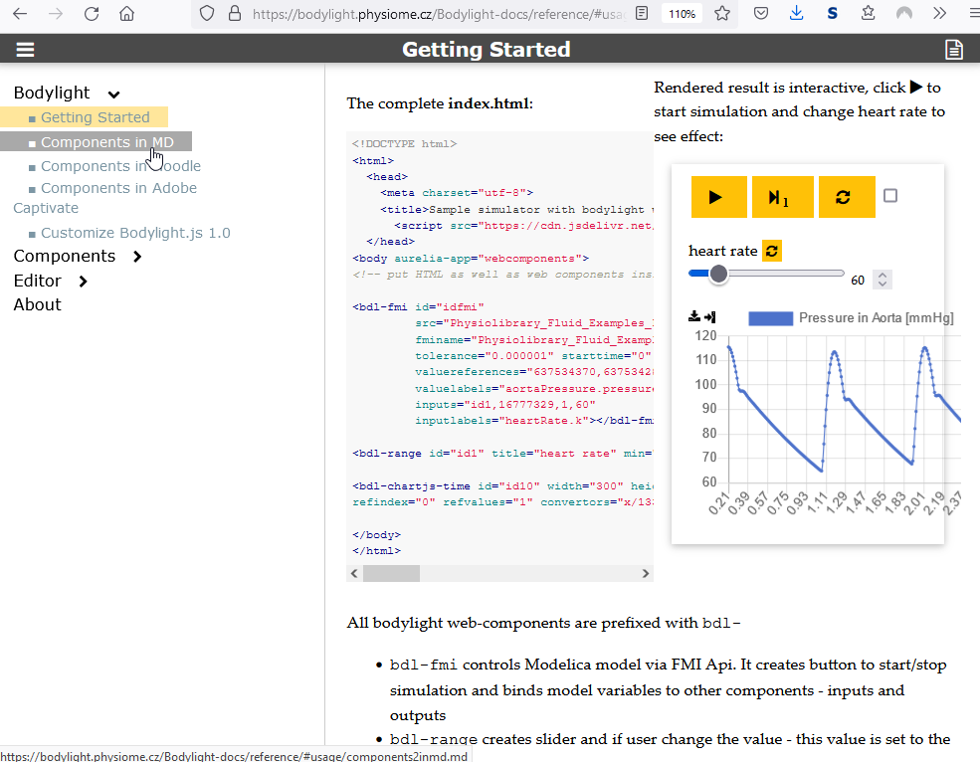
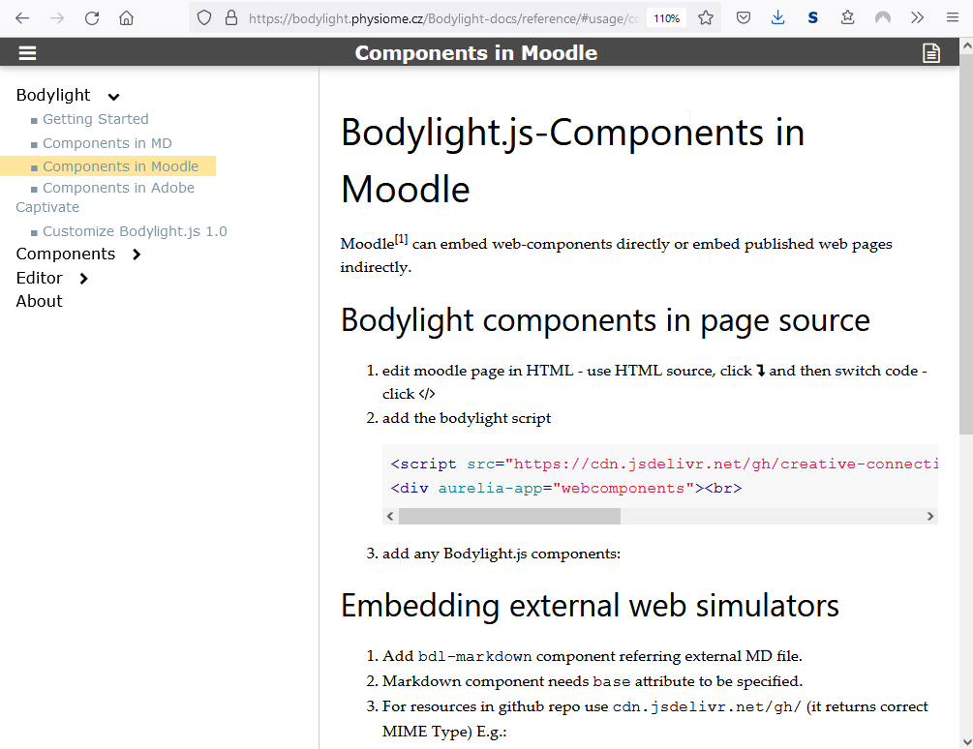
Integration to HTML, MarkDown, Wiki, LMS Moodle, Adobe Captivate, …

Slide 25
WebGL– web api for 3D visualisation

Slide 26
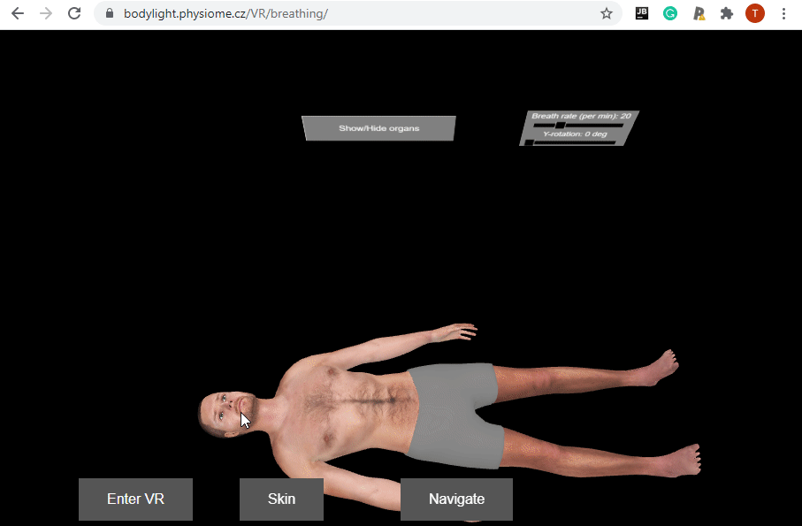
WebXR – web api for immersive view for virtual and augmented reality

Slide 27
Summary
Workflow of tools for exporting Modelica models to in-browser simulator
Compiler – FMU -> JS with webAssembly
Web components in Bodylight.js library
  facilitate development of web simulator
  Eliminate coding in javascript
Performance of FMU in web browser
  <10% slower compared to FMU performed natively
  Most demanding are animation, chart updates, …
Not for system analysis
For system visualization, reporting results, e-learning, …

Slide 28
Summary
Web simulators – do not require installation of complex software – they work in standard web browsers, desktop PC, mobile devices, tablets, VR/AR headsets, …
Tools and technologies around Bodylight.js simplify collaboration and improve productivity among biomedical engineers, computer scientists, medical doctors, physiologists, computer graphic designer
Enabling technology for
  E-learning with web simulators
  Digital twin for clinical decision support

Slide 29
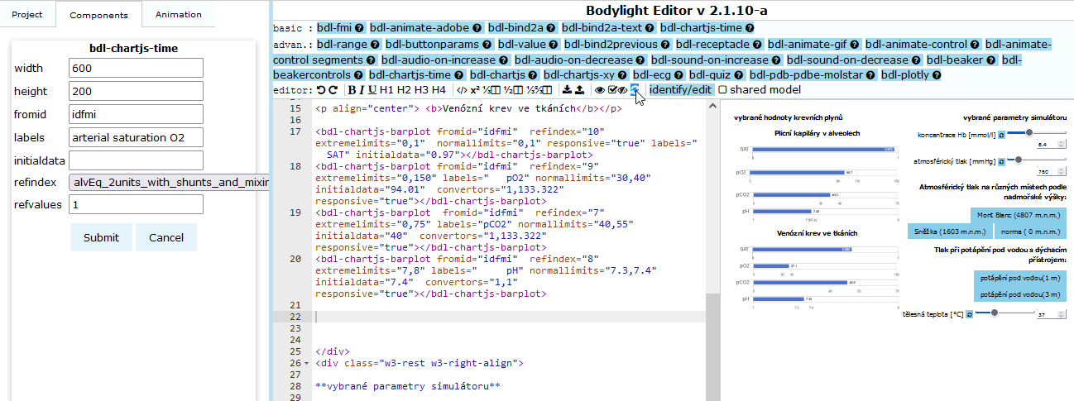
Future work
Improve our or other low-code, no-code tools to create web simulators with web components: Bodylight-Editor, Bodylight-Composer

Slide 30
Future work
Improve our or other low-code, no-code tools to create web simulators with web components: Bodylight-Editor, Bodylight-Composer
Improve support of other tools (FMU -> JS with webAssembly in OpenModelica)
  And/or join effort to standardize FMU with source codes
It’s open-source
  Seeking for funding (public or commercial)
  Seeking for collaboration (academy or industry)

Slide 31
Thank you for your attention
https://bodylight.physiome.cz/
Mgr. Tomáš Kulhánek, Ph.D.
1.Lékařská fakulta, Univerzita Karlova, Praha
Creative Connections, s.r.o.
tomas.kulhanek@matfyz.cz

