Slide 1
Trauma-Informed Strategies Responding to Adverse Experiences
Elyse Dobney (she/her)
Social Justice and City Mission Director
Peggy McGee (she/her)
Territorial Youth Leadership and Resource Development

Slide 2
Trauma-Informed Care
A program, organization, or system that is trauma-informed:
Realizes the widespread impact of trauma and understands its potential paths for recovery;
Recognizes the signs and symptoms of trauma in clients, families, staff, and others involved with the system;
Responds by fully integrating knowledge about trauma into policies, procedures, and practices; and
Seeks to actively resist re-traumatization.
www.samhsa.gov/mctic/trauma-interventions

Slide 3
Trauma-Informed Lens
Clients’ current behaviors represent their best efforts to cope with what has happened to them and to survive. Don’t take it personally. Honor their survival skills and encourage them to learn more adaptive functioning once they are safely removed from exploitation.

Slide 4
Types of Coping Skills
For trauma, the goals of coping skills are to help manage the symptoms to the point of minimal disruption in daily functioning
Three types of PTSD coping skills:
Comfort Techniques
Distracting Techniques
Grounding Techniques

Slide 5
Practice Tips
Change your perspective.
What did you do? → What happened to you?
Be mindful of your body language (verbal, non-verbal cues and reactions).
Listen actively, validate and acknowledge experiences.
Know what information you NEED and do not require sharing of personal information that is not necessary.
Be comfortable discussing challenging events/topics.
Maintain boundaries – define your role and know what other resources are available to meet additional needs (health and mental health services, addictions services, therapeutic services, etc.).
Monitor expectations with clear, consistent communication.
Be authentic.
Refraining from language that has the victim pleasing or performing for you– “do it for me…” “can you do this for me, I’m going to check in with you next week.”
Practice good self-awareness - “wanting people to like you.”
Assist in identifying activities that would provide a sense of purpose and meaning.
Encourage/assist in connecting in a meaningful way with themselves, safe family members, friends, culture and community.

Slide 6
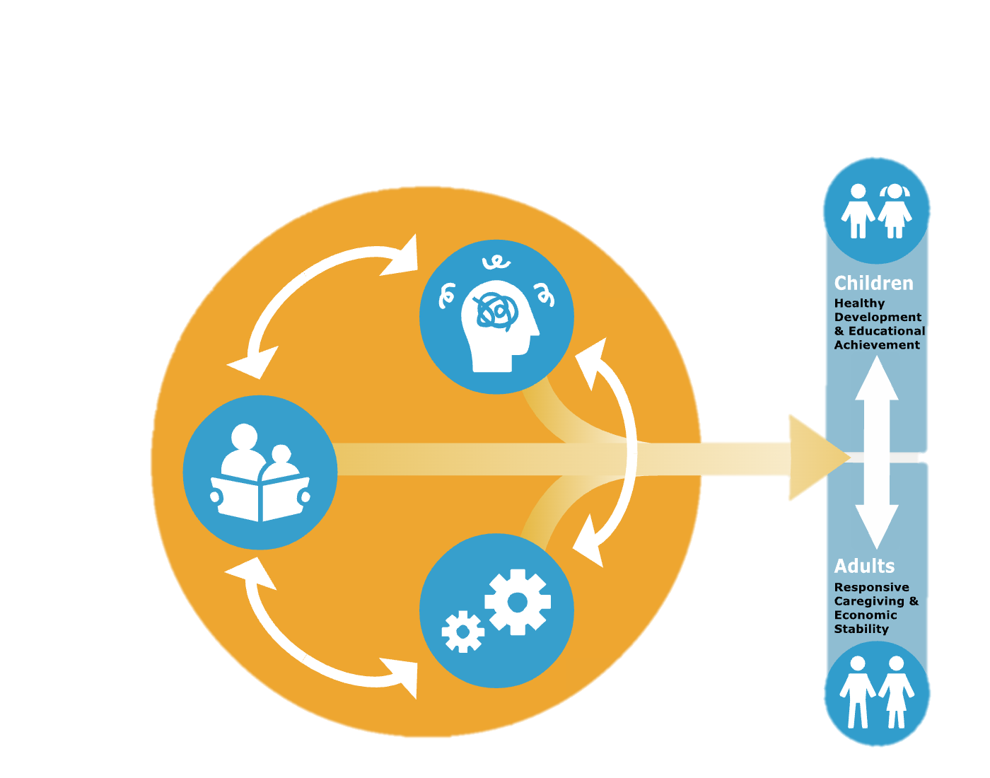
Building Resiliency
Reduce
Sources of
Stress
Support
Responsive
Relationships
Strengthen
Core
Skills
Harvard Center for the Developing Child, 2021,
https://harvardcenter.wpenginepowered.com/wp-content/uploads/2017/10/3Principles_Update2021v2.pdf
Notes:
Support responsive relationships for children and adults.
Strengthen core skills for planning, adapting, and achieving goals.
Reduce sources of stress in the lives of children and families.

Slide 7
Organizational Responsibilities
Accept stressors as real and legitimate, impacting individuals and the staff as a whole.
Work in a team.
Create a culture to counteract the effects of trauma.
Establish a clear value system within your organization.
Be clear about job tasks and personnel guidelines.
Obtain (or provide) supervisory/management support.
Maximize collegiality.
Encourage democratic processes in decision-making and conflict resolution.
View the issue as affecting the entire group, not just an individual.
Remember the general approach is to seek solutions, not assign blame.
Expect a high level of tolerance for individual disturbance.
Communicate openly and effectively, ensure transparency.
Expect a high degree of cohesion.
Expect considerable flexibility of roles.
Join with others to deal with organizational bullies.
Eliminate any subculture of violence and abuse.
Source: www.workplacestrategiesformentalhealth.com

