Slide 1
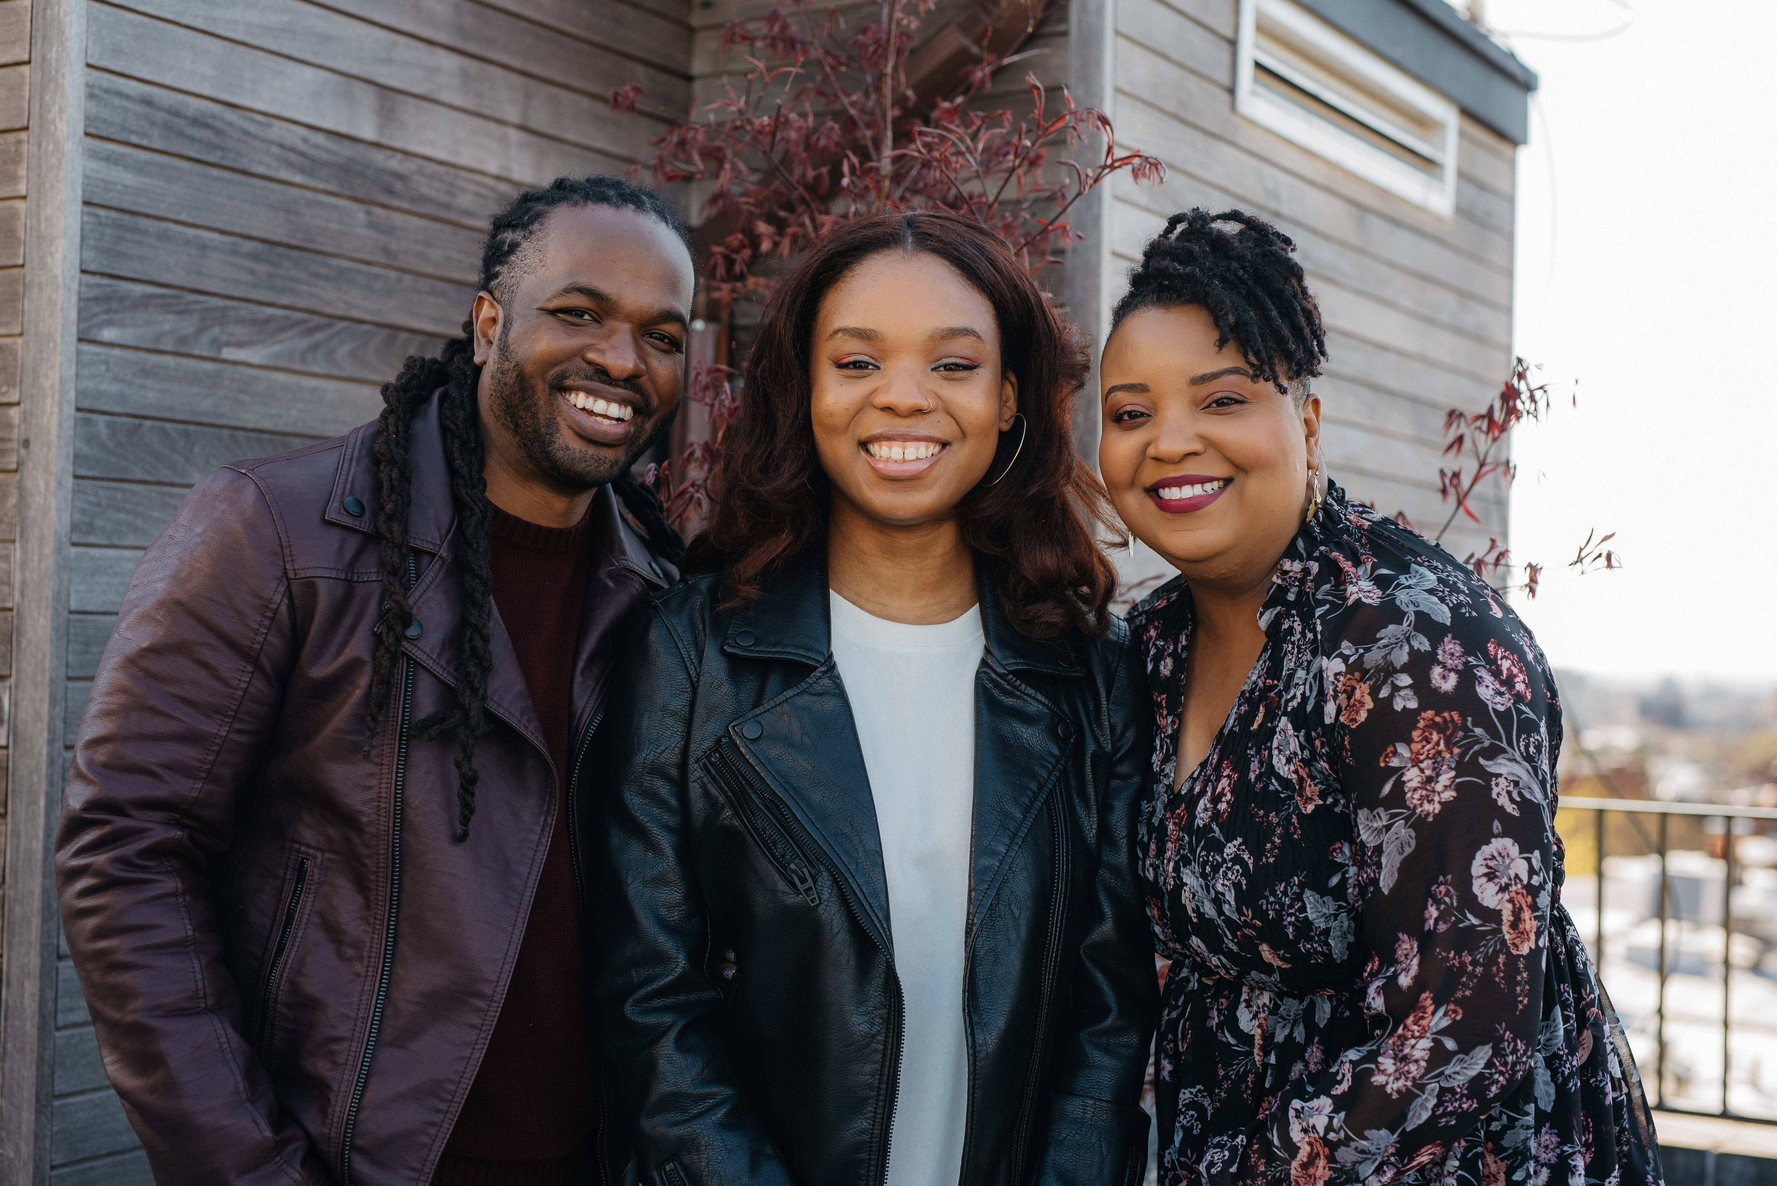
Notes:
My family

Slide 2
I pray not only for these, but also for those who believe in me through their word. May they all be one, as you, Father, are in me and I am in you. May they also be in us, so that the world may believe you sent me.
- Jesus
Notes:
john 17:20-21: Jesus both anticipates the problem of community & empowers us to overcome those problems.

Slide 3
But you will receive power when the Holy Spirit has come on you, and you will be my witnesses in Jerusalem, in all Judea and Samaria, and to the end of the earth.
- Acts 1:8
Notes:
King (justice) & Lord (Righteousness). Witnesses. with lips & lives. Outline of Acts. Confronting what divides us is Gospel issue. protest outside

Slide 4
Confronting What Divides Us Is A Gospel Issue
Notes:
NYT: Quiet Exodus. Charmain Pruitt: member of a mostly white mega church near Dallas. Appreciated warmth … until things changed. The concerns of her community were ignored, and worse dismissed …

Slide 5
In those days, as the disciples were increasing in number, there arose a complaint by the Hellenistic Jews against the Hebraic Jews that their widows were being overlooked in the daily distribution.
Notes:
Complaint arises … Hellenistic and Hebraic Jews. Major difference. Judea/Diaspora. Physical, cultural and religious dimensions. NYC

Slide 6
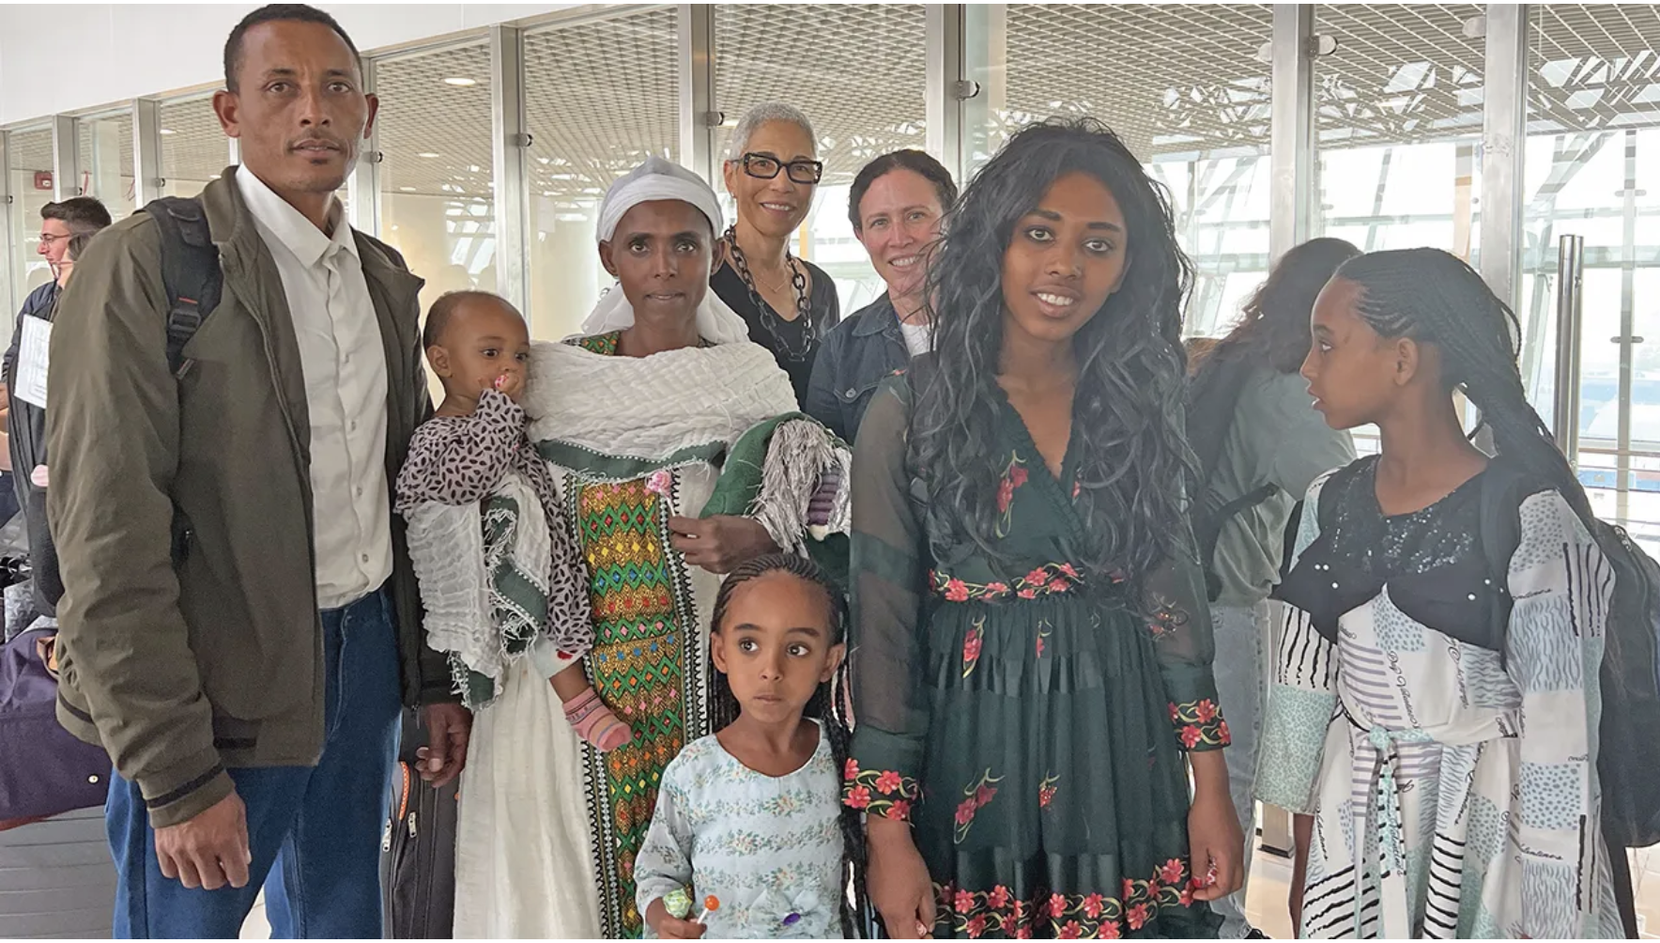
Notes:
I live in an Hasidic Jewish neighborhood. Kosher/Sabbath. Diff from progressive Jews. Hebrew/Laws. “narrative of difference”.#1- listened

Slide 7
1. Listen to the complaints.
Notes:
Was A6 intentional or not? Don’t know. Big ? could this movement grow beyond Jerusalem. Or was it like every one else: justice … Tell your story.

Slide 8
The daily distribution was a justice issue that compromised the gospel.
Notes:
daily “soup kitchen”. 1000+, immigrant widows.Gospel at stake. undefiled religion:look after orphans & widows/ unstained. James 1:27.

Slide 9
The doctrine of Imago Dei is so embedded in our hearts that we have to create stories to deny it in order to justify distorting it.
Notes:
In these days can you hear the complaints arising? Daniel: Naming. We need to name them.

Slide 10
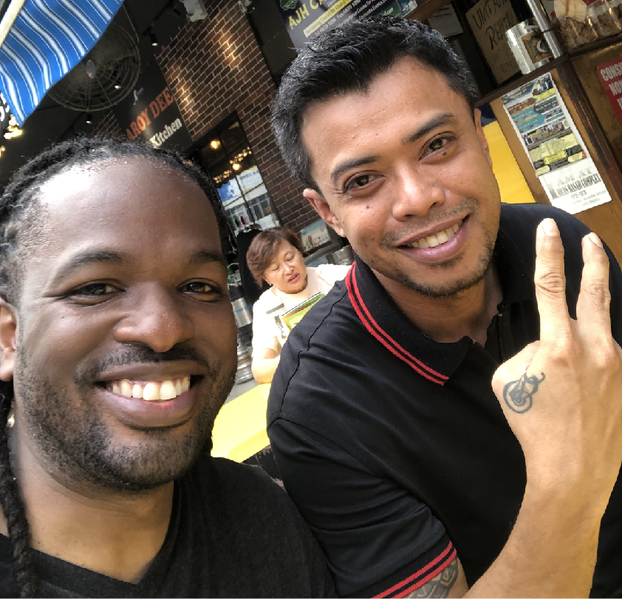
Notes:
My family

Slide 11
In the American Christian narrative … we have yet to engage in a proper funeral dirge for our tainted racial history and continue to deny the deep spiritual stronghold of a nation that sought to justify slavery.
- Soong Chan Rah, Prophetic Lament
Notes:
In these days can you hear the complaints arising? Daniel: Naming. We need to name them.

Slide 12
Have you listened to the complaints that have arisen?
Notes:
Info age. Educate yourself. Ask if you ready to act. Not voyeurism. Racism creates a false hierarchy: impacts all. Acts 6:2-3

Slide 13
The Twelve summoned the whole company of the disciples and said, “It would not be right for us to give up preaching the word of God to wait on tables. Brothers and sisters, select from among you seven men of good reputation, full of the Spirit and wisdom, whom we can appoint to this duty.
- Acts 6:2-3
Notes:
Whole company. Like this. They Understood their limits. They were with Jesus. But, Used power to change. Not tokenism #2. Lead by responding

Slide 14
2. Lead by Lamenting.
Notes:
The marginalized spoke up. Speak up. 12 were aware of their power and influence. They spoke up for those who were not being heard.

Slide 15
“You cannot have that conversation without shame, because you cannot talk about race without talking about privilege. And when people start talking about privilege, they get paralyzed by shame.” - Brené Brown
Notes:
In these days can you hear the complaints arising? Daniel: Naming. We need to name them.

Slide 16
True reconciliation, justice and shalom require a remembering of suffering, an unearthing of a shameful history and a willingness to enter into lament.
Notes:
In these days can you hear the complaints arising? Daniel: Naming. We need to name them.

Slide 17
The Twelve spoke up for those who were not being heard.
Notes:
It is hard to speak truth to power. It will be inconvenient, time-consuming, messy, but necessary. In 1963, MLK responds. Look @ quote

Slide 18
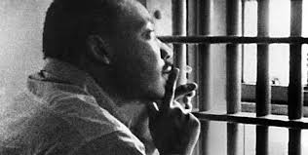
I would not hesitate to say that it is unfortunate that so-called demonstrations are taking place in Birmingham at this time, but I would say in more emphatic terms that it is even more unfortunate that the white power structure of this city left the Negro community with no other alternative.
Notes:
creative tension. You can’t talk about race w/o racism. Can’t talk racism w/o steps to true comm

Slide 19
pseudo-community:
Where participants are "nice with each other", playing-safe, and presenting what they feel is the most favorable sides of their personalities.
- Steve Peck,
The Different Drum
Notes:
Majority can choose to move away from discomfort or move towards community. Have you listened to the complaints that have arose?

Slide 20
pseudo community
chaos
emptiness
true community
Notes:
Chaos: ppl feel safe to present "shadow" selves.
Empty: beyond the attempts to fix, admit broken True comm: respect & listening others needs
Committed to helping resolve the complaint?

Slide 21
Are you committed to helping resolve the complaint?
Notes:
We often choose the appearance of peace over fighting for justice? Look at in Acts 6:5-6: “The proposal pleased”

Slide 22
This proposal pleased the whole company. So they chose Stephen, a man full of faith and the Holy Spirit, and Philip, Prochorus, Nicanor, Timon, Parmenas, and Nicolaus, a convert from Antioch. They had them stand before the apostles, who prayed and laid their hands on them.
Acts 6:5-6
Notes:
Good solution. 12 were Hebraic but used to solve. Chose Hellenistic Jews. Names. Power exchanged hands here. Someone lost a job. #3. Lend support as others lead out.

Slide 23
3. Lend support as others lead out.
Notes:
Listen to complaints, lead in response. lend support. The majority listened to the minority voice and empowered them to lead.

Slide 24
The majority listened to the minority voice and empowered them to lead.
Notes:
hear the complaints, use your voice. Lend support. Otherwise, alienation, narrative of racial difference unchallenged. MLK: silence of friends.

Slide 25
In the end we will not remember the words of our enemies, but the silence of our friends.
- Rev. Martin Luther King, Jr.
Notes:
11/8/16, Baylor white bumped Natasha Nkhama
‘no n—–s allowed on the sidewalk,’” heard, “I’m just trying to make America great again.” Posted

Slide 26
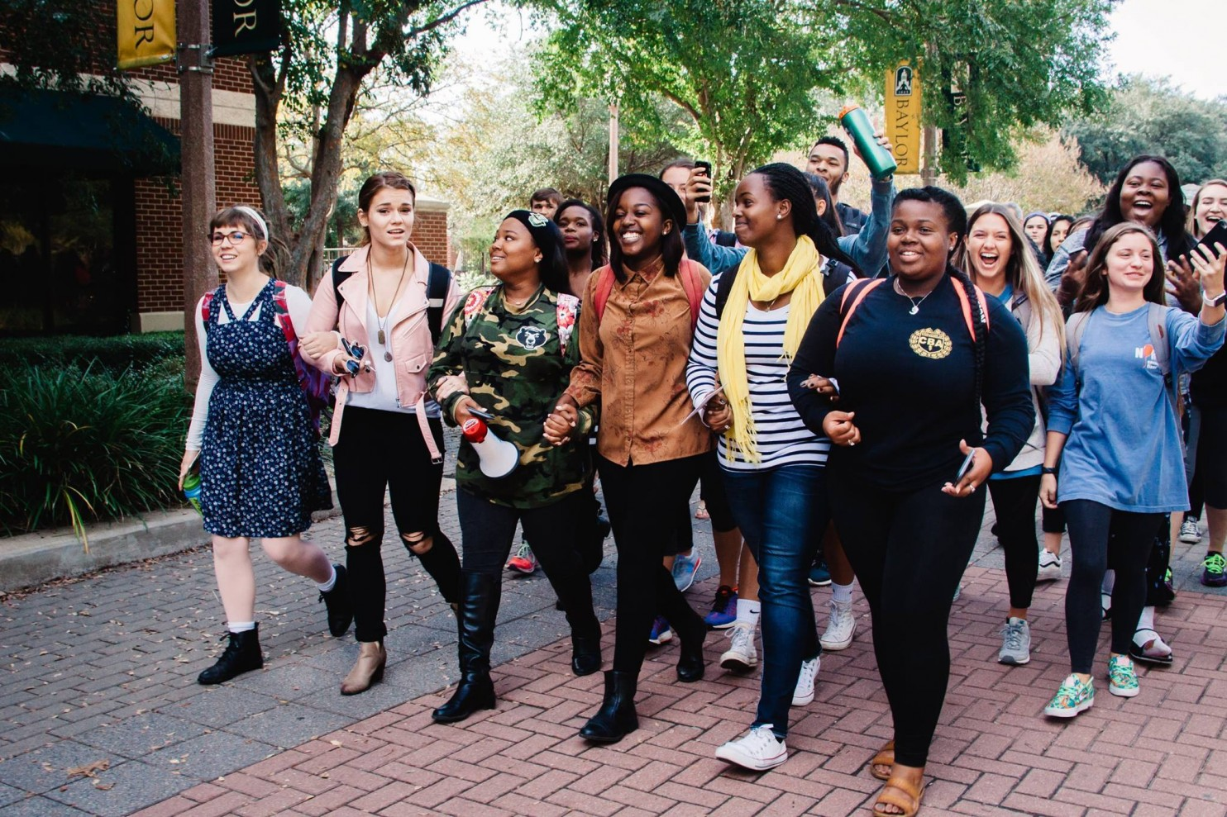
Notes:
Another black student saw the post. She reached out to Natasha & offered to walk her to school. Invited others. Staff came: word grows Acts 6:7

Slide 27
So the word of God spread, the disciples in Jerusalem increased greatly in number, and a large group of priests became obedient to the faith.
Acts 6:7
Notes:
This moment turning point in the church. Stephen, Hellenistic Jew: preaches a sermon. Gets killed, church spreads beyond city. A young Pharisee changed. TAKEN.

Slide 28
4. Commit Yourself To This Aspect of the Gospel
Notes:
Priests-Levite tribe. Colonized, When they saw how the church took care of the marginalized, they were attracted. Spread the Word. See the growth. Gospel Lift Every Voice

Slide 29
Notes:
James Weldon Johnson composed the lyrics of "Lift Ev'ry Voice and Sing," originally written for a celebration of Abraham Lincoln's birthday at Stanton School. 1900. 35 yrs after slavery, lynching.

Slide 30
The Gospel Lifts Every Voice.
Notes:
James Weldon Johnson composed the lyrics of "Lift Ev'ry Voice and Sing," originally written for a celebration of Abraham Lincoln's birthday at Stanton School. 1900. 35 yrs after slavery, lynching.

Slide 31
Lift every voice and sing,
Till earth and heaven ring,
Ring with the harmonies of Liberty;
Let our rejoicing rise
High as the list’ning skies,
Let it resound loud as the rolling sea.
Sing a song full of the faith that the dark past has taught us,
Sing a song full of the hope that the present has brought us;
Facing the rising sun of our new day begun,
Let us march on till victory is won.
Notes:
let’s sing this together.

Slide 32
Have you listened to the complaints that have arisen?

