Slide 1
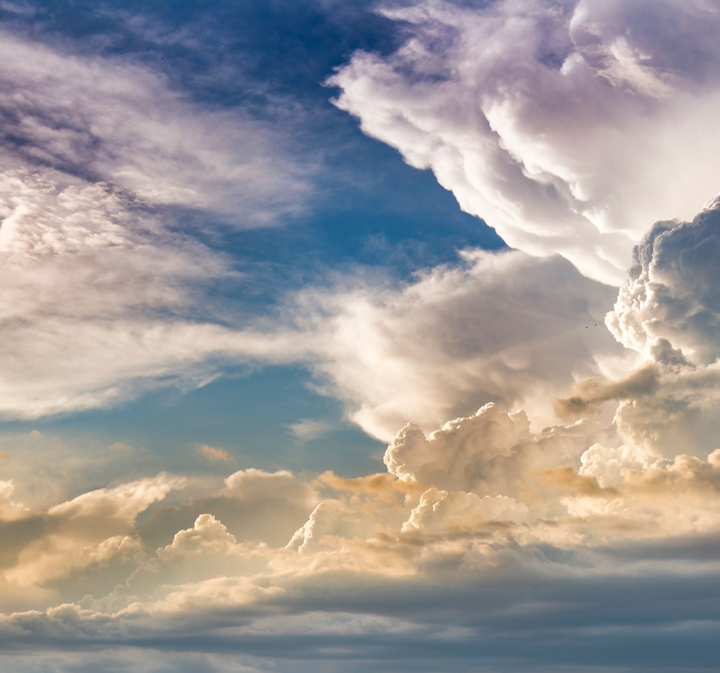
How to have a dynamic, biblically-based prayer meeting

Slide 2
Informational Source: John Franklin “And the Place was Shaken”
http://www.johnfranklinministries.org/
26-WEEK GUIDE FOR PRAYER MEETING

Slide 3
Acts 4:1-31
While Peter and John were speaking to the people, they were confronted by the priests, the captain of the Temple guard, and some of the Sadducees. ² These leaders were very disturbed that Peter and John were teaching the people that through Jesus there is a resurrection of the dead. ³ They arrested them and, since it was already evening, put them in jail until morning. ⁴ But many of the people who heard their message believed it, so the number of men who believed now totaled about 5,000.

Slide 4
Acts 4:1-31
⁵ The next day the council of all the rulers and elders and teachers of religious law met in Jerusalem. ⁶ Annas the high priest was there, along with Caiaphas, John, Alexander, and other relatives of the high priest. ⁷ They brought in the two disciples and demanded, “By what power, or in whose name, have you done this?”

Slide 5
Acts 4:1-31
⁸ Then Peter, filled with the Holy Spirit, said to them, “Rulers and elders of our people, ⁹ are we being questioned today because we’ve done a good deed for a crippled man? Do you want to know how he was healed? ¹⁰ Let me clearly state to all of you and to all the people of Israel that he was healed by the powerful name of Jesus Christ the Nazarene, the man you crucified but whom God raised from the dead. ¹¹ For Jesus is the one referred to in the Scriptures, where it says,
‘The stone that you builders rejected has now become the cornerstone.’

Slide 6
Acts 4:1-31
¹² There is salvation in no one else! God has given no other name under heaven by which we must be saved.”

Slide 7
Acts 4:1-31
¹³ The members of the council were amazed when they saw the boldness of Peter and John, for they could see that they were ordinary men with no special training in the Scriptures. They also recognized them as men who had been with Jesus. ¹⁴ But since they could see the man who had been healed standing right there among them, there was nothing the council could say. ¹⁵ So they ordered Peter and John out of the council chamber and conferred among themselves.

Slide 8
Acts 4:1-31
¹⁶ “What should we do with these men?” they asked each other. “We can’t deny that they have performed a miraculous sign, and everybody in Jerusalem knows about it. ¹⁷ But to keep them from spreading their propaganda any further, we must warn them not to speak to anyone in Jesus’ name again.” ¹⁸ So they called the apostles back in and commanded them never again to speak or teach in the name of Jesus.

Slide 9
Acts 4:1-31
¹⁹ But Peter and John replied, “Do you think God wants us to obey you rather than him? ²⁰ We cannot stop telling about everything we have seen and heard.”
²¹ The council then threatened them further, but they finally let them go because they didn’t know how to punish them without starting a riot. For everyone was praising God ²² for this miraculous sign—the healing of a man who had been lame for more than forty years.

Slide 10
Acts 4:1-31
²³ As soon as they were freed, Peter and John returned to the other believers and told them what the leading priests and elders had said. ²⁴ When they heard the report, all the believers lifted their voices together in prayer to God: “O Sovereign Lord, Creator of heaven and earth, the sea, and everything in them— ²⁵ you spoke long ago by the Holy Spirit through our ancestor David, your servant, saying,
‘Why were the nations so angry? Why did they waste their time with futile plans? ²⁶ The kings of the earth prepared for battle; the rulers gathered together against the Lord and against his Messiah.’

Slide 11
Acts 4:1-31
²⁷ “In fact, this has happened here in this very city! For Herod Antipas, Pontius Pilate the governor, the Gentiles, and the people of Israel were all united against Jesus, your holy servant, whom you anointed. ²⁸ But everything they did was determined beforehand according to your will. ²⁹ And now, O Lord, hear their threats, and give us, your servants, great boldness in preaching your word. ³⁰ Stretch out your hand with healing power; may miraculous signs and wonders be done through the name of your holy servant Jesus.”

Slide 12
Acts 4:1-31
³¹ After this prayer, the meeting place shook, and they were all filled with the Holy Spirit. Then they preached the word of God with boldness.

Slide 13
Foundation of Prayer #1: FOCUS ON GOD “God-Centered Relationship”

Slide 14
Foundation of Prayer #1: FOCUS ON GOD “God-Centered Relationship”
Acts 4:24
²⁴ When they heard the report, all the believers lifted their voices together in prayer to God: “O Sovereign Lord, Creator of heaven and earth, the sea, and everything in them—

Slide 15
Foundation of Prayer #1: FOCUS ON GOD “God-Centered Relationship”
Peter and John faced the temptation to focus on their struggle for life; instead, they chose to focus on the Creator who determined their life!

Slide 16
Foundation of Prayer #1: FOCUS ON GOD “God-Centered Relationship”
Peter and John faced the temptation to focus on their struggle for life; instead, they chose to focus on the Creator who determined their life!
Their 3 years with Jesus had trained them to center on God more than on the storm, their enemies, or anything else that would oppose them

Slide 17
Foundation of Prayer #2: RESPOND FROM THE HEART “Meaningful Relationships”

Slide 18
Foundation of Prayer #2: RESPOND FROM THE HEART “Meaningful Relationships”
Relationship with other believers: LOVE

Slide 19
Foundation of Prayer #2: RESPOND FROM THE HEART “Meaningful Relationships”
Relationship with other believers: LOVE
Result: God responds in powerful ways!

Slide 20
Foundation of Prayer #2: RESPOND FROM THE HEART “Meaningful Relationships”
Relationship with other believers: LOVE
Result: God responds in powerful ways!
“Prayer rides the rails of relationship!”

Slide 21
Foundation of Prayer #3: SEEK FIRST GOD’S KINGDOM “Hearts right with God”

Slide 22
Foundation of Prayer #3: SEEK FIRST GOD’S KINGDOM “Hearts right with God”
God has always required a right heart

Slide 23
Foundation of Prayer #3: SEEK FIRST GOD’S KINGDOM “Hearts right with God”
God has always required a right heart
God doesn’t answer prayer; He answers you!

Slide 24
Foundation of Prayer #3: SEEK FIRST GOD’S KINGDOM “Hearts right with God”
God has always required a right heart
God doesn’t answer prayer; He answers you!
2 Heart qualities God is looking for:
Desire

Slide 25
Foundation of Prayer #3: SEEK FIRST GOD’S KINGDOM “Hearts right with God”
God has always required a right heart
God doesn’t answer prayer; He answers you!
2 Heart qualities God is looking for:
Desire
Faith

Slide 26
Foundation of Prayer #4: PRESENT YOUR REQUESTS “Believers in one accord”
United in our purpose as the Body of believers

Slide 27
Foundation of Prayer #5: CELEBRATE! “Hearts rejoicing with God”
Thanksgiving

Slide 28
Foundation of Prayer #5: CELEBRATE! “Hearts rejoicing with God”
Thanksgiving
Praise

Slide 29
Foundation of Prayer #5: CELEBRATE! “Hearts rejoicing with God”
Thanksgiving
Praise
Declaration of what God has done and will do

Slide 30
Foundation #1: FOCUS ON GOD

Slide 31
Foundation #1: FOCUS ON GOD
Foundation #2: RESPOND FROM THE HEART

Slide 32
Foundation #1: FOCUS ON GOD
Foundation #2: RESPOND FROM THE HEART
Foundation #3: SEEK FIRST GOD’S KINGDOM

Slide 33
Foundation #1: FOCUS ON GOD
Foundation #2: RESPOND FROM THE HEART
Foundation #3: SEEK FIRST GOD’S KINGDOM
Foundation #4: PRESENT YOUR REQUESTS

Slide 34
Foundation #1: FOCUS ON GOD
Foundation #2: RESPOND FROM THE HEART
Foundation #3: SEEK FIRST GOD’S KINGDOM
Foundation #4: PRESENT YOUR REQUESTS
Foundation #5: CELEBRATE!

