Slide 1
THE SCATTERED
GATHERING
@emanuelwos
@worldoutspoken
www.worldoutspoken.com

Slide 4
LOSS AND RUPTURE

Slide 6
Destroy, O Lord, divide their tongues; for I see violence and strife in the city.
— Psalm 55:9

Slide 7
A SCATTERED GATHERING
A DIASPORA KINSHIP

Slide 8
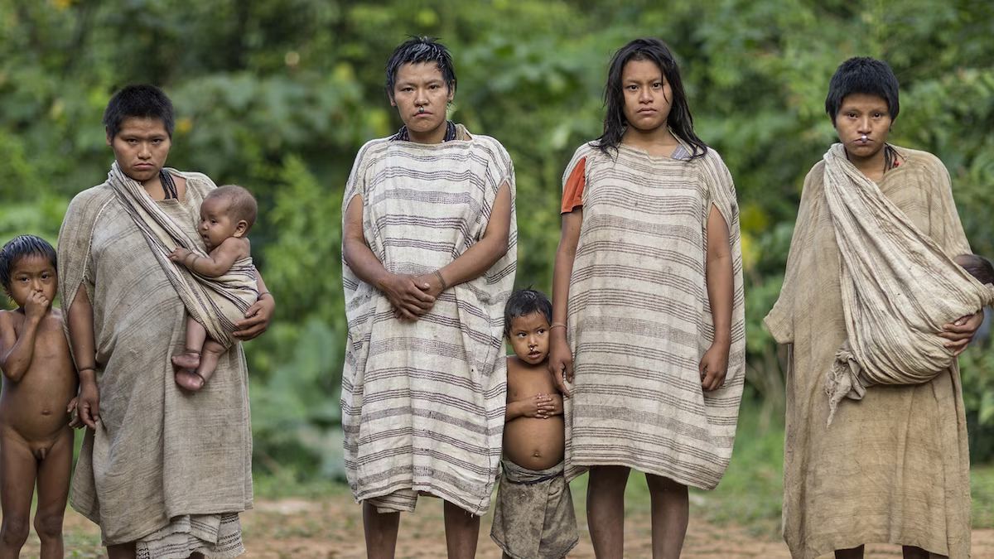

Slide 9
THE MACHIGUENGA STORYTELLER IS “TANGIBLE PROOF THAT STORYTELLING CAN BE SOMETHING MORE THAN MERE ENTERTAINMENT … SOMETHING PRIMORDIAL, SOMETHING THAT THE VERY EXISTENCE OF A PEOPLE MAY DEPEND ON
-Mario Pedro Vargas Llosa, The Storyteller

Slide 10
5 YOU ALSO, LIKE LIVING STONES, ARE BEING BUILT INTO A SPIRITUAL HOUSE ...
You are a chosen people, Once you were not a people, but now you are the people of God
--1 Peter 2:5, 9a, 10a

Slide 11
10 THIS IS WHAT THE LORD SAYS: “WHEN SEVENTY YEARS ARE COMPLETED FOR BABYLON, I WILL COME TO YOU … I WILL GATHER YOU FROM ALL THE NATIONS AND PLACES WHERE I HAVE BANISHED YOU, AND WILL BRING YOU BACK TO THE PLACE FROM WHICH I CARRIED YOU INTO EXILE.
-Jeremiah 29:10-14

Slide 12
Join our Community
A Latina/o ministry empowering the church in-between
@emanuelwos
@worldoutspoken
www.worldoutspoken.com

